Slide 1

Machine learning based Buyer Segmentation and Investment Profiling for Real Estate Market Intelligence
Muskan Sharma

Slide 2
RESEARCH PAPER PRESENTATION
Introduction & Background
Engagement Profiling: Categorizes customers into key behavioral segments (e.g., Active Engaged, Inactive Disengaged, Active Low-Product, and Inactive High-Balance).
Product Utilization Analysis: Examines how relationship depth (holding 1 vs. multiple bank products) impacts churn and customer retention.
Financial Commitment vs. Activity: Identifies "At-Risk Premium Customers"—high-balance account holders who are inactive and single-product users, making them vulnerable to silent churn.
Retention Strength & KPIs: Tracks key metrics such as Engagement Retention Ratio, Product Depth Index, High-Balance Disengagement Rate, and Relationship Strength Index to measure overall account loyalty.
Interactive Streamlit Web App: A dynamic analytics platform allowing stakeholders to filter by geography, product counts, active status, and financial thresholds to explore churn drivers in real time.
The real estate sector is characterized by high transaction values and a highly diverse buyer base with varying purchasing behaviors, financial capacities, and strategic goals. Modern real estate platforms interact with a broad spectrum of client archetypes, including:
Individual Homebuyers: Local consumers purchasing for primary residential utility.
First-Time Buyers: Budget-conscious clients heavily reliant on mortgage financing.
Institutional & Corporate Buyers: Organizations executing high-volume or commercial acquisitions.
High-Net-Worth & International Investors: Cross-border buyers focused on portfolio growth and yield optimization.
Treating all buyers as a single, uniform cohort leads to significant operational inefficiencies, including high Customer Acquisition Costs (CAC), broad marketing strategies, and mismatched property recommendations

Slide 3
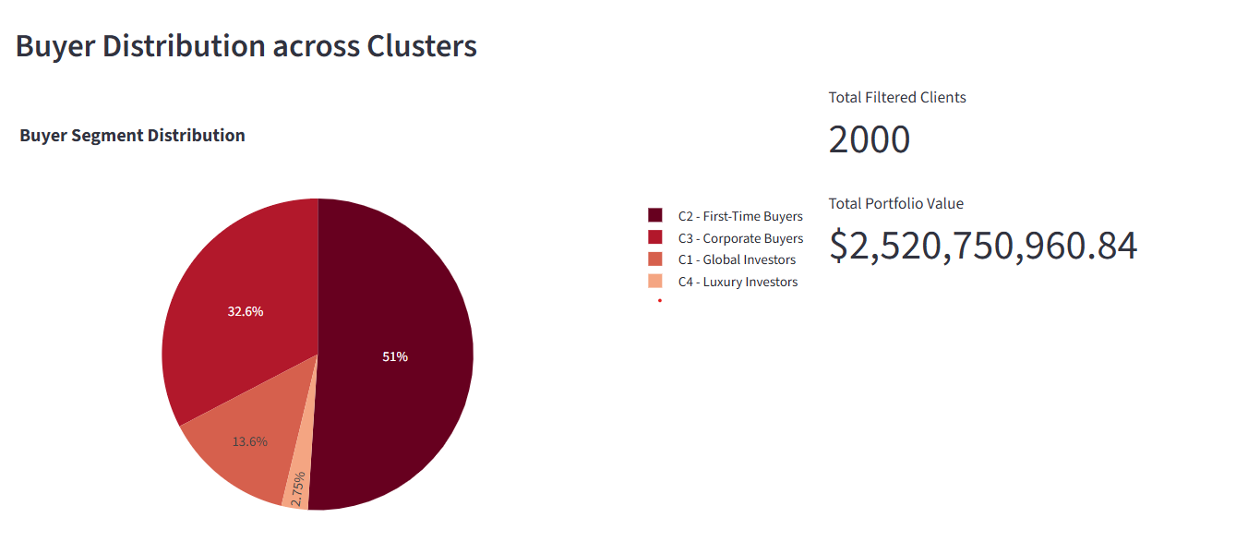

Slide 4
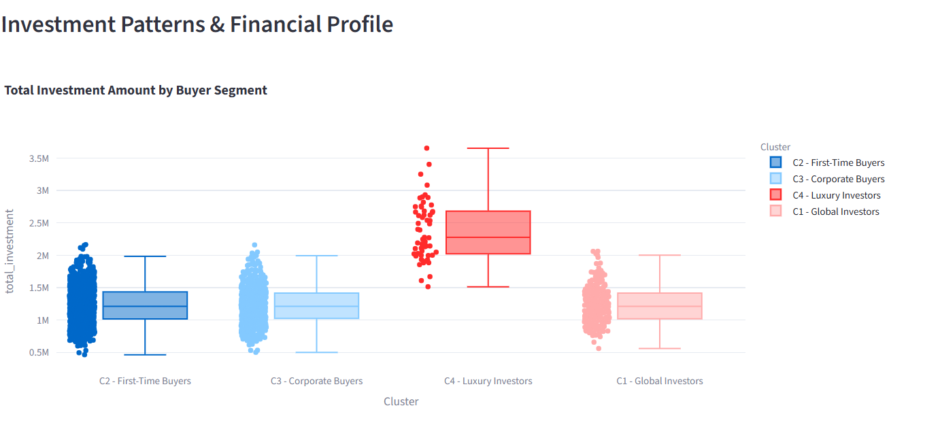

Slide 5
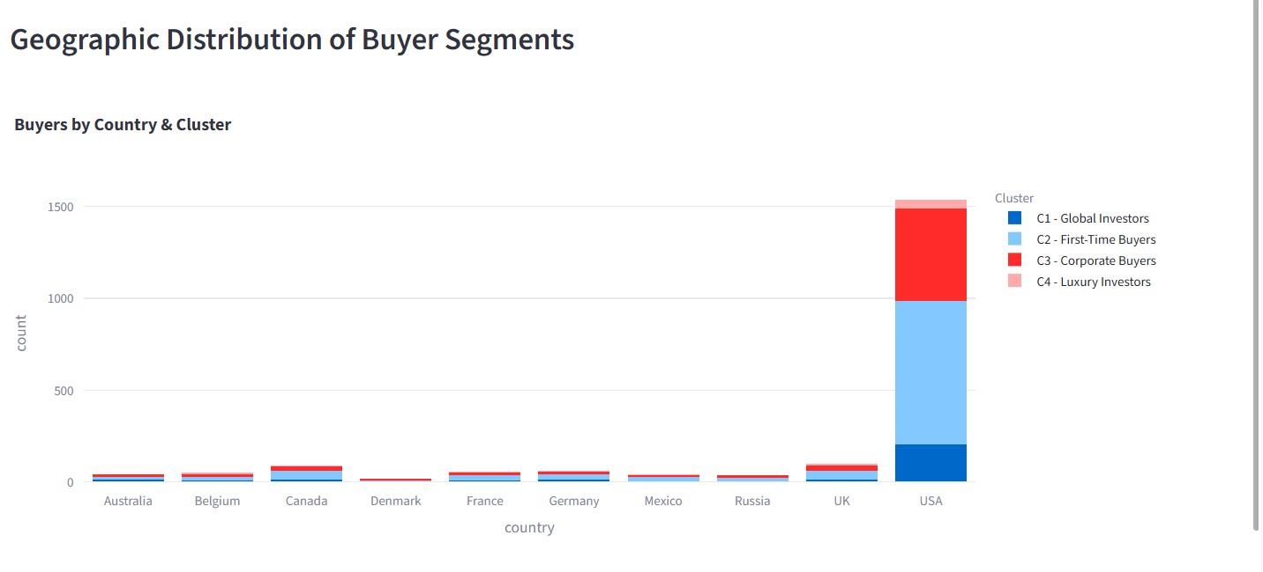

Slide 6
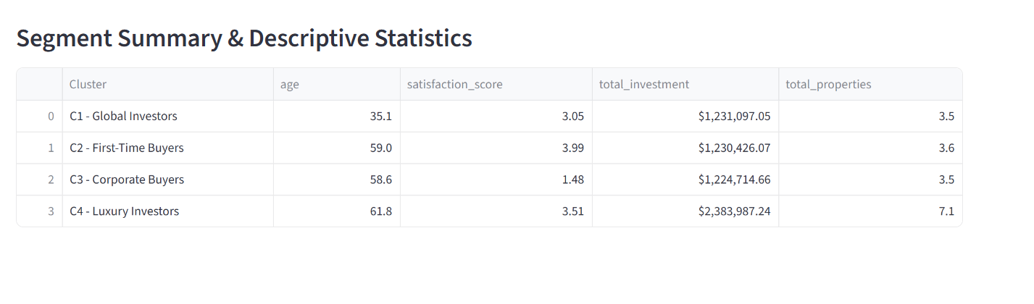

Slide 7
Problem Statement Overview
In modern real estate markets, customer bases are highly heterogeneous, spanning individual homebuyers, corporate entities, high-net-worth individuals, and first-time buyers. Parcl Co. Limited currently lacks a structured, data-driven framework to understand and categorize these distinct buyer segments.
Without granular market intelligence, the platform operates under a uniform, one-size-fits-all model. This creates specific analytical and operational knowledge gaps across four core areas:
Different Types of Property Buyers
The Issue: Unawareness of distinct customer archetypes (e.g., individual buyers vs. corporate entities, first-time homeowners vs. seasoned investors).
Impact: Treating high-net-worth buyers the same as budget-constrained first-time buyers leads to irrelevant property recommendations and poor user experience.
Investment Motivations Across Demographics
The Issue: Lack of visibility into primary acquisition drivers (e.g., personal primary residence vs. long-term capital appreciation or rental yield).
Impact: Marketing campaigns fail to resonate because promotional messaging is not tailored to the buyer's core financial intent.
Geographic Differences in Investment Behavior
The Issue: Inability to track spatial trends and cross-border purchasing habits across different countries and regions.
Impact: Missed opportunities in identifying high-growth regional demand or catering to cross-border/international investors seeking portfolio diversification.
Customer Financing Patterns
The Issue: Unclear insights into buyer financial dependency, such as mortgage reliance versus full cash funding.
Impact: Failure to present timely financial products, pre-approval tools, or tailored mortgage assistance to loan-dependent segments at crucial points in the buyer funnel.

Slide 8
Thank you

