Slide 1

PREDICTIVE MODELING FOR COURSE DEMAND AND REVENUE FORECASTING ON EDUPRO
Muskan Sharma

Slide 2
RESEARCH PAPER PRESENTATION
Introduction & Background
Engagement Profiling: Categorizes customers into key behavioral segments (e.g., Active Engaged, Inactive Disengaged, Active Low-Product, and Inactive High-Balance).
Product Utilization Analysis: Examines how relationship depth (holding 1 vs. multiple bank products) impacts churn and customer retention.
Financial Commitment vs. Activity: Identifies "At-Risk Premium Customers"—high-balance account holders who are inactive and single-product users, making them vulnerable to silent churn.
Retention Strength & KPIs: Tracks key metrics such as Engagement Retention Ratio, Product Depth Index, High-Balance Disengagement Rate, and Relationship Strength Index to measure overall account loyalty.
Interactive Streamlit Web App: A dynamic analytics platform allowing stakeholders to filter by geography, product counts, active status, and financial thresholds to explore churn drivers in real time.
EduPro is an online learning platform currently relying on historical intuition rather than quantitative forecasts to make core business decisions—such as launching new courses, adjusting pricing, and onboarding instructors. This lack of predictive visibility increases financial and operational risk.
Introduction
To move EduPro from reactive reporting to proactive planning, this project implements predictive machine learning models to forecast course demand (enrollment counts) and revenue at both the individual course and category levels. By analyzing multi-dimensional historical data (courses, instructors, and transactions), the project delivers data-driven insights to optimize content roadmaps, pricing strategy, and resource allocation.

Slide 3
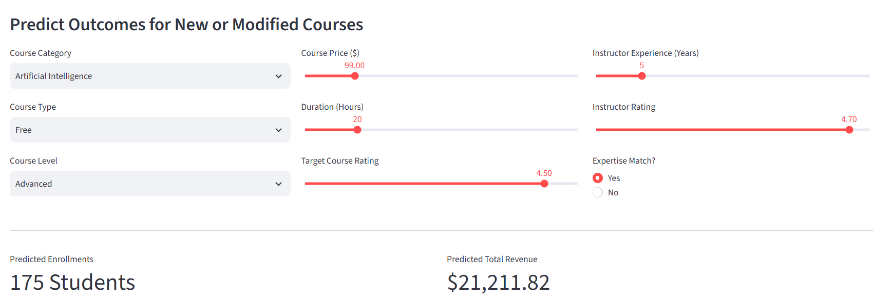

Slide 4
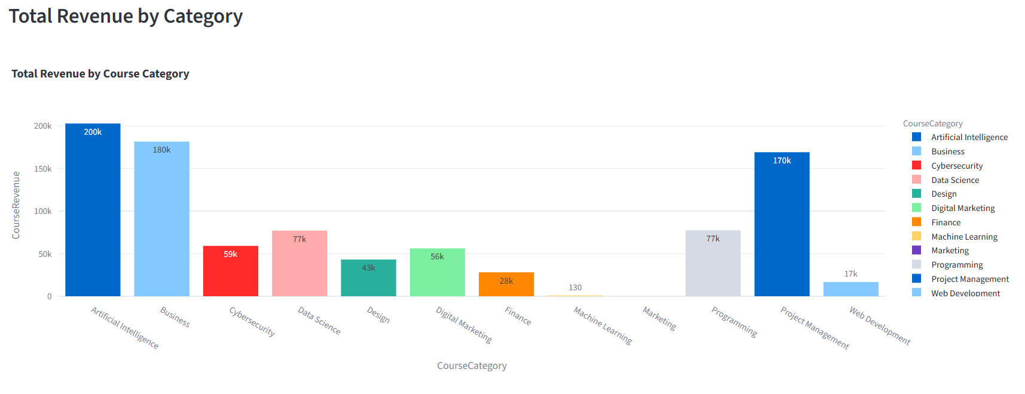

Slide 5
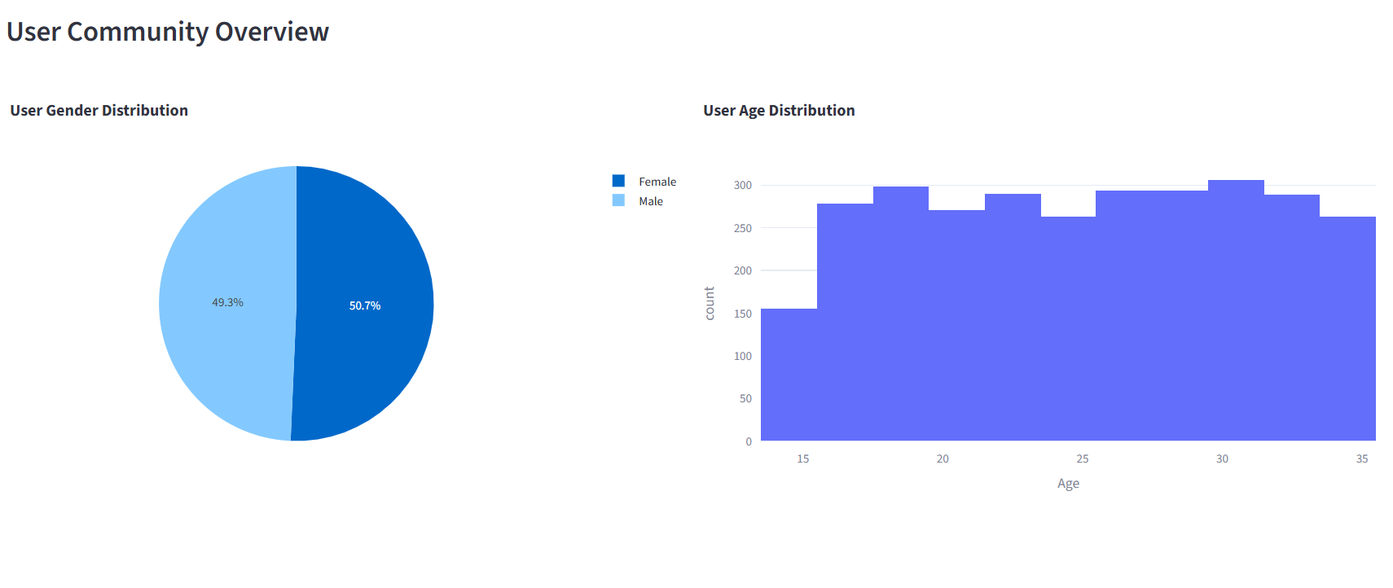

Slide 6
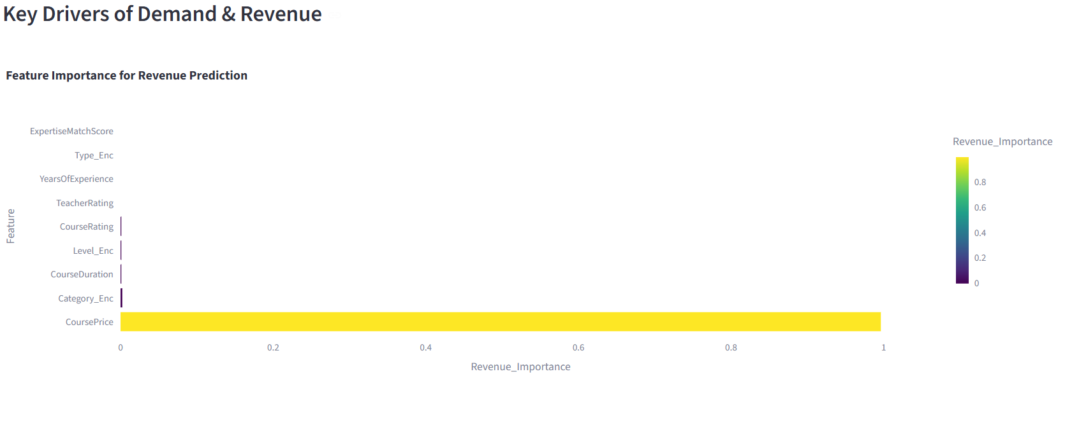

Slide 7
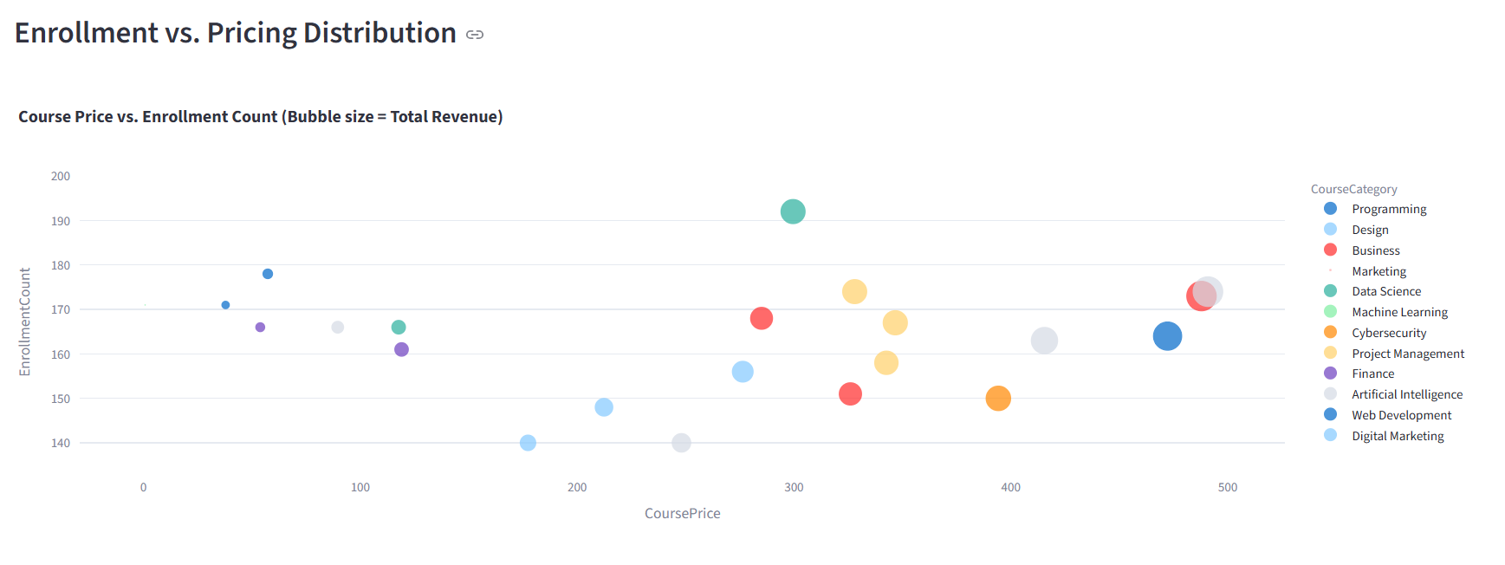

Slide 8
Executive Summary for Government Stakeholders
Overview
The Executive Summary for Government Stakeholders translates complex predictive modeling into high-level, actionable policy and economic insights. Government bodies, workforce development agencies, and educational regulators care less about machine learning algorithms and more about how digital learning platforms impact skill alignment, public education funding efficiency, and economic readiness.
1. Alignment with Workforce & Economic Goals
Details how predictive demand modeling helps identify emerging industry skill gaps (e.g., high demand in specific tech or business categories).
Demonstrates how data-driven course forecasting aligns online learning with national/regional workforce development initiatives.
2. Resource Allocation & Public Investment Efficiency
Outlines how forecasting course success and revenue prevents wasted financial resources on obsolete or under-enrolled programs.
Shows how public subsidies, grants, or educational partnerships can be targeted toward high-impact categories.
3. Regulatory & Accessibility Compliance
Summarizes how pricing models and course durations affect educational accessibility across different demographic tiers.
Ensures data privacy, algorithmic fairness, and ethical standard compliance when using predictive models to drive educational decisions.
4. Strategic Policy Recommendations
Translates top predictive drivers (e.g., pricing sensitivity, instructor experience) into high-level policy recommendations for digital education frameworks.
Highlights long-term economic scalability and sustainable revenue models for public-private educational partnerships.

Slide 9
Thank you

