Slide 1

System Capacity & Care Load Analytics for Unaccompanied Children
European Bank
Muskan Sharma

Slide 2
RESEARCH PAPER PRESENTATION
Introduction & Background
Engagement Profiling: Categorizes customers into key behavioral segments (e.g., Active Engaged, Inactive Disengaged, Active Low-Product, and Inactive High-Balance).
Product Utilization Analysis: Examines how relationship depth (holding 1 vs. multiple bank products) impacts churn and customer retention.
Financial Commitment vs. Activity: Identifies "At-Risk Premium Customers"—high-balance account holders who are inactive and single-product users, making them vulnerable to silent churn.
Retention Strength & KPIs: Tracks key metrics such as Engagement Retention Ratio, Product Depth Index, High-Balance Disengagement Rate, and Relationship Strength Index to measure overall account loyalty.
Interactive Streamlit Web App: A dynamic analytics platform allowing stakeholders to filter by geography, product counts, active status, and financial thresholds to explore churn drivers in real time.
The System Capacity & Care Load Analytics for Unaccompanied Children initiative provides a comprehensive analytics framework to monitor, analyze, and forecast the operational capacity of federal child welfare pipelines.
Every year, thousands of Unaccompanied Alien Children (UAC) cross the U.S. border. Managing their safety, healthcare, and transition requires seamless coordination between law enforcement and social service agencies. This project translates raw operational counts into actionable capacity metrics, allowing decision-makers to anticipate stress windows, evaluate humanitarian responses, and maintain high standards of child welfare delivery.
Intake & Initial Custody: CBP processes initial border apprehensions and holds children in short-term custody.
HHS Care & Support: Children are transferred to HHS-funded shelters for medical evaluations, quarantine, and holistic welfare support.
Discharge & Placement: Children are discharged from HHS care once eligible sponsors are vetted and approved.

Slide 3
Problem Statement
While daily operational records are gathered across agencies, the lack of a unified analytical framework makes tracking system-wide load difficult. Without continuous monitoring of inflow-outflow balance and capacity stress:
Decision-making remains reactive rather than proactive.
Sudden border influxes lead to facility overcrowding and care delays.
Staffing and shelter allocation become inefficient.
Key Objectives
Quantify System Load: Calculate active and cumulative care responsibilities across both CBP and HHS.
Monitor Inflow vs. Outflow: Evaluate daily net intake and identify backlog accumulation over time.
Identify Capacity Strain: Use rolling metrics and volatility indices to detect prolonged stress windows.
Empower Stakeholders: Deliver an interactive dashboard for real-time situational awareness and policy planning.

Slide 4
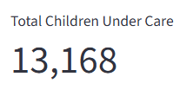
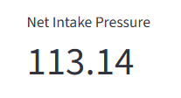
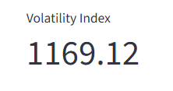
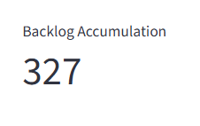
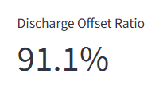
RESEARCH PAPER PRESENTATION
Key Performance Indicators

Slide 5
Key Performance Indicators (KPIs)
Total Children Under Care
Short Description: Measures the active, system-wide volume of children currently in federal responsibility (combining CBP custody and HHS shelter care) at any given point in time.
Net Intake Pressure
Short Description: Tracks the real-time daily imbalance between children entering HHS care (transfers from CBP) versus those leaving (discharges to sponsors), indicating whether the system is expanding or contracting.
Care Load Volatility Index
Short Description: Measures short-term fluctuations and variance in total care load (typically via a 7-day standard deviation) to assess operational stability and predict sudden surges.
Backlog Accumulation Rate
Short Description: Quantifies sustained intake pressure over time by tracking the cumulative growth of un-discharged children, highlighting growing delays in reunification.
Discharge Offset Ratio
Short Description: Evaluates the system's operational efficiency by comparing total discharges to total intakes over a period (e.g., 30 days) to measure its capacity to clear cases and relieve load.

Slide 6
Problem Statement
Although daily operational data is collected across agencies, the Department of Health and Human Services (HHS) currently lacks a centralized analytical framework to continuously assess system health and operational capacity. Without real-time, consolidated metrics, key decision-makers face significant operational blind spots in the following areas:
1. Total Care System Load
The Issue: Data is often fragmented across immediate law enforcement custody (CBP) and longer-term shelter infrastructure (HHS).
Impact: Lacking a unified view of the Total System Load makes it difficult to understand the overall federal responsibility at any given moment, leading to misaligned resource and shelter allocations.
2. Balance Between Inflow and Outflow
The Issue: Daily intake into the care pipeline (transfers into HHS) and outflow (discharges to vetted sponsors) fluctuate independently.
Impact: Without tracking Net Intake Pressure, sudden surges in border apprehensions can quietly accumulate into massive backlogs before HHS operational teams can respond.
4. Sustainability of Care Delivery Over Time
The Issue: Operational planning requires understanding long-term seasonal patterns, year-over-year trends, and discharge efficiency ratios.
Impact: Without longitudinal trend analysis, leadership cannot reliably forecast future capacity requirements, evaluate policy intervention effectiveness, or ensure consistent standards of child welfare delivery over time.
3. Capacity Stress and Relief Periods
The Issue: Critical operational bottlenecks (e.g., medical evaluation backlogs, sponsor vetting delays) are hard to isolate using raw daily counts alone.
Impact: Lacking rolling metrics and volatility tracking leaves administration reactive during peak strain windows, increasing risks of facility overcrowding and care delays.

Slide 7
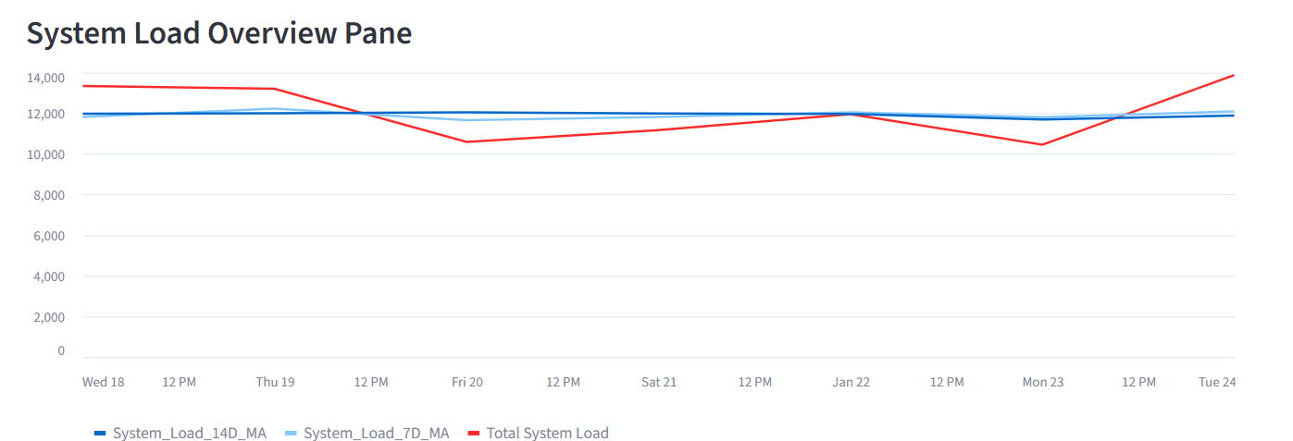
RESEARCH PAPER PRESENTATION
Engagement Classification & Risk Analysis
Breakdown of customer share and churn risk across engagement profiles

Slide 8
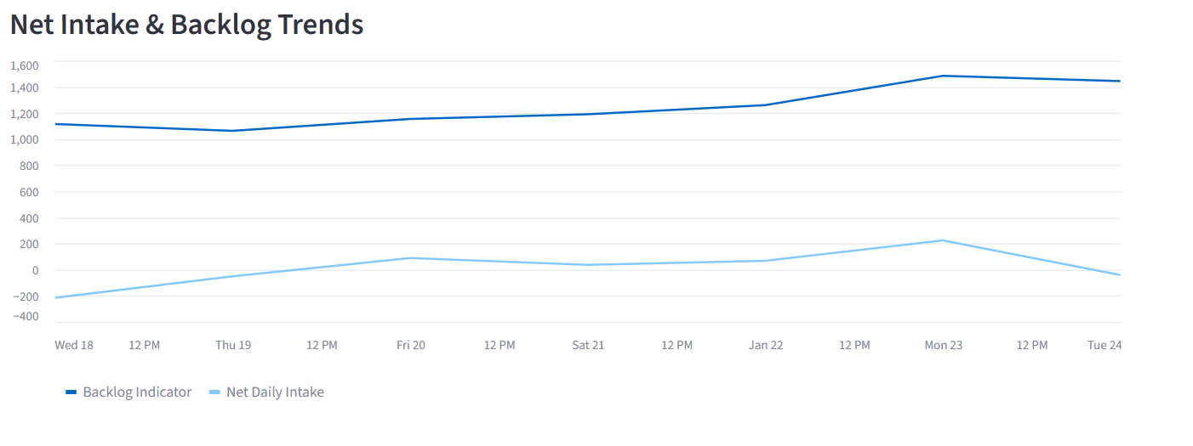

Slide 9
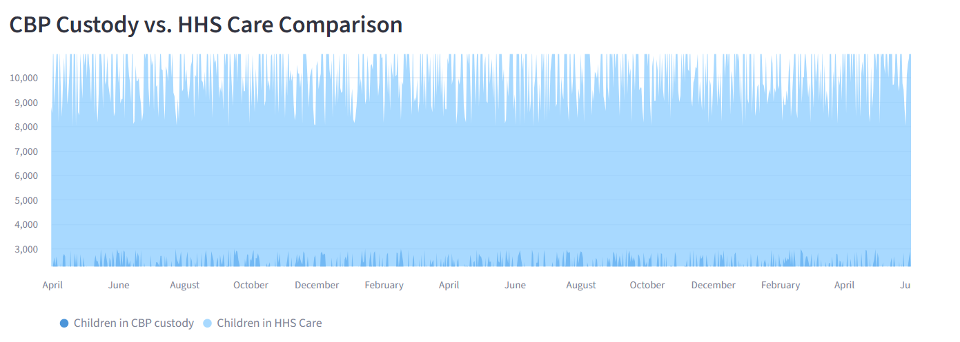

Slide 10
RESEARCH PAPER PRESENTATION
Exploratory Data Analysis (EDA) & Key Findings
System Load & Temporal Patterns
Surge Inflow Dynamics: Daily apprehensions by CBP exhibit non-uniform, clustered spikes rather than a steady baseline. Rapid increases in arrivals create immediate shockwaves in border custody facilities before downstream HHS shelter transfers can adjust.
System Duration Asymmetry: Children remain in short-term CBP custody for days, whereas the average stay in HHS shelter care extends across weeks or months while sponsor vetting is conducted. Consequently, HHS shelters absorb 80%–90% of total active system load at any given time.
Intake vs. Outflow Mismatch: Periods where HHS transfers exceed sponsor releases trigger a compounded increase in the Backlog Accumulation Rate. When net intake remains positive over consecutive weeks, shelter capacity reaches critical stress thresholds.

Slide 11
Volatility & Stress Identification
Care Load Volatility: Short-term fluctuations (evaluated via a 7-day rolling standard deviation) spike primarily during major seasonal or policy shifts. High volatility index scores correlate with prolonged stay durations in temporary overflow facilities.
Discharge Offset Deficit: Analyzing the ratio of monthly discharges to monthly transfers demonstrates that operational capacity strain is driven more by sponsor vetting bottlenecks than by the rate of physical intakes alone
Short-Term Operational Interventions
Automated Early Warning Alerts: Set up automated triggers when the Net Intake Pressure stays positive for 5 consecutive days or when the Care Load Volatility Index exceeds historical 90th percentile thresholds.
Streamlined Category-1 Sponsor Vetting: Prioritize expedite-vetting protocols for direct parents and legal guardians (Category 1 sponsors) to safely accelerate discharges and free up shelter capacity during high-demand windows.
Inter-Agency Real-Time Data Pipelines: Replace batch reporting with live API integrations between CBP border processing systems and HHS shelter tracking databases to improve intake forecasting.

Slide 12
Strategic & Policy Recommendations
Dynamic Flexible Bed Reserves: Maintain a baseline of scalable emergency contract beds that can be activated gradually based on 14-day rolling intake projections, reducing reliance on emergency facilities.
Regional Sponsor Vetting Hubs: Decentralize sponsor evaluation teams to regions with high potential-sponsor density, directly addressing the core bottleneck in the care pipeline.
Standardized Reporting Auditing: Implement continuous validation scripts (similar to the data quality phase in the pipeline) to prevent misclassified records and missing dates across agency feeds.

Slide 13
Thank you

