Slide 1
NIFTY 50 Stock Price
Prediction System
A Machine Learning Based Approach Using Facebook Prophet

Slide 2
Agenda
1. Introduction & Problem Statement
2. Dataset Overview
3. Data Preprocessing & Feature Engineering
4. Exploratory Data Analysis
5. System Architecture
6. Model: Facebook Prophet
7. Training & Evaluation Results
8. Web Application Demo
9. Conclusion & Future Scope

Slide 3
Introduction
• NIFTY 50: Benchmark index of India's NSE (50 largest companies)
• Challenge: Predict future OHLC prices using historical data
• Approach: Facebook Prophet + Technical Indicators
• 10 years of data: Feb 2016 – Feb 2026
• Four independent models for Open, High, Low, Close
• Interactive Flask web application for predictions

Slide 4
Problem Statement & Objectives
Problem:
Design a system to forecast NIFTY 50 OHLC prices for any future date using ML and deploy as a web app
Objectives:
• Train Prophet models on 10 years of NIFTY 50 data
• Achieve MAPE < 1% on test data
• Build user-friendly web interface with Chart.js
• Support single-date & range predictions with CSV export

Slide 5
Dataset Overview
Metric | Value
Total Records | 2479
Date Range | 08 February 2016 — 05 February 2026
Latest Close | ₹25,642.80
All-Time High | ₹26,373.20
All-Time Low | ₹6,825.80
Average Close | ₹15,317.52
Avg Daily Return | 0.0536%

Slide 6
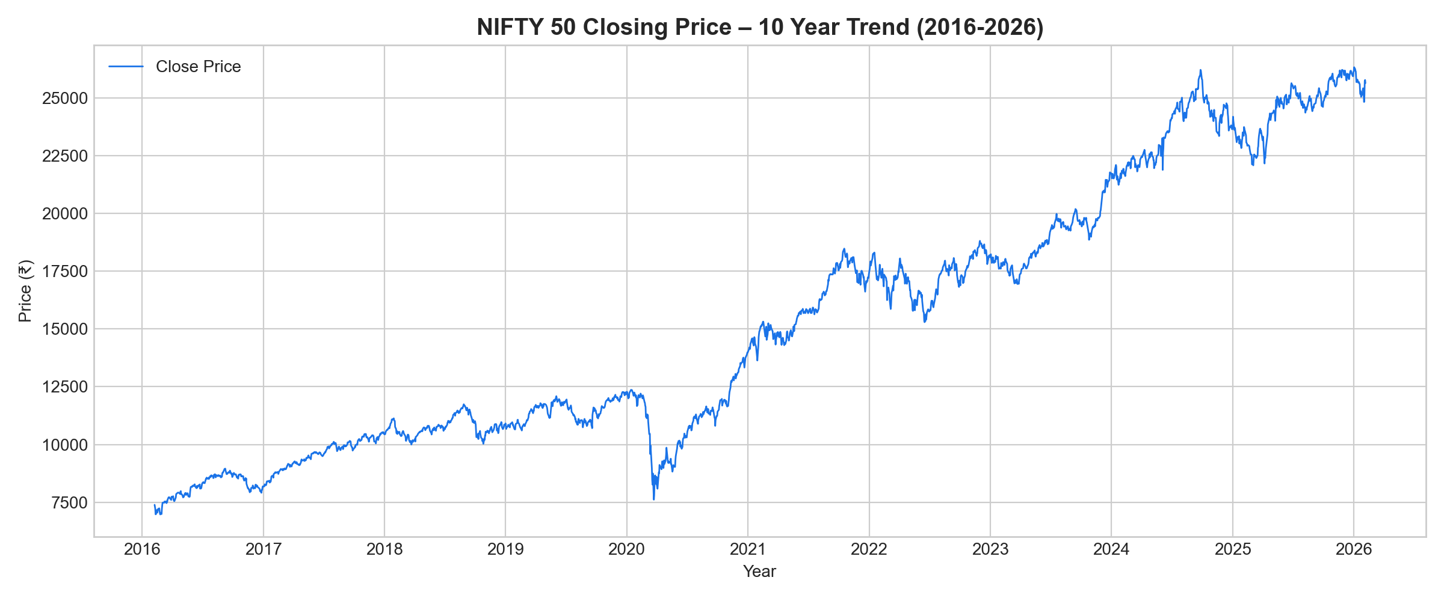
10-Year NIFTY 50 Close Price Trend
Data from 08 February 2016 to 05 February 2026

Slide 7
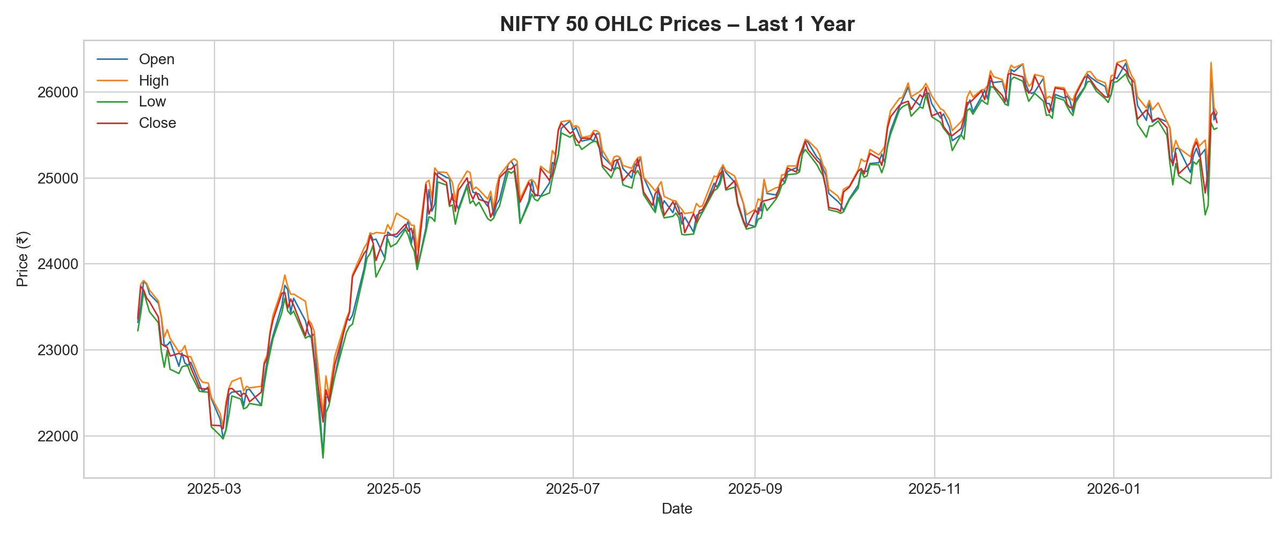
OHLC Prices – Last 1 Year
Open, High, Low, Close daily prices

Slide 8
Feature Engineering
Feature | Formula | Window | Purpose
MA_5 | Rolling mean | 5 days | Short-term trend
MA_20 | Rolling mean | 20 days | Medium-term trend
MA_50 | Rolling mean | 50 days | Long-term trend
volatility_10 | Rolling std | 10 days | Market uncertainty
daily_return | % change | 1 day | Momentum
day_range | High − Low | 1 day | Intraday spread

Slide 9
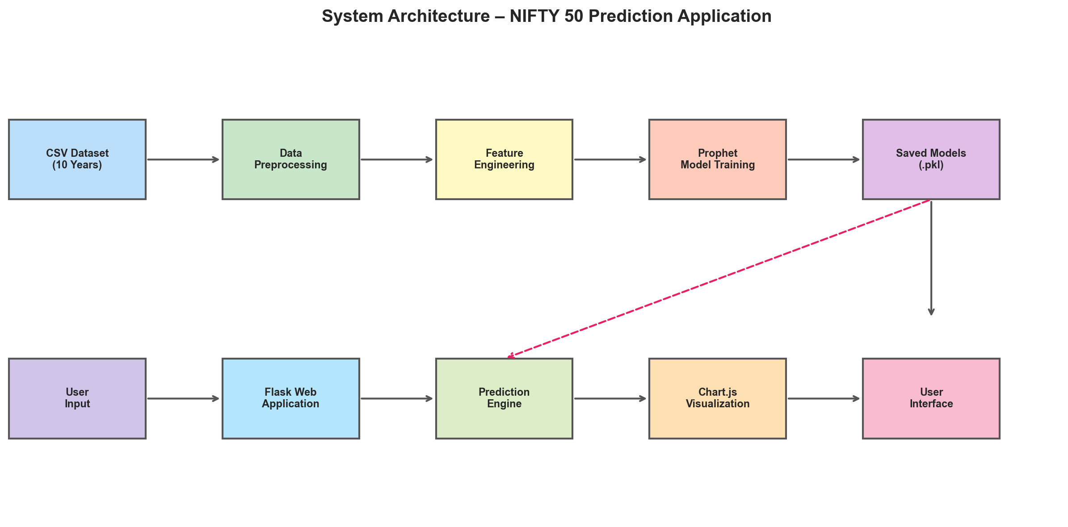
System Architecture
End-to-end pipeline: Data → Model → Flask → User

Slide 10
Technology Stack
Layer | Technology | Purpose
Backend | Python 3.8+ | Core language
ML Model | Facebook Prophet | Time-series forecasting
Web | Flask | HTTP server & routing
Frontend | Bootstrap 5 + Chart.js | UI & interactive charts
Data | Pandas + NumPy | Processing & computation
Evaluation | scikit-learn | MAE, MAPE metrics

Slide 11
Prophet Model Configuration
Parameter | Value | Rationale
daily_seasonality | False | Daily data, no intraday
weekly_seasonality | True | Mon-Fri trading patterns
yearly_seasonality | True | Annual market cycles
changepoint_prior_scale | 0.1 | Moderate trend flexibility
seasonality_prior_scale | 10.0 | Strong seasonal signals
Regressors | MA_5, MA_20, MA_50, vol_10 | Technical indicators

Slide 12
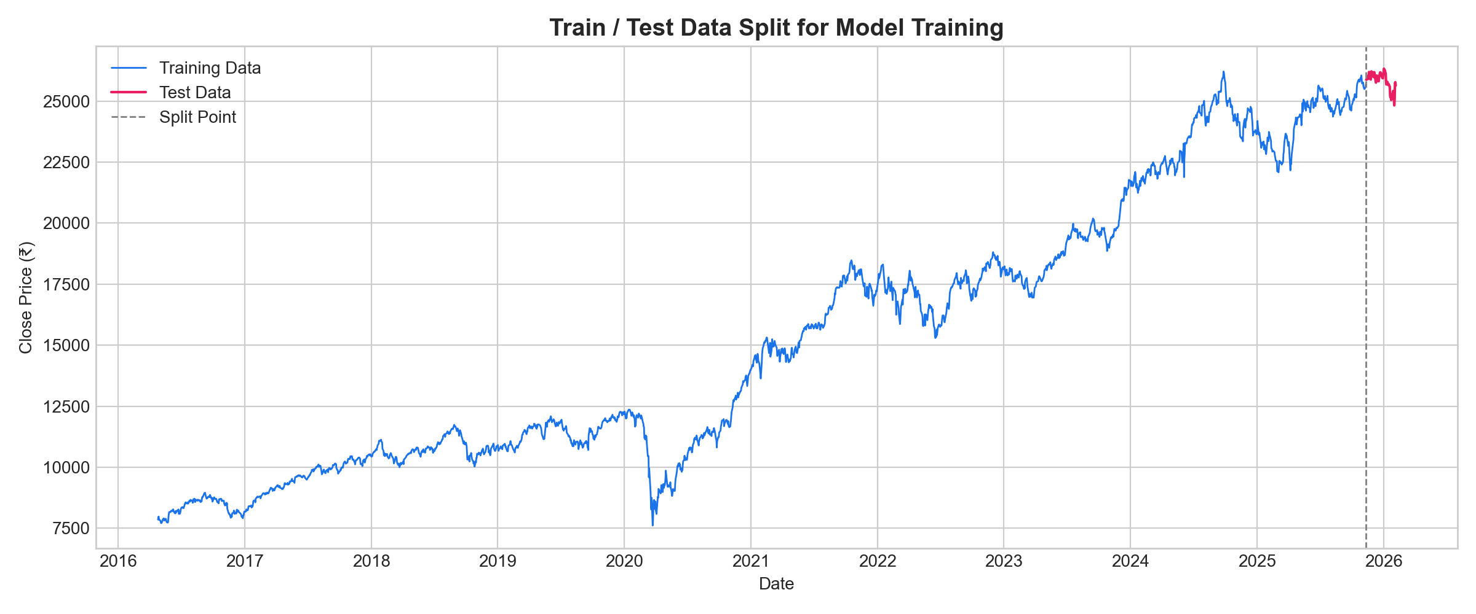
Train / Test Data Split
Training: 2370 samples | Test: 60 samples

Slide 13
Model Evaluation Results
Target | MAE (Points) | MAPE (%) | Rating
Open | 133.42 | 0.52% | Excellent
High | 111.85 | 0.43% | Best
Low | 141.05 | 0.55% | Good
Close | 139.23 | 0.54% | Good

Slide 14
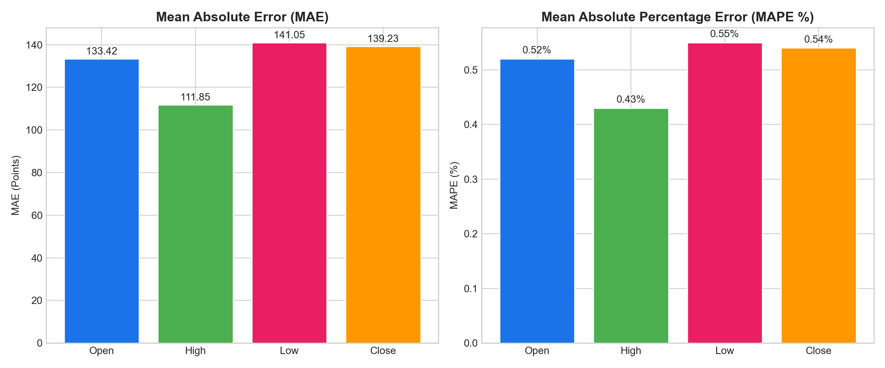
Model Accuracy Comparison
All models achieve MAPE < 1% — Excellent accuracy

Slide 15
Web Application Features
• Single Date Prediction — OHLC values as stat cards
• Date Range Prediction — Interactive Chart.js line chart
• Historical Data Page — 250-day trend with moving averages
• CSV Export — One-click download of predictions
• Responsive Design — Works on mobile, tablet, desktop
• Client-side Validation — Input checks before submission
• About Page — Methods, metrics, and tech stack details

Slide 16
Key Findings
• NIFTY 50 grew from ₹6,826 to ₹26,373 in 10 years
• Moving averages significantly improve Prophet accuracy
• High price model achieves lowest error (MAPE 0.43%)
• Volatility regressor helps during turbulent markets
• Sub-1% MAPE across all targets validates the approach
• Web app makes ML predictions accessible to all users

Slide 17
Limitations
• Static regressor values for future dates
• No external data (news, sentiment, global events)
• Accuracy degrades beyond 30-60 day horizon
• Index-level only — not for individual stocks
• No real-time data integration
• Educational purpose — not for actual trading

Slide 18
Future Scope
• Sentiment analysis from news & social media
• LSTM/Transformer ensemble with Prophet
• Live data feeds & automatic retraining
• Individual stock predictions (NIFTY 50 constituents)
• REST API for trading bot integration
• Cloud deployment (AWS/GCP) for production
• Advanced charts: Candlestick, RSI, MACD, Bollinger

Slide 19
Conclusion
• Successfully built an ML-powered NIFTY 50 predictor
• Prophet + technical indicators achieves <1% MAPE
• User-friendly Flask web app with interactive charts
• Demonstrates practical ML application in finance
• Validates time-series + domain features approach

Slide 20
References
[1] Taylor & Letham (2018) — Forecasting at Scale
[2] NSE India — NIFTY 50 Index Data
[3] Facebook Prophet Documentation
[4] Flask Web Framework Documentation
[5] Chart.js Documentation
[6] Bootstrap 5 Documentation
[7] scikit-learn Metrics Documentation

