Slide 1


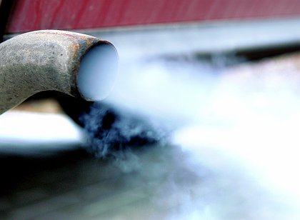

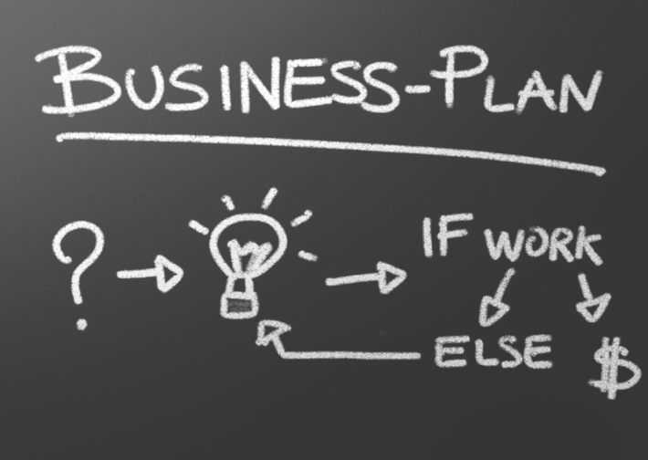
“Green the world, make it a better place, for you , for me and the entire human race”
Eco-Friendly Traffic
By
Muskan Tantia & Prachi Agarwal
National Institute Of Technology, Raipur

Slide 2

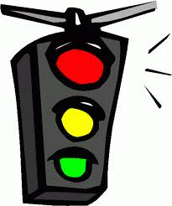
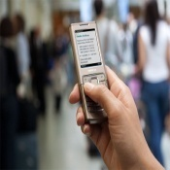

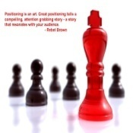
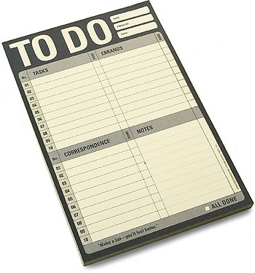



AGENDA
Plan Overview
Defining Our Customers
Market Analysis
Product Details
Financial/Marketing Model
Competitive Scenario & Risk Analysis

Slide 3

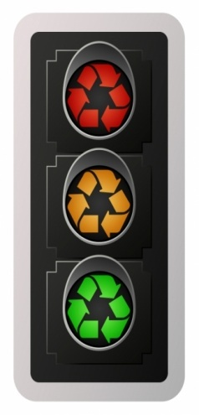
Plan Overview
Provide eco-friendly solution to the customers through inexpensive products using innovative technology
Design technology products for a pure and pollution free environment
Automatically switch off the vehicle’s engines
Idle at the traffic signal for more than 10 seconds
Speed of vehicle : Zero km/ph
Technology Implemented
Problem Identification
FM Transmission-Receiver Model
Transmitter – Traffic Signals - Government
Receiver – Vehicle – General Public/Automobile Companies
Huge amount of emission by vehicles idling at the traffic signals
Attitude of Consumer of not switching off the vehicle at traffic signals
No Manual Intervention Solution
Major Issues
Creating Values
Contributes to the majority of the pollution
Fuel Wastage
Impairs the operating efficiency of the cars
Business seeks opportunity in limiting the smoke emission to
the environment
General public (saving fuel & money)
Automobile companies (creating a value)
Government (pollution control)

Slide 4
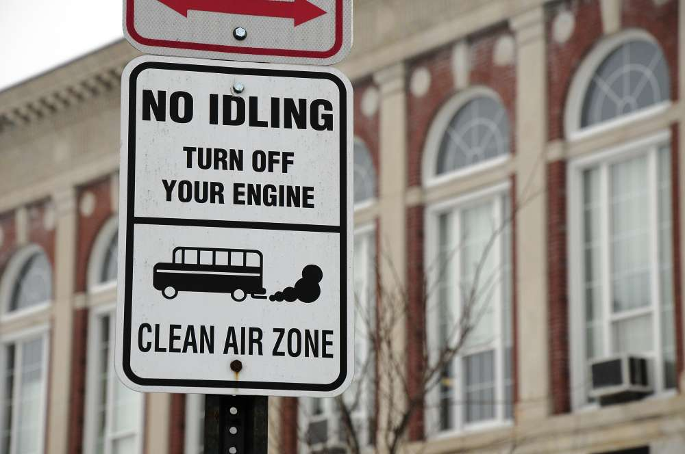
misconception
This is a common misconception that more fuel is wasted while restarting the vehicle compared to idling of the vehicle. But according to a recent analysis just 10 seconds of idling uses as much fuel as restarting your car, hence it is recommended that you shut off your car when you’re parked (at a drive-through business, for instance) for more than 10 seconds.And besides wasting fuel, excessive idling can damage cylinders, spark plugs and the exhaust system.
To test the cost of idling, testers drove two cars for 10 miles—they stopped 10 times and idled for two minutes each time. Then testers drove the same route but turned off the engine and restarted at each of the 10 stops. They estimated nearly 20 percent fuel savings on the restarted cars.

Slide 5



Defining Our Customers
Customer Segments
Value Proposition
General Consumer using a vehicle.
Government – Ministry of Environment and State Government Transport
Automobile Companies
Engine Power | Fuel Consumption while idling at traffic signals | Type of Vehicle
500-700 RPM | 1.9 litres/hour | 4-wheeler
900-1200 RPM | 3.78 litres/hour | Heavy Vehicles
Value to all Stakeholders
Payback Calculation
General public would be able to save more than 30% of their fuel expenses
Government’s focus on reducing emission
Ministry of Environment is seeking such solutions
State Transport Department’s public transport vehicles – low fuel efficiency
Electronic Waste Suppliers – Our supplier for certain basic electronic items
Automobile companies - want innovative value added solutions to pass to their consumers
Receiver module would be sold at Rs. 3199
A car in a metro city stands idle at a traffic signal for about 10 minutes per 100 km
Spending 0.35 litres of fuel worth more than Rs.15
Payback period of only 7 months (213 days)
Benefits Highlighted
Savings in the part of the consumer
Improved vehicle’s performance
Limiting CO₂ emission

Slide 6

Market And Product Detail
General Consumer
Four Wheelers
Auto Rickshaws
Heavy Vehicles
Light Transport Vehicles
Private Bus
Government
Ministry of Environment
State Government Transport
State Transport Bus
Public City Bus – BEST, Blueline, etc.
Automobile Companies – Maruti, Ashok Leyland, etc.
Number of vehicles (4-wheeler and above) travelling on a
particular day would be around 19 lakh(as on March 2012)
Growth in 1lakh each year
Government and Automobile Companies – Ready to invest
Type of Transport | Number
Taxi | 353679
Auto Rickshaw | 369656
Cars | 599691
Heavy Vehicles | 371969
Trends in Market
Product Details
General public want to save more on their fuel expenses
More than 71% of the public forgets to switch off the vehicle
35%-40% of the drivers are not aware of the benefit of switching off the vehicle
Government’s focus on reducing emission
Mumbai State Government set to spend Rs.14 crore to improve BEST bus performance
Bangalore State Government to spend Rs. 79 crore to improve traffic management
Dumping grounds in Third World countries facing immense Electronic waste management problems
Automobile companies - want environmental and sustainable solution
Receiver Module:
FM Receivers
Microcontroller based automation
Less Production Cost
Transmitter Module:
FM Transmitters
High Directional Antenna
Less Maintenance Cost

Slide 7
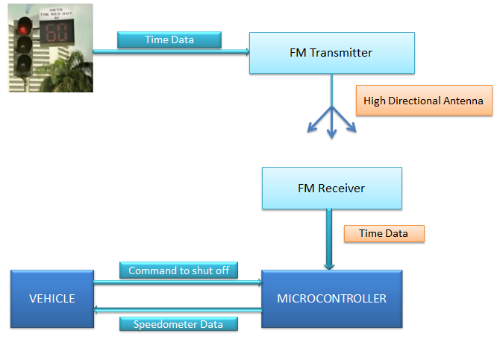
Innovation Process

Slide 8

Financial & Marketing Model
Financial Model
Marketing Model
The cost of a receiver module would be around Rs. 2400 which will be priced at Rs.3199 and the transmitter module would cost around Rs. 4500 will be sold at Rs 7999. Here if we implement in an area like Bandra, Mumbai, we could focus on around 15000 vehicles in the first phase of the project. This would require an investment of around 3.6 crore for the receiver and the initial investment to automate minimum of 15 traffic signals (60 transmitters) would come around Rs. 2.7 lakhs. Moreover for additional patent costs, electronic components, design team, technicians, labs and logistics would cost around another Rs. 2.2 lakhs.
So in total initial investment would be around Rs.3.7 crores.
Profitability Table
The profit for the first phase comes out to be Rs. 1,19,74,940. Our forecast shows that by around 1.5 years we would be able to achieve our break-even point.
Sales Action Plan:
Phase 1: (Transmitter Sale)
Directly deal with Government of India for supply of Transmitter
B2B model of Business with Government
Phase 2: (Receiver Sale)
B2B model of business to Government and Automobile Companies
General Customers directly through :
Company Owned Outlets
Auto & Spare Parts Shops
Garages
Profitability Table | Revenues in Rs.
Transmitter & Receiver Model | 4,84,64,940
Production & Input Costs | 3,64,90,000
Profit | 1,19,74,940
Promotional Plan
Approaching Government for spreading the message
Print Ads in Newspaper
Tie up with environmental organization to promote through events, trade & automobile shows
Tie up with Petrol Pumps for promotion

Slide 9
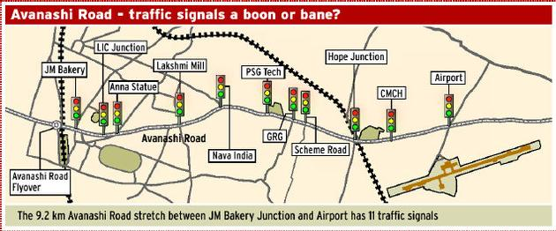

Slide 10
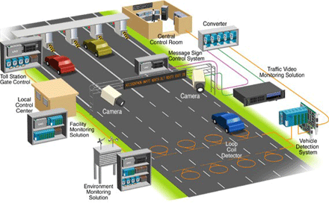
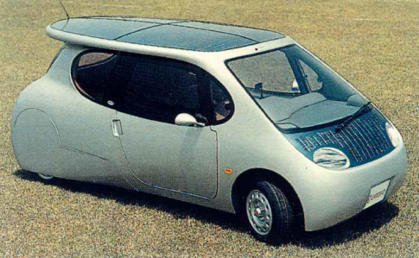
Competitive Landscape & Risk Analysis
Competitive Scenario
Risk Analysis
No direct Competition –
Current situation of us: Start-up with an innovative product
Unique Product in Market
Indirect Competition
Intelligent Traffic Management Systems for optimizing traffic flow
Engine Filters for minimizing emission – efficiency problem
Emergence of Hybrid Electric Vehicles
Business Model Risks:
High risk of Replication of idea
Will approach Patents to safeguard our idea
Office of the Controller General of Patents
Market Risks:
Automobile companies developing low pollution technology of their own
Trend Variations – Hybrid Vehicle, Solar Powered Cars
Econometric and statistical analysis tools to monitor the movement of the market
Operational Risks:
Risk of fraud by internal employees and suppliers
Limiting authority to all departments
High Quality Assurance Framework
Unauthorized Transactions
Automation of offices/labs

Slide 11

Funds Realization Plan
Funding Objectives
Using Funds
Objective of raising 50 lakh amount of money
Channels of raising funds:
Angel Investors
Green Venture Capital Firms
Self Funding
Government of India Budgetary allocation has been increased to Rs.10 billion
Investment from them
Expectation of Tax Benefits from Government
Manufacturing facility & design labs
Production of Equipment modules
Staffing the facility
Marketing & Operational Expenses
Expenses for Patent Rights
Distribution channel optimizing
General Administrative Expenses

Slide 12
OUR JOURNEY TILL TODAY
We are looking forward to work on this idea as our final year project.
We will contact the state environment minister to implement this plan.
We will continue our anlysis on this plan in future.

Slide 13

ECO friendly environmental concepts
WE THANK YOU
FOR
YOUR PRECIOUS TIME

