Slide 1
Startup Profit Analysis
Using SQL, Python & Power BI
Submitted By: Muskan Chib
Role: Data Analyst Intern
Project: PRDA-01
Tools Used: MySQL, Python, Power BI

Slide 2
Objective of the Project
Analyze startup profit data
1
Study the impact of:
2
R&D Spend
Marketing Spend
Administration
Predict future profit using Linear Regression
3
Create interactive dashboard using Power BI
4

Slide 3
Dataset Description
The dataset contains startup company information with the following columns:
Column Name | Description
RD_Spend | Research & Development investment
Administration | Administrative expenses
Marketing_Spend | Marketing investment
State | Startup location
Profit | Company profit
Dataset Source:
Initially analyzed using MySQL database
Exported as CSV for Python and Power BI analysis

Slide 4

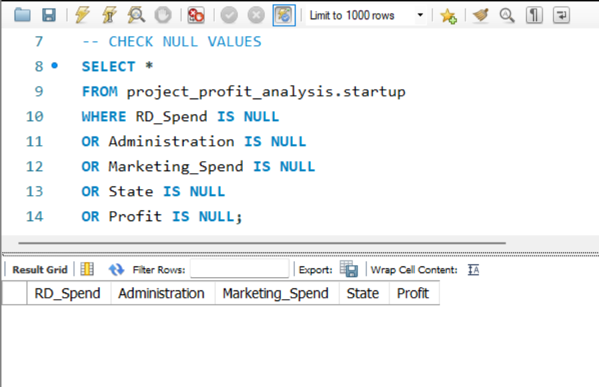
SQL Data Analysis
Key Findings:
R&D Spend shows strong positive relation with profit
Marketing Spend also increases profit
Administration has weaker impact on profit
No missing values found in dataset

Slide 5
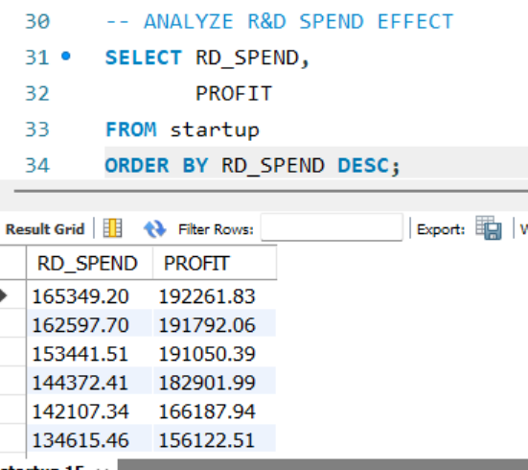
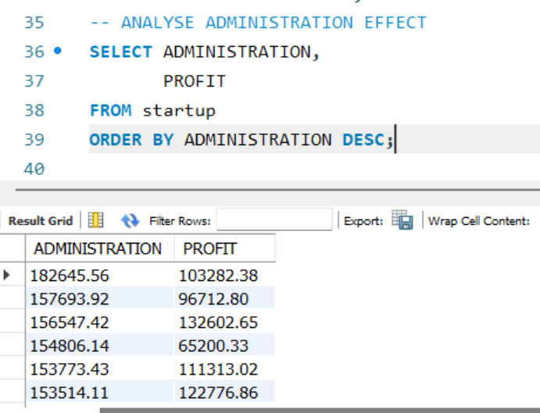

Slide 6
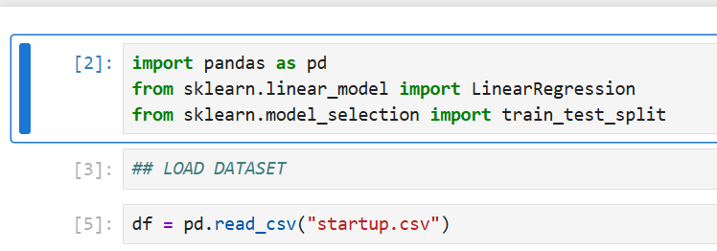
Linear Regression Analysis
Linear Regression model was trained using:
RD_Spend
Administration
Marketing_Spend
Target variable:
Profit

Slide 7
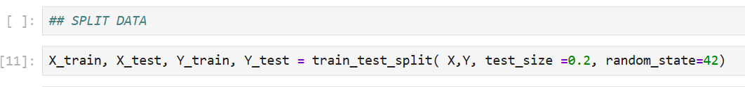
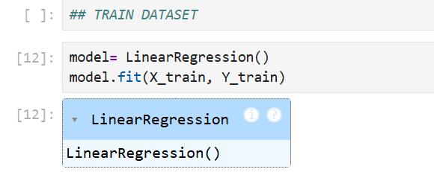

Slide 8
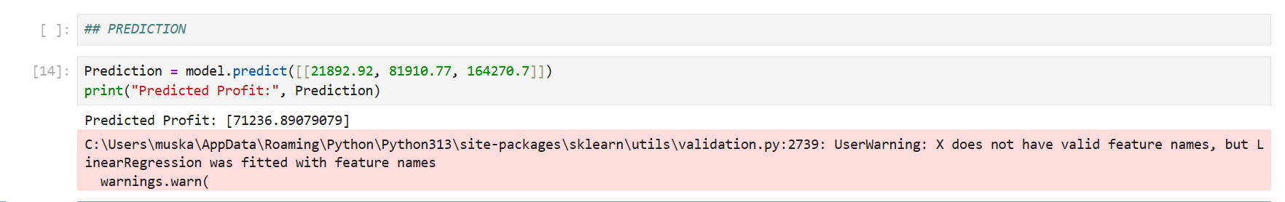
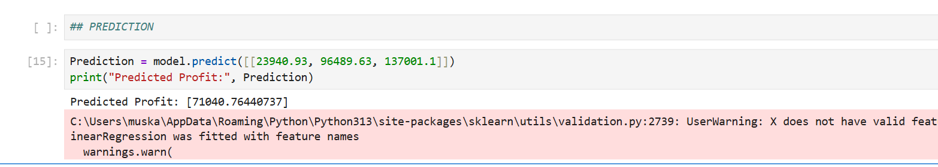

Slide 9
Predicted Profit Results
Prediction | RD Spend | Administration | Marketing Spend | Predicted Profit
1 | 21892.92 | 81910.77 | 164270.7 | 71236.89
2 | 23940.93 | 96489.63 | 137001.1 | 71040.76
Observation:
Higher R&D and Marketing investments generally lead to higher profit predictions.

Slide 10
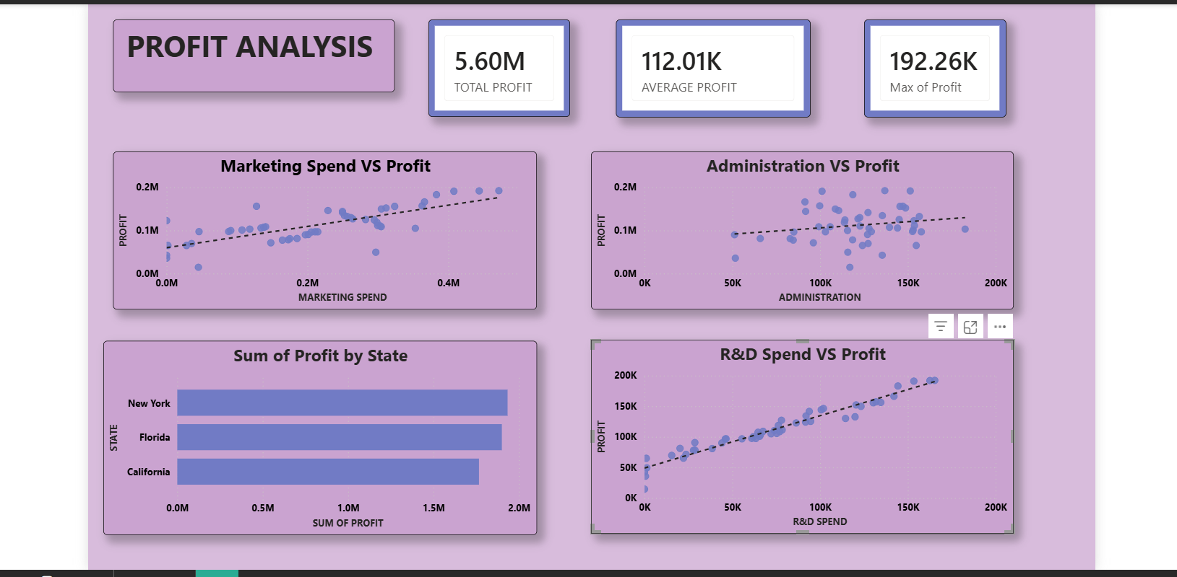
Power BI Dashboard Visualization

Slide 11
Dashboard Insights:
Marketing Spend has positive relationship with profit
R&D Spend has strongest positive impact
Administration has moderate effect
New York shows highest overall profit

Slide 12
Conclusion
R&D Spend is the most influential factor affecting profit
Marketing investment also contributes positively
Administration expenses show limited impact
Linear Regression successfully predicted startup profit
Power BI dashboard helped visualize business insights effectively

Slide 13
Recommendations
Increase investment in R&D activities
Maintain effective marketing strategies
Optimize administrative expenses
Use predictive analytics for future business planning

