Slide 1
RETENTION MODEL · DECISION SYSTEM
PREDICTING CHURN
BEFORE THE CUSTOMER LEAVES
Signals → explanation → retention action
Notes:
Frame churn as an operating problem, not a model-building exercise. The goal is to recognize rising risk early enough to change the customer’s experience.

Slide 2

CHURN IS A TIMING PROBLEM,
NOT ONLY A CLASSIFICATION PROBLEM
The useful score arrives before the decision to leave.
See rising risk early
Identify customers showing rising exit risk early enough to intervene.
Separate who from why
Distinguish who may leave from why they may leave.
Make the score useful
Turn a probability into a retention decision.
Notes:
Emphasize the intervention window. A model that identifies churn only after the customer has decided to leave may be accurate but operationally late.

Slide 3
THE MODEL CONNECTS CUSTOMER SIGNALS TO A RETENTION PLAY
A score is one step in a chain of decisions.
01
02
03
04
Assemble
Score
Explain and route
Measure
Customer, service, billing, and interaction history.
Near-term churn risk for each active customer.
Drivers translated into an appropriate action.
Save rate, cost, and customer response.
Notes:
Walk left to right. The model begins with assembled evidence, produces a risk score, explains that score, and ends with measured customer and business outcomes.

Slide 4




USE A FEATURE SET THAT REFLECTS THE CUSTOMER RELATIONSHIP
The strongest signal is rarely one field. It is the pattern across the relationship.
Relationship
Economics
Tenure, contract type, plan, household profile.
Monthly charge, discounts, payment behavior, balance.
Experience
Engagement
Outages, technical tickets, complaints, contact-center friction.
Usage trend, add-on changes, digital activity, declining activity.
Notes:
These four families make the feature set legible to the business. They also create a bridge from model output to the teams that can act on it.

Slide 5




DEFINE CHURN CAREFULLY BEFORE TRAINING ANYTHING
The label is a business decision with a clock attached.
Event
Prediction window
Intervention window
Cancellation, port-out, non-renewal, or prolonged inactivity.
Set how far ahead the score should look.
Set enough time for a treatment to work.
Leakage controls
Edge cases
Use only information available before the score date.
Document exclusions, reactivations, and multi-line accounts.
Notes:
Explain that label design determines what the model learns. The event, windows, and leakage rules must be agreed before feature engineering begins.

Slide 6
START WITH A TRANSPARENT BASELINE,
THEN EARN COMPLEXITY
Complexity is justified only when it improves the decision.
BASELINE
CANDIDATE
Regularized logistic regression
Gradient boosting
Interpretable benchmark; coefficients show direction and strength.
Captures nonlinear interactions and mixed signals when the evidence earns a more flexible model.
Compare on more than accuracy
Ranking quality · calibration · stability · actionability
Notes:
Position the baseline as a discipline, not a compromise. A candidate model must improve the measures that matter to retention, while remaining stable and actionable.

Slide 7
ACCURACY ALONE CAN HIDE A WEAK RETENTION MODEL
The best model balances ranking quality with calibrated probabilities and business value.
METRIC FAMILY | WHAT TO INSPECT | DECISION USE
Ranking | Top-decile lift | Prioritize outreach
Calibration | Predicted vs observed churn | Trust score bands
Value | Incremental saves minus offer cost | Set intervention threshold
Stability | Performance by segment and month | Approve deployment
ILLUSTRATIVE MODEL EVALUATION DASHBOARD · NO SINGLE METRIC DECIDES
Notes:
Use the table as a dashboard blueprint. Ranking finds whom to contact, calibration tells us whether score bands can be trusted, value sets the threshold, and stability protects deployment quality.

Slide 8
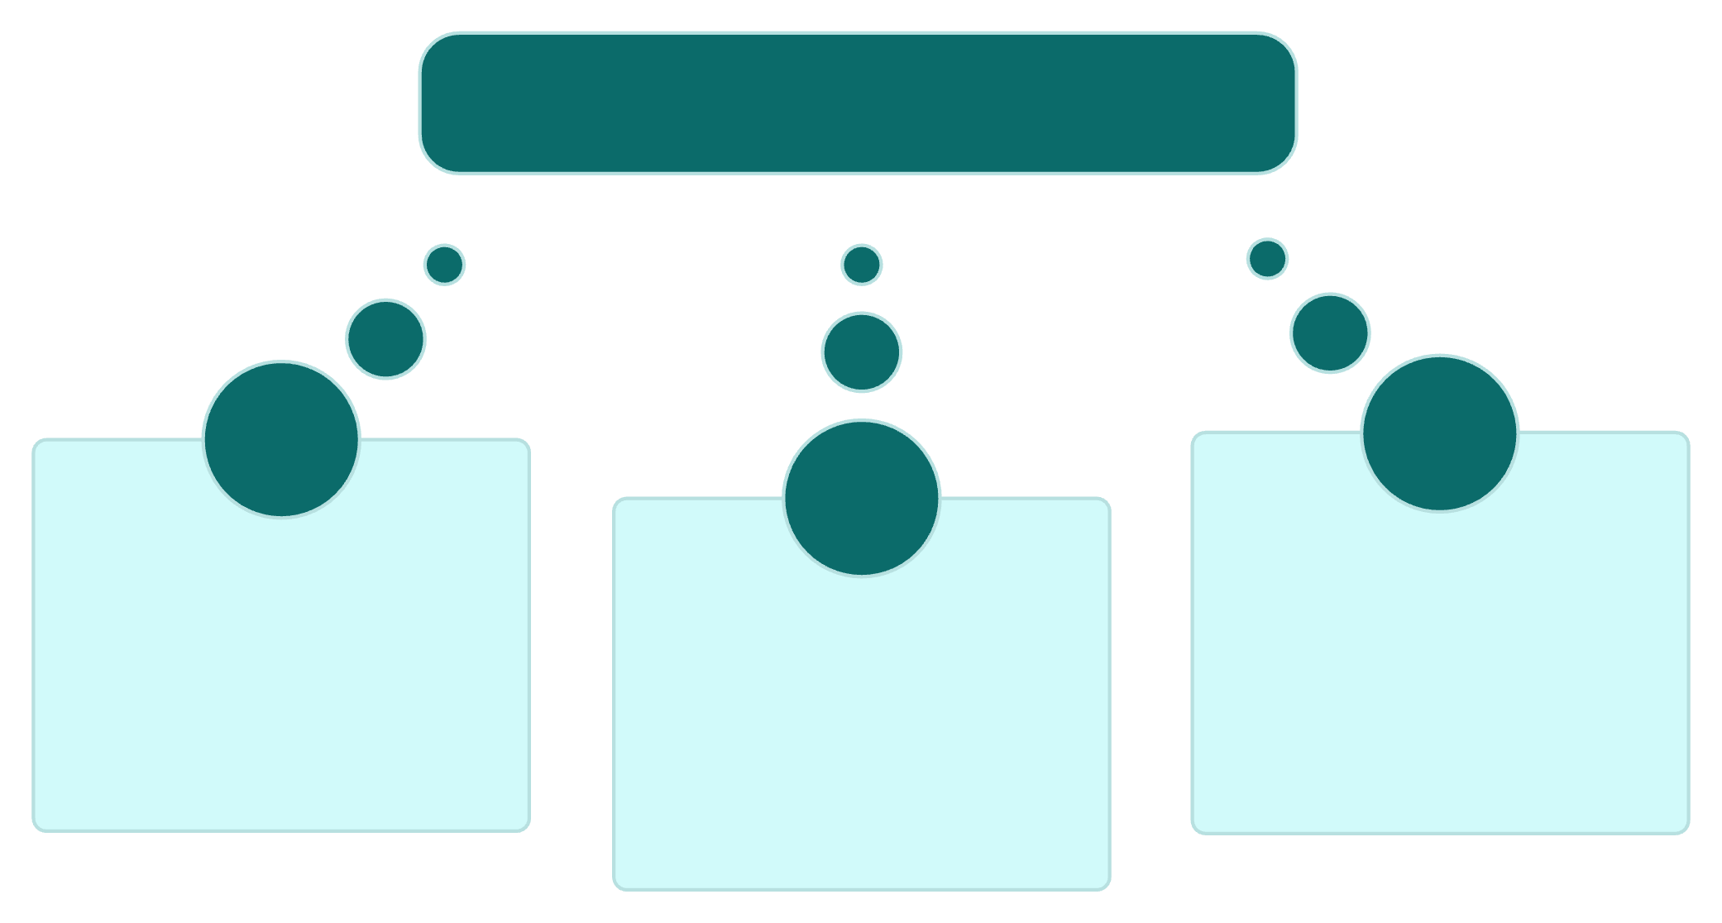



FROM SCORE TO CONVERSATION
EXPLAINABILITY TURNS A SCORE INTO A CONVERSATION
Explainable churn score
The output must be understandable to the team taking the next action.
Portfolio view
Operational translation
Signals moving overall risk
Customer view
Driver to treatment mapping
Why this score assigned
Notes:
Explain the three levels. Global explanations guide portfolio decisions, local explanations support one customer conversation, and operational translation connects a driver to a treatment and expected response. Explainable models and SHAP-style analyses are widely used to support telecom churn decisions.

Slide 9
RISK ONLY MATTERS WHEN THE ACTION MATCHES THE DRIVER
A high score without a relevant treatment is only a louder alert.
OBSERVED DRIVER | RETENTION PLAY
Service friction | Proactive technical resolution.
Price pressure | Plan review, value explanation, or targeted credit.
Contract cliff | Renewal conversation before the decision point.
Low engagement | Onboarding, usage education, or relevant add-on.
Driver → treatment → expected response
Notes:
Make the transition from prediction to action explicit. The same risk level can call for different treatments because the underlying driver changes.

Slide 10


DEPLOY THE MODEL AS A CLOSED-LOOP OPERATING SYSTEM
Every intervention creates the next training signal.
Score
Route
Eligible customers on a fixed cadence.
Risk, drivers, and treatment to the retention queue.
Learn
Log
Feed outcomes into monitoring and retraining.
Contact, offer, acceptance, and outcome.
OPERATING RHYTHM · SCORE → ROUTE → LOG → LEARN
Notes:
Close on the operating loop. Deployment is not the end of the project: scoring, routing, logging, and learning create the system that improves future decisions.

