Slide 1
TRADEMARK DMS Legal Department
Proposal to ICS

Slide 2
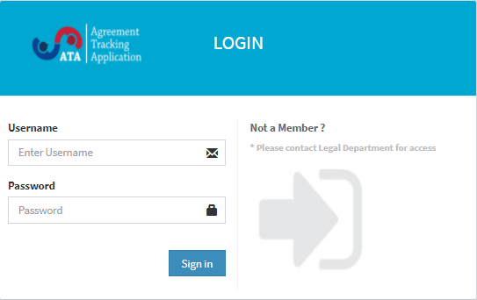
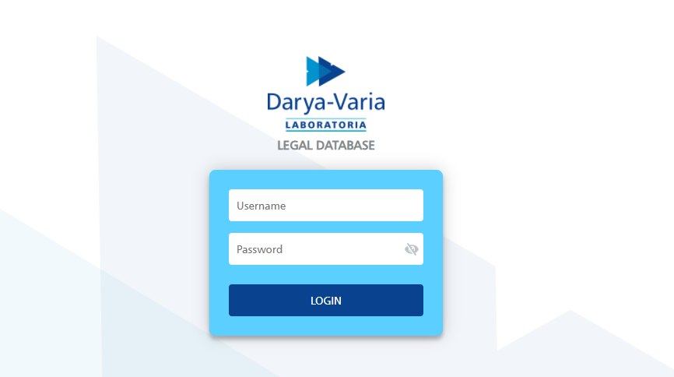
Existing DMS
Nov 2020
ATA (Agreement Tracking Application)
Legal DMS (All Legal Archive) – include the Trademarks archive
http://ata.bersatu.net/login
http://dvgsvr32/

Slide 3
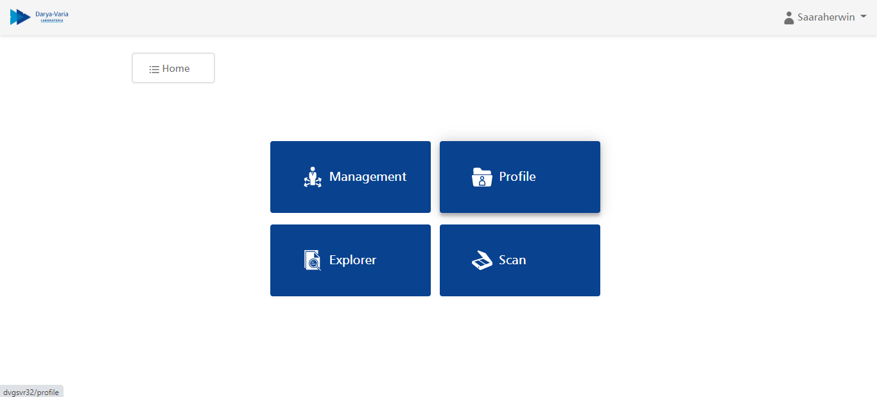
What WE NEED
Reminder system -> send through email
More detail meta data
Sub-menu to differentiate the trademark ownership
CURRENT DMS DISPLAY
TRADEMARK

Slide 4
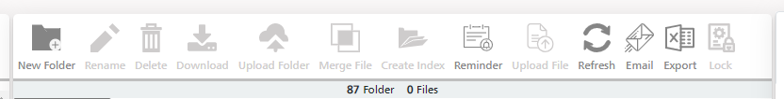
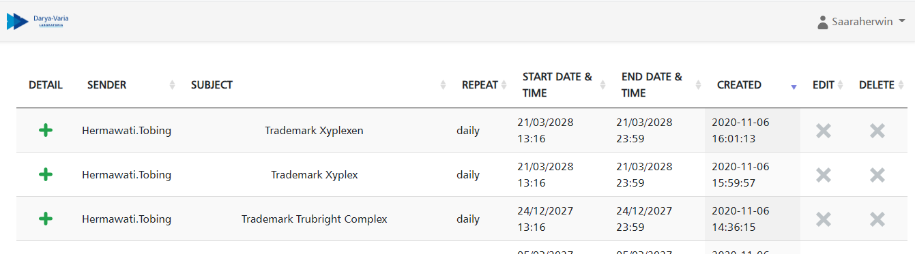
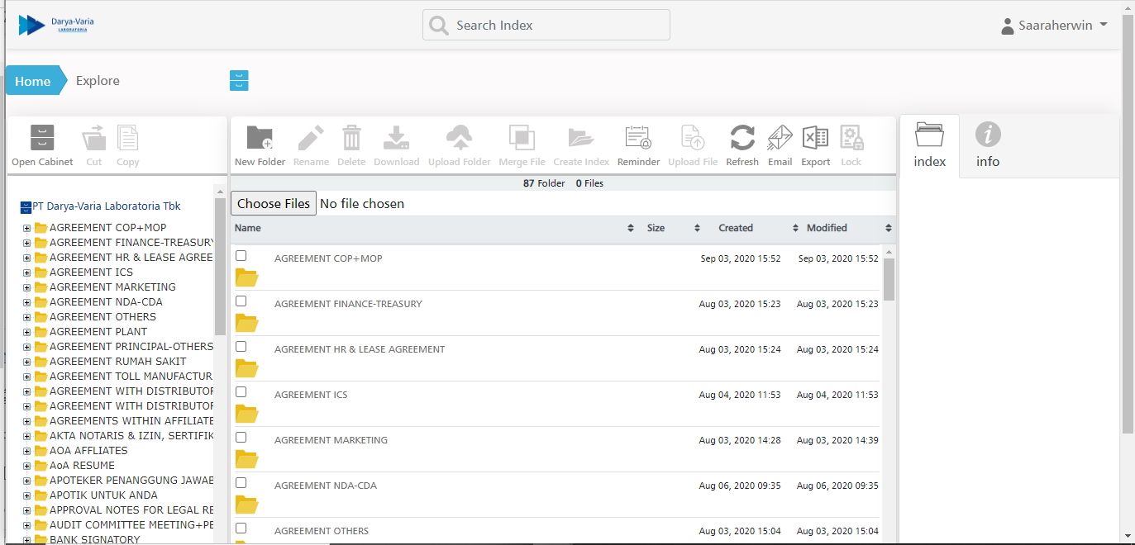
REMINDER SYSTEM

Slide 5
UPDATE 2021

Slide 6
CURRENT DMS DISPLAY
TRADEMARK
(database)
TRADEMARK APPROVAL
Request
Approve

Slide 7
TRADEMARK APPROVAL
1
Legal send the internal approval to related user. Each form consisting of 2 papers and usually user requested for max. 6 trademark submission on each approval (equal to 12 pages of paper for each approval)
2
User finalize and distribute the papers for approval from related head, legal, VPD, and PD. Duration for this process may vary, depending on the availability of each approval (in practice : more than 1 week).
3
User send the document to legal to be kept in legal archives.
Trademark Filing process
4
Legal send the actual approval form informing trademark names, logo, classification, and other related data for PD’s approval.
Whereas nowadays the form is no longer required considering the application to Ditjen HKI can be done via online submission. Each approval from consists of 4 pages of papers.
5
Once PD approved the form, legal will submit the hard copy document to Ditjen HKI. This step is no longer required considering the submission can be done online.
6
Upon submission, hard copy document will be scanned and saved in legal database and legal archive
Process 4,5,6 needs to be eliminated due to the paperless system that is currently being applied by Ditjen HKI. Legal requires a system that can facilitate online internal approval, digital signature and digital filing to shorten the lead time and to minimize paper usage.

Slide 8
TRADEMARK APPROVAL
1.
2.
3.
4.
(-) Disadvantage of current Process ☹ | (+) Improvement / Ideas that We Need! ☺
Manual form | A form that that be downloaded in the system or a form template that can be filled directly by each user without printing or downloading the document
Approval manual by email and hard copy/paperbase Which going to waste paper management? | Approval system / link that can direct send to trademark system and the Approver can click a button for approval -> maybe like ESS for Izin Cuti
Stamped and signed off | Digital signature that enables PD to approve and sign the document digitally, considering Ditjen HKI is applying online submission and only requested for PD’s signature in PDF
A long lead time due to distribution of the paper form and availability of the PIC signatory | Shorter lead time for approval, considering the approval can be done online

Slide 9
TRADEMARK FILING PROCESS
1
2
3
Trademark Certificates received from Legal PIC
Filing Manual
scan the certificates then final filing in DMS system
(soft copy)
Filing Manual
file the Certificates in data room (hard copy)
4
5
6
Update Trademark List
On Excel file and input reminder date manually
Monitor the trademark database, re-check repeatedly which trademark we haven’t received the certificates
Data Validation
Follow up the certificates to HAKI

Slide 10
TRADEMARK FILING PROCESS
1.
2.
3.
4.
5.
6.
(-) Disadvantage of current Process ☹ | (+) Improvement / Ideas that We Need! ☺
Manually input data to excel, which will make the data easily edited and non-reliable | Generate data by system -> like ATA system
Sometimes we forget to update the database | Updating online time to time
Human error in inputting the data | Reduce human error
Need more time to input the data in excel file | Time effectiveness
Lack of controlling | Trademark system to enable tracking data and documents more specific for data filing. This can be accessed during out of office
 | Can generate data, reminder system for trademark that will expire, integrated search (incl. history), online approval

Slide 11
SUMMARY
GOAL
1. The system can improve Legal services in terms of Trademark matter
2. The system will help Legal to trace data specifically for Trademark, in remind to massive data of Trademark only
3. Time effectiveness and reduce human error/data is valid
4. A system that can search trademark documents of DVL, MLI and ULS thoroughly from initial agreements, internal approval, submission form, and certificates that enables legal to easily find the searched data
5. Shorten the lead time for approval process
6. Paperless
7. Enhance the Legal system not only for Database but for Trademark operational system

Slide 12
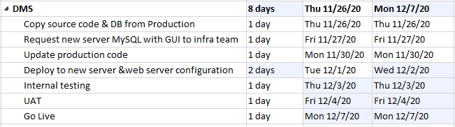
Latest timeline

Slide 13
