Slide 1

Linux Plus
for
AWS and DevOps

Slide 2

Using Package Managers

Slide 3
Table of Contents
Package Management
Popular Linux System Package Managers

Slide 4
Package Management
1

Slide 5


Package Management
A package manager is a collection of software tools that automates the process of installing, upgrading, configuring, and removing computer programs for a computer's operating system in a consistent manner.
Package Manager
Office Boy

Slide 6
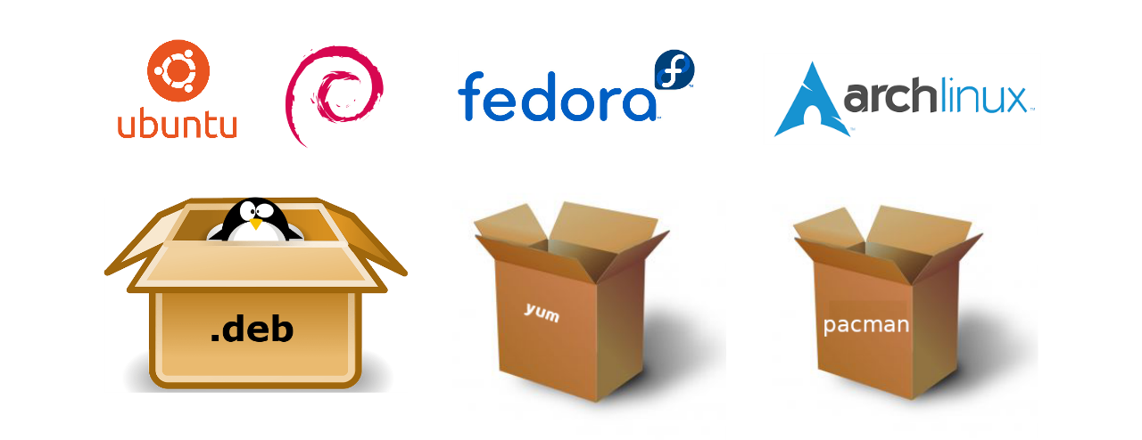
Package Management
A package manager deals with packages, distributions of software and data in archive files. Packages contain metadata, such as the software's name, description of its purpose, version number, vendor, checksum, and a list of dependencies necessary for the software to run properly. Upon installation, metadata is stored in a local package database.

Slide 7
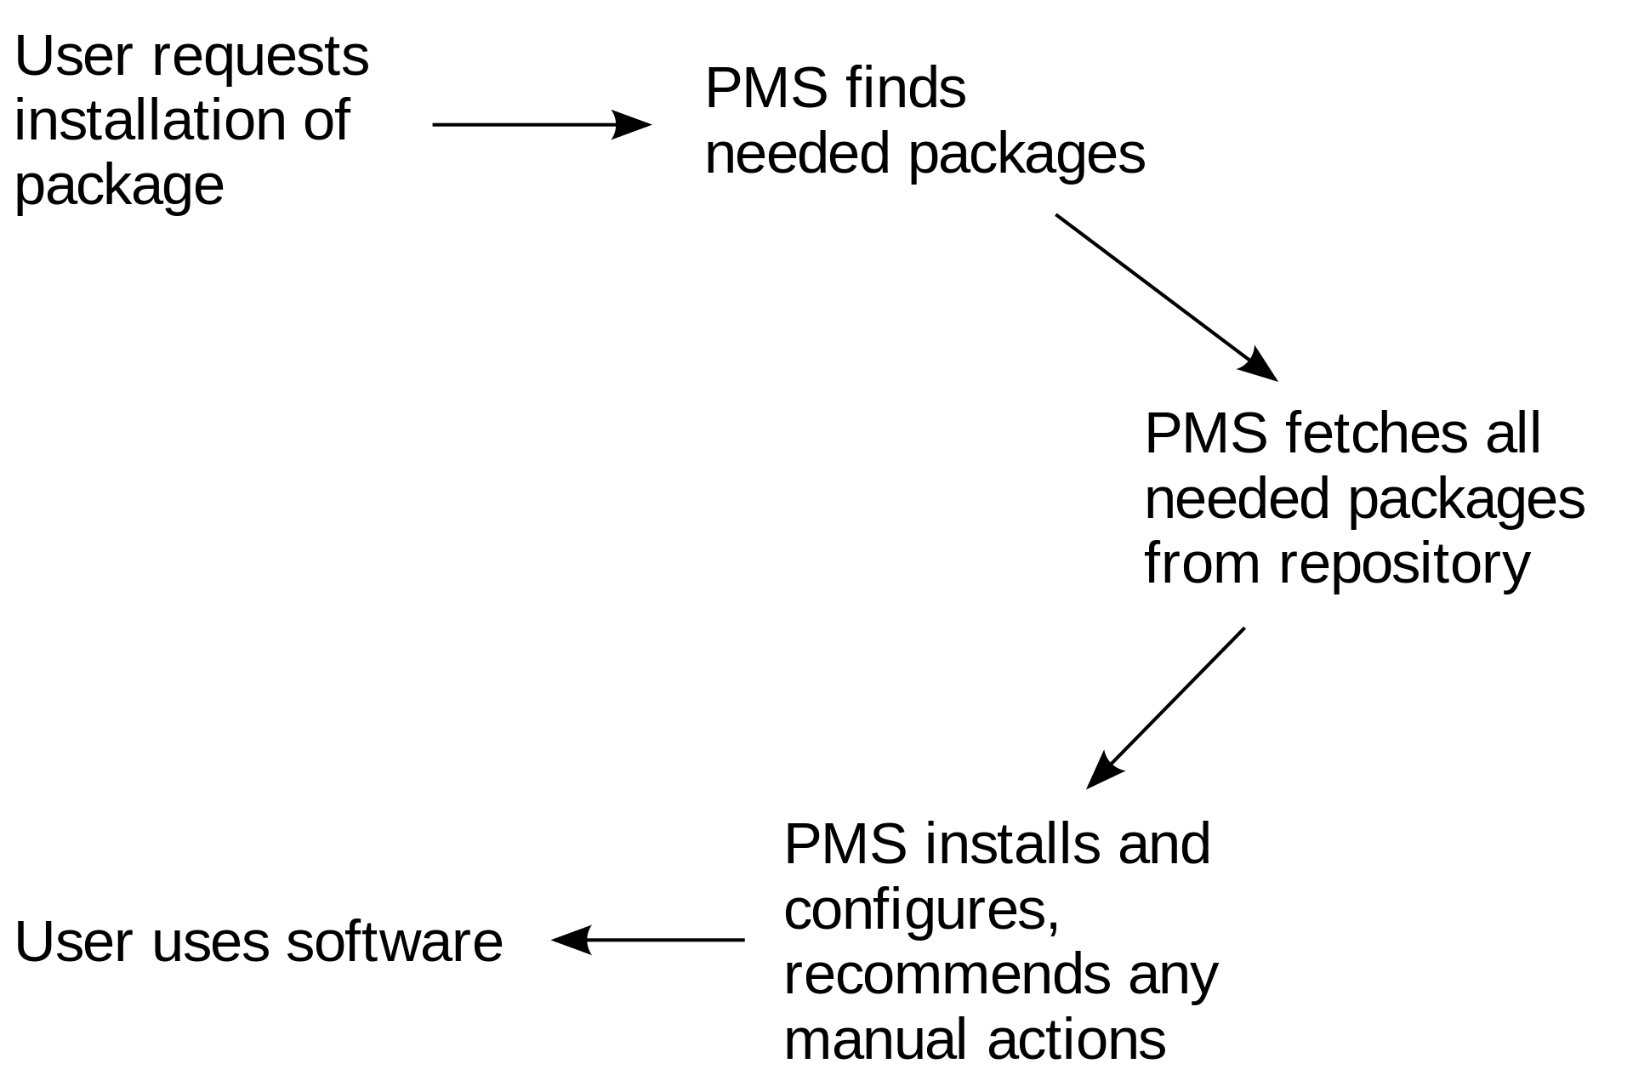
Package Management
Package managers are designed to eliminate the need for manual installs and updates. This can be particularly useful for large enterprises whose operating systems are typically consisting of hundreds or even tens of thousands of distinct software packages.

Slide 8
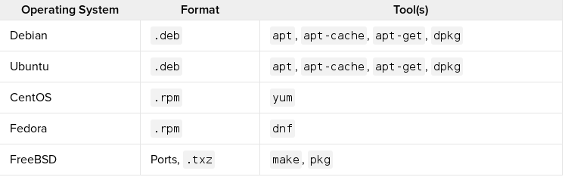
Package Management
https://stackoverflow.com/questions/10286459/multiple-package-manager

Slide 9
Popular Linux System Package Managers
2

Slide 10

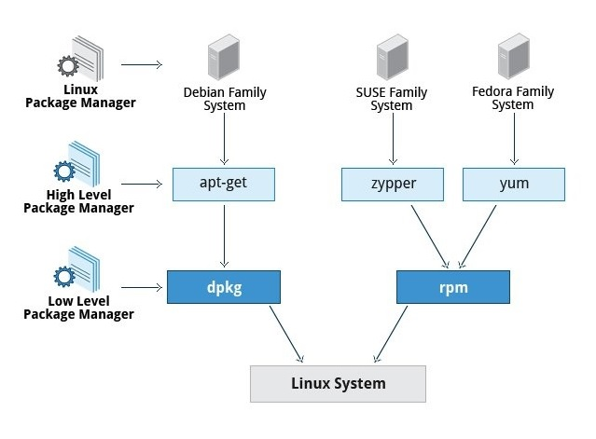

Popular Linux System Package Managers
Linux systems use package managers to add or remove the software packages. These package managers are also a package so you can install any of them.
Ubuntu
Amazon Linux

Slide 11
Popular Linux System Package Managers
Debian Package Managers
dpkg is the main package management program for the Debian Linux distros. It is used to handle Debian package files with the extension of .deb
$ dpkg -i [package-name] # Installing a package
$ dpkg -r [package-name] #Removing a package
$ dpkg -l # Lists installed packages

Slide 12
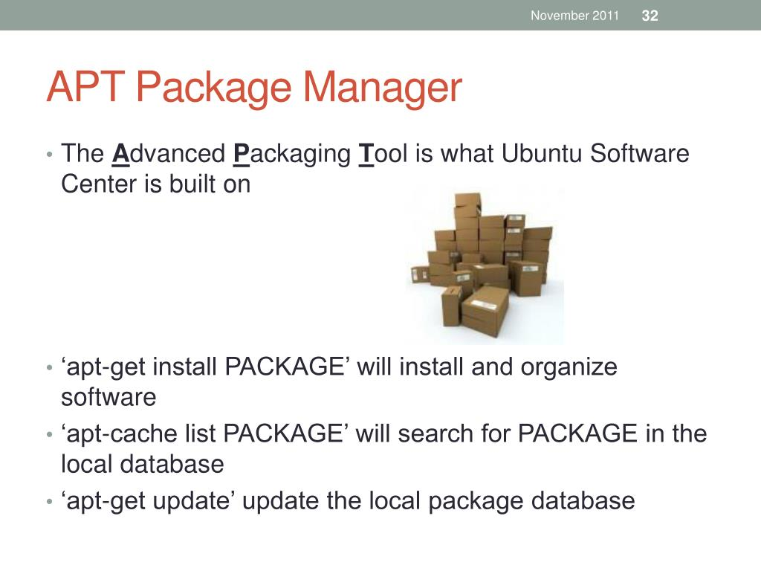
Popular Linux System Package Managers
Debian Package Managers
APT
(Advanced Package Tool)
$ apt update # Update the installed packages
$ apt install [package-name] # Install a package and all its dependencies
$ apt remove [package-name] # Remove a package
$ apt purge [package-name] # Remove a package and its configuration files

Slide 13


Popular Linux System Package Managers
Debian Package Managers
Aptitude Package Manager
aptitude tool provides the functionality of apt-get, as well as many additional features:
aptitude provides easy access to all versions of a package
aptitude tracks of obsolete software
aptitude has a powerful system for searching particular packages
$ aptitude install [package-name] # Install a package
$ apt-get install [package-name] # Install a package
https://www.tecmint.com/difference-between-apt-and-aptitude/
Notes:
aptitude is a package manager for Debian Linux systems that performs action from the visual interface and from the command-line. aptitude can be used to perform management tasks in a fast and easy way.

Slide 14
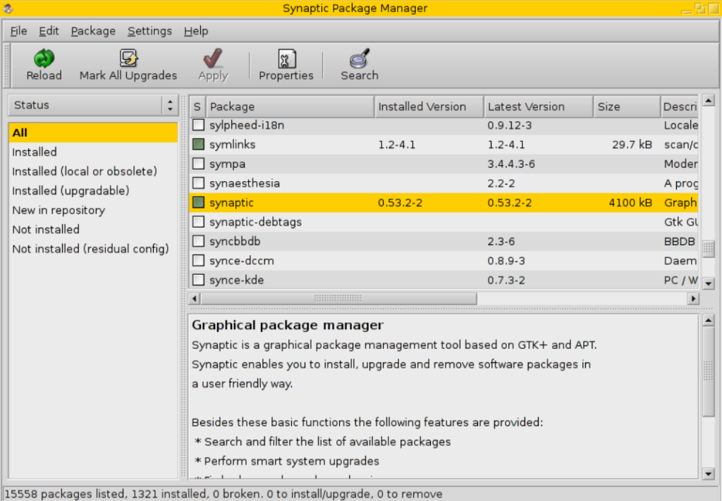
Popular Linux System Package Managers
Debian Package Managers
Synaptic Package Manager
Synaptic is a graphical package manager and used for installing, upgrading and removing single and multiple packages in a more user-friendly way.
sudo apt-get install synaptic

Slide 15

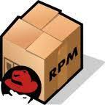
Popular Linux System Package Managers
Red Hat Package Managers
rpm is the package manager for Red Hat Linux operating systems. The installation package files have .rpm extension. These files are used for installing programs. rpm command has been used for RPM packages by default but new tools are developed for better performance.
$ rpm -i [package-name] # Install a package
$ rpm -e [package-name] # Uninstall a package

Slide 16

Popular Linux System Package Managers
Red Hat Package Managers
YUM (Yellowdog Updater Modified)
YUM is an open-source package manager that was developed by Duke University. It is used both in the command line and GUI. It works mostly the same as APT in Debian Linux systems. Here are some examples of YUM.
$ yum install [package-name] # Install a package
$ yum remove [package-name] # Remove a package
$ yum update [package-name] # Update a package

Slide 17
Popular Linux System Package Managers
Red Hat Package Managers
DNF – Dandified Yum
It is the new generation of YUM package manager. It is the default package manager of Fedora 22 and newer distros. The usage of DNF is mostly the same as YUM.
$ yum install dnf # Install DNF via yum.
$ dnf –version # Checking DNF version
$ dnf install # Installing a package
Notes:
1) To install DNF on RHEL/CentOS 7 systems, you need to set up and enable epel YUM REPO before installing DNF.
# sudo amazon-linux-extras install epel
2) Install DNF
# yum install DNF
# dnf --version
yum package managerı uninstall edip sonra yüklemek lazım…

Slide 18
Popular Linux System Package Managers
Red Hat Package Managers
Other RPM tools:
zypper (openSUSE)
up2date (Red Hat Enterprise Linux, CentOS 3 and 4, and Oracle Linux)
urpmi (Mandriva Linux, ROSA Linux, and Mageia
apt-rpm (Ark Linux,[11] PCLinuxOS and ALT Linux)
smart (Unity Linux and Fedora)
rpmquery (Red Hat Enterprise Linux)

Slide 19

Popular Linux System Package Managers
Other Package Managers
Below are a few more notable/interesting package managers.
Portage: Package manager for Gentoo.
Pacman: Arch Linux Package manager.
Nix: A ‘Fully Functional/Transactional’ package manager.
Brew: An Open Source package manager for OSX.
Chocolatey: A package manager for Windows.

Slide 20

Popular Linux System Package Managers
Other Package Managers
Programming languages have their own default package managers. They help to find and install the packages via searching libraries that exist on the internet for that language.
Examples: Python: pip / Ruby: gem, rubygems / Haskell: cabal / NodeJS: npm

Slide 21
Deep Dive into yum
$ yum install [package-name] # Install a package
$ yum -y install [package-name] # Skip confirmations during installation
$ yum remove [package-name] # Remove a package.
$ yum erase [package-name] # Remove a package (an alias to remove).
$ yum autoremove [package-name] # Remove a package and unused dependencies.
$ yum update [package-name] # Update a package
$ yum update # Update all installed packages
$ yum info [package-name] # Get information about a package
$ yum list # List all installed and available packages
$ yum list [package-name] # List available matching package(s)
$ yum list installed # List installed packages
$ yum --showduplicates list [package-name] # Lists all available versions
$ yum install [package-name]-[version] # Install a specific version
Notes:
git --version
sudo yum install git
-y (without user intervention)
sudo yum remove git

Slide 22
Exercise 1
Update all installed packages
List all installed packages start with http
Find all available packages start with http
Install httpd if available. (Skip confirmations during installation)
List installed httpd package
Remove httpd
List installed httpd package
Notes:
🍐 This is a Pear Deck Text Slide
🍐 To edit the type of question, go back to the "Ask Students a Question" in the Pear Deck sidebar.
yum update
yum list installed http*
yum list http*
yum -y install httpd
yum list installed http*
yum remove httpd
yum list installed http*

Slide 23
Exercise 2
Uninstall git with all unused dependencies
Check installed git
Find previous available git version
Install previous available git version
Check installed git version
Update git to the latest version
Check installed git version
Notes:
🍐 This is a Pear Deck Text Slide
🍐 To edit the type of question, go back to the "Ask Students a Question" in the Pear Deck sidebar.
sudo yum autoremove git
git --version
sudo yum --showduplicates list git
sudo yum install git-2...
git --version
sudo yum update git
git --version

Slide 24
THANKS!
Any questions?

