Slide 1

PROJECT PROPOSAL · ODL 2026
Privacy-Preserving
Data Analytics Platform
Differential Privacy · k-Anonymity · Python · GDPR
KAPATA MUBANGA 2410812
CHANDA KUNDA 2410762

Slide 2
Introduction — Background
Organisations increasingly share datasets for research, policy, and commercial analytics — yet most existing data sharing frameworks expose personal records, violating individual privacy and regulatory requirements such as GDPR and Zambia's Data Protection Act. The tension between the value of data sharing and the obligation to protect personal information remains unresolved in most local organisational practices.
Privacy-Preserving Data Analytics Platform
02 / 14

Slide 3
Problem Statement
Zambian institutions lack practical tools to properly anonymize sensitive data. This leads to risks of exposing personal information when sharing datasets. As a result, many organizations avoid sharing data altogether despite its potential value. There is also a lack of locally developed, privacy-compliant solutions to support safe data use.
Privacy-Preserving Data Analytics Platform
04 / 14

Slide 4
Research Objectives
01
To implement a differential privacy module using the Laplace and Gaussian mechanisms in Python that adds calibrated noise to query outputs, providing ε-differential privacy guarantees for released dataset statistics.
02
To design and develop a Privacy-Preserving Data Analytics Platform that allows organisations to upload datasets, apply differential privacy and k-anonymity transformations, and download anonymised outputs via a web interface.
03
To evaluate the platform's privacy guarantee accuracy, data utility retention, and k-anonymity compliance on benchmark datasets through structured testing.
Privacy-Preserving Data Analytics Platform
05 / 14

Slide 5
Research Questions
Q1
How can a differential privacy module using Laplace and Gaussian mechanisms be implemented to provide provable ε-differential privacy guarantees for query outputs on uploaded datasets?
Q2
How can a web-based platform be designed to enable organisations to apply differential privacy and k-anonymity transformations to uploaded datasets and download compliant anonymised outputs?
Q3
How accurately does the platform preserve privacy guarantees and data utility, and how consistently does it enforce k-anonymity compliance on benchmark datasets?
Privacy-Preserving Data Analytics Platform
06 / 14

Slide 6
Scope of the Study
This study covers the design and development of a web-based Privacy-Preserving Data Analytics Platform for single-organisation use. Key inclusions:
Differential privacy (Laplace & Gaussian mechanisms) applied to numerical dataset queries
k-Anonymity enforcement through generalisation and suppression of quasi-identifiers
CSV/Excel dataset upload with column classification (identifier, quasi-identifier, sensitive)
Privacy budget (ε) configuration and utility–privacy trade-off visualisation
Anonymised dataset export (CSV) with compliance report
Pilot evaluation on publicly available benchmark datasets (Adult, Medical)
Privacy-Preserving Data Analytics Platform
07 / 14

Slide 7
Significance of the Study (1/2)
01
02
03
Privacy-Compliant Data Sharing
Quantified Privacy Guarantees
Preserved Data Utility
Enables Zambian organisations to share research and operational datasets without exposing personal records, supporting compliance with the Data Protection Act and GDPR.
Differential privacy's ε parameter provides a mathematically verifiable privacy budget — replacing vague 'anonymisation' claims with provable guarantees.
Unlike crude anonymisation that renders data useless, differential privacy and k-anonymity preserve statistical utility while eliminating re-identification risk.
Privacy-Preserving Data Analytics Platform
08 / 14

Slide 8
Significance of the Study (2/2)
04
05
06
Regulatory Alignment
Research Enablement
Academic Contribution
Addresses Zambia's growing obligations under data protection legislation by providing a technically sound tool for compliant dataset publication and analytics.
Academic institutions, government agencies, and NGOs can share sensitive datasets (health, census, finance) with researchers without legal or ethical exposure.
Contributes a documented differential privacy and k-anonymity implementation in Python to Zambian computing and data science research literature.
Privacy-Preserving Data Analytics Platform
09 / 14

Slide 9
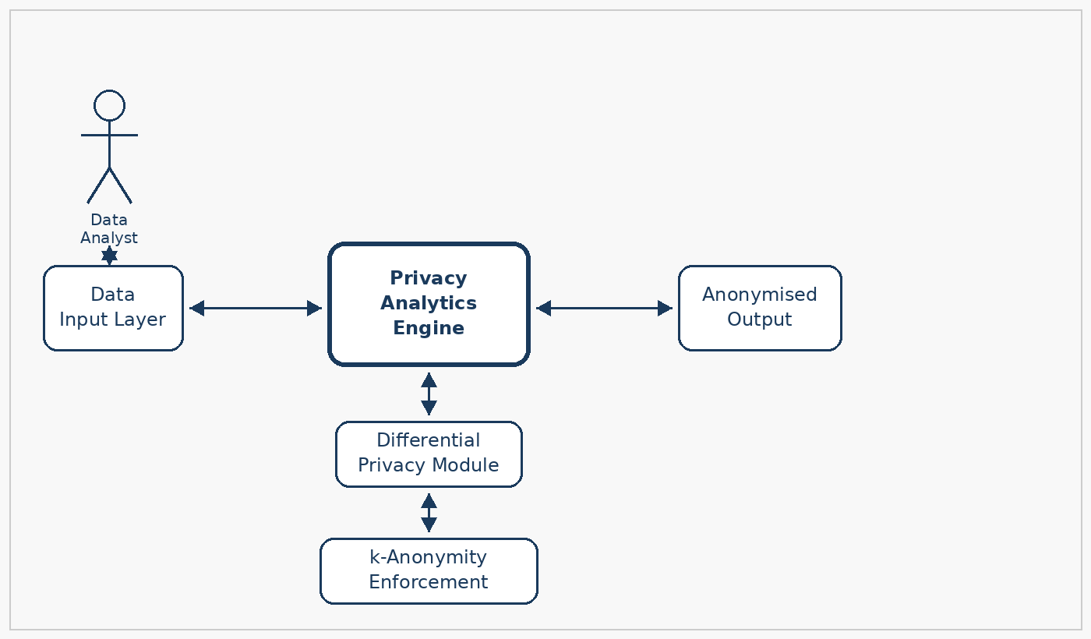
Conceptual Framework
Privacy-Preserving Data Analytics Platform
10 / 14

Slide 10
Literature Review
Author & Year | Title | Contribution | Gap
Dwork & Roth (2014) | The Algorithmic Foundations of Differential Privacy | Formal mathematical framework for ε-differential privacy and the Laplace/Gaussian mechanisms — the foundational reference for all DP implementations. | Theoretical only — no applied platform or dataset utility evaluation in the context of organisational data sharing.
Sweeney, L. (2002) | k-Anonymity: A Model for Protecting Privacy | Introduced k-anonymity, demonstrating that 87% of the US population could be identified from zip code, birth date and gender. Defined the quasi-identifier suppression/generalisation approach. | Does not address the composability of k-anonymity with differential privacy or provide a unified platform combining both techniques.
Mwale & Banda (2023) | Data Sharing Practices in Zambian Public Institutions | Survey finding that 78% of Zambian public institutions shared datasets with no anonymisation controls, and that no standardised privacy framework was in use. | Diagnostic study only — no technical solution or implementation proposed for the identified gap.
Privacy-Preserving Data Analytics Platform
11 / 14

Slide 11
Research Methodology
Data Collection
Design Tool (UML)
Tech Stack
Dev Model
Public benchmark datasets (UCI Adult, NHANES Medical)
Interviews with data officers at 2 Zambian institutions
Survey on current data-sharing anonymisation practices
Use Case Diagram
Shows data analyst, admin, and data subject actor interactions
Defines upload, transform, and export use cases
Python 3.x (diffprivlib, pandas)
Flask (REST API + web interface)
PostgreSQL (dataset + audit store)
React.js (frontend)
CRISP-DM for DP model development
Agile sprints for platform build
Privacy–utility trade-off evaluated per sprint
Privacy-Preserving Data Analytics Platform
12 / 14

Slide 12
Research Timeline · April – November 2026 (Weekly)
APRIL
MAY
JUNE
JULY
AUGUST
SEPTEMBER
OCTOBER
NOVEMBER
W1
W2
W3
W4
W1
W2
W3
W4
W1
W2
W3
W4
W1
W2
W3
W4
W1
W2
W3
W4
W1
W2
W3
W4
W1
W2
W3
W4
W1
W2
W3
W4
Proposal
Literature Review
Requirements
Design
Coding
Testing
Documentation
Privacy-Preserving Data Analytics Platform
13 / 14

Slide 13
Research Budget
# | Item / Description | Qty | Amount (ZMK)
1 | VPS Hosting — Flask API + React frontend (6 months) | 6 mo | K 1,260
2 | Domain Registration (.com, 2 years) + SSL Certificate | 1 | K 780
3 | PostgreSQL Managed Database (cloud, 6 months) | 6 mo | K 840
4 | User Testing Incentives (15 participants × K60) | 15 | K 900
5 | Transportation — institution visits and interviews | Lump | K 1,500
6 | Research Materials — IEEE Xplore, privacy textbooks | 1 | K 900
7 | Printing — proposal, interim and final reports | 9 | K 480
8 | Contingency | 1 | K 340
 | TOTAL |  | K 7,000
Privacy-Preserving Data Analytics Platform
14 / 14

