Slide 1

coviTracker
The Digital Contact Tracing Application
Abdu Musowir U
Athira M V
Fairoosa K. K
Krishna K. M

Slide 2
INTRODUCTION

Slide 3
ABSTRACT
Case investigation and contact tracing are most effective when part of a multifaceted response to an outbreak.
Currently contact tracing done by maintaining a diary for entering customer info in institutes
We check user identity through facial recognition. It is done by mobile camera
First we may store our personal details such as mobile, address etc. with a face id. After that when any of the institutes take our picture and thereby, they can understand who you are.

Slide 4
EXISTING SYSTEM
Physical records to keep track of visiting users.
Physical contact existing as people share same record.
No mechanism to search through, categorize, and access these data.
Less practical approach.

Slide 5
WHAT WE PROPOSE
Total digitalization of the system.
Facial recognition to identify the customers.
The app also simplifies the work that has to be put in for tracking the people.
Centralized database to maintain records.

Slide 6
Advantages
Institutions can record visit information using face recognition.
Institutions can view the visited customer details as a list.
Admin can change covid status of a user.
User can report themselves positive
Emergency alert system.
Effective feedback reception.
Admin can manage users and institutions under the system.

Slide 7
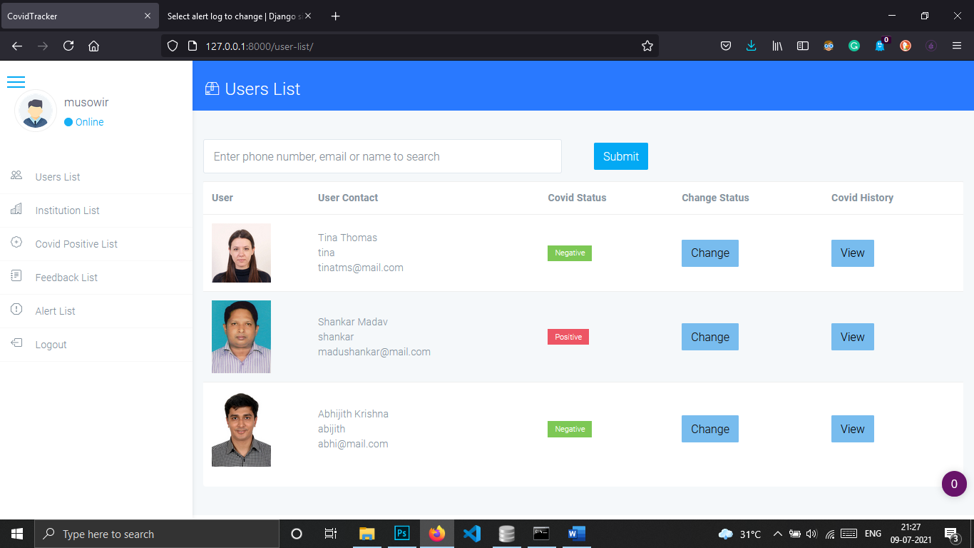
MODULE DESCRIPTION
Admin
Login
Verify institutes
Change user’s covid status
View institutions list
View user list
Track contact list
View contact list
View feedback
View alert log

Slide 8
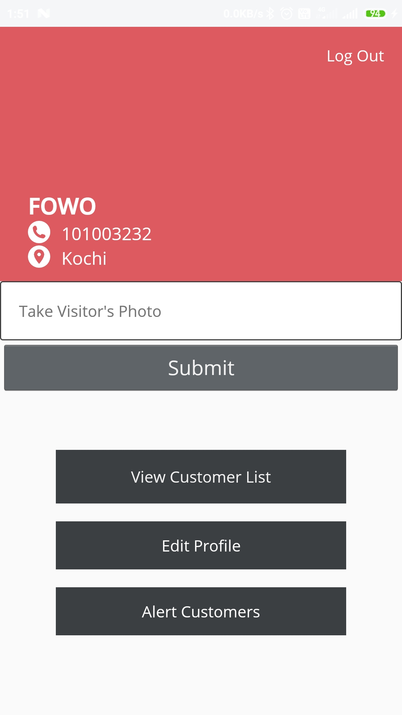
MODULE DESCRIPTION
Institute
Registration
Login
Manage profile
View contact details with date
User identification by using
face recognition
Send alert to users

Slide 9
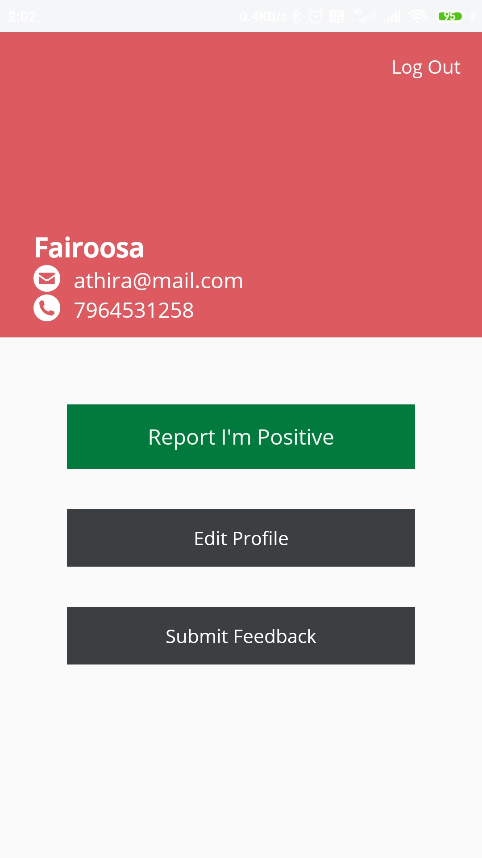
MODULE DESCRIPTION
User
Registration (face id generation)
Login
Manage profile
Add feedback
Report positive
Change password

Slide 10
HARDWARE REQUIREMENTS
Processor : Pentium 4 or above
Hard disk : 320 GB and above
RAM : 4 GB and above
Monitor : SVGA colour
Keyboard : 104 keys
Mouse : Optical/scroll mouse
Android Phone

Slide 11
SOFTWARE REQUIREMENTS
Front End : KOTLIN & XML
Back End : SQLite
Technology : DJANGO Framework & ANDROID
Software Used : Visual Studio Code, Android Studio
Web Browser : Google Chrome / Mozilla Firefox
Web Server : Django Development Server

Slide 12
We Are Feasible
coviTracker is analysed to be feasible:
Technically
Operationally
Economically

Slide 13
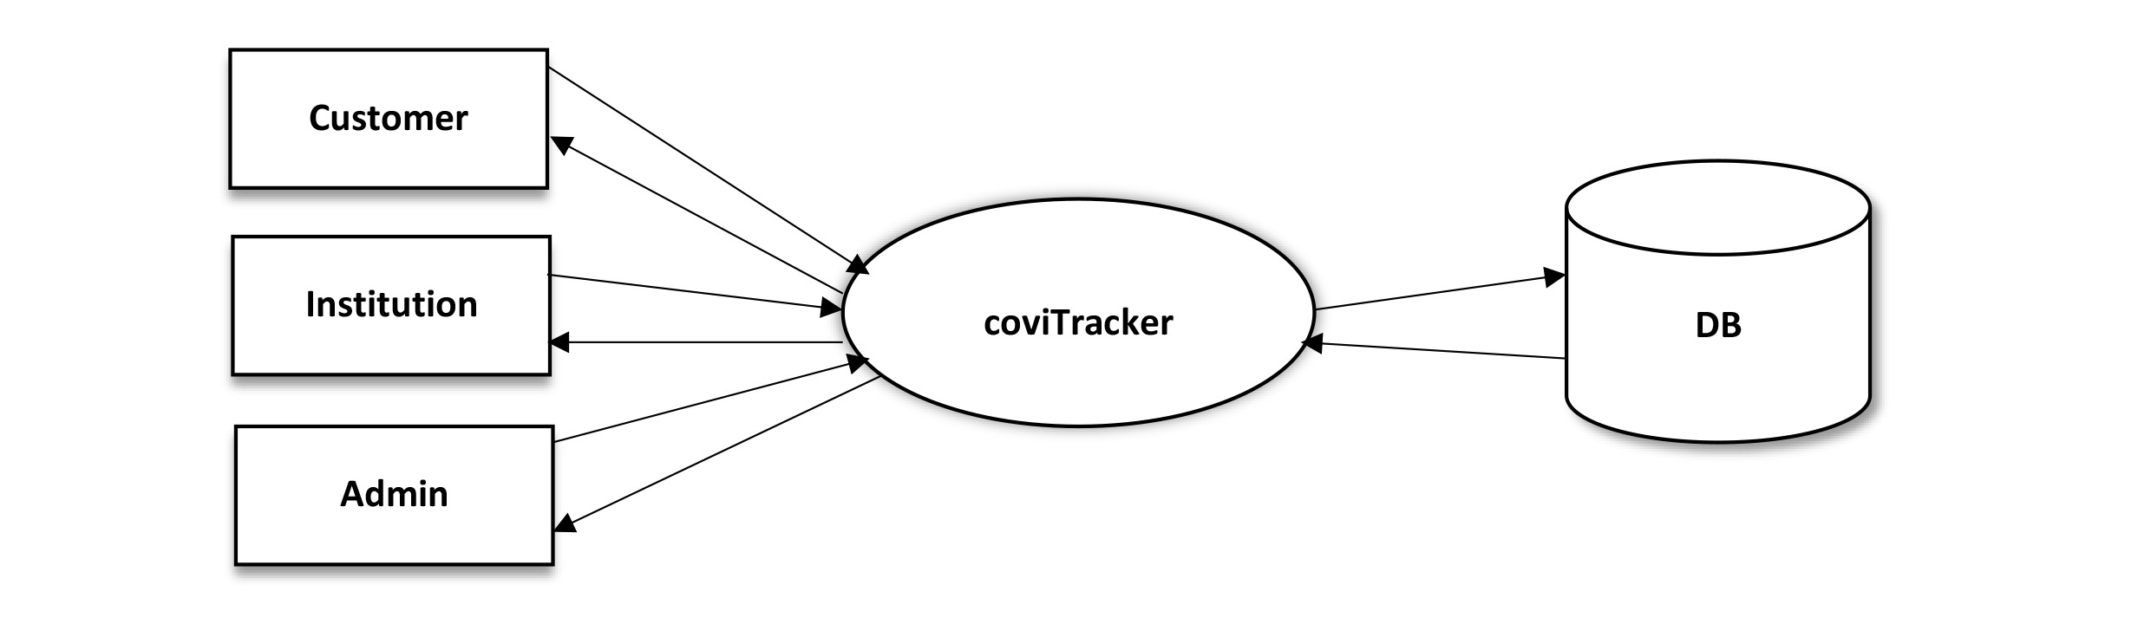
DATA FLOW DIAGRAMS
Level 0

Slide 14
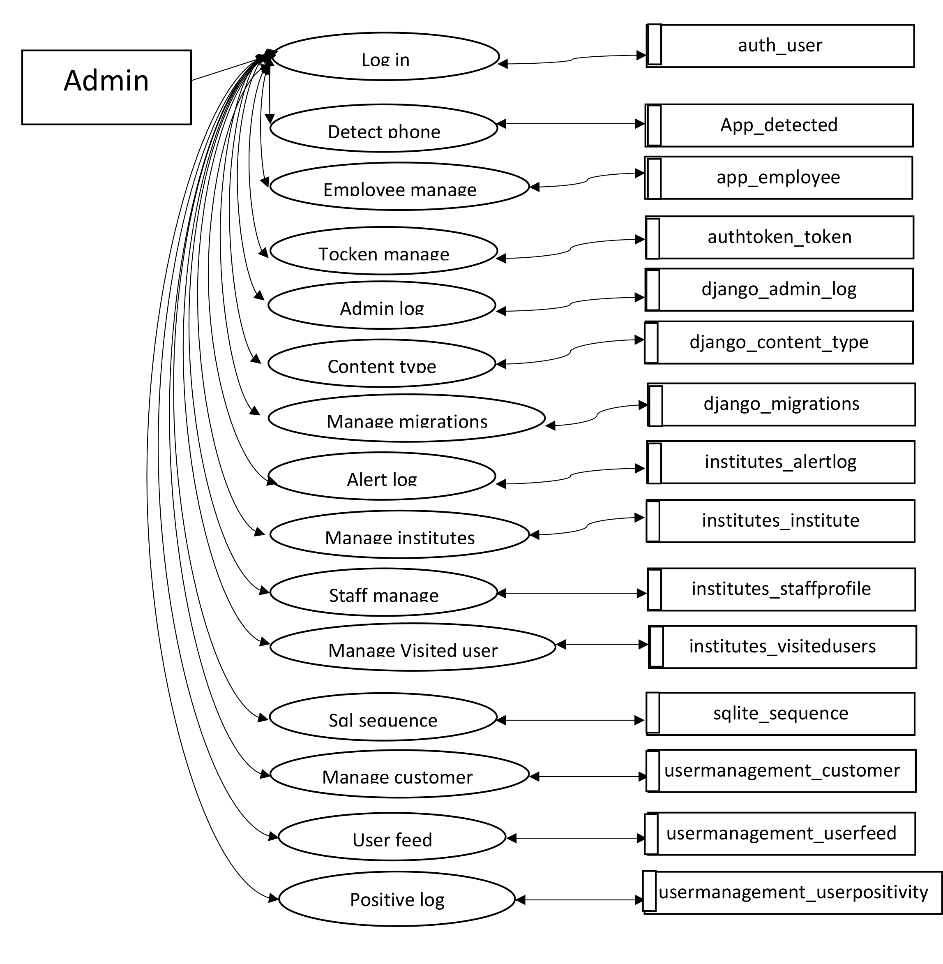
DATA FLOW DIAGRAMS
Level 1 : Admin

Slide 15
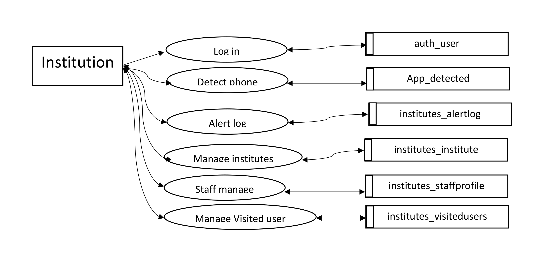
DATA FLOW DIAGRAMS
Level 2 : Institution

Slide 16
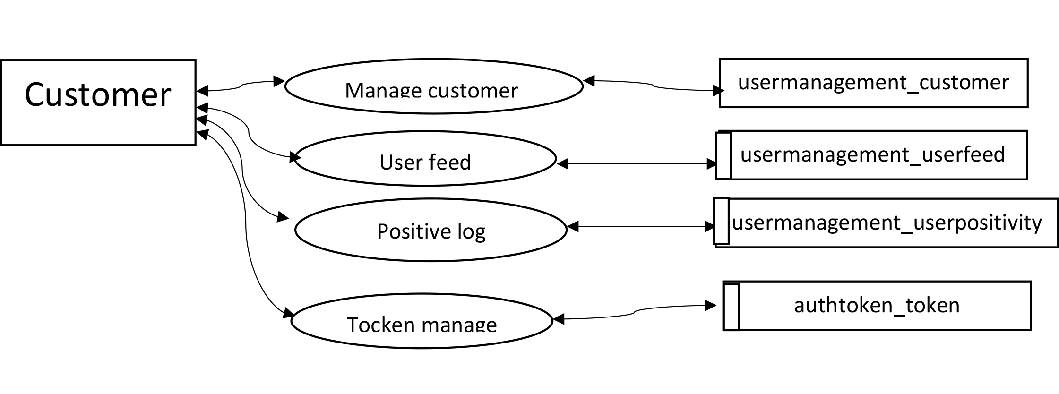
DATA FLOW DIAGRAMS
Level 3 : Customer

Slide 17
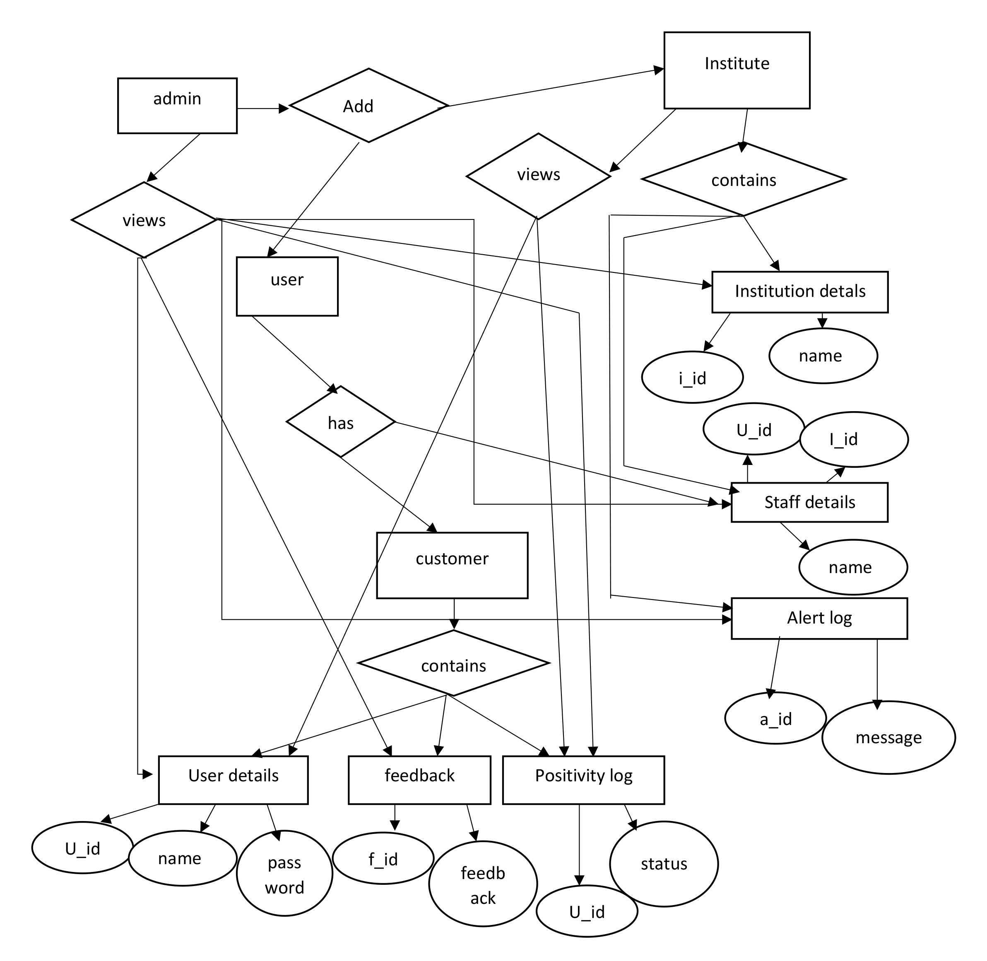
E R Model

Slide 18
STRUCTURE OF TABLE
user table
Field | Datatype | Description
id | Integer | NOT NULL
password | varchar(128) | NOT NULL
last_login | Datetime
is_superuser | Bool | NOT NULL
username | varchar(150) | NOT NULL UNIQUE
first_name | varchar(30) | NOT NULL
email | varchar(254) | NOT NULL
s_staff | Bool | NOT NULL
is_active | Bool | NOT NULL
date_joined | datetime | NOT NULL
last_name | varchar(150) | NOT NULL

Slide 19
STRUCTURE OF TABLE
institute table
Field | Datatype | Description
Id | Integer | NOT NULL
profile_pic | varchar(100)
Mobile | varchar(50) | NOT NULL
user_id | Integer | NOT NULL UNIQUE

Slide 20
STRUCTURE OF TABLE
User feedback table
Field | Datatype | Description
Id | Integer | NOT NULL
feedback | Text
timestamp | Datetime | NOT NULL

Slide 21
STRUCTURE OF TABLE
User positivity log table
Field | Datatype | Description
Id | Integer | NOT NULL
covid_status | varchar(125)
Timestamp | Datetime | NOT NULL
customer_id | Integer | NOT NULL

Slide 22
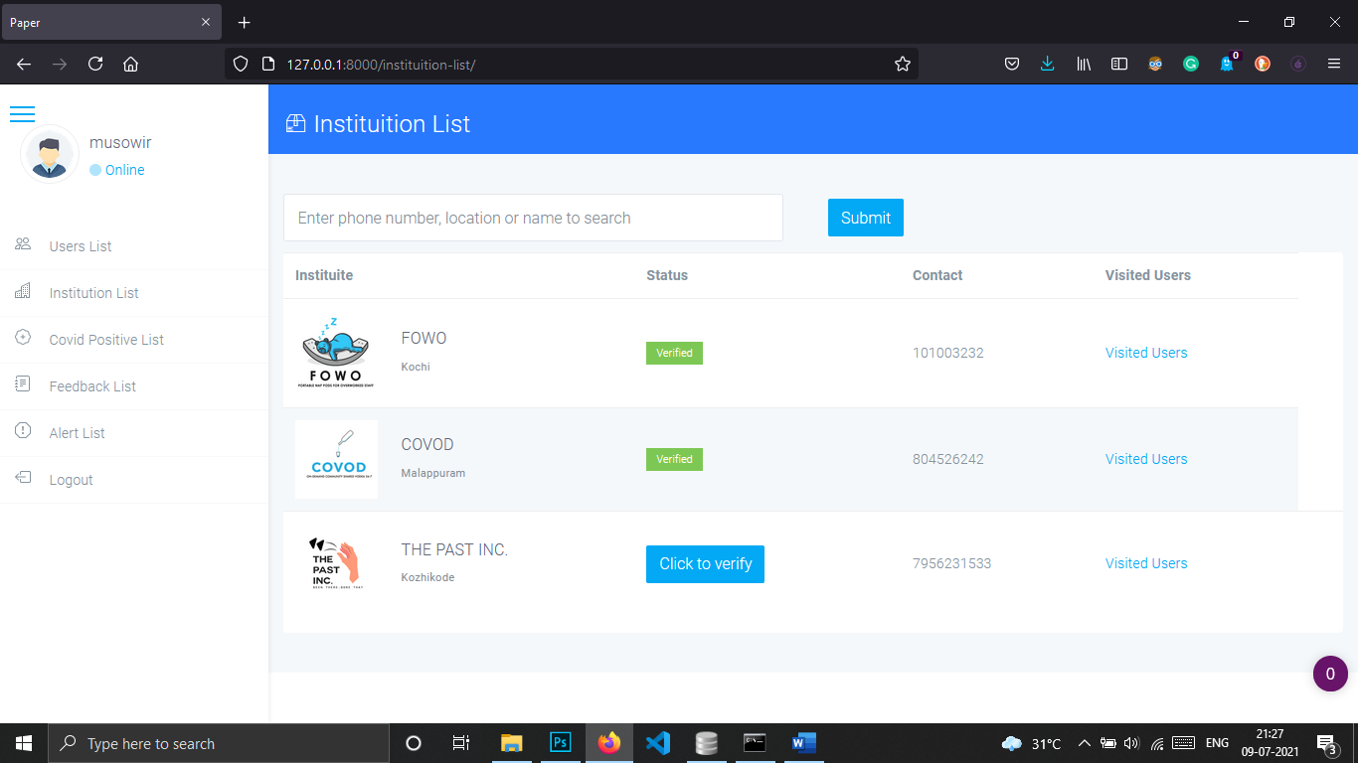
SCREENSHOTS
Admin
Users List Institutions List

Slide 23
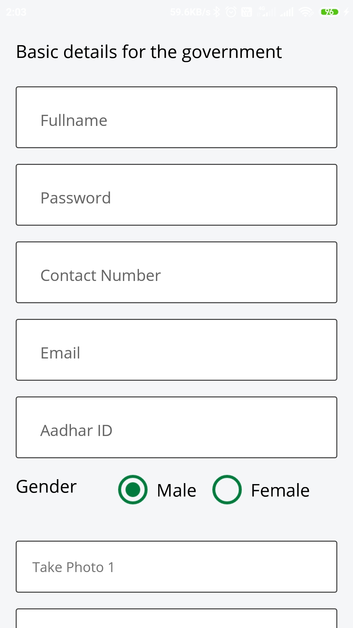
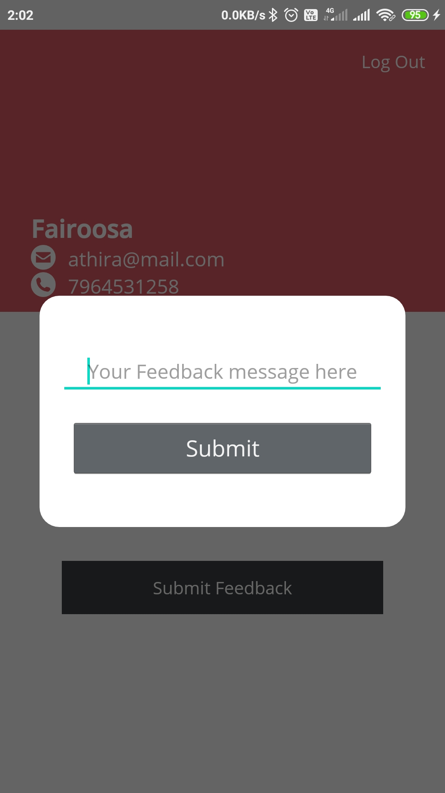
SCREENSHOTS
User
Registration Home Feedback

Slide 24
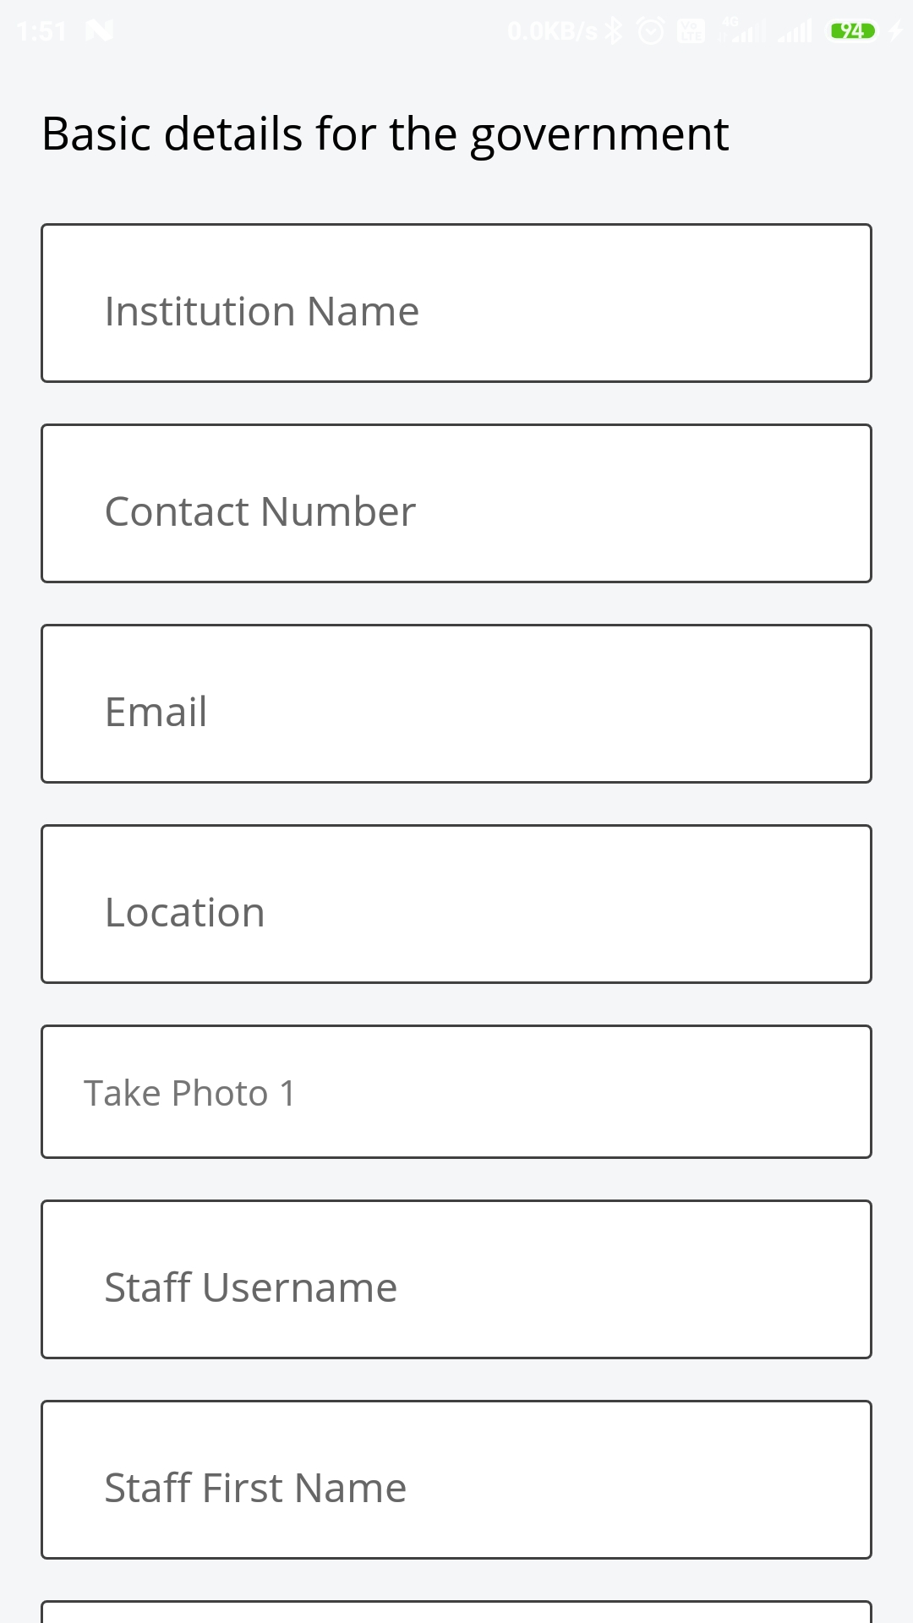
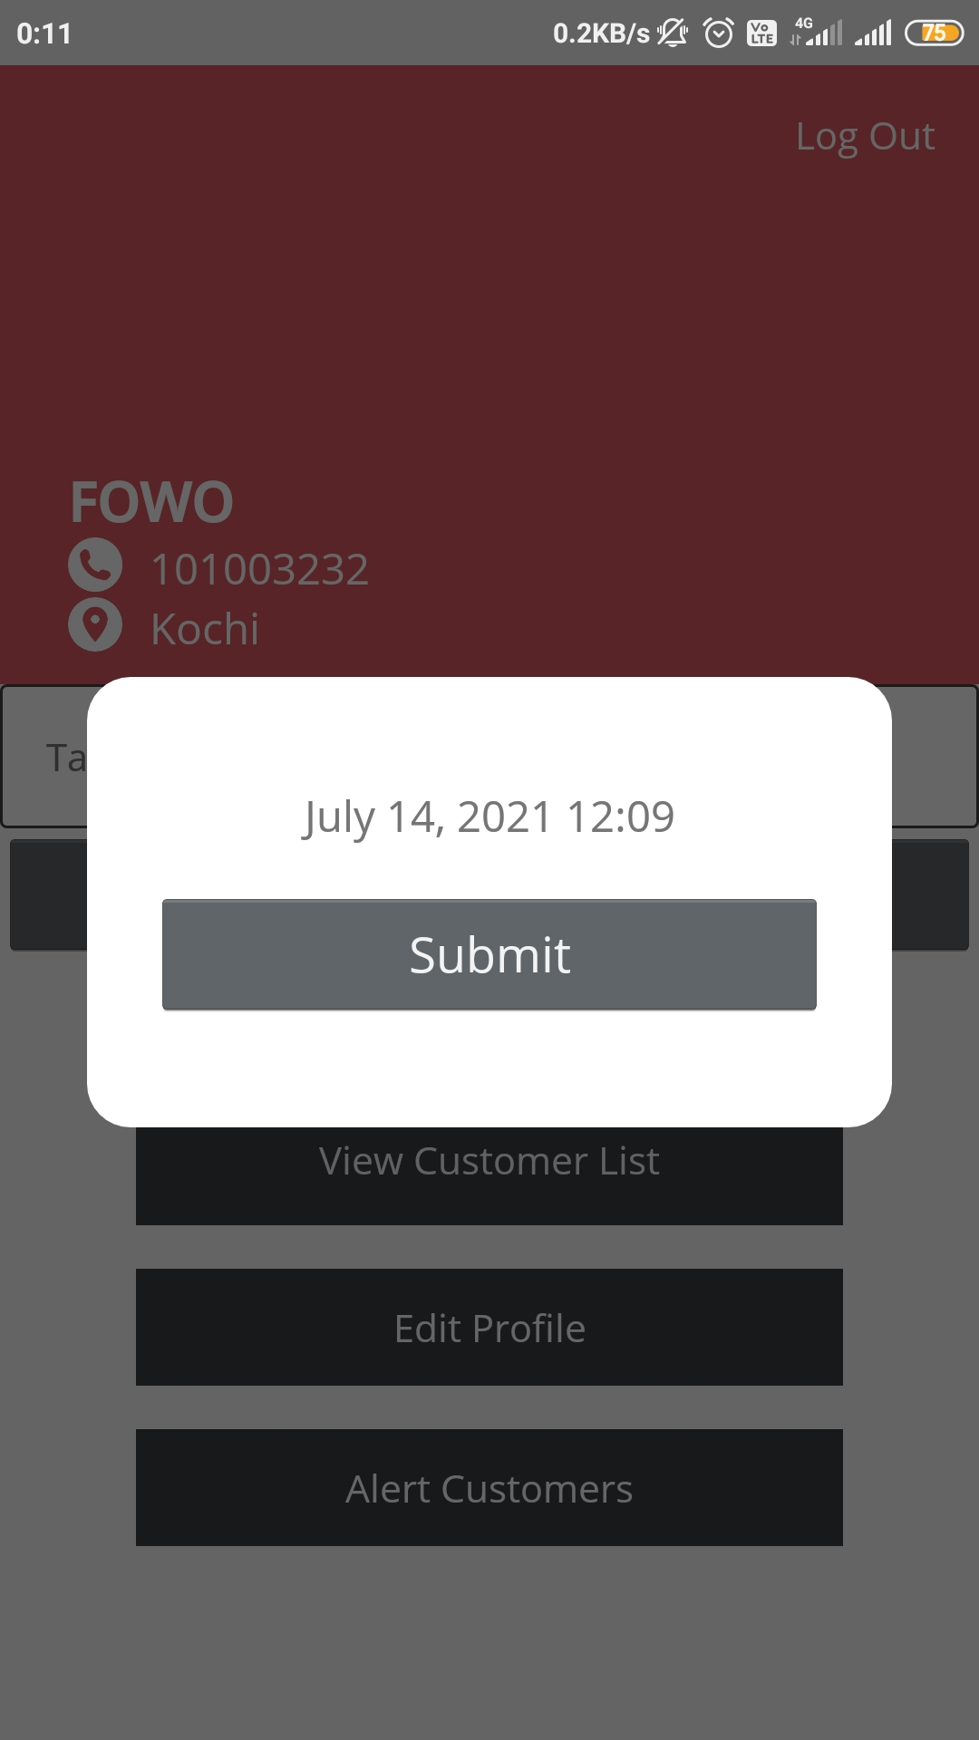
SCREENSHOTS
Institute
Registration Home Sending Alert

Slide 25
FUTURE ENHANCEMENTS
Covid prediction based on symptoms.
More efficient contact tracing using Bluetooth Technology.
Covid info and update feeds
Browsing and Institutions availability status for users.
More interactive UI

Slide 26
Thank You…

