Slide 1
We expect that crime rate would be associated with living areas of population, and with higher percentage of single parents

Slide 2
The variables:
State Id
State Name
Violent crime per 10000 people
Murders per 10000 people
% of the population living in metropolitan
% of the population is white
% of the population with high education
% of the population under poverty
% of the population are single parents

Slide 3
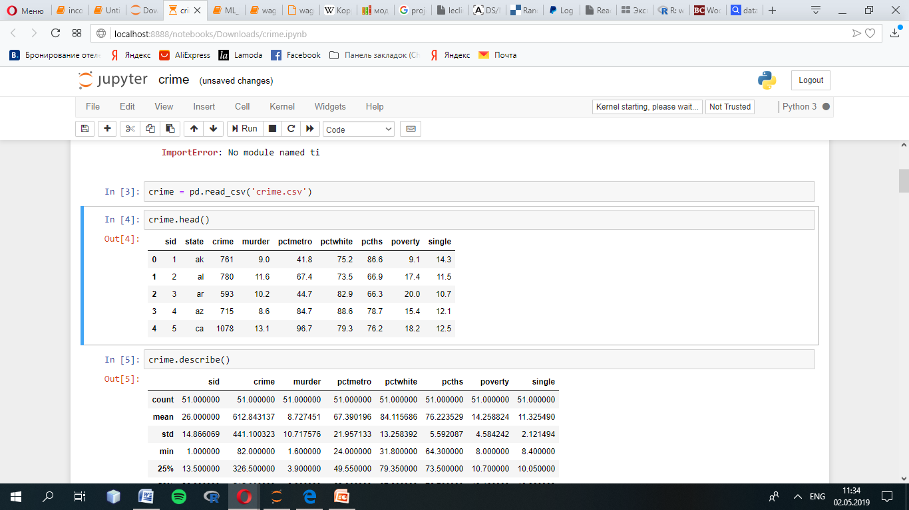

Slide 4
Data Analysis
Is there any missing data?
Distribution of the data, visualization like box plot
The correlation between the data
Is there any outliers?

Slide 5
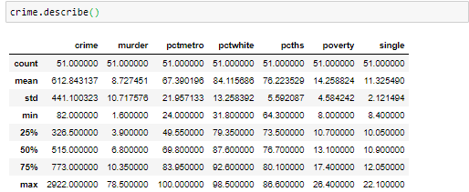
Summary information like how many missing values, mean, std
As we can see, data does not have missing values.

Slide 6
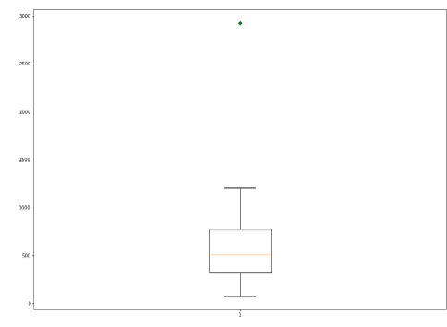
Density plot
From the box plot we see outliers.

Slide 7
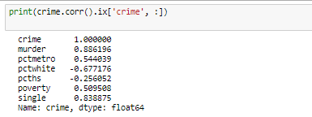
The correlation of the data

Slide 8
Scatter plot of all the variables in the data
This will scatter plot all the pairs of the data so that we can easily find their relations. If there is too many variables, this is not a good way, so the correlation will be easier to check.

Slide 9
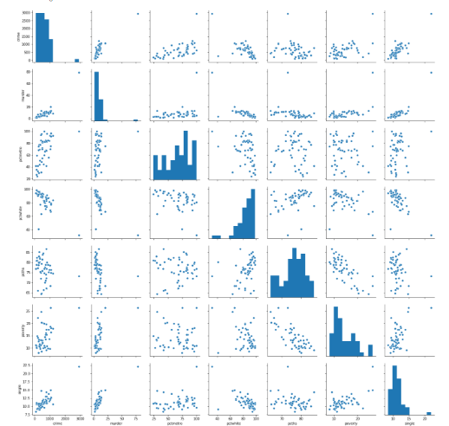

Slide 10
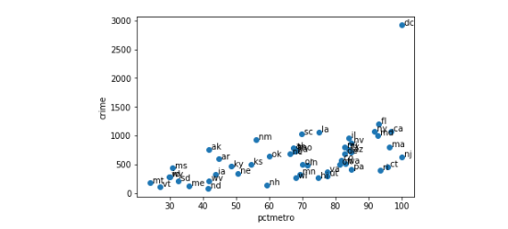
All the scatter plots suggest that the observation for state = dc is a point that requires extra attention since it stands out away from all of the other points.
Some leverage and High Influence

Slide 11
Let’s try regression predicting crime from pctmetro, poverty and single. We will perform regressions with outliers and without.
Our model looks like:
Crime = β0 +β1*pctmetro + β2*poverty + β3*single + ε

Slide 12
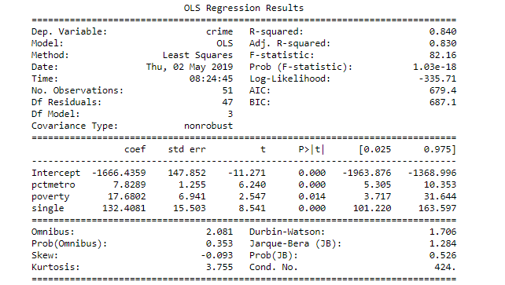
With outliers

Slide 13
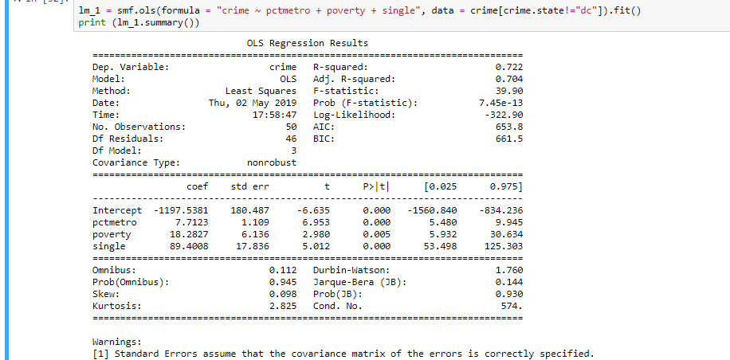
Without outliers

Slide 14
Summary:
We found DC was a point of major concern.
We performed a regression with it and without it and the regression model were very different.
We can removing it from our analysis because our model is to predict crime rate for states, not for metropolitan areas.

Slide 15
Tests for Normality of Residuals

Slide 16
Tests for Heteroscedasticity

