Slide 1

TRADITIONAL GOVERNANCE DATA ANALYTICS AND VISUALIZATION PLATFORM
Chapter 4
Results and Discussion
Verified implementation outcomes, live-data visualizations, statistical findings, and academic interpretation.
University Graduation Project • 8 August 2026
Notes:
Introduce Chapter 4 as the evidence chapter. Explain that every interface screenshot and every numerical result comes from the running project and the connected MySQL database. State that the discussion reports associations, not causal effects.

Slide 2
4.1 • INTRODUCTION
What Chapter 4 demonstrates
From implementation to verified evidence.
01
02
03
SYSTEM RESULTS
DATA RESULTS
ANALYTICAL RESULTS
Functional pages and navigation
Live Flask–MySQL integration
Responsive bilingual interface
1,557 groups across 130 countries
Descriptive geographic patterns
Filterable charts and comparisons
Inferential tests selected by variable type
Missing values excluded transparently
Effect sizes interpreted with p-values
Acceptance criterion: evidence was captured only after the live page finished loading and no fetch or console errors were present.
Chapter 4 • Results and Discussion
Notes:
Explain that this chapter answers two questions: did the system work as intended, and what patterns are visible in the current data? Mention that screenshots, API responses, and statistical outputs were checked together.

Slide 3
4.2 • FINAL SYSTEM OVERVIEW
The completed system turns records into evidence
A transparent path from relational data to an interactive research interface.
MySQL
Flask
Pandas
SciPy
JSON
Frontend
Chart.js
1,557 records
REST routes
Preparation
Tests
Structured results
HTML • CSS • JS
Visual evidence
1
2
3
4
5
Search & filters
Pagination
Comparisons
Statistics
Analysis
SQL-side
One page/request
Aggregated profiles
Dynamic scope
Inferential output
DATASET ROWS
COUNTRIES
CONTINENTS
REGIONS
WITH TPI
1,557
130
5
7
1,351
Chapter 4 • Results and Discussion
Notes:
Walk from left to right. MySQL stores the dataset. Flask performs parameterized queries and statistical preparation. Pandas, NumPy, and SciPy calculate results. The REST API returns JSON. JavaScript and Chart.js render the final interface.

Slide 4

4.3 • HOME PAGE
The home dashboard communicates scope immediately
Live counters, navigation, distribution map, and recently added groups.
Primary project purpose
Global preferences
1
3
2
Figure 4.1: Home Page of the Traditional Governance Platform
Live summary metrics
Chapter 4 • Results and Discussion
Notes:
Point out that the homepage is not a static mock-up. The totals and continent markers were read from the Flask API. Explain that the page gives a researcher an immediate understanding of dataset coverage.

Slide 5
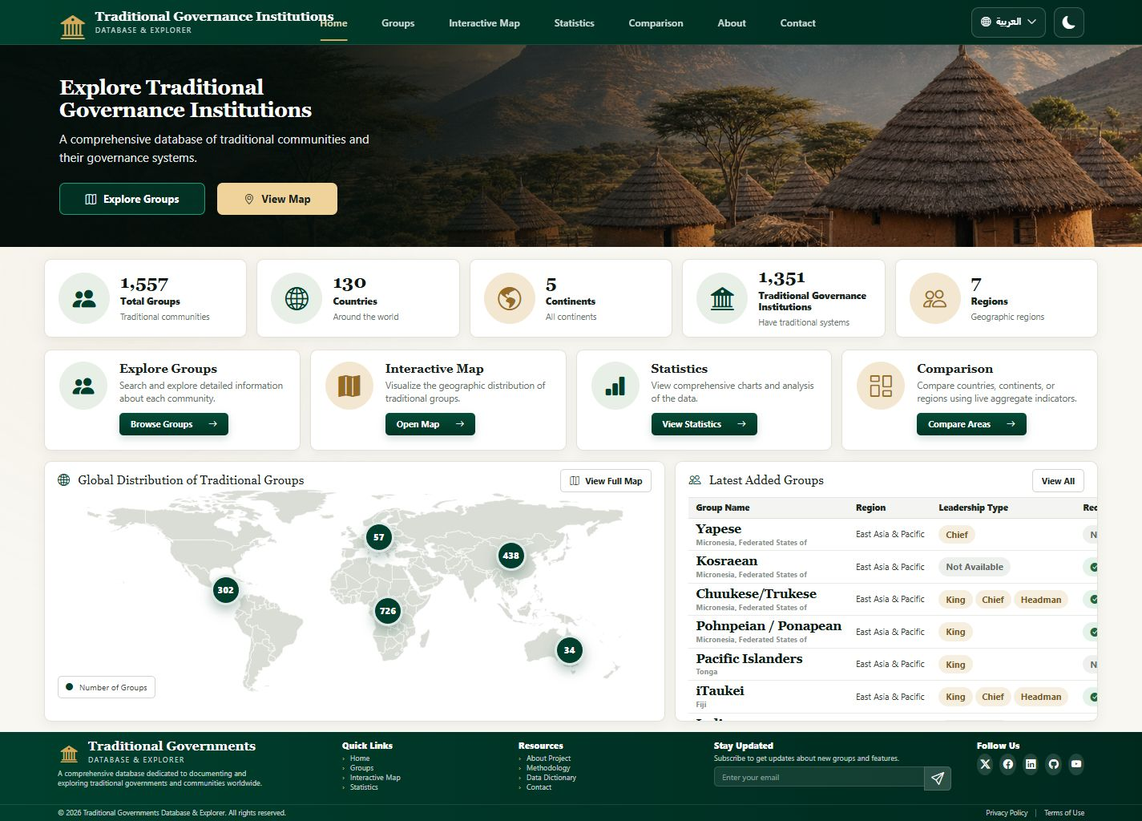
4.3 • HOME PAGE
Homepage outcomes verified from the API
The dashboard summarizes the same database used by all analytical modules.
TRADITIONAL GROUPS
COUNTRIES
1,557
130
WITH A TPI
FORMALLY RECOGNIZED
1,351
744
Interpretation
The system exposes broad geographic coverage.
Homepage counts are consistent with the analytical API.
Navigation directs users from summary evidence to record-level detail.
Figure 4.2: Complete Home Dashboard
Chapter 4 • Results and Discussion
Notes:
Read the figures aloud. Explain that the homepage totals match GET /api/stats and that the map markers match continent aggregation from the live database.

Slide 6

4.4 • GROUPS PAGE
Server-side exploration of individual records
Search and filters return only the requested page of matching database rows.
Verified interaction
Search term: Arab
Continent: Africa
6 matching live records
100-record page limit
URL state preserved for sharing
Result: responsive filtering with one API request for the active page—not a preload of all 1,557 records.
Figure 4.3: Group Records and Filtering Interface
Chapter 4 • Results and Discussion
Notes:
Explain that this interface avoids downloading the whole dataset. Search, continent, region, country, leadership, recognition, sorting, and pagination are sent to Flask and executed in SQL.

Slide 7
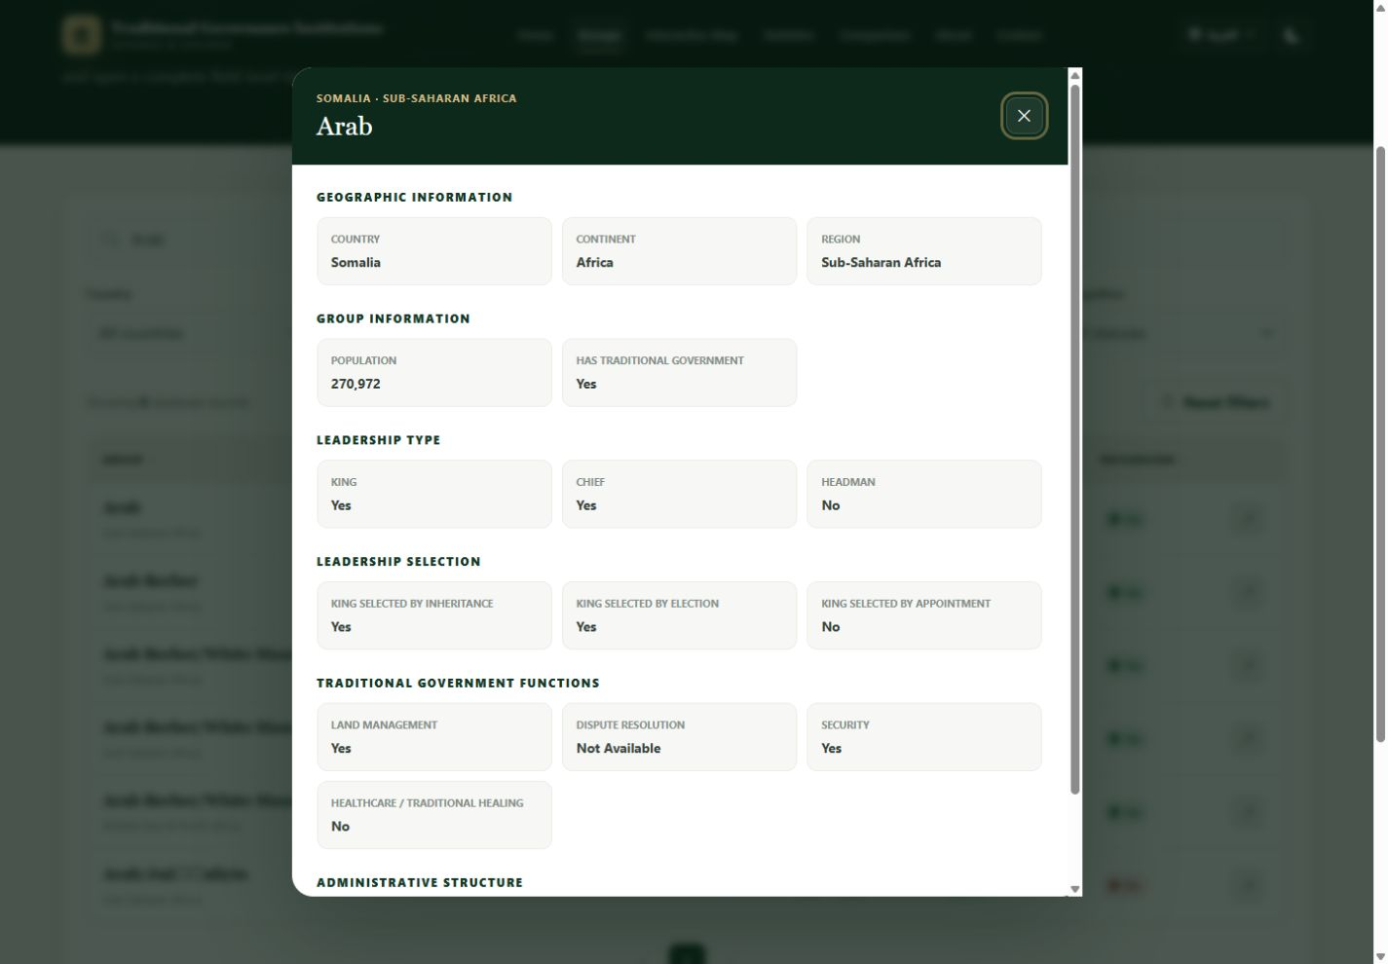
4.4 • GROUPS PAGE
From filtered rows to a structured group profile
Detailed information is opened without leaving the explorer.
Record interpretation
Binary values are rendered as Yes / No.
Nulls are rendered as Not Available.
English source names remain readable in RTL pages.
The same dialog is retained after pagination and filtering.
What this proves
The platform supports both overview analysis and auditable record-level inspection.
Figure 4.4: Detailed Traditional Group Record
Chapter 4 • Results and Discussion
Notes:
Use this slide to show the transition from discovery to inspection. The dialog organizes geographic, leadership, selection, governance-function, council, assembly, and recognition fields. Missing data is presented safely as Not Available.

Slide 8

4.5 • INTERACTIVE MAP
Geographic distribution is directly explorable
One live marker represents each backend continent category.
Live marker totals
Africa
726
Asia
438
Americas
302
Europe
57
Oceania
34
Marker totals sum to 1,557 groups.
Figure 4.5: Interactive Geographic Map
Chapter 4 • Results and Discussion
Notes:
Explain that the map uses the current world-map asset and five live markers. The database uses one Americas category, so one marker represents North and South America together.

Slide 9
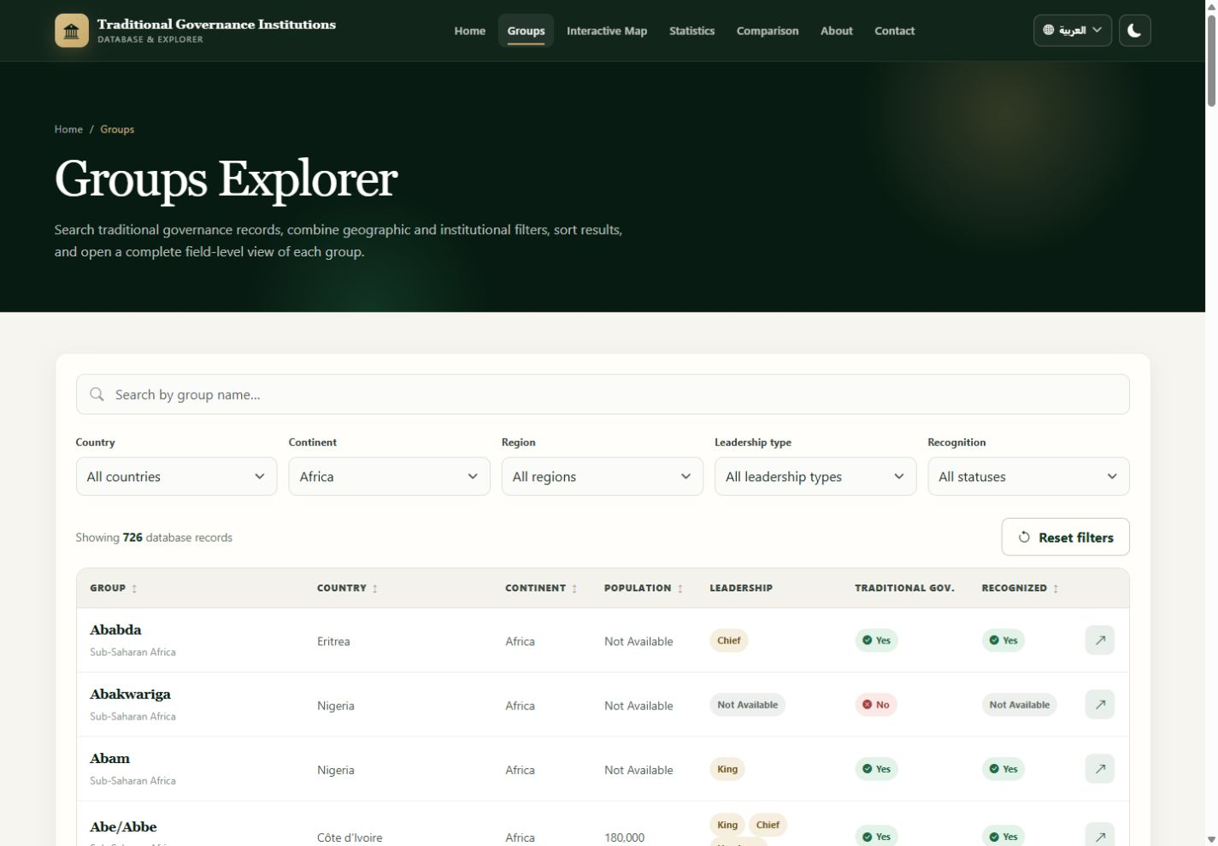
4.5 • INTERACTIVE MAP
A marker click becomes a reproducible filter
The map transfers context through the URL and the Groups page applies it after data loads.
1
Select
Africa marker
2
Navigate
?continent=Africa
3
Load
First filtered page
4
Verify
726 records
Figure 4.6: Map Marker Navigation to Africa-Filtered Records
Chapter 4 • Results and Discussion
Notes:
Describe the tested path: Africa marker, query parameter, continent filter, then 726 matching records. This verifies that the visualization is interactive rather than decorative.

Slide 10
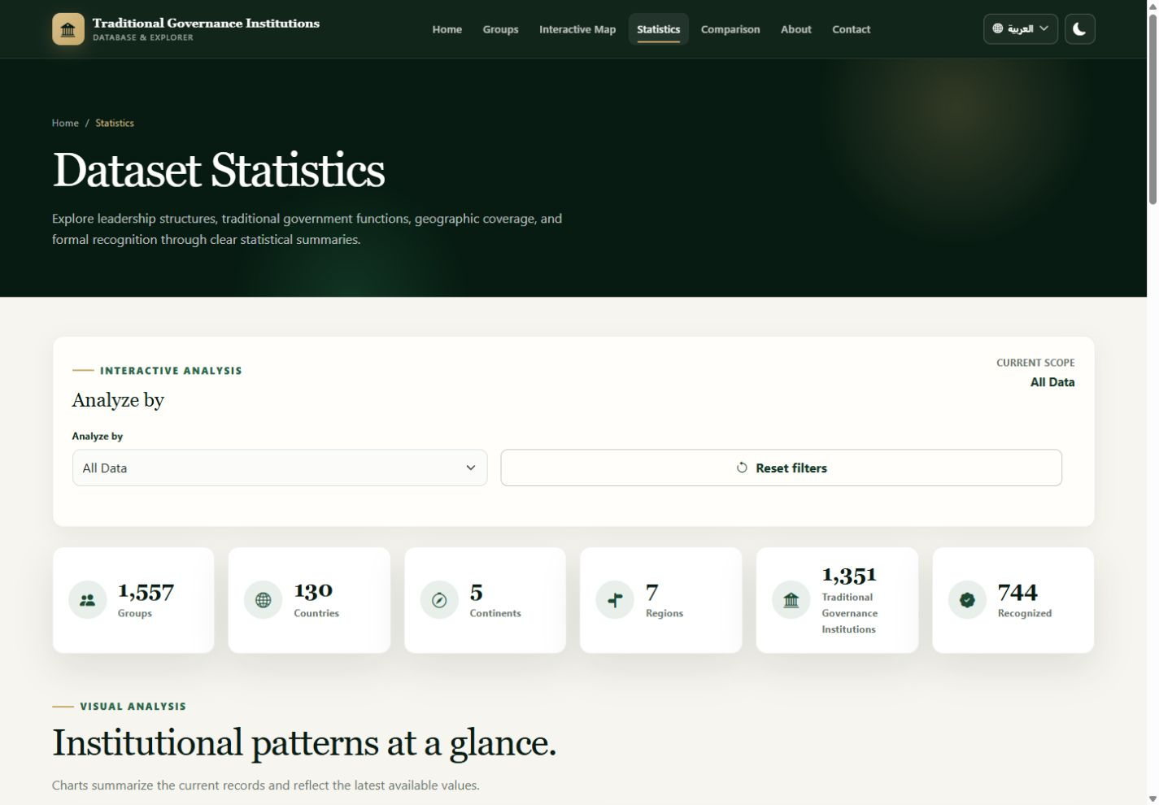
4.6 • STATISTICS PAGE
Descriptive statistics reveal the dataset structure
Seven charts update from one scoped statistics request.
All-data scope
Leadership types
Selection methods
Governance functions
Recognition status
Continent distribution
Largest groups
Top 10 countries
The dashboard reads aggregated values—not raw rows—reducing browser memory and network load.
Figure 4.7: Descriptive Statistics Dashboard
Chapter 4 • Results and Discussion
Notes:
Explain that the page combines summary totals with leadership, leadership selection, functions, recognition, geography, largest populations, and top-country views. The charts reuse their instances and update with new values.

Slide 11
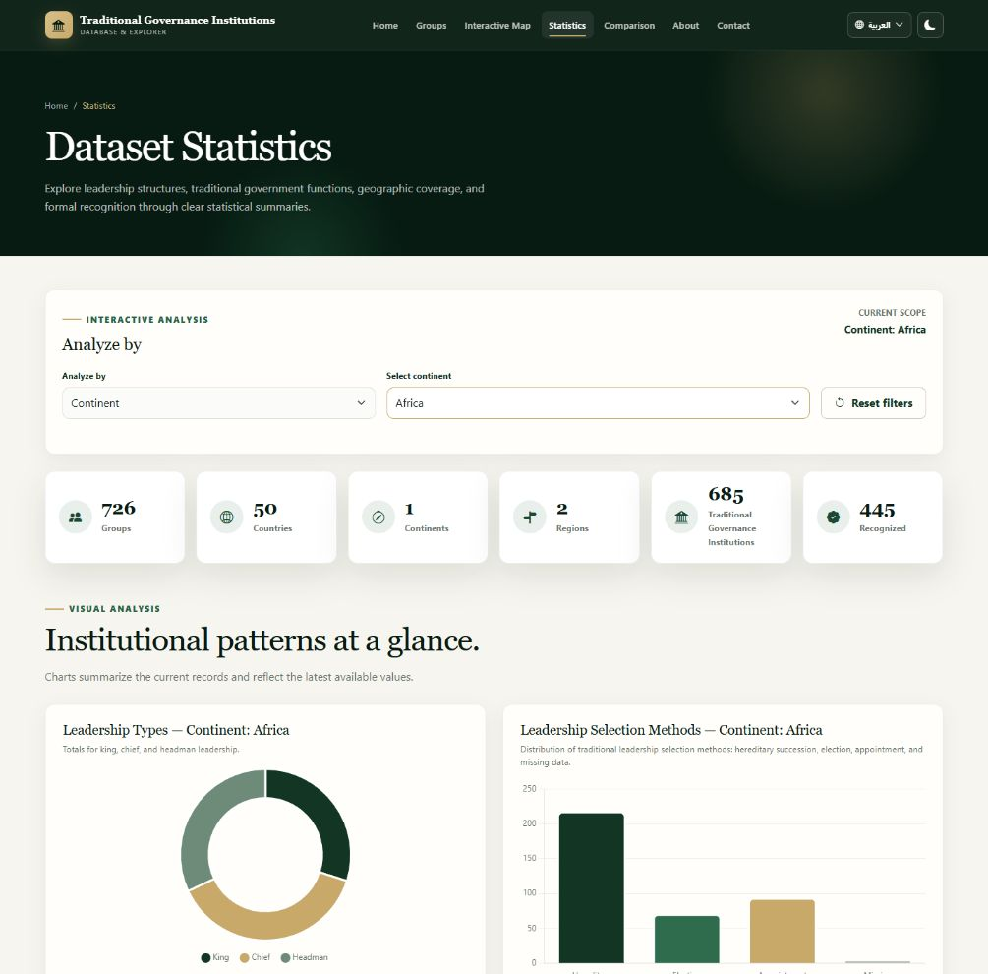
4.6 • STATISTICS PAGE
Geographic scope changes the entire dashboard
A single continent filter refreshes metrics and charts without rebuilding the interface.
GROUPS
726
COUNTRIES
50
WITH TPI
685
RECOGNIZED
445
The selected scope is visible, reproducible, and reflected in every chart title.
Figure 4.8: Africa-Scoped Statistics Dashboard
Chapter 4 • Results and Discussion
Notes:
Point to the current scope label and the Africa metrics. Explain that the backend applies one geographic filter and returns a complete statistics payload for the selected scope.

Slide 12
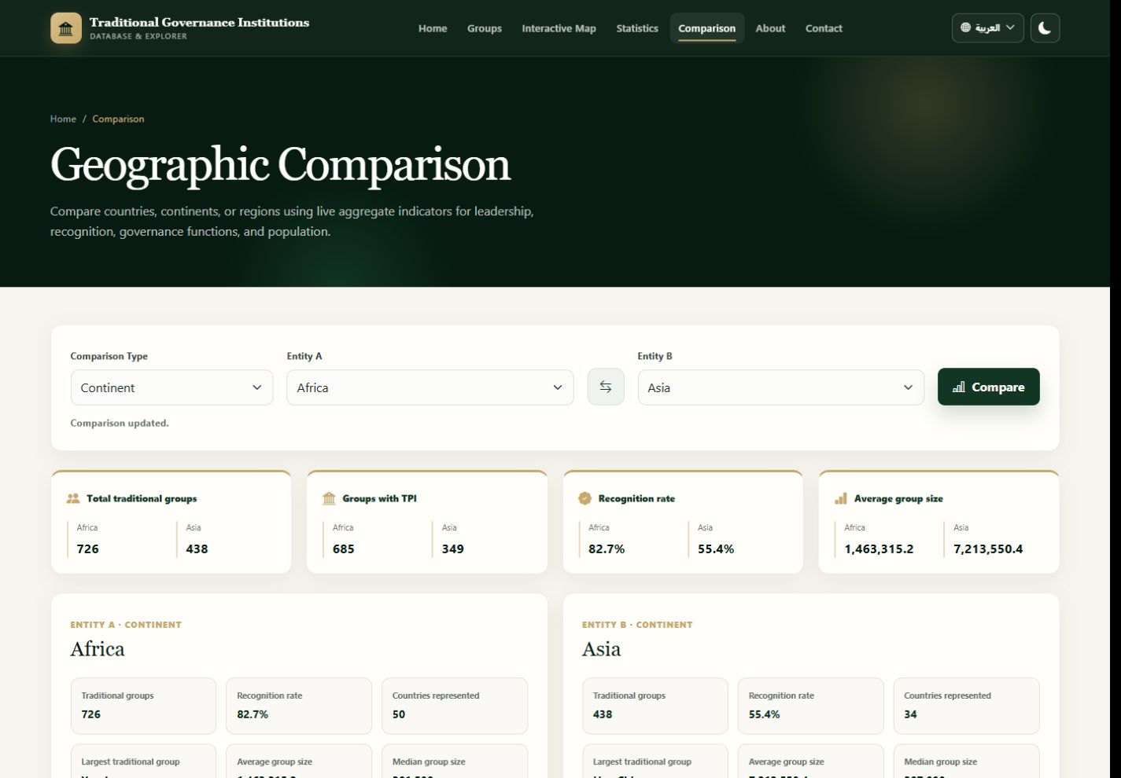
4.7 • GEOGRAPHIC COMPARISON
Africa and Asia compared from database aggregates
The comparison endpoint returns two complete, normalized geographic profiles.
Verified profile
Groups
726
438
Countries
50
34
Recognized
445
138
Kings
282
34
Chiefs
358
92
AFRICA
ASIA
Figure 4.9: Geographic Comparison Interface
Chapter 4 • Results and Discussion
Notes:
Explain why comparison is useful: the same indicators are aligned side by side, avoiding manual cross-page reading. The selected entities here are Africa and Asia.

Slide 13
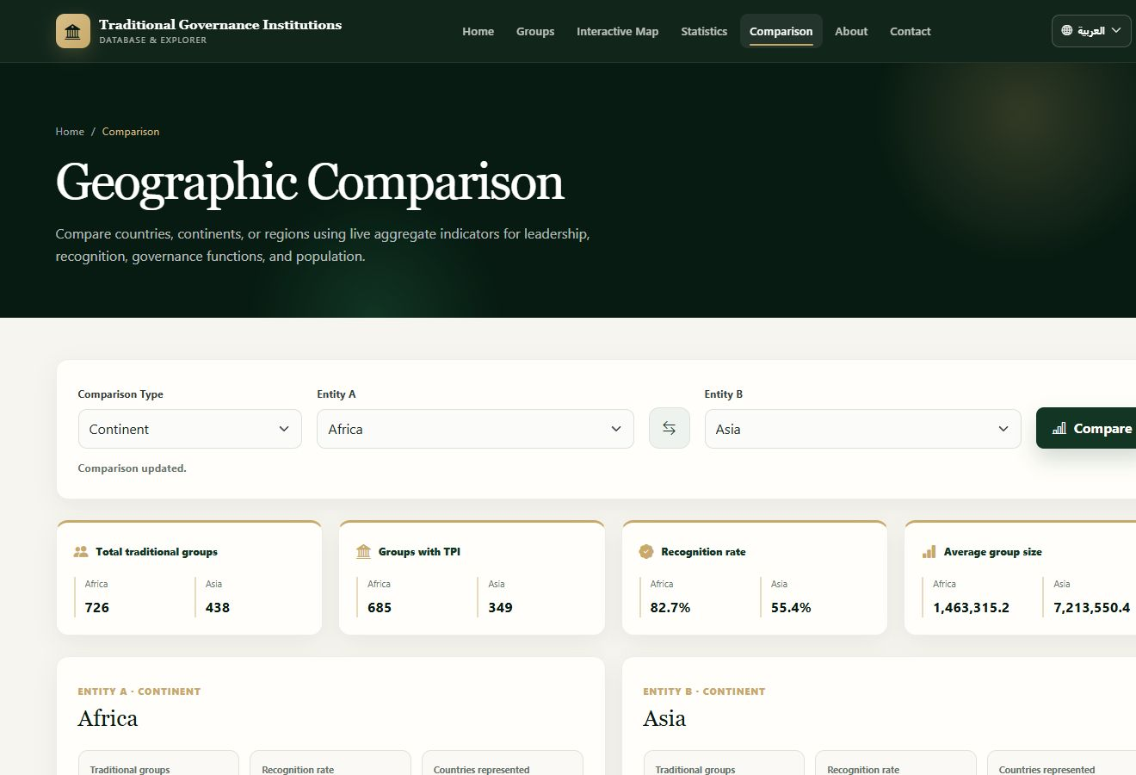
4.7 • GEOGRAPHIC COMPARISON
Aligned charts make differences visible
Leadership, recognition, governance functions, and normalized indicators share one visual grammar.
How to read
Counts show absolute institutional presence.
Recognition bars separate recognized, non-recognized, and missing values.
Radar values are normalized to each entity's total groups.
Comparison describes patterns; it does not explain their historical causes.
Figure 4.10: Comparison Charts for Africa and Asia
Chapter 4 • Results and Discussion
Notes:
Explain that raw counts and normalized percentages answer different questions. Raw counts show scale; normalized values help compare profiles with different numbers of groups.

Slide 14
4.8 • STATISTICAL ANALYSIS MODULE
The module moves beyond description
Implemented analyses test relationships, differences, and effect sizes using complete cases.
Analytical pipeline
1
Prepare
Exclude missing/invalid values
2
Select
Method follows variable types
3
Calculate
SciPy statistics and effect sizes
4
Visualize
Tables, charts, and heatmaps
5
Interpret
Association/difference—not causation
Every displayed value was compared with the current API response before presentation generation.
Figure 4.11: Complete Statistical Analysis Interface
Chapter 4 • Results and Discussion
Notes:
Explain that descriptive charts show what is present, while inferential tests examine whether observed patterns are unlikely under a null model. Mention that the current project contains seven predefined analyses and one dynamic engine.

Slide 15
4.8 • STATISTICAL ANALYSIS MODULE
How to read the inferential results
Statistical significance and practical strength answer different questions.
CHI-SQUARE
p-VALUE
Compares observed and expected categorical counts.
Probability of an equal-or-more-extreme result under H₀.
χ² increases as the tables diverge.
p < .05 is treated as statistically significant.
CRAMER'S V
MANN–WHITNEY U
Effect size for Chi-Square association.
Compares ranked values between two groups.
Near 0 = weak; larger values = stronger.
Used when population distributions are non-normal.
A significant result does not prove causation. It reports an association or distributional difference in this observational dataset.
Chapter 4 • Results and Discussion
Notes:
Use this slide before the individual analyses. A small p-value indicates evidence against independence or equal distributions. The effect size describes strength. Observed frequencies are real counts; expected frequencies are theoretical null-model values.

Slide 16
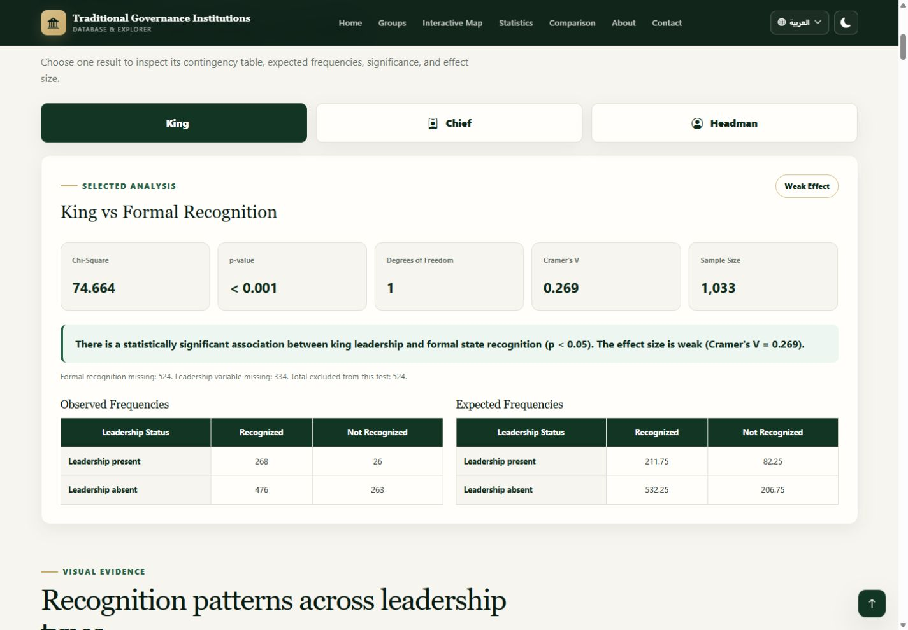
4.8 • ANALYSIS 1
Leadership type × formal recognition
Research question: Is leadership type associated with formal state recognition?
Leadership | χ² | df | p | V | Strength
King | 74.664 | 1 | < .001 | 0.269 | weak
Chief | 53.382 | 1 | < .001 | 0.227 | weak
Headman | 5.043 | 1 | = 0.025 | 0.070 | weak
Interpretation
All three leadership indicators are associated with recognition. The King and Chief effects are weak; the Headman effect is very weak. These results do not show that a leadership title causes recognition.
Figure 4.12: Leadership Type and Formal Recognition Result
Chapter 4 • Results and Discussion
Notes:
Explain that King, Chief, and Headman were tested separately against binary formal recognition using Chi-Square. For the displayed King result, N is 1,033 after 524 rows with missing recognition were excluded.

Slide 17
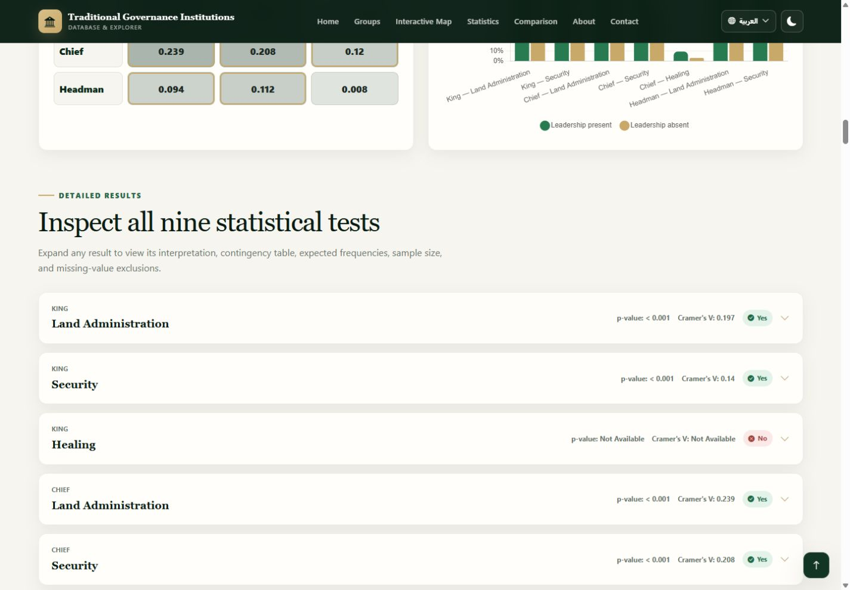
4.8 • ANALYSIS 2
Leadership type × governance functions
Nine Chi-Square tests examine Land, Security, and Healing responsibilities.
Relationship | χ² | p | V | N
King–Land | 44.047 | < .001 | 0.197 | 1,139
King–Security | 22.205 | < .001 | 0.140 | 1,139
King–Healing | N/A | N/A | N/A | 306
Chief–Land | 64.975 | < .001 | 0.239 | 1,139
Chief–Security | 49.478 | < .001 | 0.208 | 1,139
Chief–Healing | 4.436 | = 0.035 | 0.120 | 306
Headman–Land | 10.048 | = 0.002 | 0.094 | 1,139
Headman–Security | 14.234 | < .001 | 0.112 | 1,139
Headman–Healing | 0.018 | = 0.894 | 0.008 | 306
Figure 4.13: Leadership and Governance Functions Interface
Strongest observed relationship: Chief × Land Administration, V = .239 (weak).
Chapter 4 • Results and Discussion
Notes:
Explain that seven relationships were significant. King–Healing could not be estimated safely from the available complete table, and Headman–Healing was not significant. Most measurable effects were weak or very weak.

Slide 18
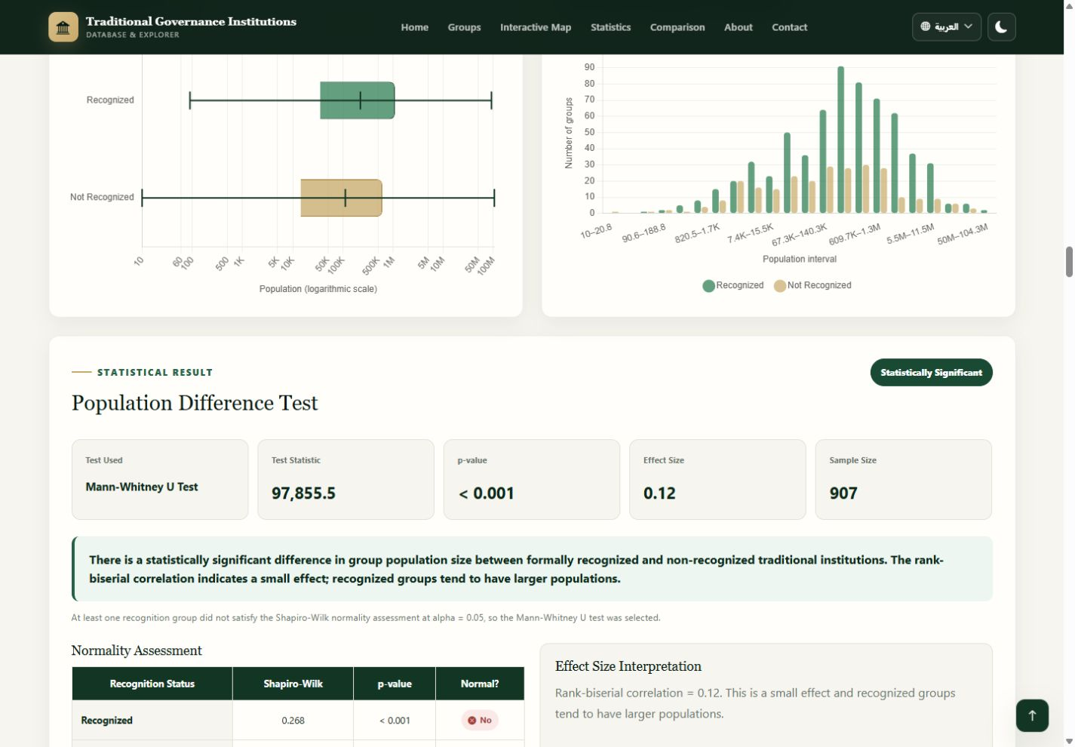
4.8 • ANALYSIS 3
Group population size × formal recognition
Non-normal population distributions required a Mann–Whitney U test.
TEST
SAMPLE
Mann–Whitney U
907
U STATISTIC
P-VALUE
97,855.5
< .001
EFFECT
STRENGTH
0.120
small
Finding
Significant difference; recognized groups tend to rank higher in population, but the effect is small.
Figure 4.14: Population Size and Formal Recognition Result
Chapter 4 • Results and Discussion
Notes:
Explain the method selection: Shapiro–Wilk indicated non-normality, so a rank-based test was used. The result is significant, but the rank-biserial effect is small. Recognized groups tend to have larger populations in rank terms.

Slide 19
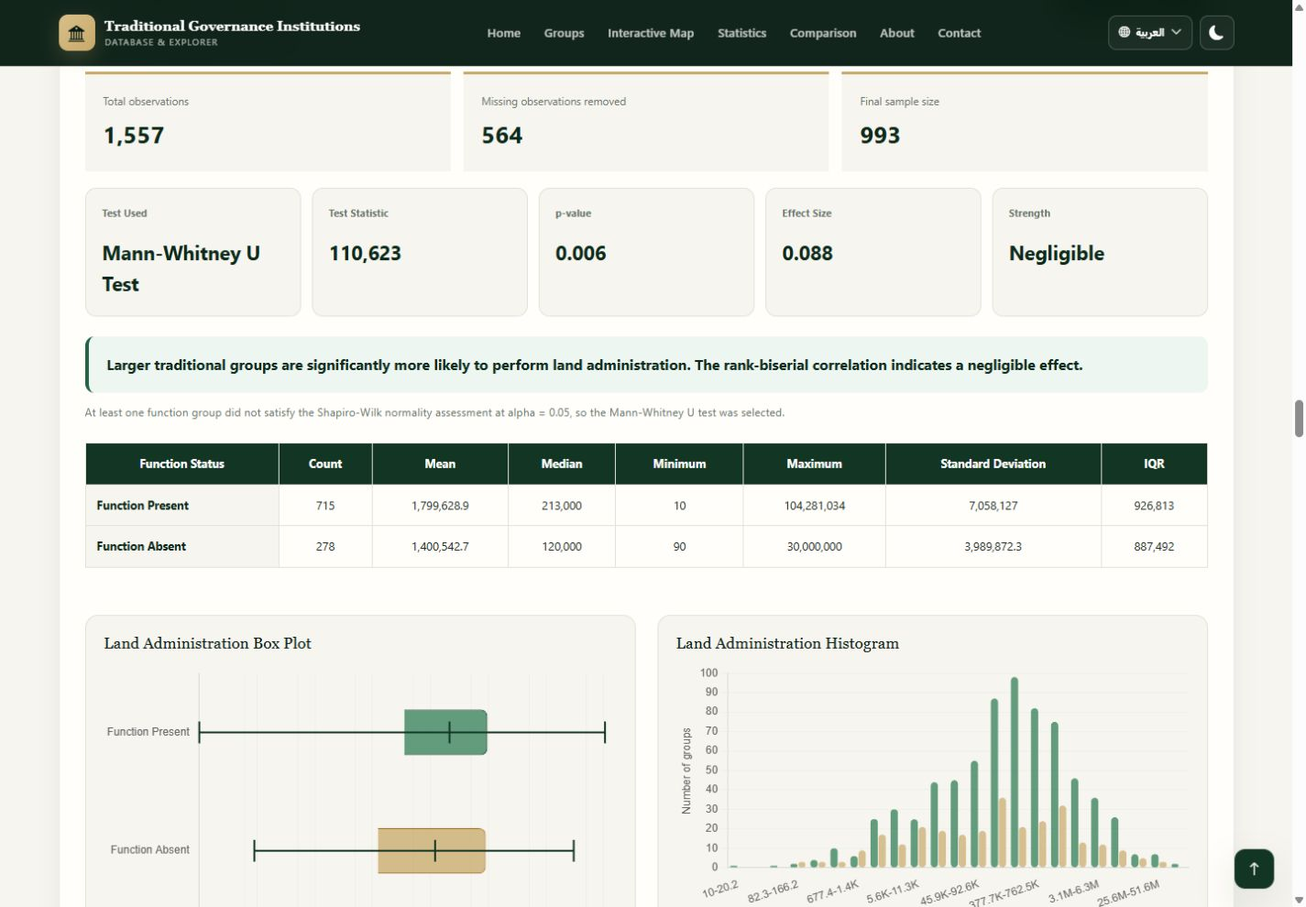
4.8 • ANALYSIS 4
Group population size × governance functions
Three Mann–Whitney tests compare function-present and function-absent groups.
Function | U | p | Effect | N | Finding
Land Administration | 110,623 | = 0.006 | 0.088 | 993 | Significant
Security | 128,801.5 | = 0.003 | 0.096 | 993 | Significant
Healing | 2,259.5 | = 0.882 | 0.010 | 252 | Not significant
Interpretation
Land and Security: significant, negligible effects.
Healing: no significant population-size difference.
Statistical significance should not be confused with a large practical difference.
Figure 4.15: Population Size and Governance Functions Results
Chapter 4 • Results and Discussion
Notes:
Explain that all three population/function distributions were non-normal. Land and Security differences were statistically significant, but both effects were negligible. Healing was not significant and had a much smaller sample because of missing values.

Slide 20
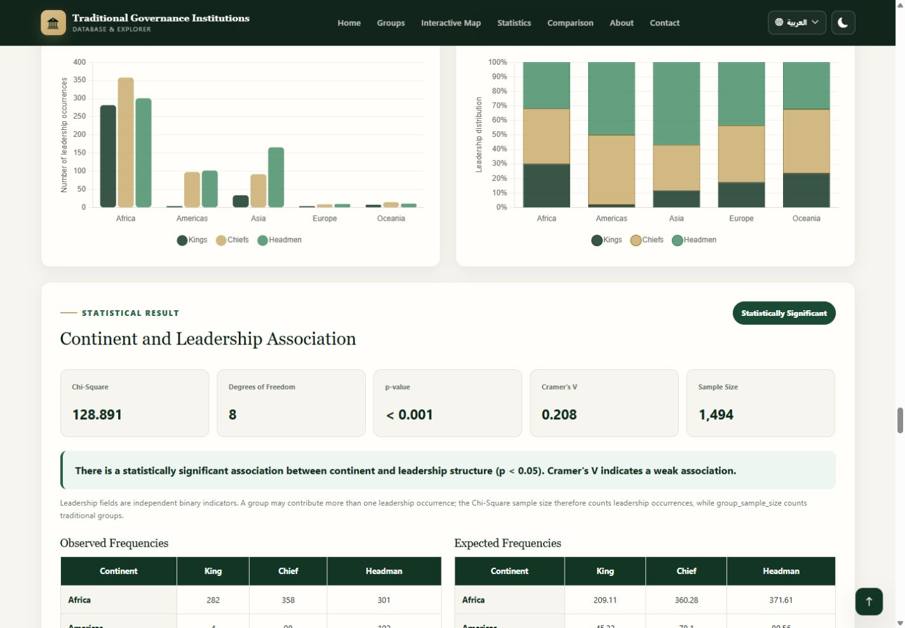
4.8 • ANALYSIS 5
Continent × leadership distribution
Chi-Square tests whether leadership structures vary geographically.
CHI-SQUARE
DF
128.891
8
P-VALUE
CRAMER'S V
< .001
0.208
OCCURRENCES
STRENGTH
1,494
weak
Leadership structure differs by continent, but the association is weak; geography is not a causal explanation.
Figure 4.16: Continental Leadership Distribution Result
Chapter 4 • Results and Discussion
Notes:
Explain that leadership fields are separate binary indicators, so a group may contribute more than one leadership occurrence. The inferential sample of 1,494 therefore counts complete leadership occurrences, not unique groups.

Slide 21
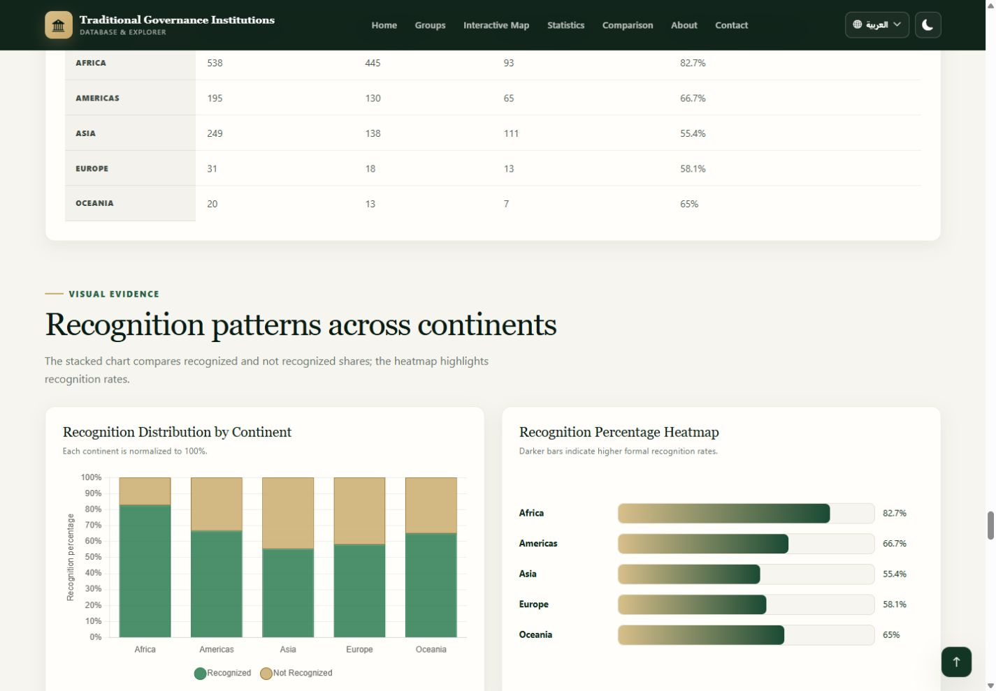
4.8 • ANALYSIS 6
Continent × formal recognition
Recognition status differs significantly across continents.
CHI-SQUARE
DF
70.837
4
P-VALUE
CRAMER'S V
< .001
0.262
SAMPLE
STRENGTH
1,033
weak
Rates among complete cases: Africa 82.7% • Asia 55.4%
Figure 4.17: Recognition Distribution by Continent
Chapter 4 • Results and Discussion
Notes:
Explain the complete-case table: N is 1,033 after missing recognition values are excluded. Africa has the highest complete-case recognition rate and Asia the lowest in the current data.

Slide 22
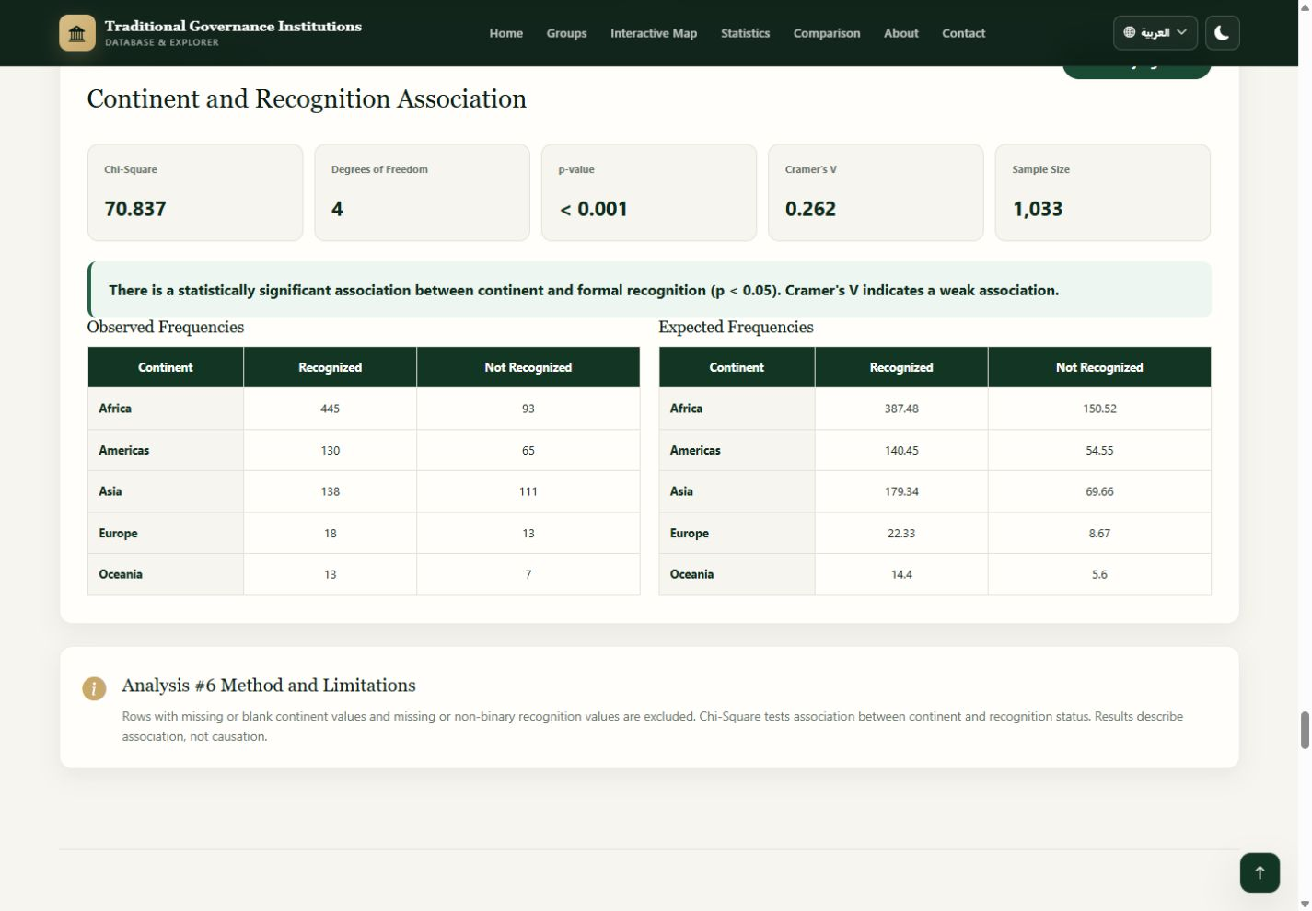
4.8 • ANALYSIS 6
Observed counts versus expected frequencies
Expected values are calculated under the null hypothesis of independence.
OBSERVED
Actual database counts
Whole numbers only
EXPECTED
Theoretical null-model values
Decimals are correct; they are not fractional real groups.
Figure 4.18: Observed and Expected Continent-Recognition Frequencies
Chapter 4 • Results and Discussion
Notes:
Point to both tables. Observed values are actual database counts and therefore whole numbers. Expected values are theoretical values distributed according to the row and column totals, so decimals are mathematically correct and do not represent fractional groups.

Slide 23
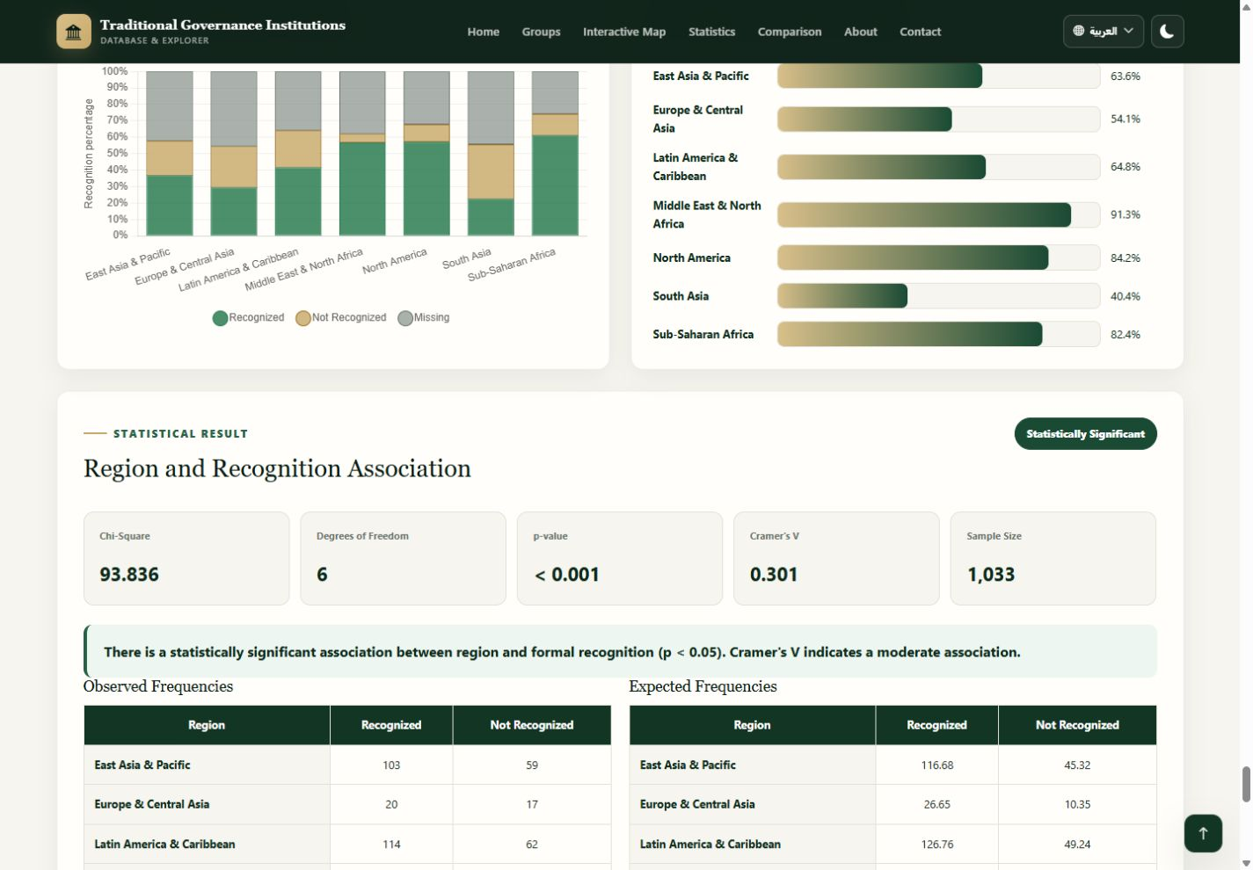
4.8 • ANALYSIS 7
Region × formal recognition
Regional variation has the largest geographic recognition effect in the module.
CHI-SQUARE
DF
93.836
6
P-VALUE
CRAMER'S V
< .001
0.301
SAMPLE
STRENGTH
1,033
moderate
Highest: Middle East & North Africa (91.3%)
Lowest: South Asia (40.4%)
Figure 4.19: Regional Recognition Statistical Result
Chapter 4 • Results and Discussion
Notes:
Explain that the seven-region table produced a significant moderate association. The highest complete-case rate is Middle East and North Africa, and the lowest is South Asia. Missing recognition is still displayed descriptively even though the test uses complete binary cases.

Slide 24
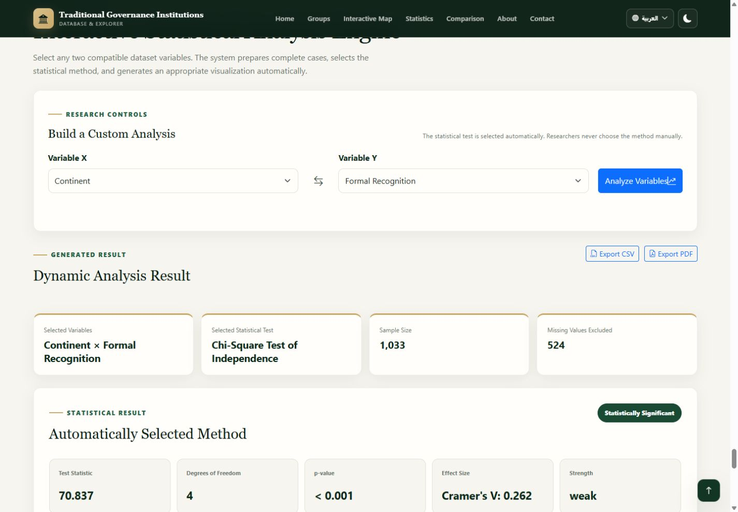
4.8 • DYNAMIC ANALYSIS ENGINE
Researchers can select compatible variable pairs
The engine automatically prepares complete cases and chooses the statistical method.
Verified sample run
Variable X: Continent
Variable Y: Formal Recognition
Selected test: Chi-Square
N = 1,033; 524 excluded
χ²(4) = 70.837; p < .001
Cramer's V = .262 (weak)
The engine complements predefined analyses; it does not change their methodology.
Figure 4.20: Dynamic Continent × Formal Recognition Analysis
Chapter 4 • Results and Discussion
Notes:
Explain that this is a capability demonstration, not an additional independent finding. For the verified sample, Continent and Formal Recognition reproduce Analysis 6 and therefore return the same Chi-Square values.

Slide 25
4.9 • STATISTICAL FINDINGS
Verified findings at a glance
Significance is reported together with effect size and the relevant complete-case sample.
Analysis | Test | Statistic | p | Effect | N | Conclusion
King × Recognition | Chi-Square | 74.664 | < .001 | V=.269 weak | 1,033 | Significant
Chief × Land | Chi-Square | 64.975 | < .001 | V=.239 weak | 1,139 | Significant
Population × Recognition | Mann–Whitney | 97,855.5 | < .001 | r=.120 small | 907 | Significant
Population × Land | Mann–Whitney | 110,623 | =.006 | r=.088 negligible | 993 | Significant
Continent × Leadership | Chi-Square | 128.891 | < .001 | V=.208 weak | 1,494* | Significant
Continent × Recognition | Chi-Square | 70.837 | < .001 | V=.262 weak | 1,033 | Significant
Region × Recognition | Chi-Square | 93.836 | < .001 | V=.301 moderate | 1,033 | Significant
* Leadership indicators can overlap; N = 1,494 counts complete leadership occurrences, while the dataset contains 1,557 group rows.
Chapter 4 • Results and Discussion
Notes:
Summarize the pattern: many associations are statistically significant, but most effects are weak, very weak, small, or negligible. The strongest effect in the predefined module is the moderate region-recognition association.

Slide 26
4.9 • STATISTICAL FINDINGS
Effect size prevents overstatement
A low p-value can coexist with a weak practical relationship.
CRAMER'S V
Very weak
Weak
Moderate
Strong
Very strong
0.0–0.1
0.1–0.3
0.3–0.5
0.5–0.7
0.7–1.0
Continent × recognition
0.262
King × recognition
0.269
Continent × leadership
0.208
Region × recognition
0.301
The most defensible conclusion is that several variables are associated, but most measured relationships are modest.
Chapter 4 • Results and Discussion
Notes:
Use the effect-size scale to explain why the chapter does not describe every significant result as strong. Large datasets can produce small p-values for modest differences. Region-recognition is moderate; most remaining relationships are weak or smaller.

Slide 27
4.10 • DISCUSSION
What the combined results suggest
Patterns vary by leadership form, population distribution, continent, and region.
01
Leadership & recognition
02
Functions
03
Population
All three indicators are significant; effects range from very weak to weak.
Land and security show more consistent relationships than healing, which has extensive missingness.
Recognized and function-present groups often rank higher, but effects are small or negligible.
04
Geography
05
Interpretive boundary
Recognition varies across continents and regions; the regional effect is moderate.
The dataset is observational and cross-sectional. Historical mechanisms require separate research.
Chapter 4 • Results and Discussion
Notes:
Discuss the results cautiously. Leadership institutions and governance responsibilities are related in several tests, but effect sizes are generally weak. Recognition varies geographically, with regional classification showing the strongest association. Population differences exist but are small in practical terms.

Slide 28
4.10 • DISCUSSION
Missing data shapes the strength of inference
Complete-case samples differ across analyses and must be reported explicitly.
Formal recognition
524 missing
Leadership variables
334 missing
Land / Security
418 missing
Healing
1,251 missing
Population
187 missing
Key limitation: healing analyses use much smaller complete-case samples and should be interpreted cautiously.
Chapter 4 • Results and Discussion
Notes:
Explain that missing values are not treated as No. They are excluded from inferential tests unless they form a separate descriptive category. Healing has the largest missingness, so conclusions about healing are the least stable.

Slide 29

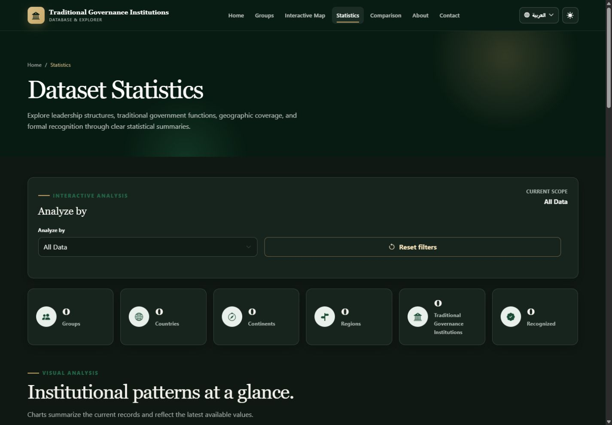
4.10 • DISCUSSION
The interface supports bilingual and dark-mode use
Presentation preferences persist across the multi-page website.
Figure 4.21: Arabic Right-to-Left Interface
Figure 4.22: Dark-Mode Statistics Interface
Saved preferences remain active across page navigation and refresh.
Chapter 4 • Results and Discussion
Notes:
Explain that Arabic changes document language and direction to RTL, while English source group names remain isolated for readability. Dark mode applies consistently to cards, tables, forms, charts, and navigation.

Slide 30
4.11 • SYSTEM RESULT SUMMARY
The completed platform meets its research-interface goals
The same database supports discovery, visualization, comparison, and statistical testing.
01
EXPLORE
02
MAP
03
DESCRIBE
Search, filters, sorting, pagination, detail dialog
Five live continent totals and marker navigation
Scoped dashboard with seven dynamic charts
04
COMPARE
05
ANALYZE
06
PRESENT
Country, continent, and region profiles
Predefined tests plus a dynamic method selector
Responsive, bilingual, accessible, dark-mode interface
GROUPS
COUNTRIES
CONTINENTS
RECOGNIZED
API ERRORS
1,557
130
5
744
0
Chapter 4 • Results and Discussion
Notes:
Summarize the system result in six points. Emphasize integration: these are not isolated mock-ups. Each page consumes the Flask API and reflects the same MySQL source.

Slide 31
4.12 • CHAPTER SUMMARY
Chapter 4 established both technical and analytical outcomes
The platform is functional, evidence-based, and ready to support the final conclusions.
Established in this chapter
NEXT
Chapter 5
The final frontend is connected to live Flask–MySQL services.
Search, filters, map navigation, statistics, and comparisons are operational.
Inferential outputs match the current API and preserve decimal expected frequencies.
Most significant relationships have weak, very weak, small, or negligible effects.
Geographic recognition differences are evident, with the regional result showing a moderate effect.
Findings describe association or difference—not causation.
Conclusions, recommendations, and future development priorities.
Chapter 4 • Results and Discussion
Notes:
Close the chapter. State that the implementation was verified end to end and that the statistical evidence was interpreted with effect sizes, missing-value limitations, and non-causal language. Transition to Chapter 5, which should synthesize conclusions, recommendations, and future work.

