Slide 1

TRADITIONAL GOVERNANCE DATA ANALYTICS AND VISUALIZATION PLATFORM
Chapter 4
Results and Discussion
Verified implementation outcomes, live-data visualizations, statistical findings, and academic interpretation.
University Graduation Project • 9 August 2026
Notes:
Introduce Chapter 4 as the evidence chapter. Explain that every interface screenshot and every numerical result comes from the running project and the connected MySQL database. State that the discussion reports associations, not causal effects.

Slide 2
4.1 • INTRODUCTION
What the final system demonstrates
Chapter 4 presents the completed interface and the results users can obtain from it.
01
EXPLORE
02
UNDERSTAND
Browse and inspect traditional governance records.
View clear summaries, maps, and descriptive charts.
03
COMPARE
04
ANALYZE
Compare countries, continents, and regions.
Review statistical relationships and their interpretation.
The following slides explain the final system from the user's perspective: what each page is, what it shows, what the user can do, and the benefit it provides.
Chapter 4 • Results and Discussion
2
Notes:
This slide introduces Chapter 4. It presents the final system and the results that a user can obtain from it. I will explain each page in simple terms: what it is, what it shows, what the user can do, and the benefit of the page.

Slide 3
4.2 • FINAL SYSTEM OVERVIEW
A connected research journey
The platform guides the user from a broad overview to detailed evidence and statistical interpretation.
1
2
3
4
5
6
Home
Groups
Map & Statistics
Comparison
Analysis
About & Contact
See the platform overview
Find relevant records
Understand patterns
Compare geographic areas
Interpret relationships
Understand and engage
USER BENEFIT
The user can move from a global summary to filtered records, geographic comparisons, and statistical conclusions without leaving the same research platform.
Chapter 4 • Results and Discussion
3
Notes:
This is an overview of the user's journey through the platform. The user begins on the Home page, explores records, studies maps and statistics, compares geographic areas, and then reviews statistical analysis. The About and Contact pages provide context and communication support.

Slide 4
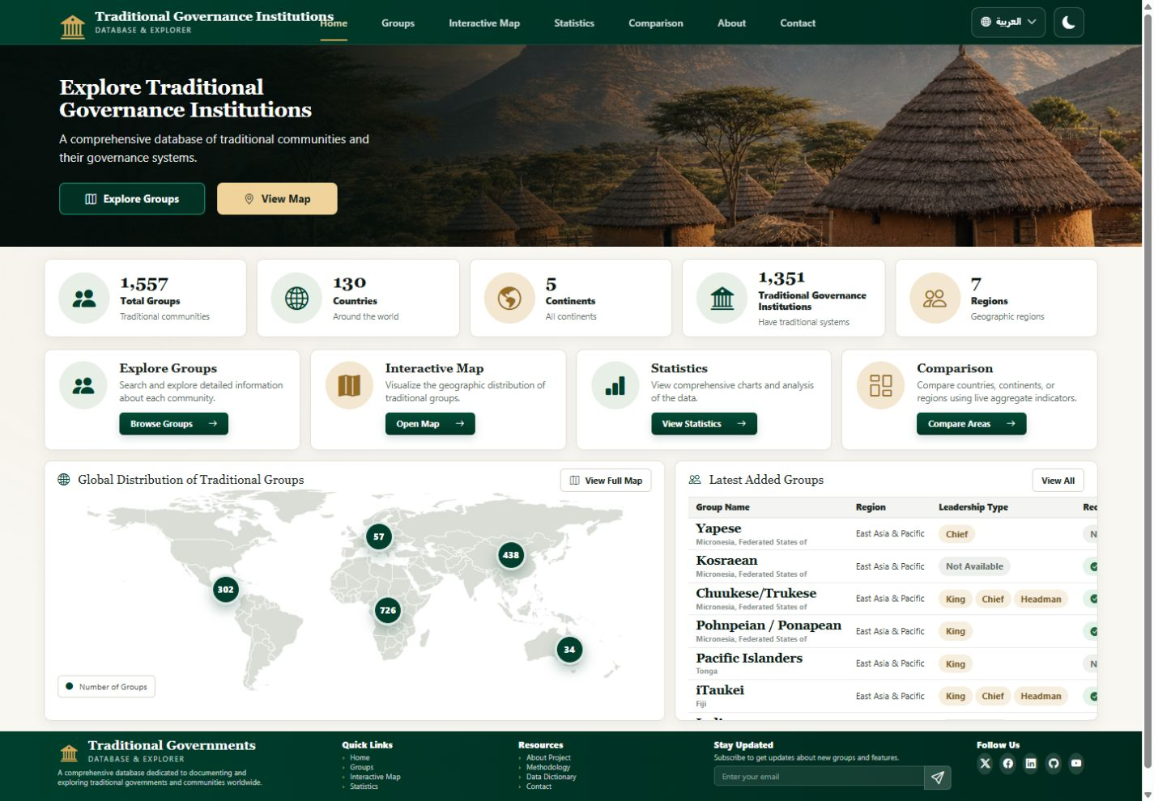

4.3 • HOME PAGE
The starting point for exploration
The Home page introduces the platform and presents the main dataset overview.
1
WHAT IS IT?
The main entry page of the platform.
2
WHAT DOES IT SHOW?
Summary indicators, key tools, a world map, and recent records.
3
WHAT CAN THE USER DO?
Open Groups, Map, Statistics, or Comparison.
4
WHAT IS THE BENEFIT?
It gives a quick understanding of the dataset and where to begin.
Figure 4.1: Home Page of the Traditional Governance Platform
Chapter 4 • Results and Discussion
4
Notes:
This is the Home page. It gives the user a quick overview of the platform and the dataset. It shows summary indicators, the main exploration tools, a geographic map, and recent group records. The user can use the buttons and navigation links to begin exploring the page that is most relevant to the research task.

Slide 5
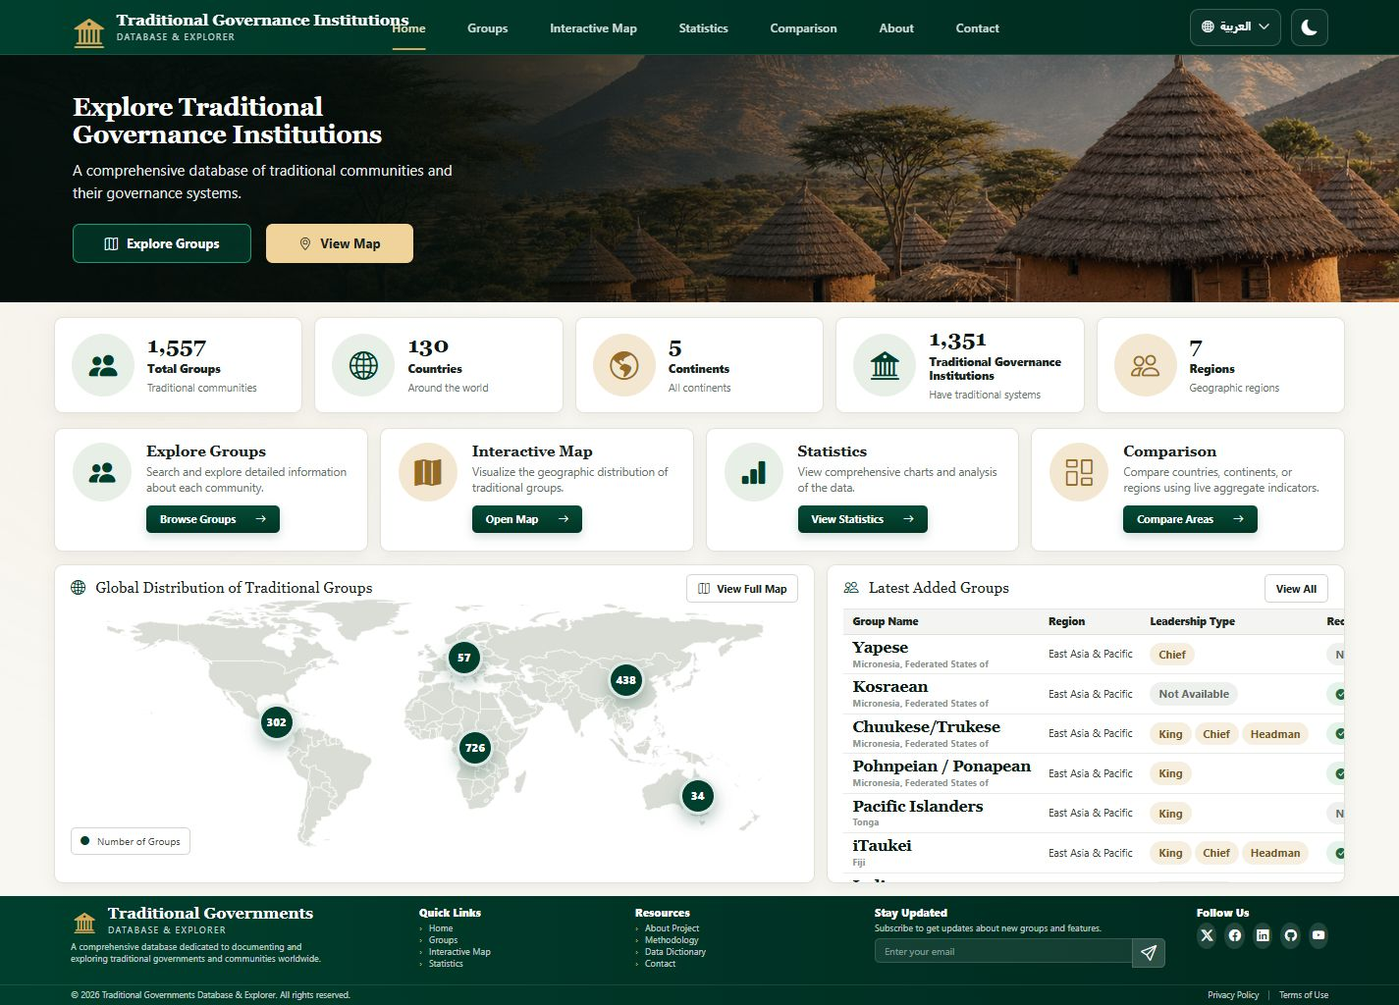
4.3 • HOME PAGE
What the user gains from the dashboard
The Home page converts a large dataset into an understandable first view.
1,557
130
5
1,351
GROUPS
COUNTRIES
CONTINENTS
WITH TPI
Shows the overall dataset size.
Shows the international coverage.
Introduces the geographic distribution.
Shows how many records include a traditional institution.
The user can choose a direct path: browse records, view geographic distribution, read descriptive statistics, or compare areas. This reduces the time needed to find the correct part of the system.
HOW THE USER BEGINS
Chapter 4 • Results and Discussion
5
Notes:
This slide explains the benefit of the Home page. The summary indicators tell the user how large and geographically broad the dataset is. The four main tools provide direct access to record exploration, geographic viewing, statistics, and comparison.

Slide 6
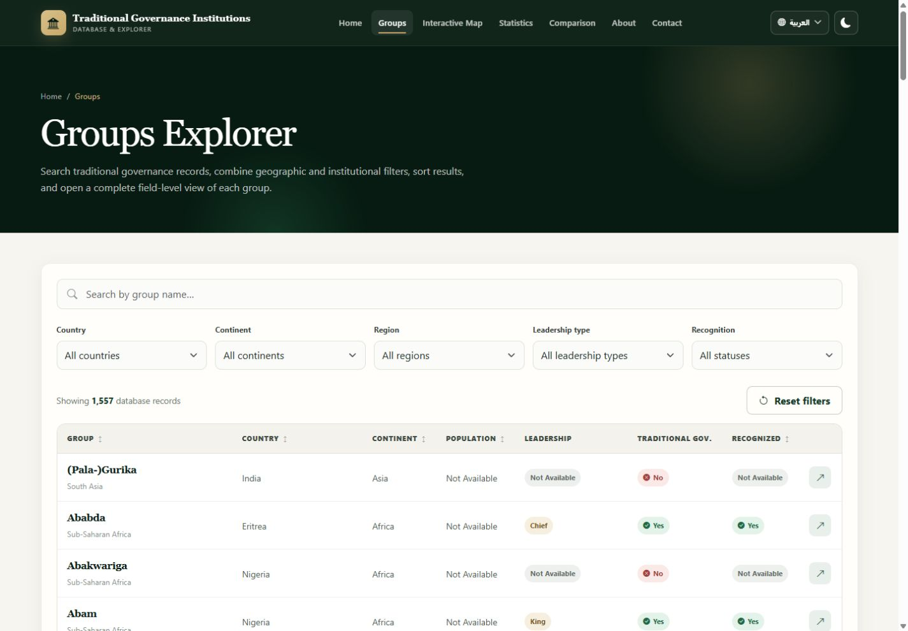
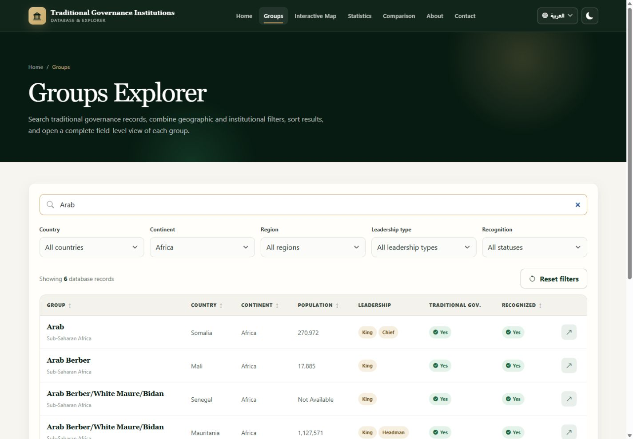
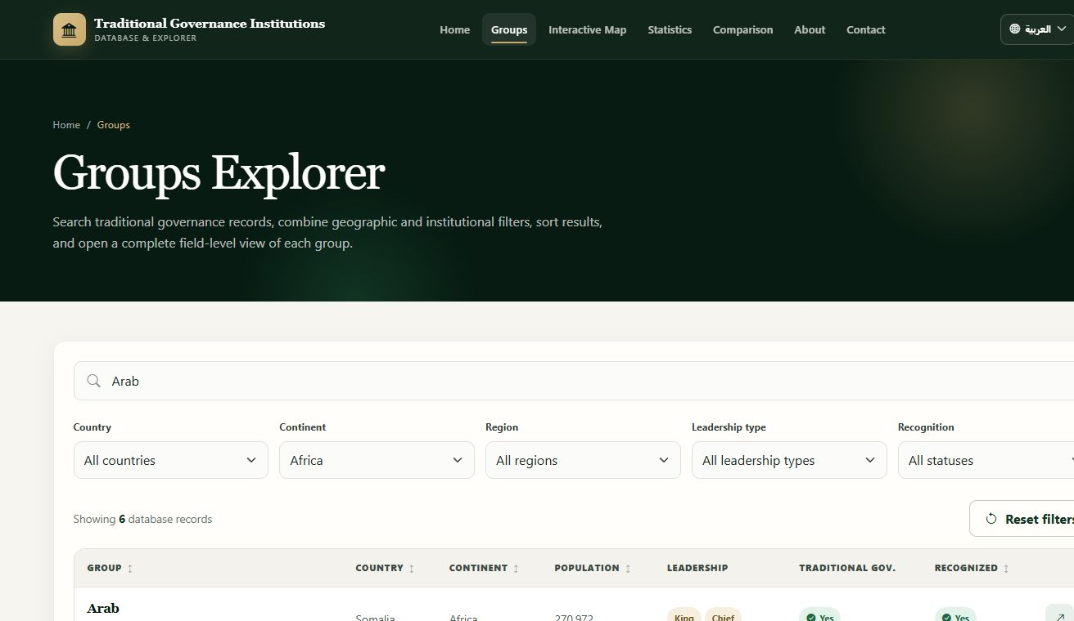
4.4 • GROUPS PAGE
Browse and narrow the traditional group records
Search and filters help the user focus on records that match a research interest.
Figure 4.2: Default Group Records Interface
Figure 4.3: Groups Filtered by Africa and the Search Term ‘Arab’
The user can search by group name and combine country, continent, region, leadership, and recognition filters. The visible records change to match the selected criteria.
Chapter 4 • Results and Discussion
6
Notes:
This is the Groups page. The left image shows the normal list of records. The right image shows a real example after searching for Arab and selecting Africa. The user can combine the available filters to narrow the results and find groups that are relevant to a country, region, leadership type, or recognition question.

Slide 7
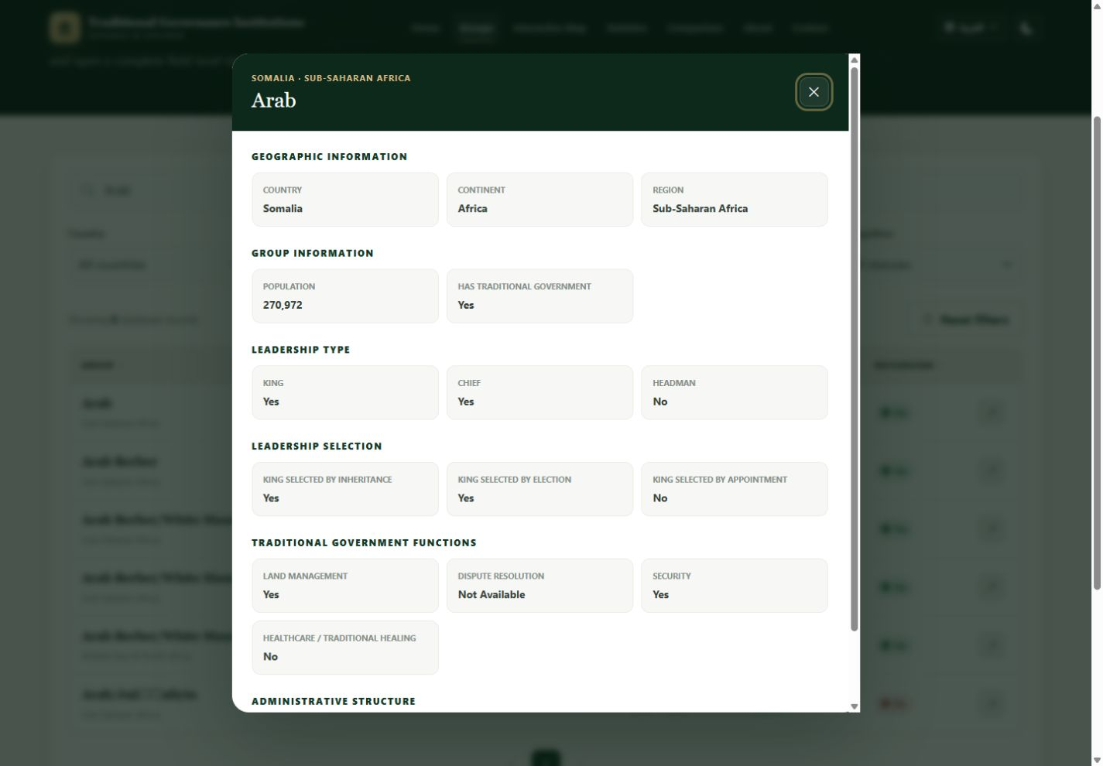
4.4 • GROUPS PAGE
Inspect a selected group in detail
The detailed view organizes geographic, leadership, governance-function, and recognition information.
1
WHAT IS IT?
A focused profile for one selected group.
2
WHAT DOES IT SHOW?
Location, population, leadership, functions, and recognition.
3
WHAT CAN THE USER DO?
Read the available fields without leaving the explorer.
4
WHAT IS THE BENEFIT?
It supports record-level inspection after broader filtering.
Figure 4.4: Detailed Traditional Group Record
Chapter 4 • Results and Discussion
7
Notes:
This is the detailed group view. After finding a relevant record, the user can open it and inspect the available information. The page clearly displays Yes, No, and Not Available values. The benefit is that the user can move from a broad list to detailed evidence for one group.

Slide 8
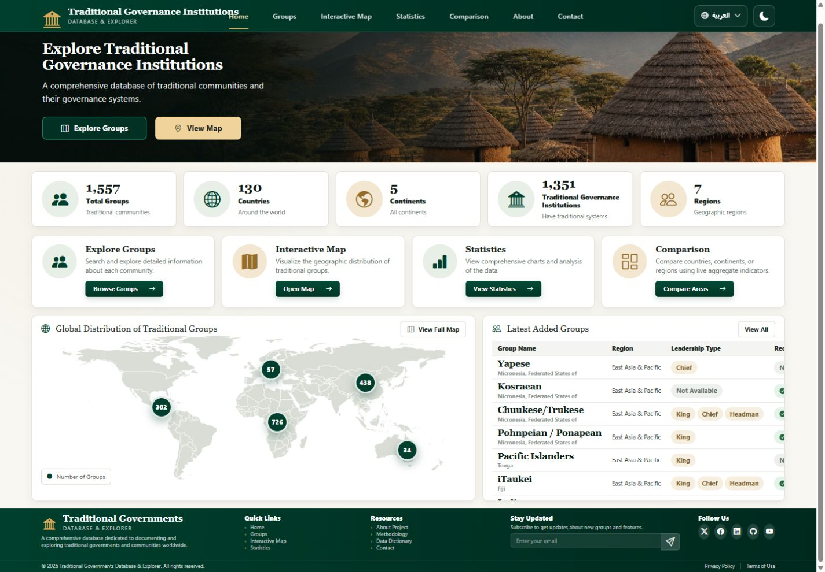

4.5 • INTERACTIVE MAP
See how groups are distributed geographically
The map displays the number of traditional groups represented in each continent category.
1
WHAT IS IT?
A visual geographic overview of the dataset.
2
WHAT DOES IT SHOW?
A world map with a group total for each continent.
3
WHAT CAN THE USER DO?
Select a marker to open the related group records.
4
WHAT IS THE BENEFIT?
It makes geographic concentration easy to understand.
Figure 4.5: Interactive Geographic Map
Chapter 4 • Results and Discussion
8
Notes:
This is the Interactive Map section. It represents the geographic distribution of the traditional groups. Each marker displays the number of records in a continent. The user can select a marker to continue to the related records. The benefit is a quick visual understanding of where the dataset is concentrated.

Slide 9
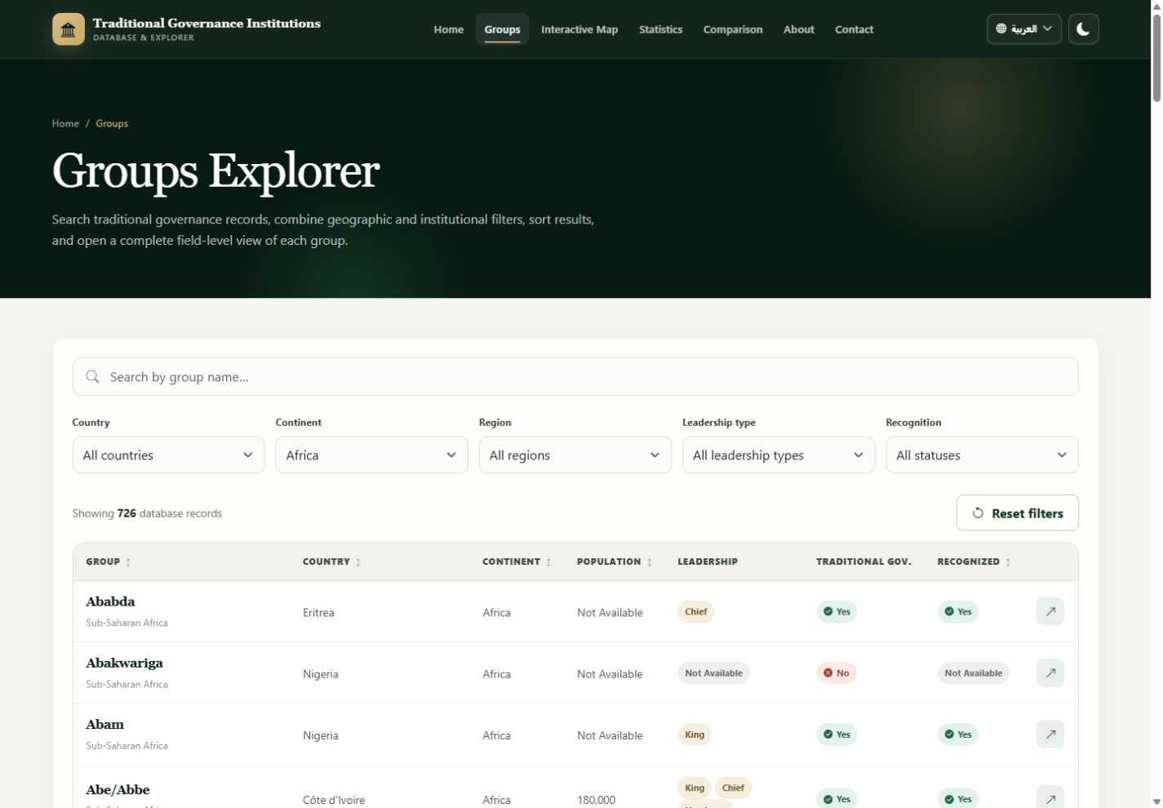
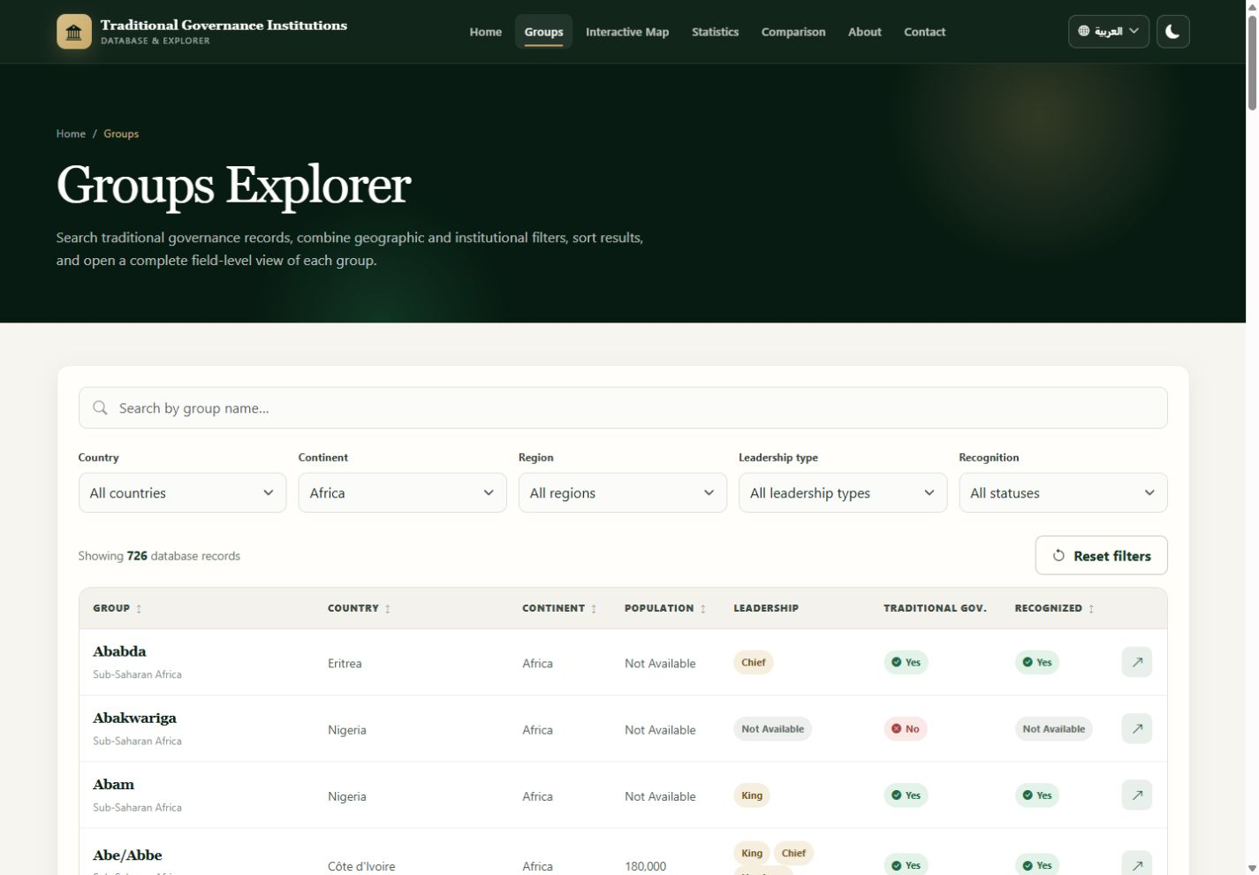
4.5 • INTERACTIVE MAP
A map selection opens the matching records
The geographic view supports direct movement from a marker to a filtered list.
1
SELECT
Africa marker
2
OPEN
Groups page
3
FILTER
Continent = Africa
4
LEARN
726 matching records
Figure 4.6: Africa Map Marker Result
Chapter 4 • Results and Discussion
9
Notes:
This slide shows a real map interaction. The user selected Africa, and the Groups page opened with the Africa filter already applied. The result shows 726 matching records. This helps the user move naturally from a visual overview to the detailed data.

Slide 10
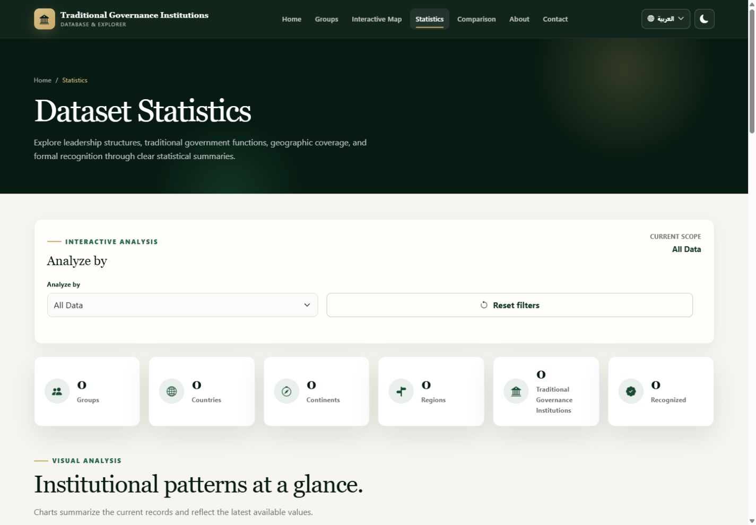

4.6 • STATISTICS PAGE
A visual summary of the dataset
The page brings the most important descriptive patterns together in one dashboard.
1
WHAT IS IT?
The descriptive overview of the dataset.
2
WHAT DOES IT SHOW?
Leadership, selection, functions, recognition, geography, population, and top countries.
3
WHAT CAN THE USER DO?
Read charts and select a geographic scope.
4
WHAT IS THE BENEFIT?
It makes broad dataset patterns easier to understand.
Figure 4.7: Descriptive Statistics Dashboard
Chapter 4 • Results and Discussion
10
Notes:
This is the Statistics page. It provides a visual and descriptive summary of the dataset. The user can see leadership distribution, selection methods, governance functions, formal recognition, geographic coverage, largest groups, and top countries. The charts make the main patterns easier to understand.

Slide 11
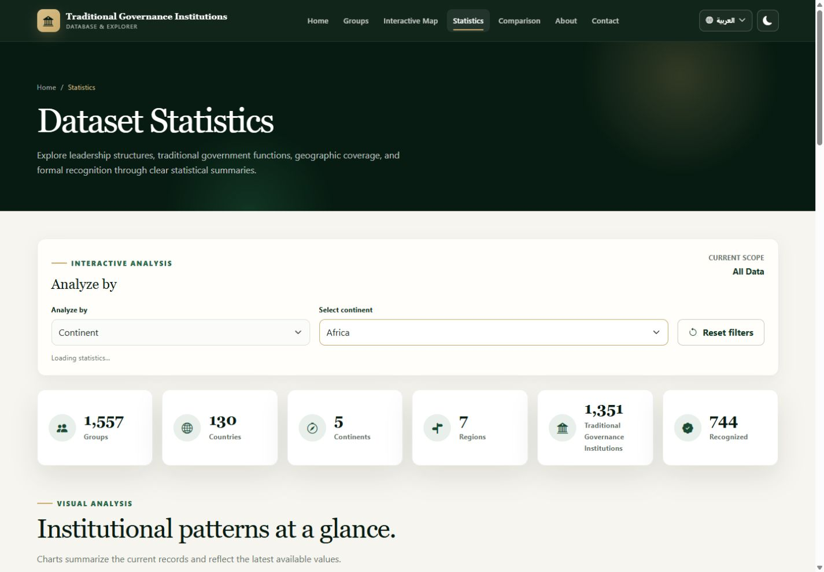
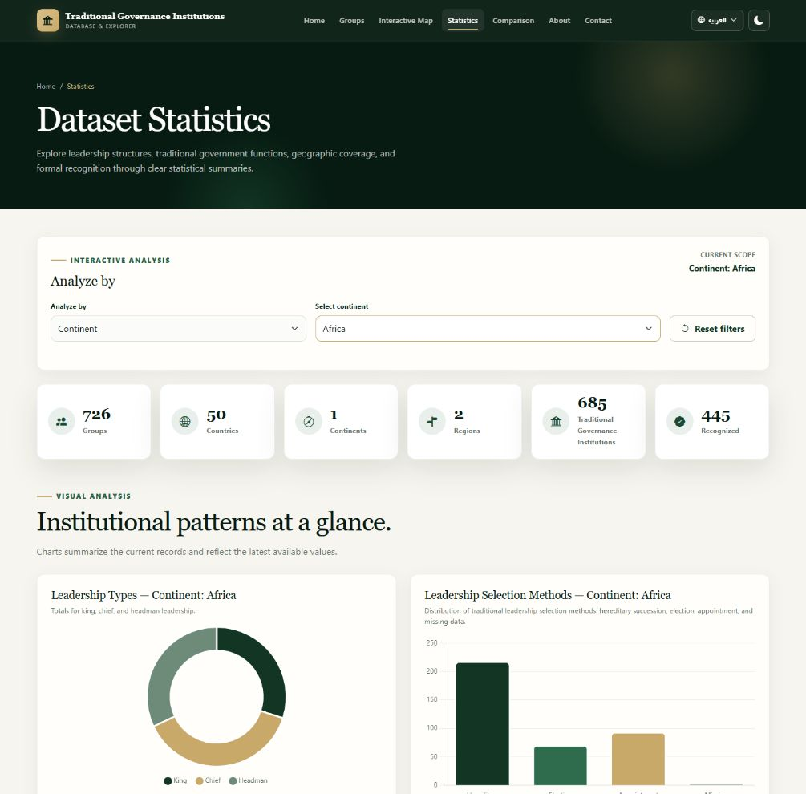
4.6 • STATISTICS PAGE
Focus the dashboard on a geographic area
The selected scope changes the summary indicators and every chart on the page.
GROUPS
726
COUNTRIES
50
WITH TPI
685
RECOGNIZED
445
The benefit is a focused description of one country, continent, or region instead of the whole dataset.
Figure 4.8: Africa-Scoped Statistics Dashboard
Chapter 4 • Results and Discussion
11
Notes:
This example shows the Statistics page after selecting Africa. All summary values and charts reflect the selected continent. The user can therefore study one geographic area instead of viewing only the global dataset.

Slide 12
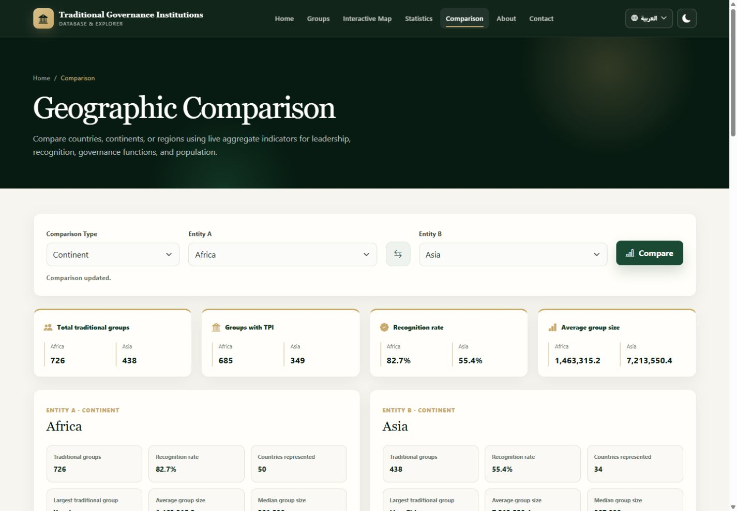
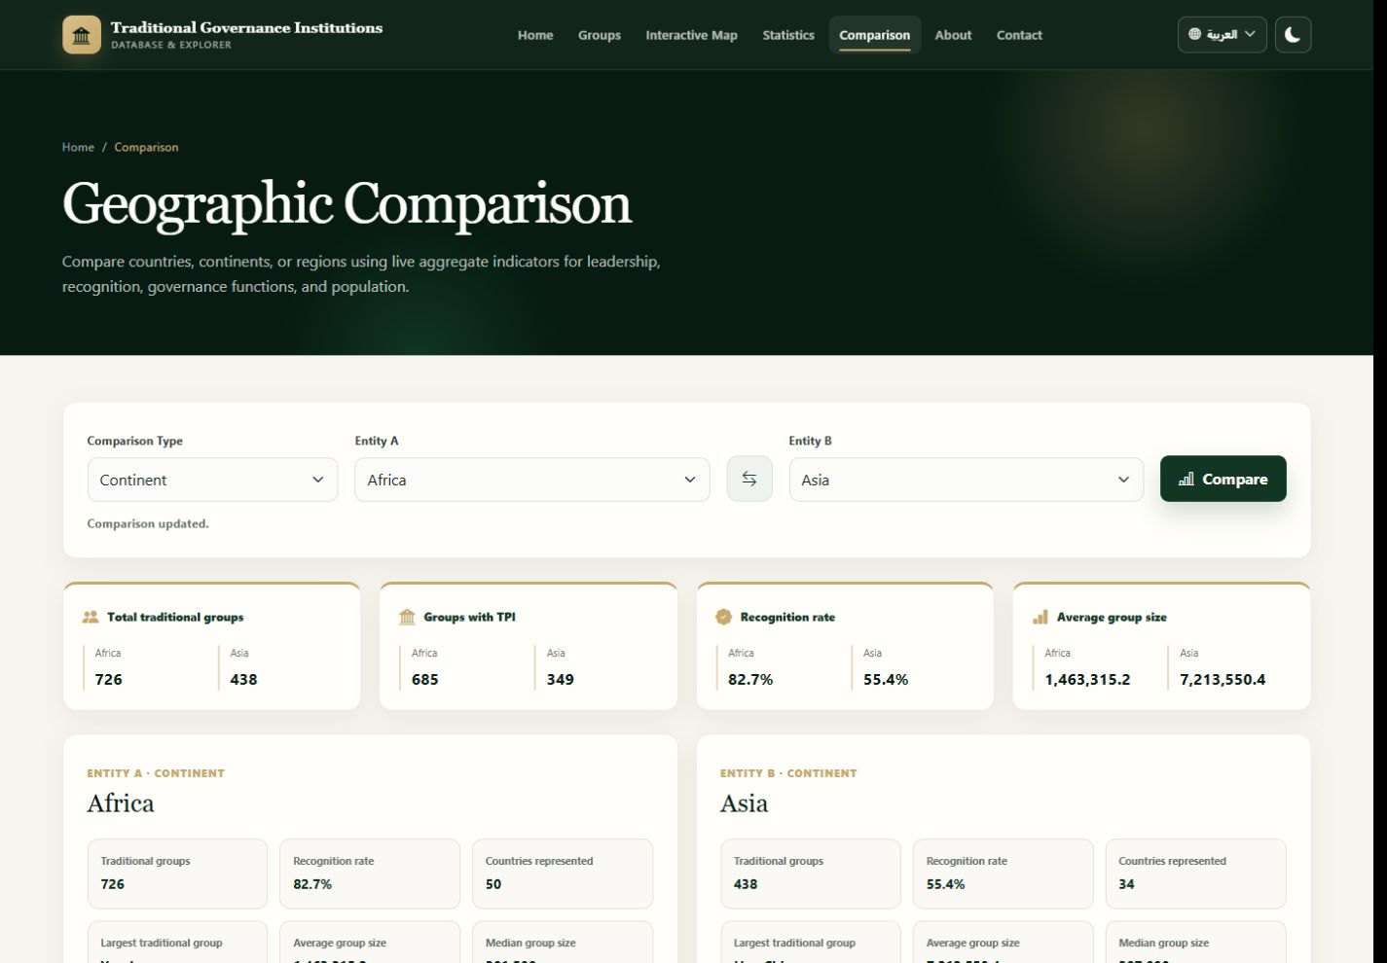
4.7 • GEOGRAPHIC COMPARISON
Compare two geographic entities side by side
The user selects a comparison level, Entity A, and Entity B before reviewing their differences.
1
WHAT IS IT?
A side-by-side geographic comparison page.
2
WHAT DOES IT SHOW?
Group totals, leadership, recognition, functions, and population.
3
WHAT CAN THE USER DO?
Choose Country, Continent, or Region and select two entities.
4
WHAT IS THE BENEFIT?
Differences become easier to identify using aligned indicators.
Figure 4.9: Continent Comparison between Africa and Asia
Chapter 4 • Results and Discussion
12
Notes:
This is the Geographic Comparison page. The user first chooses the comparison type, then selects Entity A and Entity B, and starts the comparison. The page shows aligned indicators for leadership, recognition, governance functions, and population. This example compares Africa and Asia.

Slide 13
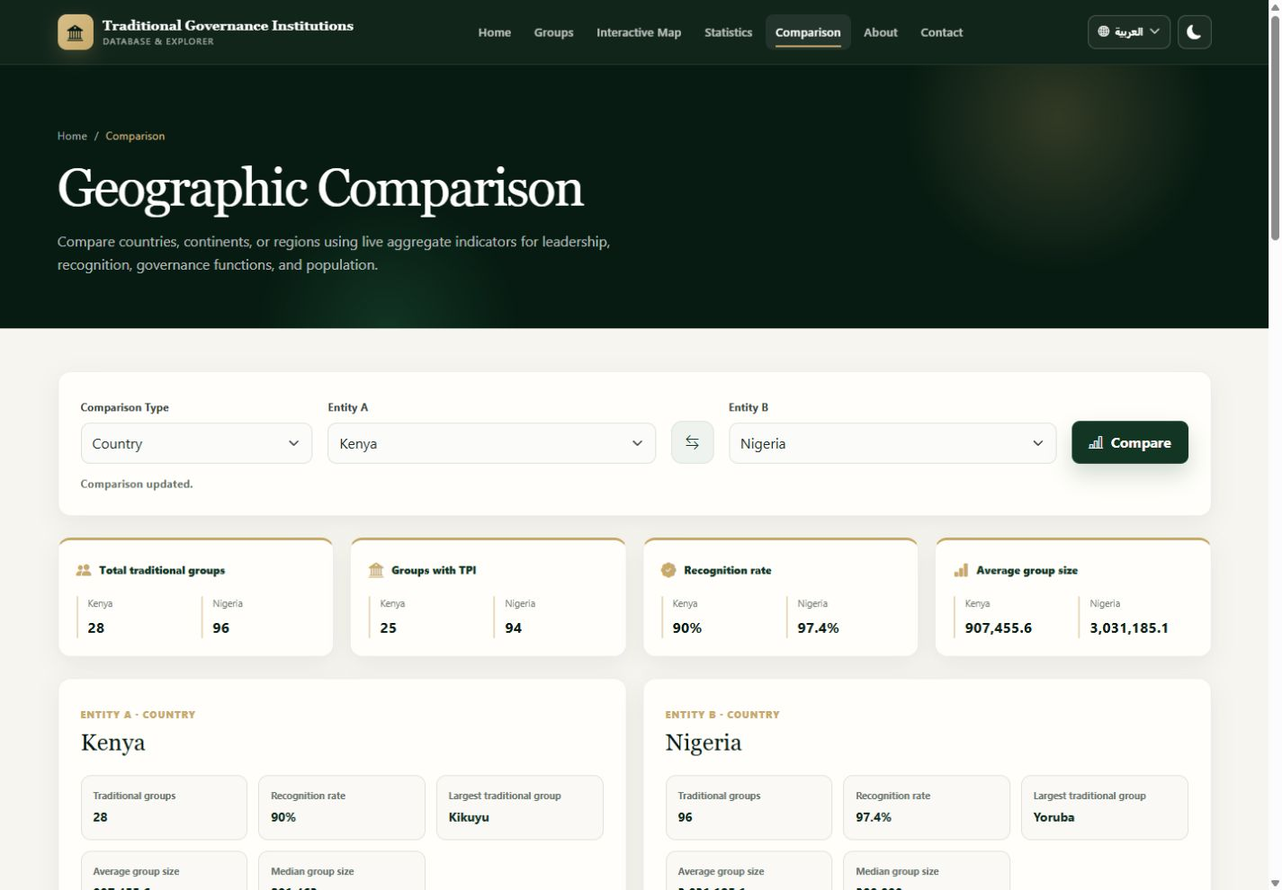
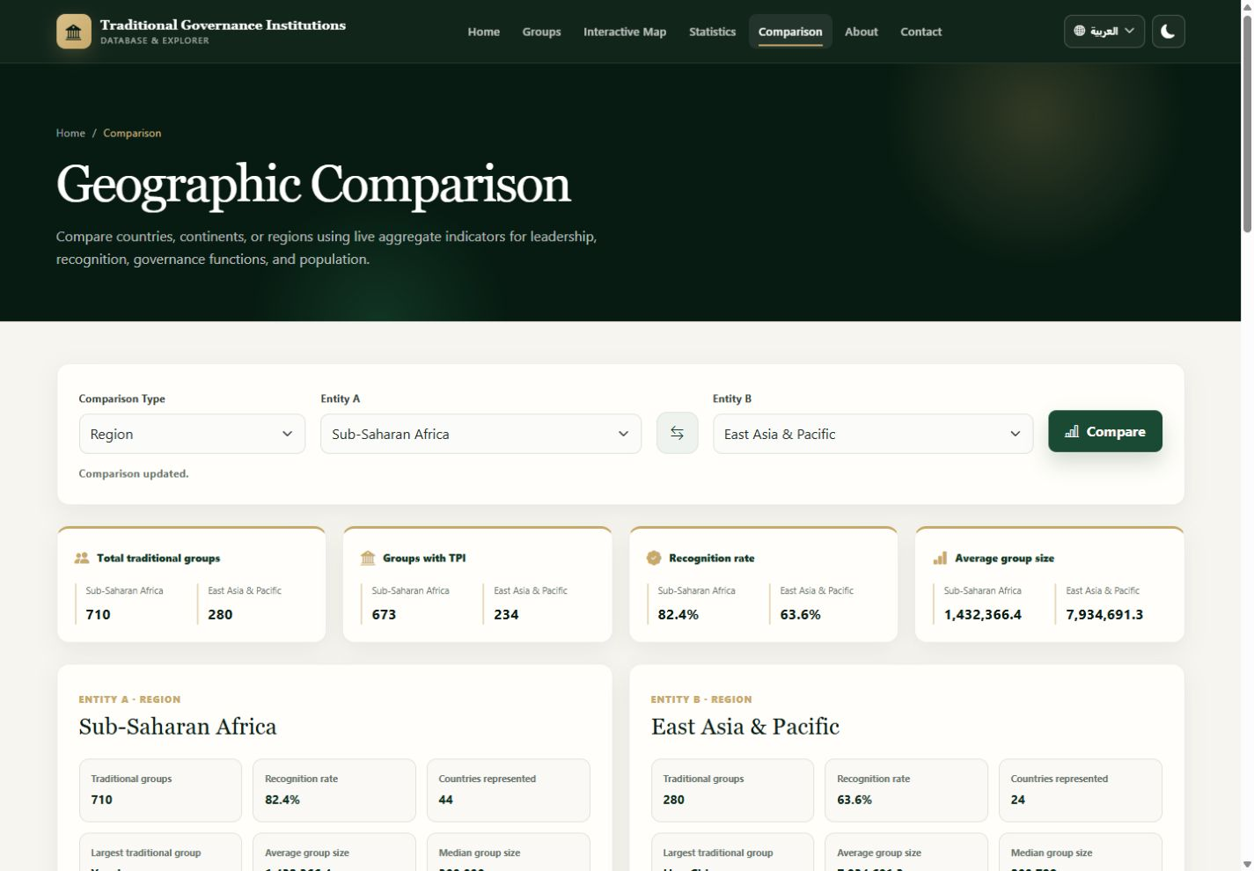
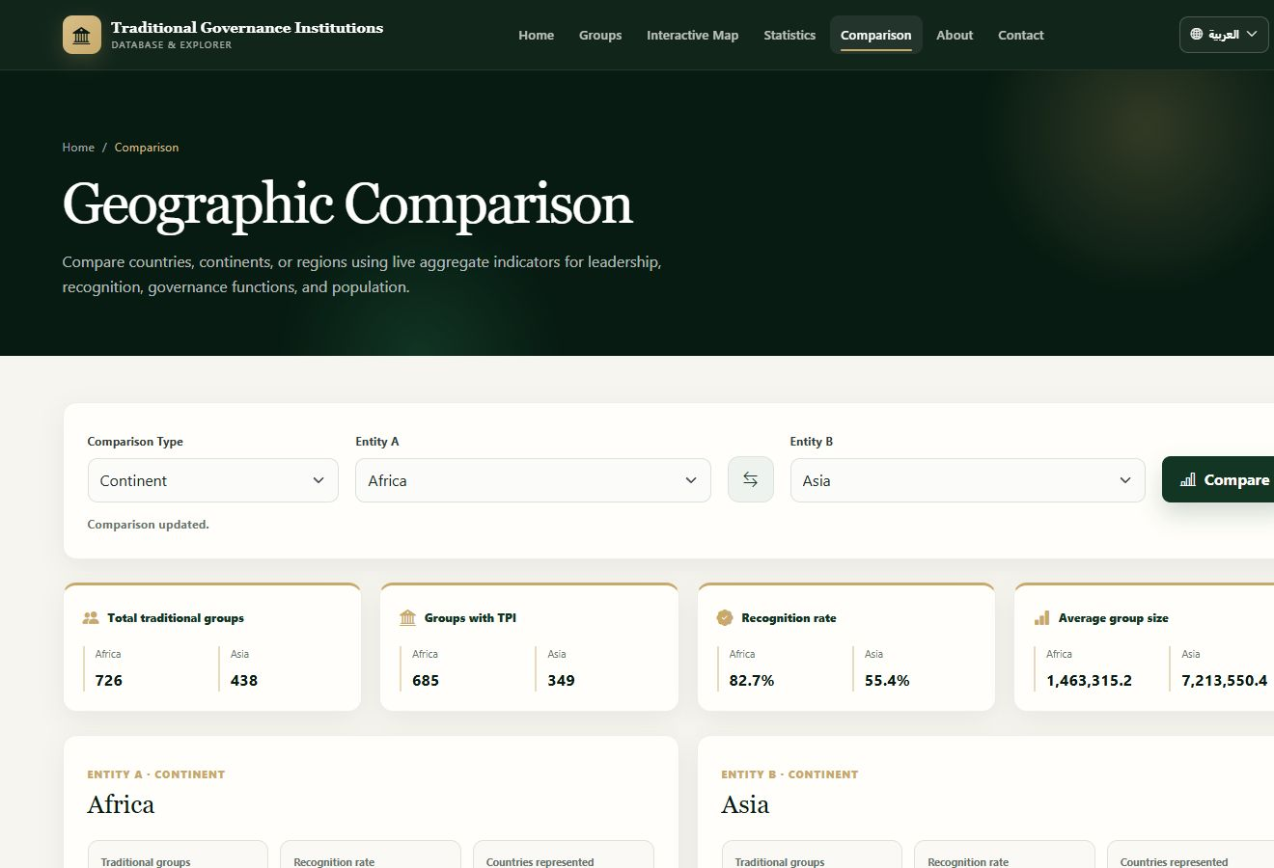
4.7 • GEOGRAPHIC COMPARISON
Country, continent, and region are all supported
The following completed examples demonstrate the remaining comparison levels.
Figure 4.10: Country Comparison between Kenya and Nigeria
Figure 4.11: Region Comparison between Sub-Saharan Africa and East Asia & Pacific
Together with the continent example, these screens verify all three final comparison levels without using Group-versus-Group comparison.
Chapter 4 • Results and Discussion
13
Notes:
This slide provides visual evidence for the other two comparison levels. The left side compares Kenya and Nigeria as countries. The right side compares Sub-Saharan Africa and East Asia and Pacific as regions. Together with the previous continent example, the system supports Country, Continent, and Region comparison.

Slide 14
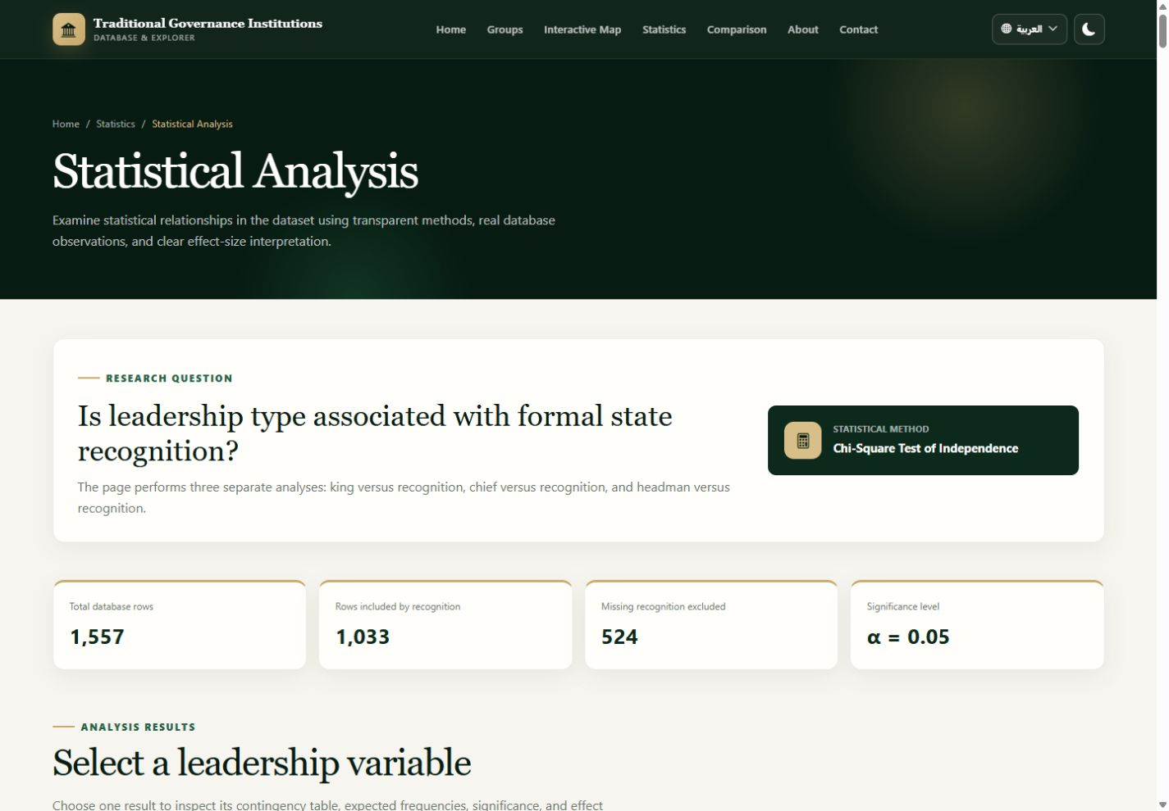
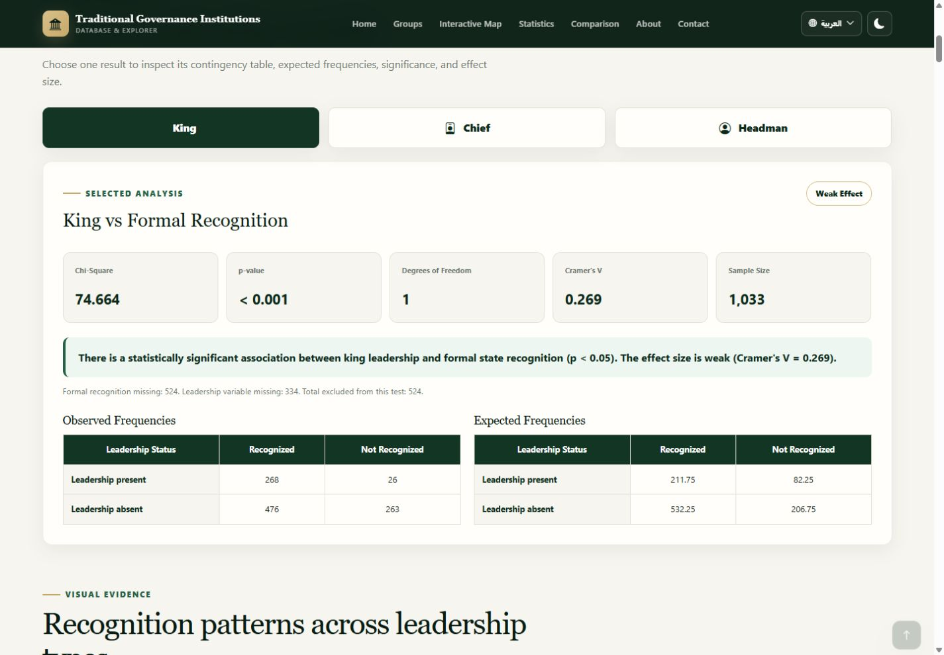
4.8 • STATISTICAL ANALYSIS INTERFACE
Where the user reads the statistical evidence
Two readable views replace the previous long, compressed page screenshot.
Figure 4.12: Research Question, Method, and Sample Summary
Figure 4.13: Statistical Result, Interpretation, and Frequency Tables
1 Research question • 2 Statistical method • 3 Sample size • 4 Statistic and p-value • 5 Effect size • 6 Interpretation and tables
Chapter 4 • Results and Discussion
14
Notes:
This is the Statistical Analysis page. The left image shows the research question, selected method, total records, valid sample, missing values, and significance level. The right image shows the test statistic, p-value, degrees of freedom, effect size, sample size, interpretation, and the observed and expected tables. The user can use these elements to understand both the statistical result and its meaning.

Slide 15

4.9 • ABOUT PAGE
Understand the purpose and scope of the project
The About page explains why the platform exists and what research activities it supports.
1
WHAT IS IT?
The background and purpose page for the project.
2
WHAT DOES IT SHOW?
The platform's purpose, scope, and research experience.
3
WHAT CAN THE USER DO?
Learn how the system supports discovery, analysis, comparison, and current insights.
4
WHAT IS THE BENEFIT?
It provides context before the user interprets the data.
Figure 4.14: About Page of the Traditional Governance Platform
Chapter 4 • Results and Discussion
15
Notes:
This is the About page. It explains the purpose and scope of the Traditional Governance platform. It shows that the system supports discovery, analysis, comparison, and communication of current insights. The benefit is that users understand the role of the project before interpreting its data.

Slide 16
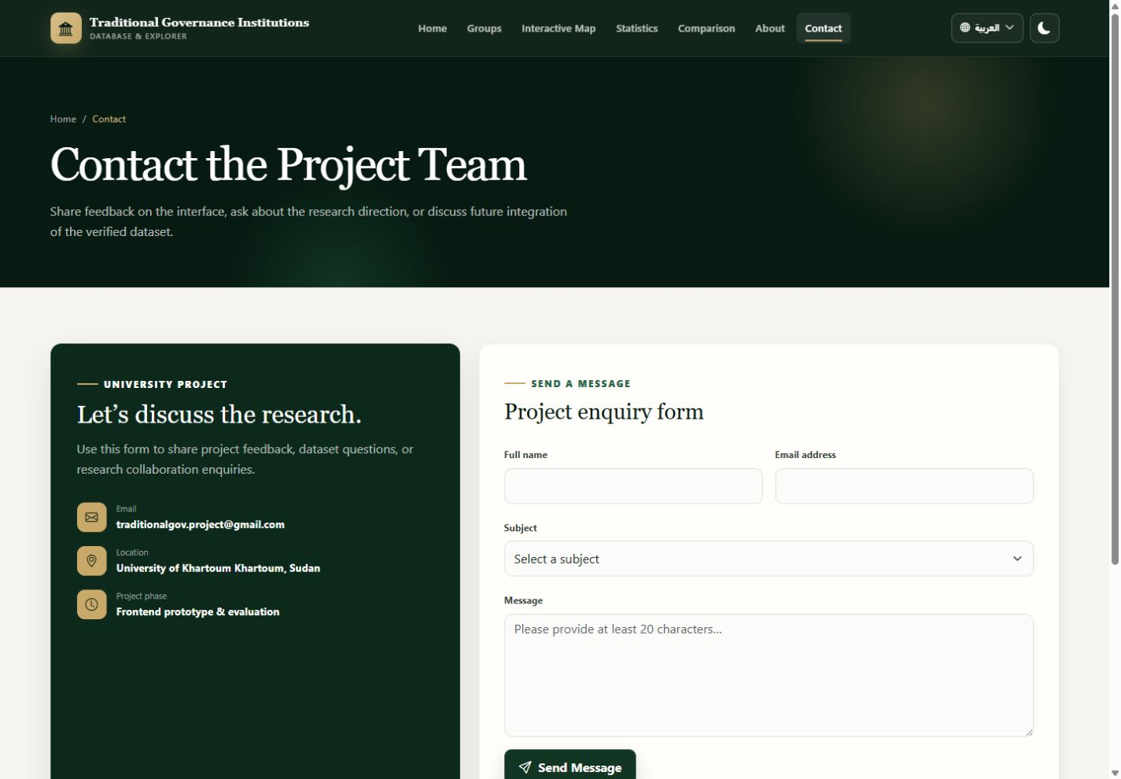
4.10 • CONTACT PAGE
Communicate with the project team
The Contact page provides a structured form for project feedback, dataset questions, and collaboration enquiries.
1
WHAT IS IT?
The communication page for the project.
2
WHAT DOES IT SHOW?
Project contact details and an enquiry form.
3
WHAT CAN THE USER DO?
Enter a name, email, subject, and message, then select Send Message.
4
WHAT IS THE BENEFIT?
It supports feedback, questions, and possible research collaboration.
Verification note: no message was sent during this review; delivery depends on the configured contact service.
Figure 4.15: Contact Page and Project Enquiry Form
Chapter 4 • Results and Discussion
16
Notes:
This is the Contact page. It provides project contact information and a form with Full name, Email address, Subject, and Message fields. The user can prepare feedback, a dataset question, or a collaboration enquiry and select Send Message. No message was sent during this review, so I do not claim that an email reached an inbox in the local environment.

Slide 17
STATISTICAL RESULTS • READING GUIDE
How to read the inferential results
Statistical significance and practical strength answer different questions.
CHI-SQUARE
p-VALUE
Compares observed and expected categorical counts.
Probability of an equal-or-more-extreme result under H₀.
χ² increases as the tables diverge.
p < .05 is treated as statistically significant.
CRAMER'S V
MANN–WHITNEY U
Effect size for Chi-Square association.
Compares ranked values between two groups.
Near 0 = weak; larger values = stronger.
Used when population distributions are non-normal.
A significant result does not prove causation. It reports an association or distributional difference in this observational dataset.
Chapter 4 • Results and Discussion
Notes:
Use this slide before the individual analyses. A small p-value indicates evidence against independence or equal distributions. The effect size describes strength. Observed frequencies are real counts; expected frequencies are theoretical null-model values.

Slide 18
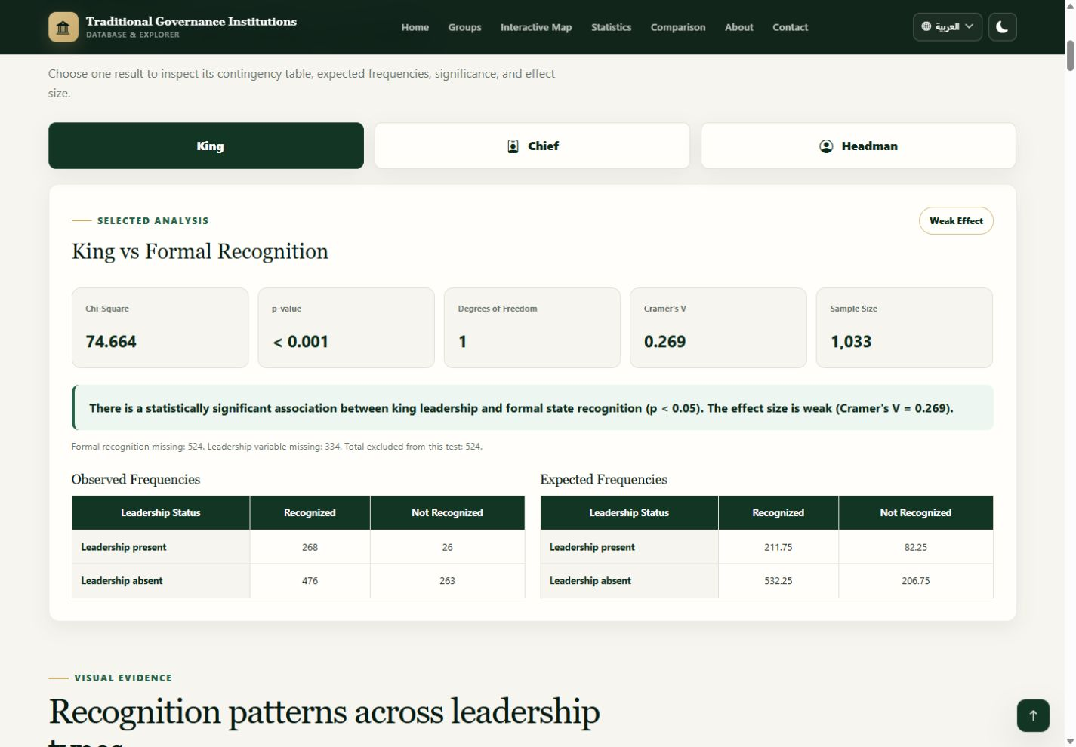
STATISTICAL RESULTS • ANALYSIS 1
Leadership type × formal recognition
Research question: Is leadership type associated with formal state recognition?
Leadership | χ² | df | p | V | Strength
King | 74.664 | 1 | < .001 | 0.269 | Weak
Chief | 53.382 | 1 | < .001 | 0.227 | Weak
Headman | 5.043 | 1 | = 0.025 | 0.070 | Weak
Interpretation
All three leadership indicators are associated with recognition. The King and Chief effects are weak; the Headman effect is very weak. These results do not show that a leadership title causes recognition.
Figure 4.16: Leadership Type and Formal Recognition Result
Chapter 4 • Results and Discussion
Notes:
Explain that King, Chief, and Headman were tested separately against binary formal recognition using Chi-Square. For the displayed King result, N is 1,033 after 524 rows with missing recognition were excluded.

Slide 19
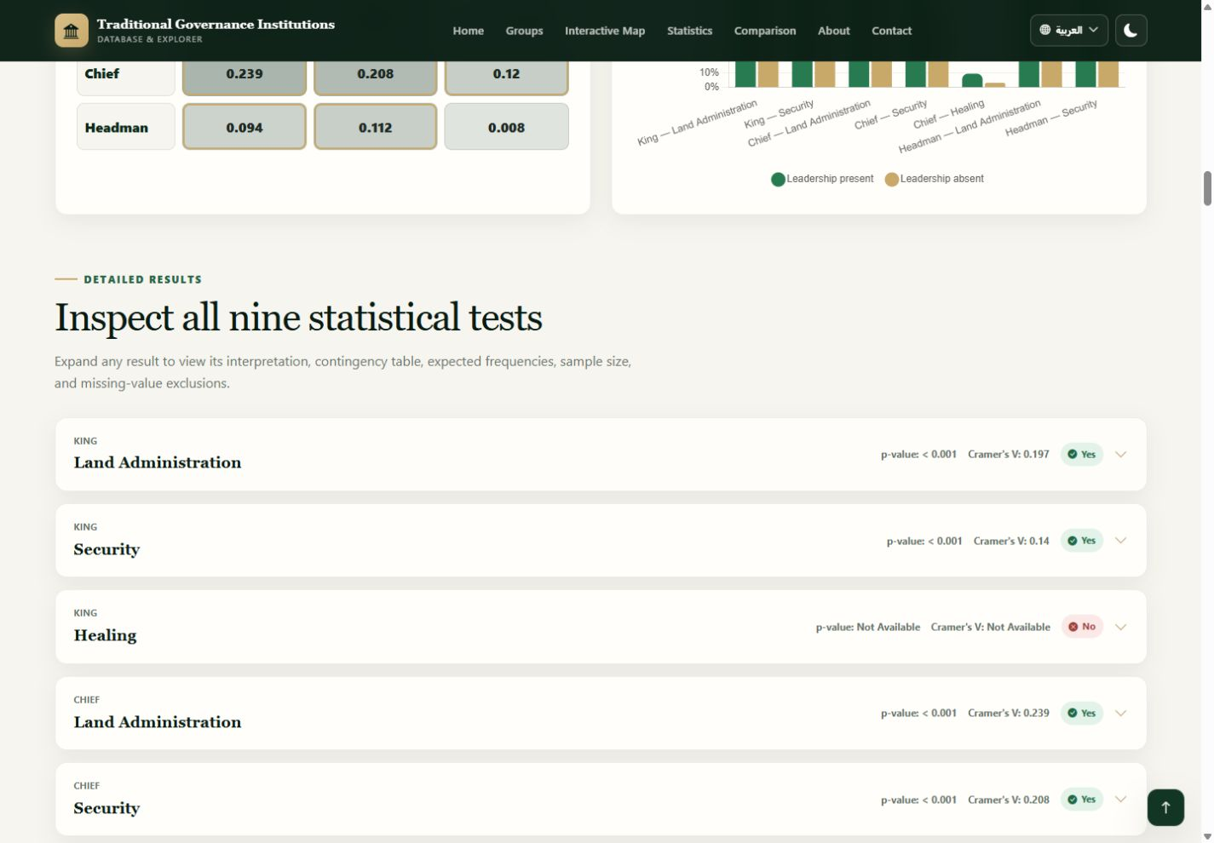
STATISTICAL RESULTS • ANALYSIS 2
Leadership type × governance functions
Nine Chi-Square tests examine Land, Security, and Healing responsibilities.
Relationship | χ² | p | V | N
King–Land | 44.047 | < .001 | 0.197 | 1,139
King–Security | 22.205 | < .001 | 0.140 | 1,139
King–Healing | N/A | N/A | N/A | 306
Chief–Land | 64.975 | < .001 | 0.239 | 1,139
Chief–Security | 49.478 | < .001 | 0.208 | 1,139
Chief–Healing | 4.436 | = 0.035 | 0.120 | 306
Headman–Land | 10.048 | = 0.002 | 0.094 | 1,139
Headman–Security | 14.234 | < .001 | 0.112 | 1,139
Headman–Healing | 0.018 | = 0.894 | 0.008 | 306
Figure 4.17: Leadership and Governance Functions Interface
Strongest observed relationship: Chief × Land Administration, V = .239 (weak).
Chapter 4 • Results and Discussion
Notes:
Explain that seven relationships were significant. King–Healing could not be estimated safely from the available complete table, and Headman–Healing was not significant. Most measurable effects were weak or very weak.

Slide 20
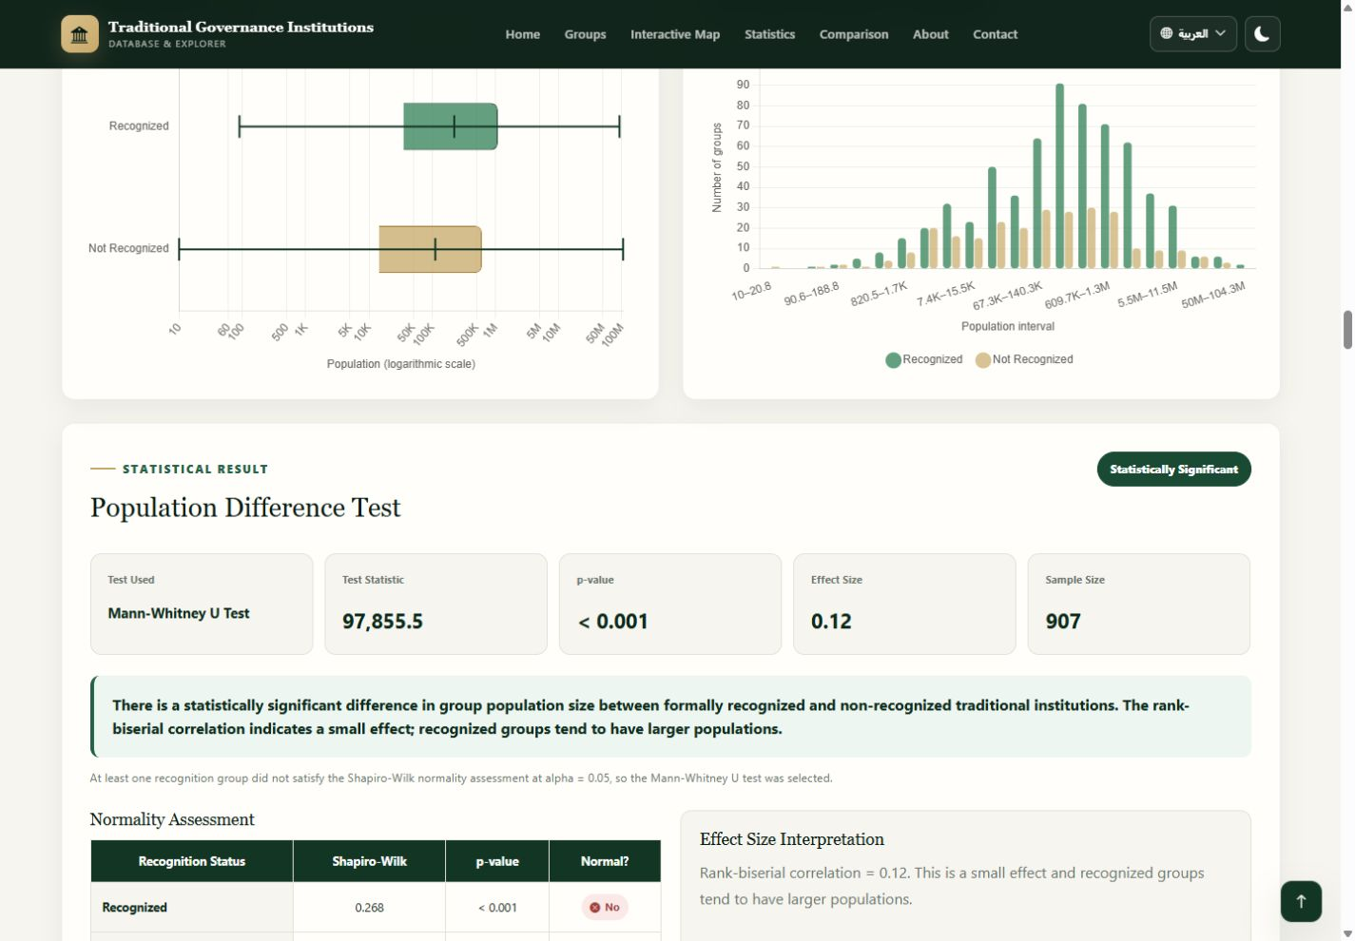
STATISTICAL RESULTS • ANALYSIS 3
Group population size × formal recognition
Non-normal population distributions required a Mann–Whitney U test.
TEST
SAMPLE
Mann–Whitney U
907
U STATISTIC
P-VALUE
97,855.5
< .001
EFFECT
STRENGTH
0.120
small
Finding
Significant difference; recognized groups tend to rank higher in population, but the effect is small.
Figure 4.18: Population Size and Formal Recognition Result
Chapter 4 • Results and Discussion
Notes:
Explain the method selection: Shapiro–Wilk indicated non-normality, so a rank-based test was used. The result is significant, but the rank-biserial effect is small. Recognized groups tend to have larger populations in rank terms.

Slide 21
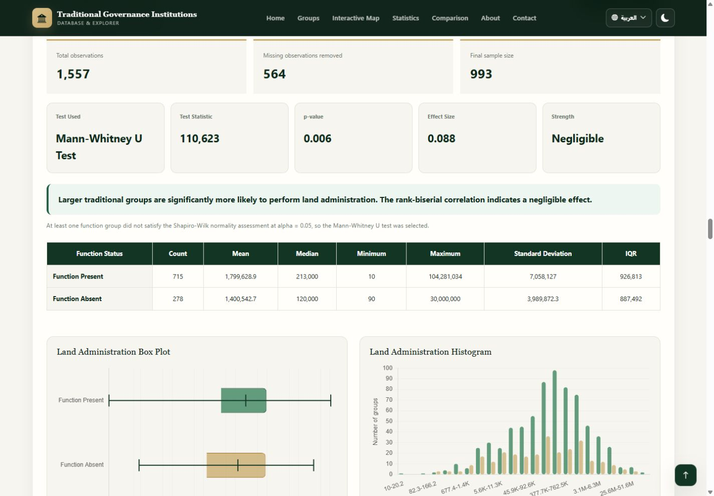
STATISTICAL RESULTS • ANALYSIS 4
Group population size × governance functions
Three Mann–Whitney tests compare function-present and function-absent groups.
Function | U | p | Effect | N | Finding
Land Administration | 110,623 | = 0.006 | 0.088 | 993 | Significant
Security | 128,801.5 | = 0.003 | 0.096 | 993 | Significant
Healing | 2,259.5 | = 0.882 | 0.010 | 252 | Not significant
Interpretation
Land and Security: significant, negligible effects.
Healing: no significant population-size difference.
Statistical significance should not be confused with a large practical difference.
Figure 4.19: Population Size and Governance Functions Results
Chapter 4 • Results and Discussion
Notes:
Explain that all three population/function distributions were non-normal. Land and Security differences were statistically significant, but both effects were negligible. Healing was not significant and had a much smaller sample because of missing values.

Slide 22
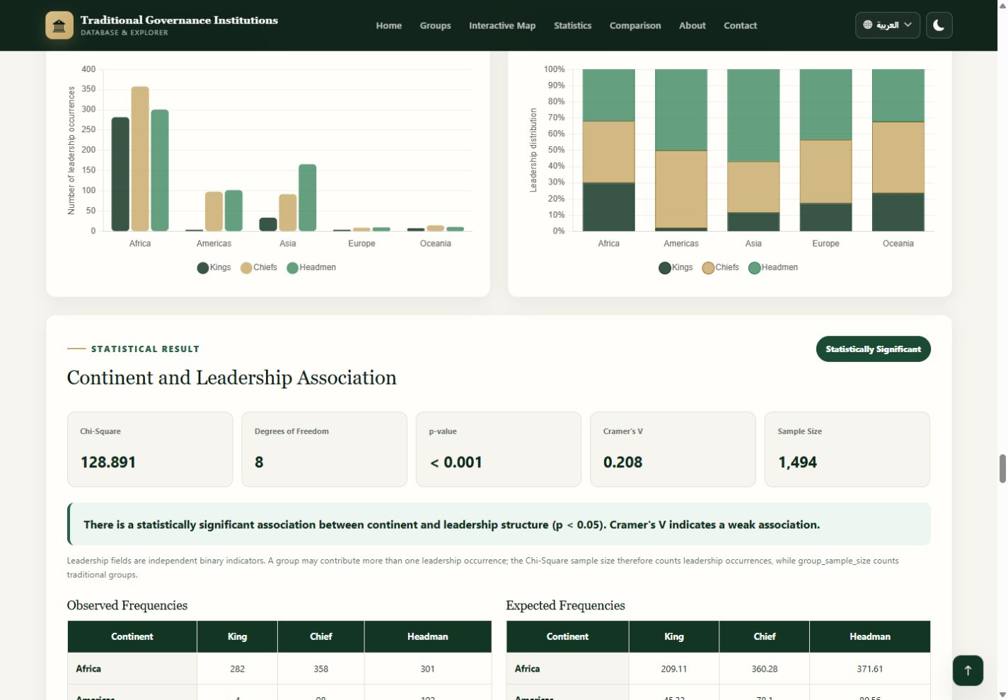
STATISTICAL RESULTS • ANALYSIS 5
Continent × leadership distribution
Chi-Square tests whether leadership structures vary geographically.
CHI-SQUARE
DF
128.891
8
P-VALUE
CRAMER'S V
< .001
0.208
OCCURRENCES
STRENGTH
1,494
weak
Leadership structure differs by continent, but the association is weak; geography is not a causal explanation.
Figure 4.20: Continental Leadership Distribution Result
Chapter 4 • Results and Discussion
Notes:
This analysis asks whether leadership distribution differs across continents. King, Chief, and Headman are separate binary indicators and may overlap within one group. Therefore, leadership occurrences are not the same as the number of unique groups. The result is statistically significant with a weak effect, and it describes association rather than causation.

Slide 23
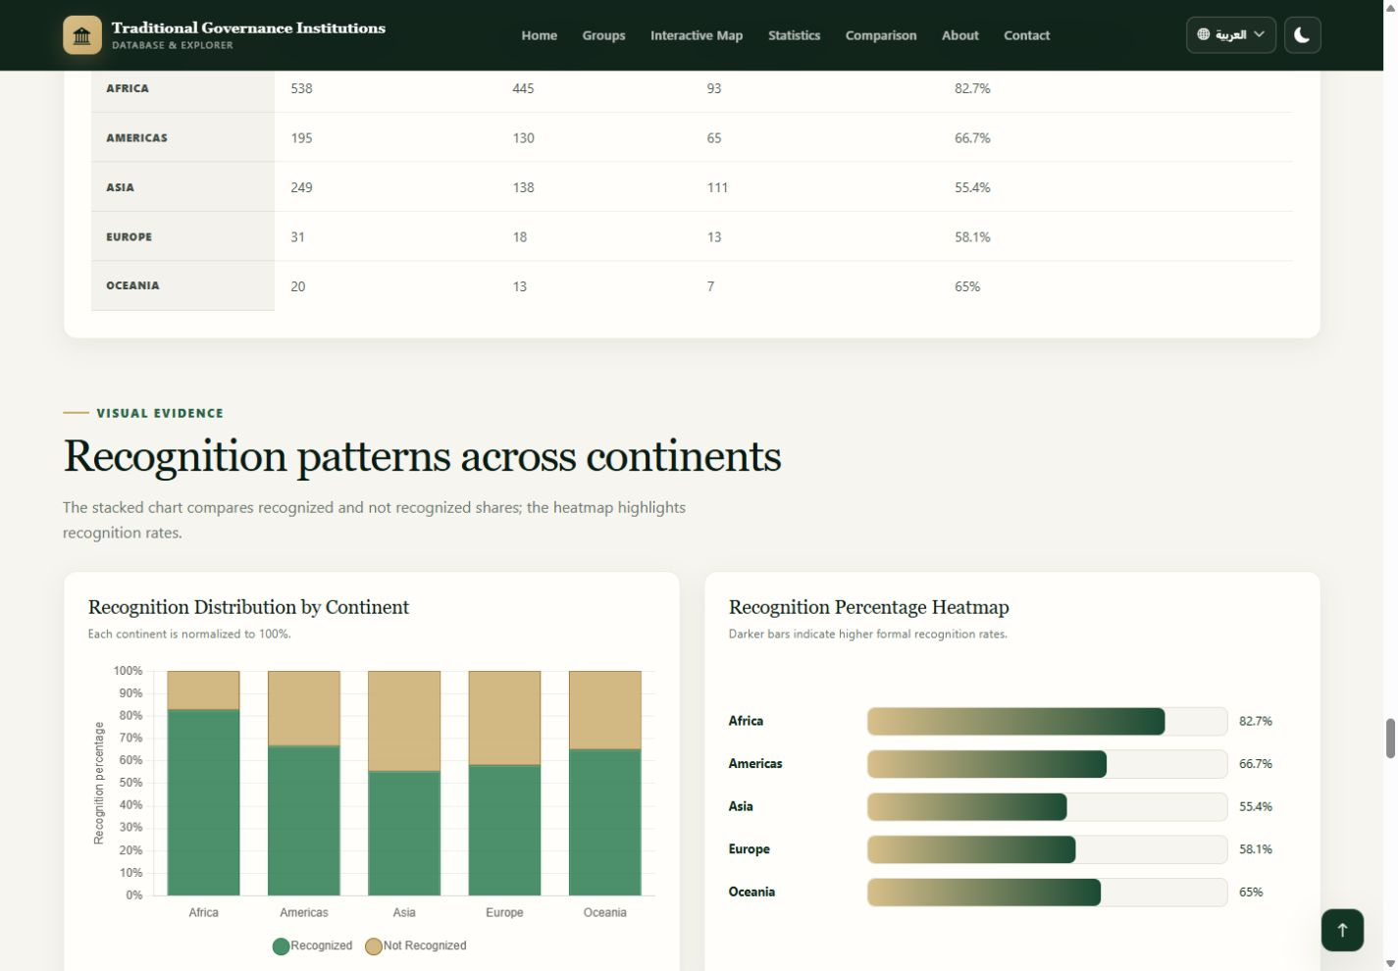
STATISTICAL RESULTS • ANALYSIS 6
Continent × formal recognition
Recognition status differs significantly across continents.
CHI-SQUARE
DF
70.837
4
P-VALUE
CRAMER'S V
< .001
0.262
SAMPLE
STRENGTH
1,033
weak
Rates among complete cases: Africa 82.7% • Asia 55.4%
Figure 4.21: Recognition Distribution by Continent
Chapter 4 • Results and Discussion
Notes:
Explain the complete-case table: N is 1,033 after missing recognition values are excluded. Africa has the highest complete-case recognition rate and Asia the lowest in the current data.

Slide 24
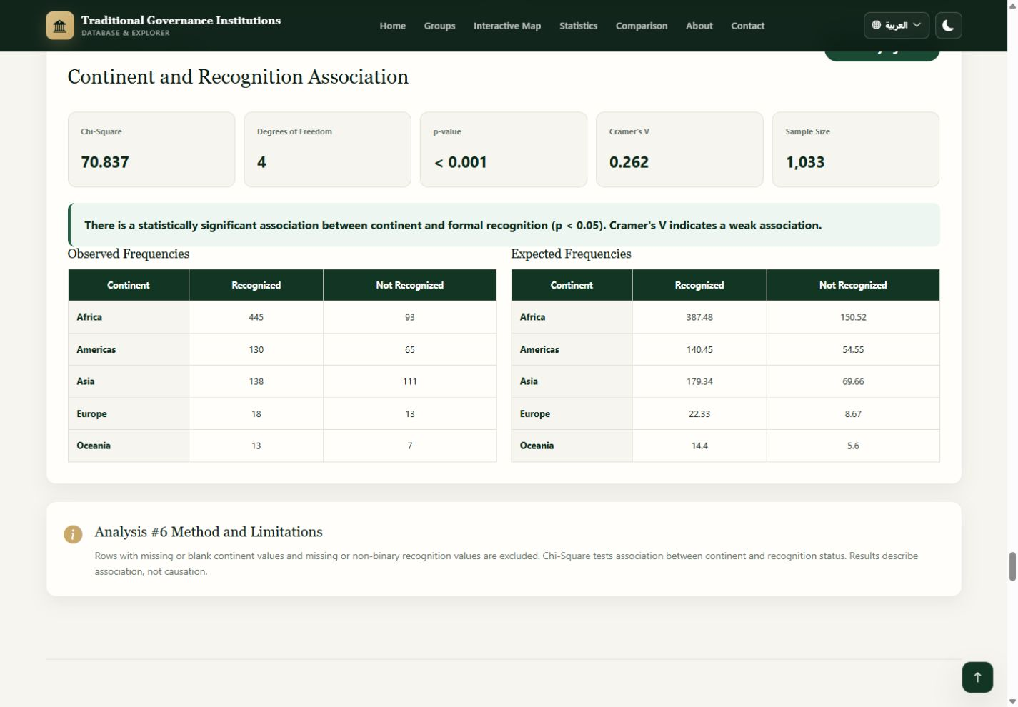
STATISTICAL RESULTS • ANALYSIS 6
Observed counts versus expected frequencies
Expected values are calculated under the null hypothesis of independence.
OBSERVED
Actual database counts
Whole numbers only
EXPECTED
Theoretical null-model values
Decimals are correct; they are not fractional real groups.
Figure 4.22: Observed and Expected Continent-Recognition Frequencies
Chapter 4 • Results and Discussion
Notes:
Point to both tables. Observed values are actual database counts and therefore whole numbers. Expected values are theoretical values distributed according to the row and column totals, so decimals are mathematically correct and do not represent fractional groups.

Slide 25
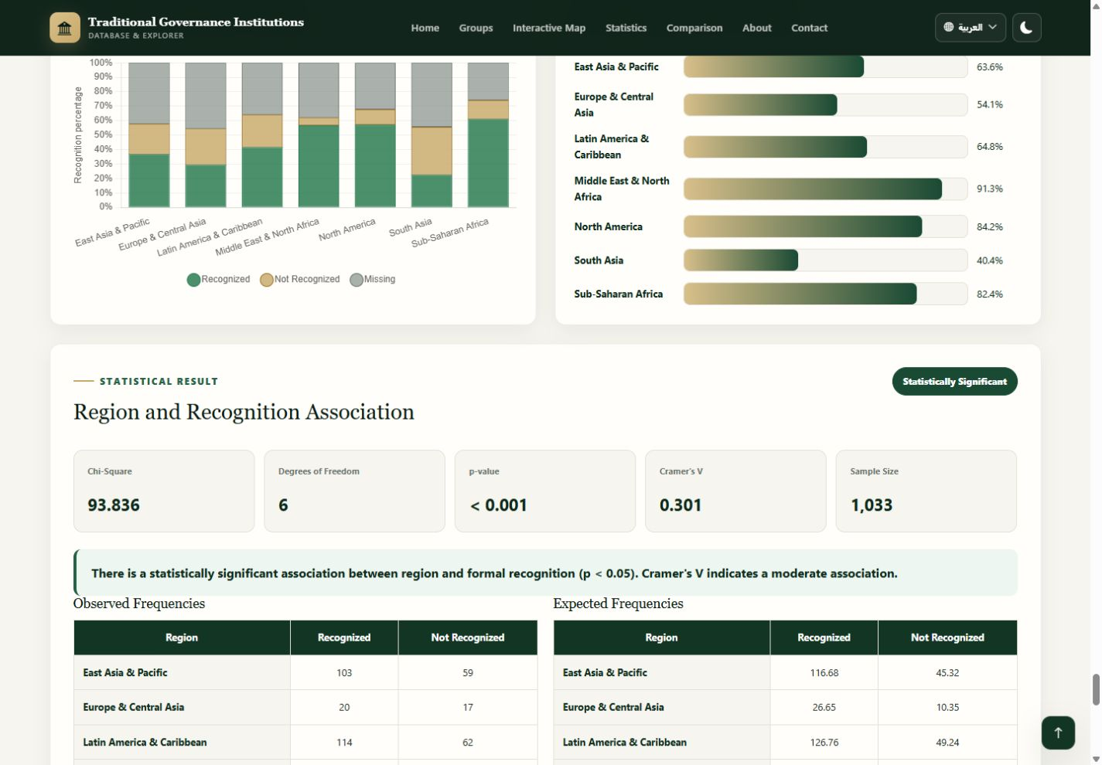
STATISTICAL RESULTS • ANALYSIS 7
Region × formal recognition
Regional variation has the largest geographic recognition effect in the module.
CHI-SQUARE
DF
93.836
6
P-VALUE
CRAMER'S V
< .001
0.301
SAMPLE
STRENGTH
1,033
moderate
Highest: Middle East & North Africa (91.3%)
Lowest: South Asia (40.4%)
Figure 4.23: Regional Recognition Statistical Result
Chapter 4 • Results and Discussion
Notes:
Explain that the seven-region table produced a significant moderate association. The highest complete-case rate is Middle East and North Africa, and the lowest is South Asia. Missing recognition is still displayed descriptively even though the test uses complete binary cases.

Slide 26
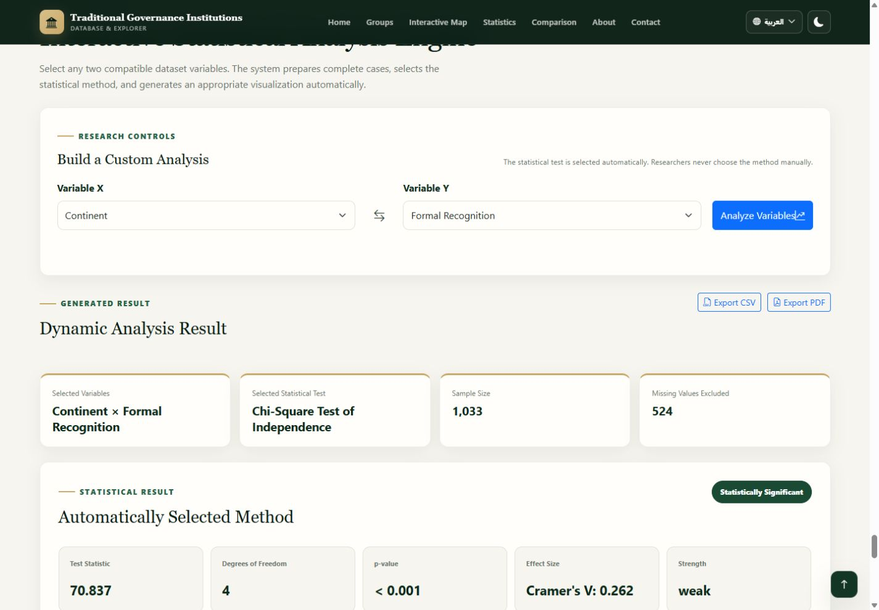
STATISTICAL RESULTS • DYNAMIC ENGINE
Researchers can select compatible variable pairs
The engine automatically prepares complete cases and chooses the statistical method.
Verified sample run
Variable X: Continent
Variable Y: Formal Recognition
Selected test: Chi-Square
N = 1,033; 524 excluded
χ²(4) = 70.837; p < .001
Cramer's V = .262 (weak)
The engine complements predefined analyses; it does not change their methodology.
Figure 4.24: Dynamic Continent × Formal Recognition Analysis
Chapter 4 • Results and Discussion
Notes:
Explain that this is a capability demonstration, not an additional independent finding. For the verified sample, Continent and Formal Recognition reproduce Analysis 6 and therefore return the same Chi-Square values.

Slide 27
KEY FINDINGS
Verified findings at a glance
Significance is reported together with effect size and the relevant complete-case sample.
Analysis | Test | Statistic | p | Effect | N | Conclusion
King × Recognition | Chi-Square | 74.664 | < .001 | V=.269 weak | 1,033 | Significant
Chief × Land | Chi-Square | 64.975 | < .001 | V=.239 weak | 1,139 | Significant
Population × Recognition | Mann–Whitney | 97,855.5 | < .001 | r=.120 small | 907 | Significant
Population × Land | Mann–Whitney | 110,623 | =.006 | r=.088 negligible | 993 | Significant
Continent × Leadership | Chi-Square | 128.891 | < .001 | V=.208 weak | 1,494* | Significant
Continent × Recognition | Chi-Square | 70.837 | < .001 | V=.262 weak | 1,033 | Significant
Region × Recognition | Chi-Square | 93.836 | < .001 | V=.301 moderate | 1,033 | Significant
* Leadership indicators can overlap; N = 1,494 counts complete leadership occurrences, while the dataset contains 1,557 group rows.
Chapter 4 • Results and Discussion
Notes:
Summarize the pattern: many associations are statistically significant, but most effects are weak, very weak, small, or negligible. The strongest effect in the predefined module is the moderate region-recognition association.

Slide 28
KEY FINDINGS • EFFECT SIZE
Effect size prevents overstatement
A low p-value can coexist with a weak practical relationship.
CRAMER'S V
Very weak
Weak
Moderate
Strong
Very strong
0.00–0.09
0.10–0.29
0.30–0.49
0.50–0.69
0.70–1.00
Continent × recognition
0.262
King × recognition
0.269
Continent × leadership
0.208
Region × recognition
0.301
The most defensible conclusion is that several variables are associated, but most measured relationships are modest.
Chapter 4 • Results and Discussion
Notes:
Use the effect-size scale to explain why the chapter does not describe every significant result as strong. Large datasets can produce small p-values for modest differences. Region-recognition is moderate; most remaining relationships are weak or smaller.

Slide 29
DISCUSSION
What the combined results suggest
Patterns vary by leadership form, population distribution, continent, and region.
01
Leadership & recognition
02
Functions
03
Population
All three indicators are significant; effects range from very weak to weak.
Land and security show more consistent relationships than healing, which has extensive missingness.
Recognized and function-present groups often rank higher, but effects are small or negligible.
04
Geography
05
Interpretive boundary
Recognition varies across continents and regions; the regional effect is moderate.
The dataset is observational and cross-sectional. Historical mechanisms require separate research.
Chapter 4 • Results and Discussion
Notes:
Discuss the results cautiously. Leadership institutions and governance responsibilities are related in several tests, but effect sizes are generally weak. Recognition varies geographically, with regional classification showing the strongest association. Population differences exist but are small in practical terms.

Slide 30
LIMITATIONS • MISSING DATA
Missing data shapes the strength of inference
Complete-case samples differ across analyses and must be reported explicitly.
Formal recognition
524 missing
Leadership variables
334 missing
Land / Security
418 missing
Healing
1,251 missing
Population
187 missing
Missing values were not treated as ‘No’. Inferential analyses used valid complete cases for the variables required by each test.
Key limitation: healing analyses use much smaller complete-case samples and should be interpreted cautiously.
Chapter 4 • Results and Discussion
Notes:
This slide explains the main data limitation. Missing values are different from No. The analyses used valid complete cases for the variables required by each test. Healing has the largest amount of missing data, so healing-related findings should be interpreted with the greatest caution.

Slide 31
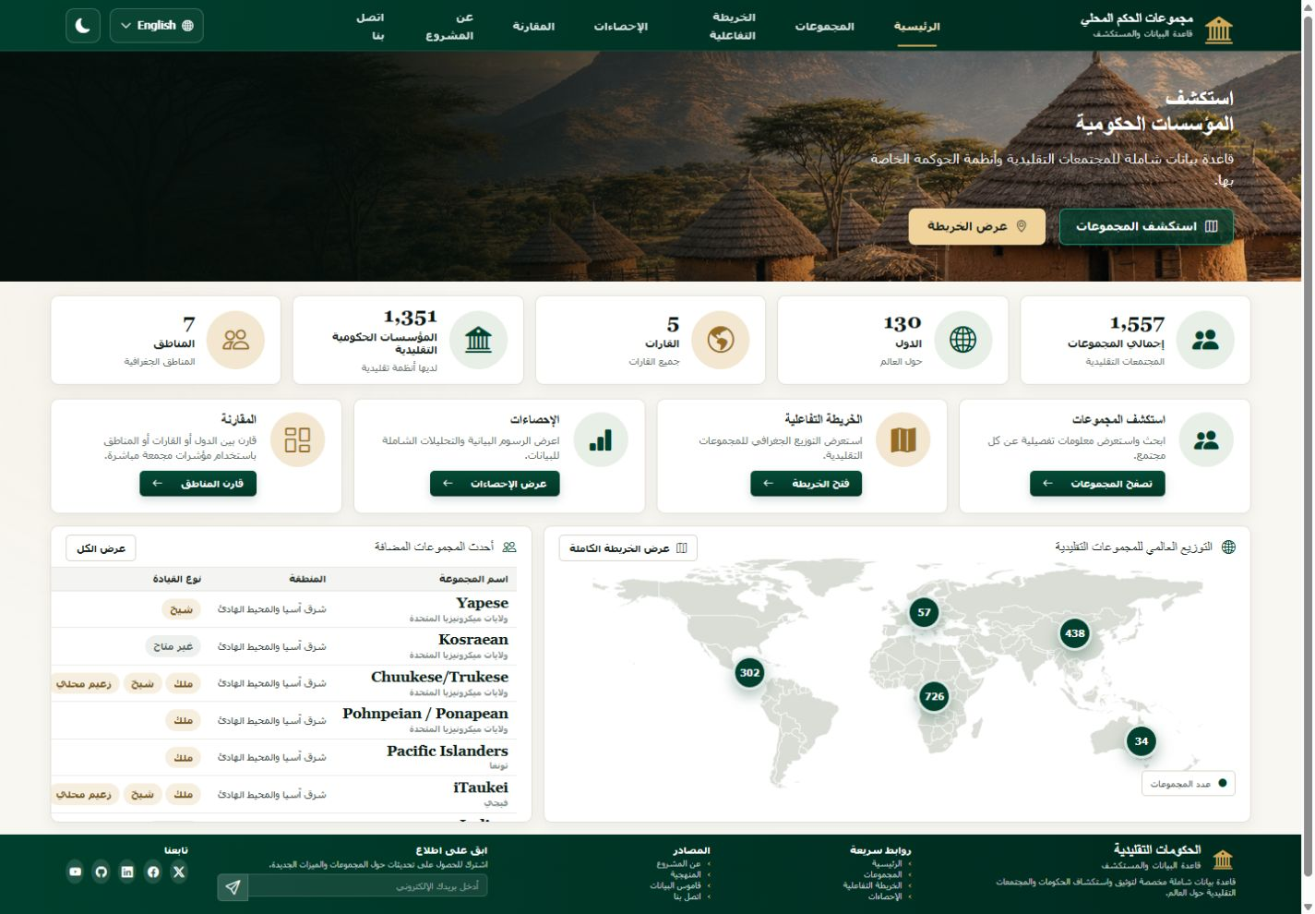
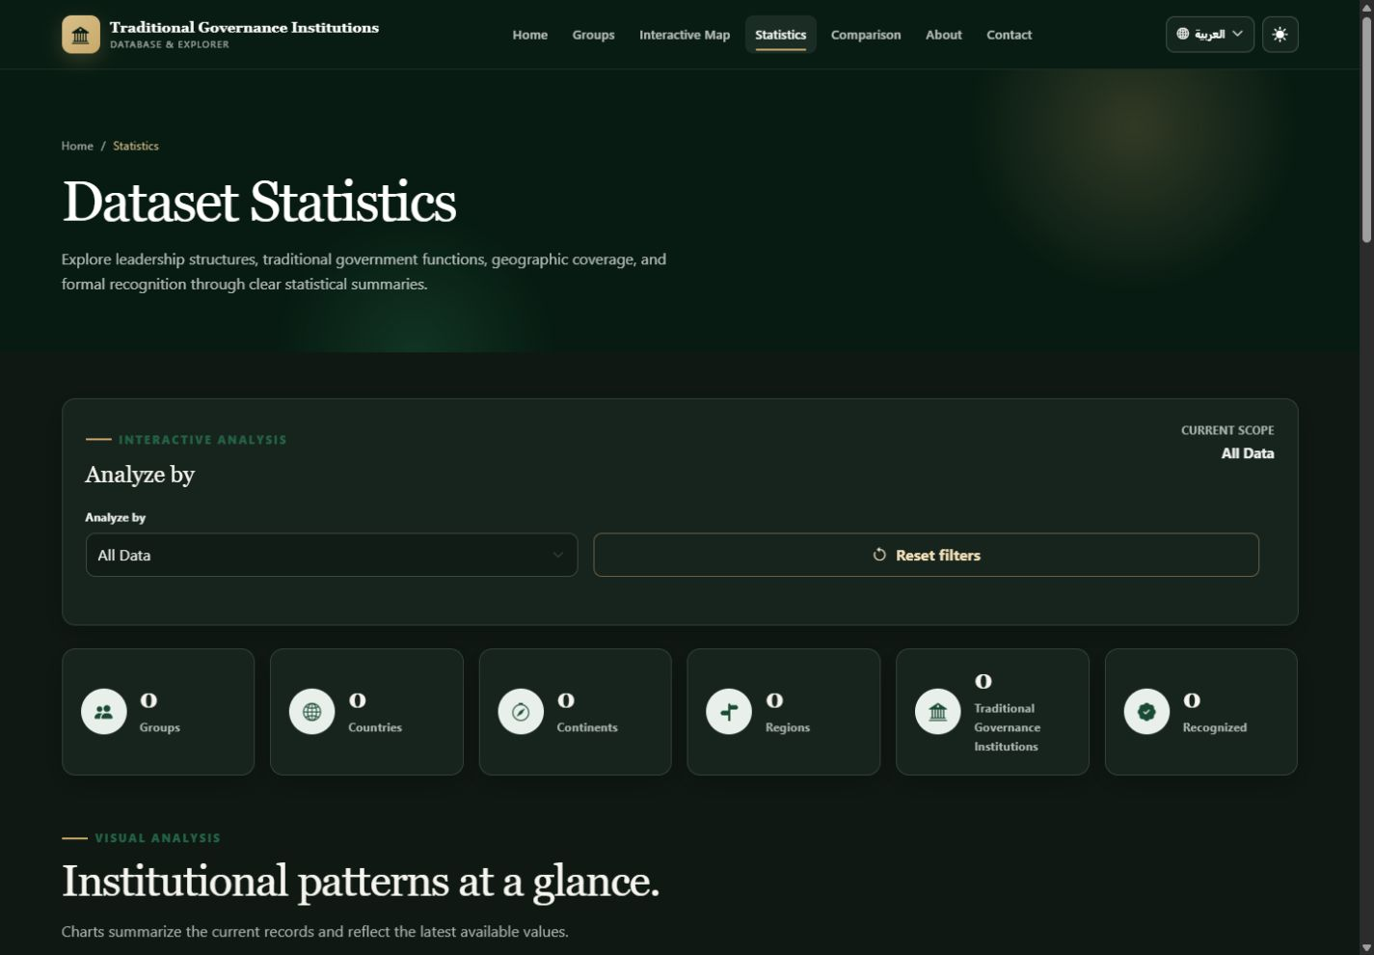
SYSTEM ACCESSIBILITY
The interface supports bilingual and dark-mode use
Presentation preferences persist across the multi-page website.
Figure 4.25: Arabic Right-to-Left Interface
Figure 4.26: Dark-Mode Statistics Interface
Saved preferences remain active across page navigation and refresh.
Chapter 4 • Results and Discussion
Notes:
Explain that Arabic changes document language and direction to RTL, while English source group names remain isolated for readability. Dark mode applies consistently to cards, tables, forms, charts, and navigation.

Slide 32
SYSTEM RESULT SUMMARY
The completed platform meets its research-interface goals
The same database supports discovery, visualization, comparison, and statistical testing.
01
EXPLORE
02
MAP
03
DESCRIBE
Search, filters, sorting, pagination, detail dialog
Five live continent totals and marker navigation
Scoped dashboard with seven dynamic charts
04
COMPARE
05
ANALYZE
06
PRESENT
Country, continent, and region profiles
Predefined tests plus a dynamic method selector
Responsive, bilingual, accessible, dark-mode interface
GROUPS
COUNTRIES
CONTINENTS
RECOGNIZED
API ERRORS
1,557
130
5
744
0
Chapter 4 • Results and Discussion
Notes:
Summarize the system result in six points. Emphasize integration: these are not isolated mock-ups. Each page consumes the Flask API and reflects the same MySQL source.

Slide 33
CHAPTER SUMMARY
Chapter 4 established both technical and analytical outcomes
The platform is functional, evidence-based, and ready to support the final conclusions.
Established in this chapter
NEXT
Chapter 5
The final frontend is connected to live Flask–MySQL services.
Search, filters, map navigation, statistics, and comparisons are operational.
Inferential outputs match the current API and preserve decimal expected frequencies.
Most significant relationships have weak, very weak, small, or negligible effects.
Geographic recognition differences are evident, with the regional result showing a moderate effect.
Findings describe association or difference—not causation.
Conclusions, recommendations, and future development priorities.
Chapter 4 • Results and Discussion
Notes:
Close the chapter. State that the implementation was verified end to end and that the statistical evidence was interpreted with effect sizes, missing-value limitations, and non-causal language. Transition to Chapter 5, which should synthesize conclusions, recommendations, and future work.

