Slide 1
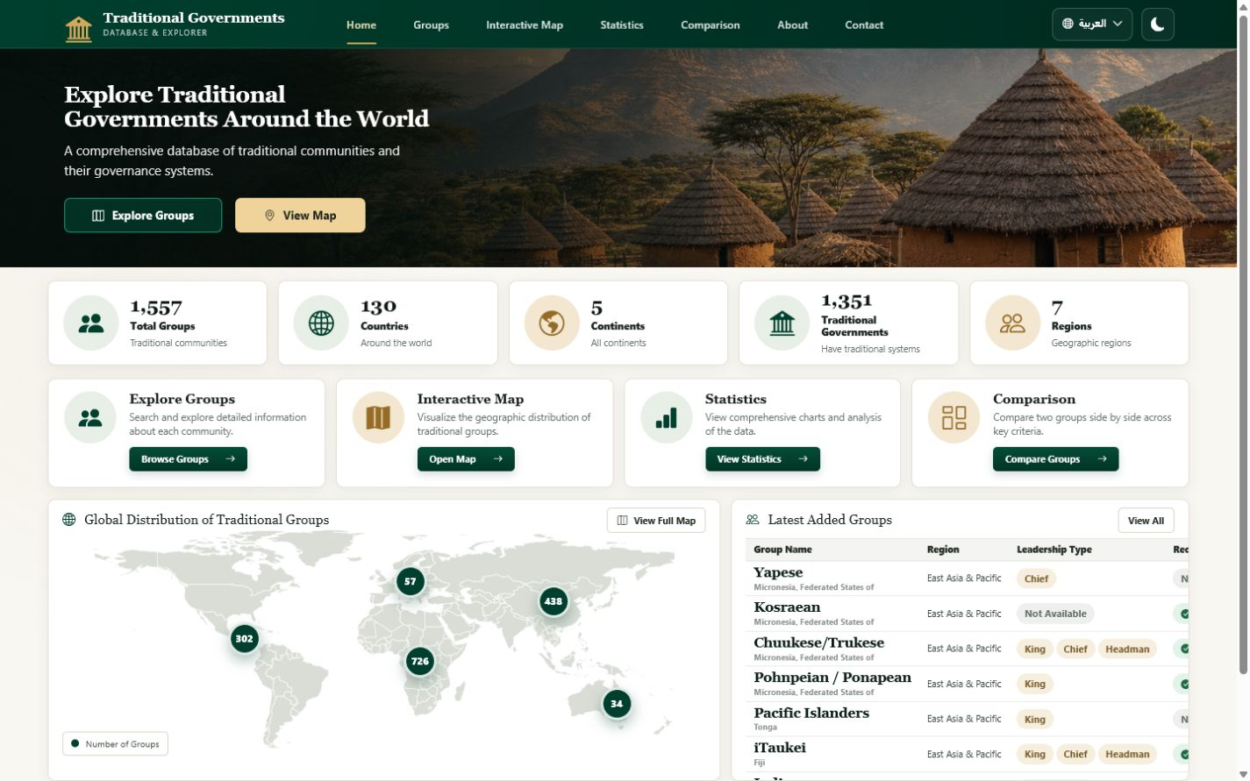
TRADITIONAL GOVERNMENTS DATABASE & EXPLORER
Traditional Governments
Database & Explorer
From blank browser to a complete, data-driven academic website
HTML5
CSS3
JavaScript
Bootstrap 5
01
Notes:
Introduce the project as an academic exploration platform, then frame the presentation as a development story: structure first, visual system second, interaction third, and finally the complete live website.

Slide 2
PROJECT FOUNDATION
Why this website exists
A structured research interface for discovering, analysing, and comparing traditional governance records.
01
02
03
DISCOVER
ANALYSE
COMPARE
Search 1,500+ group records across countries, continents, and regions.
Reveal patterns in leadership, functions, recognition, population, and geography.
Inspect complete records and compare two groups field by field.
Dataset fields span geography, population, leadership, selection methods, functions, councils, assemblies, and formal recognition.
02
Notes:
Explain the three user goals. Emphasize that the interface does not replace the dataset; it makes a complex research dataset understandable and navigable for students, researchers, and evaluators.

Slide 3
DEVELOPMENT ROADMAP
One implementation path, five visible stages
The presentation mirrors the actual construction sequence of the project.
01
02
03
04
05
DATA
STRUCTURE
STYLE
INTERACTION
EXPERIENCE
MySQL records
via Flask API
Semantic HTML
and page sections
CSS tokens, grids,
cards, responsive rules
API loading, filters,
charts, language, theme
Responsive bilingual
research website
Each layer is independent enough to maintain — and connected enough to create one coherent product.
03
Notes:
Use this slide as the roadmap for the rest of the presentation. The deck now follows the same direction as the arrows: HTML, CSS, JavaScript, and then the finished interface.

Slide 4
TECHNOLOGY STACK
A deliberately simple frontend stack
Standards-based technology keeps the project readable, portable, and easy to connect to data services.
HTML5
CSS3
JavaScript
Bootstrap 5
Structure
Presentation
Behaviour
Foundation
Semantic pages, navigation, sections, forms, tables, dialogs
Design tokens, component styling, responsive grids, dark mode, RTL
API loading, filtering, sorting, pagination, charts, preferences
Responsive utilities and consistent cross-device behaviour
Backend connection: Flask + MySQL through a stable JSON API contract
04
Notes:
Clarify that the presentation focuses on website development. Bootstrap supports the layout, while the custom CSS and JavaScript provide the project’s distinctive visual system and data-driven behaviour.

Slide 5
STAGE 1 · HTML
01
Begin with structure
Semantic HTML turns a blank browser into a navigable information architecture.
index.html · foundation
01 <!doctype html>
02 <header>…</header>
03 <main>…</main>
04 <footer>…</footer>
05
Notes:
Transition into the HTML stage. At this point the goal is not visual polish; it is to establish meaning, hierarchy, accessibility, and a stable structure that later layers can enhance.

Slide 6
STAGE 1 · HTML
The first render: a valid document, but almost no interface
The browser understands the page before it looks like the final product.
index.html · lines 1–14
localhost:5500/index.html
01 <!doctype html>
02 <html lang="en" dir="ltr">
Traditional Governments Database & Explorer
03 <head>
04 <meta charset="utf-8">
A blank semantic canvas
05 <meta name="viewport"
06 content="width=device-width">
07 <title>Traditional Governments…</title>
08 </head>
09 <body>
10 <main id="main-content"></main>
11 </body>
12 </html>
06
Notes:
Point out the metadata that makes the page robust: UTF-8, viewport scaling, document language and direction, and a meaningful title. These choices are invisible but essential.

Slide 7
STAGE 1 · HTML
Add the project message and first user actions
The hero establishes purpose and gives users two clear routes into the dataset.
index.html · lines 52–66
localhost:5500/index.html
01 <section class="home-hero">
02 <div class="home-hero-content">
Explore Traditional Governments Around the World
03 <h1>
04 <span>Explore Traditional</span>
05 <span>Governments Around the World</span>
06 </h1>
A comprehensive database of traditional communities and their governance systems.
07 <p>A comprehensive database…</p>
08 <a href="groups.html">Explore Groups</a>
Explore Groups View Map
09 <a href="#distribution-map">View Map</a>
10 </div>
11 </section>
07
Notes:
Explain how the hero is already functional without CSS: the heading communicates scope, the paragraph explains value, and the two anchor links create a usable navigation path.
PowerPoint finalization: apply Morph transition to this slide (0.8 seconds, on click) so repeated objects transform smoothly from the previous slide.

Slide 8
STAGE 1 · HTML
Build a reusable navigation shell
One shared navigation model connects every project page and preserves language and theme controls.
index.html · lines 18–47
localhost:5500/index.html
01 <header class="site-header">
Traditional Governments
02 <a class="brand" href="index.html">…</a>
03 <button id="navToggle">…</button>
Home Groups Interactive Map Statistics Comparison About Contact
04 <nav aria-label="Primary navigation">
05 <a href="index.html">Home</a>
06 <a href="groups.html">Groups</a>
Explore Traditional Governments Around the World
07 <a href="statistics.html">Statistics</a>
08 <a href="comparison.html">Comparison</a>
09 </nav>
10 <button id="languageSwitch">…</button>
11 <button id="themeSwitch">…</button>
12 </header>
08
Notes:
Discuss semantic navigation and accessibility. The toggle button is present for mobile, while language and theme buttons are placed in the same shared header across all pages.
PowerPoint finalization: apply Morph transition to this slide (0.8 seconds, on click) so repeated objects transform smoothly from the previous slide.

Slide 9
STAGE 1 · HTML
Turn the homepage into a dashboard of information blocks
Statistics, tools, map controls, and a latest-groups table are defined before any styling is applied.
index.html · lines 68–142
localhost:5500/index.html
01 <section class="home-stats">…</section>
Dataset summary
02 <section class="home-features">…</section>
03 <section class="home-lower-grid">
04 <article id="distribution-map">
05 <img src="world-map.svg">
06 <button data-continent="Africa">…</button>
Explore Groups Interactive Map Statistics Comparison
07 </article>
08 <article class="home-table-panel">
09 <table>
10 <tbody id="latestGroupsBody"></tbody>
World map image + continent buttons
Latest groups table
11 </table>
12 </article>
13 </section>
09
Notes:
Point out that the HTML already anticipates dynamic content: data-metric attributes receive summary values, map buttons carry continent keys, and table bodies have stable IDs for JavaScript rendering.
PowerPoint finalization: apply Morph transition to this slide (0.8 seconds, on click) so repeated objects transform smoothly from the previous slide.

Slide 10
STAGE 1 · HTML
HTML complete: the application has a full information architecture
Six pages reuse the same header, footer, language hooks, and data-oriented component patterns.
01
Home
02
Groups Explorer
03
Statistics
Summary · tools · map · latest records
Search · filters · table · detail dialog
Metrics · Chart.js visualisations
04
Comparison
05
About
06
Contact
Selectors · profiles · field comparison
Purpose · methodology · data dictionary
Project contact · validation feedback
Structure is finished. The next task is to give it a coherent visual language.
10
Notes:
Summarize the HTML stage. The project is now navigable, accessible, and prepared for dynamic data, but it still lacks hierarchy, brand identity, spacing, and responsive refinement.
PowerPoint finalization: apply Morph transition to this slide (0.8 seconds, on click) so repeated objects transform smoothly from the previous slide.

Slide 11
STAGE 2 · CSS
02
Create the visual system
CSS transforms semantic blocks into a premium academic interface — without changing the information architecture.
11
Notes:
Transition into CSS. The design direction is academic and restrained: deep forest green for authority, warm white for calm reading, and gold for selective emphasis.

Slide 12
STAGE 2 · CSS
Start with tokens, not isolated declarations
Shared variables make color, spacing, radius, shadow, and motion consistent across the entire multi-page site.
css/style.css · lines 6–27
PROJECT PALETTE
01 :root {
02 --forest-950: #071b12;
Forest 950
#071B12
03 --forest-800: #123524;
04 --gold-500: #c8a96a;
05 --warm-white: #f7f5ef;
Forest 800
#123524
06 --paper: #fffefa;
07 --ink: #1d2922;
Gold 500
#C8A96A
08 --muted: #69746d;
09 --shadow-sm: 0 8px 26px rgba(15,42,29,.065);
Warm White
#F8F7F3
10 --radius-md: 14px;
11 --transition: 180ms ease;
Paper
#FFFEFA
12 }
14 px radius · soft shadow · 180 ms transitions
12
Notes:
Explain that tokens reduce visual drift. A later theme change can be made at the root instead of editing every component. These exact colors come from the live project stylesheet.
PowerPoint finalization: apply Morph transition to this slide (0.8 seconds, on click) so repeated objects transform smoothly from the previous slide.

Slide 13
STAGE 2 · CSS
Transform the hero into the project’s visual anchor
Image, overlay, typography, and actions are layered deliberately to preserve readability.
css/home.css · hero rules
01 .home-hero {
02 min-height: 252px;
03 background-image:
04 linear-gradient(90deg, rgba(4,19,12,.96),
05 rgba(5,25,16,.56), rgba(5,25,16,.12)),
06 url('../assets/images/hero-village.png');
07 background-size: cover;
08 background-position: center 57%;
09 }
10 .home-hero h1 {
11 font-family: Georgia, serif;
12 color: #fff;
13 }
dark overlay
serif heading
two CTAs
13
Notes:
Describe the contrast strategy: the left-to-right overlay is strongest behind the copy and fades toward the village. The result communicates place and tradition without sacrificing legibility.
PowerPoint finalization: apply Morph transition to this slide (0.8 seconds, on click) so repeated objects transform smoothly from the previous slide.

Slide 14
STAGE 2 · CSS
Use grid rules that adapt instead of collapsing
The same content hierarchy is preserved from desktop through mobile.
css/home.css · grid + breakpoints
DESKTOP
01 .home-stats {
02 display: grid;
03 grid-template-columns: repeat(5, 1fr);
04 gap: 12px;
05 }
06 .home-lower-grid {
07 display: grid;
08 grid-template-columns: 1.42fr 1fr;
09 }
10 @media (max-width: 768px) {
MOBILE
11 .home-stats { grid-template-columns: 1fr 1fr; }
5 → 2 → 1 columns
12 .home-lower-grid { grid-template-columns: 1fr; }
13 }
14
Notes:
Explain that responsiveness is not only shrinking. The map and table become stacked panels, card grids reduce their column count, and controls remain large enough for touch interaction.
PowerPoint finalization: apply Morph transition to this slide (0.8 seconds, on click) so repeated objects transform smoothly from the previous slide.

Slide 15
STAGE 2 · CSS
Define one component language for cards, tables, and data states
Reusable surfaces make six pages feel like one product.
css/style.css · component layer
01 .surface, .home-panel {
1,557
Interactive Map
02 background: var(--paper);
03 border: 1px solid var(--line);
Total Groups
Visualize geographic distribution.
04 border-radius: var(--radius-md);
Traditional communities
Open Map →
05 box-shadow: var(--shadow-sm);
06 }
07 .data-table tbody tr:hover {
08 background: rgba(200,169,106,.08);
GROUP
COUNTRY
LEADERSHIP
RECOGNIZED
09 }
Ababda
Eritrea
Chief
Yes
10 .status-yes { color: var(--success); }
Abe/Abbe
Côte d’Ivoire
King · Chief
Yes
11 .status-no { color: var(--danger); }
Aikanã
Brazil
Not Available
No
15
Notes:
Show how the same surface treatment appears in stat cards, feature cards, tables, filters, chart panels, and comparison profiles. Consistency helps users transfer understanding between pages.
PowerPoint finalization: apply Morph transition to this slide (0.8 seconds, on click) so repeated objects transform smoothly from the previous slide.

Slide 16
STAGE 2 · CSS
Make interaction states visible and predictable
Buttons, form fields, focus rings, hover states, and status badges communicate what users can do.
css/style.css · states
BUTTONS
01 .home-btn {
02 border-radius: 8px;
Explore Groups
View Map
Reset filters
03 transition: transform var(--transition),
04 box-shadow var(--transition);
FORM CONTROLS
05 }
06 .home-btn:hover {
Search by group name…
All continents ▾
07 transform: translateY(-2px);
08 box-shadow: var(--shadow-md);
09 }
DATA STATES
10 input:focus, select:focus {
11 outline: 3px solid rgba(200,169,106,.25);
● Yes
● No
Not Available
12 border-color: var(--gold-500);
13 }
Visible focus · readable hover · clear feedback
16
Notes:
Emphasize accessibility and feedback. Hover is subtle, focus is explicit, and binary values are expressed as readable words rather than unexplained 1/0 codes.
PowerPoint finalization: apply Morph transition to this slide (0.8 seconds, on click) so repeated objects transform smoothly from the previous slide.

Slide 17
STAGE 2 · CSS
CSS result: the same HTML now reads as a coherent academic product
Brand, hierarchy, spacing, component rhythm, and responsiveness are all visible at once.
forest + gold identity
responsive cards
data-first layout
17
Notes:
Pause on the visual transformation. This screenshot is the real live project, not a mock-up. The interface is now polished, but the values and records still need JavaScript to become dynamic.
PowerPoint finalization: apply Morph transition to this slide (0.8 seconds, on click) so repeated objects transform smoothly from the previous slide.

Slide 18
STAGE 3 · JAVASCRIPT
03
Connect data and behaviour
JavaScript turns styled components into a searchable, filterable, bilingual, data-driven research application.
fetch
normalize
filter
render
persist
18
Notes:
Transition into JavaScript. The design already contains placeholders and stable IDs; JavaScript now supplies real API data, keeps application state, and responds to user input.

Slide 19
STAGE 3 · JAVASCRIPT
Load one API contract, then render every data surface
The frontend normalizes backend fields once and reuses the resulting state across pages.
js/script.js · API loading
01 async function loadApiData() {
02 const [stats, groups, continents] = await Promise.all([
Flask API
→
normalizeGroup
→
shared state
→
DOM renderers
03 apiRequest('/stats'),
04 apiRequest('/groups?page=1&limit=100'),
05 apiRequest('/continents')
06 ]);
ONE RESPONSE, MANY VIEWS
07 state.groups = groups.data.map(normalizeGroup);
08 renderHomeMetrics(stats.data);
Animated summary counters
Continent map totals
09 renderMapCounts(continents.data);
10 renderLatestGroups();
11 }
Latest-groups table
Charts + comparison selectors
19
Notes:
Explain the separation of concerns: fetching is centralized, fields are normalized into predictable names, and each page renderer consumes the same application state. This makes future database changes easier to manage.
PowerPoint finalization: apply Morph transition to this slide (0.8 seconds, on click) so repeated objects transform smoothly from the previous slide.

Slide 20
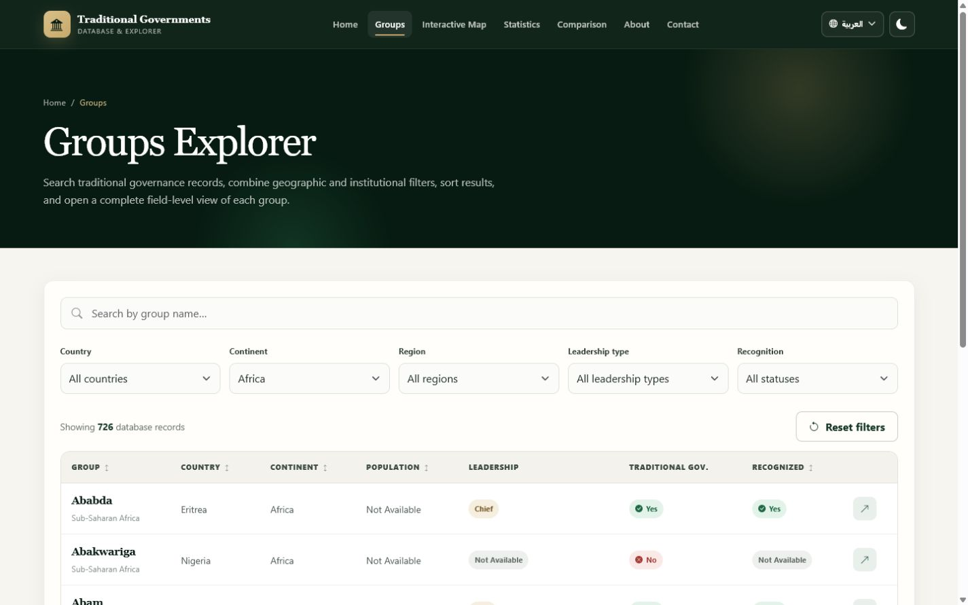
STAGE 3 · JAVASCRIPT
Turn user input into a live exploration workflow
Search, geographic filters, leadership, recognition, sorting, pagination, and URL state work together.
js/script.js · explorer controls
01 populateFilter('countryFilter', uniqueValues('Country'));
02 populateFilter('continentFilter', uniqueValues('Continent'));
03 applyExplorerQueryParameters();
04
05 controls.forEach(control => {
06 control.addEventListener('change', () => {
07 state.page = 1;
08 applyExplorerFilters();
09 updateExplorerQueryString();
10 });
11 });
URL: ?continent=Africa
726 matching records
20
Notes:
Walk through a concrete example: clicking the Africa map marker opens the explorer with continent=Africa in the URL, the select control is populated, and the table immediately shows the 726 matching API records.
PowerPoint finalization: apply Morph transition to this slide (0.8 seconds, on click) so repeated objects transform smoothly from the previous slide.

Slide 21
STAGE 4 · BACKEND
04
Backend — Processing, Data, and APIs
The backend works behind the interface. It receives requests, processes data, communicates with MySQL, and returns results.
FRONTEND
BACKEND
DATABASE
→
→
What the user sees
What Flask processes
Where records are stored
21
Notes:
Introduce the server-side stage. The frontend is the visible interface, Flask performs the processing, and MySQL stores the research records. Click 1: show Frontend. Click 2: show Backend. Click 3: show Database and the complete three-layer relationship.
PowerPoint finalization: apply Morph transition to this slide (0.8 seconds, on click) so repeated objects transform smoothly from the previous slide.

Slide 22
STAGE 4 · BACKEND
One backend supplies every data-driven page
The Flask API gives the interface a controlled, reusable path to the same MySQL research dataset.
01
GROUP RECORDS
02
DISCOVERY
03
SUMMARIES
Paginated lists and individual group details
Search, continent, region, and TPI query filters
Countries, continents, regions, and leadership views
04
ANALYSIS
05
RELIABILITY
06
COMPATIBILITY
Totals, largest groups, and top-country aggregates
Validation, health checks, and JSON error messages
One stable API contract for the existing frontend
Browser interface → Flask logic → MySQL research data
22
Notes:
Explain why the project needs a backend: multiple pages need consistent access to the same dataset. The backend centralizes data access, pagination, summary calculations, validation, and errors instead of allowing the browser to connect directly to MySQL. Click 1: reveal record access. Click 2: reveal discovery and summaries. Click 3: reveal reliability and the final flow.
PowerPoint finalization: apply Morph transition to this slide (0.8 seconds, on click) so repeated objects transform smoothly from the previous slide.

Slide 23
STAGE 4 · BACKEND
The project uses a compact, verified backend stack
Every technology shown here appears in backend-flask/requirements.txt or the application source.
Python
Flask
MySQL
MySQL Connector
PY
FL
DB
MC
Application language
Web framework and routes
Persistent research records
Pooled database access
JSON
Flask-CORS
python-dotenv
{}
↔
ENV
Browser–server data format
Approved local frontend origins
Environment-based settings
23
Notes:
Define each real technology in one sentence. Python holds the application logic, Flask maps URLs to functions, mysql-connector-python manages MySQL connections, JSON carries data, Flask-CORS permits the two local frontend origins, and python-dotenv loads settings. Click 1: reveal Python and Flask. Click 2: reveal MySQL and its connector. Click 3: reveal JSON, CORS, and dotenv.
PowerPoint finalization: apply Morph transition to this slide (0.8 seconds, on click) so repeated objects transform smoothly from the previous slide.

Slide 24
STAGE 4 · BACKEND
The backend folder separates startup, routes, configuration, and data access
A small structure makes each responsibility easy to locate and maintain.
real project tree · generated folders omitted
app.py
Creates Flask, enables CORS, registers routes, handles errors, starts the server.
01 backend-flask/
02 ├── app.py
03 ├── config.py
config.py
Reads environment variables and validates database and server ports.
04 ├── requirements.txt
05 ├── .env.example
06 ├── database/
database/db.py
Creates the connection pool and provides fetch_one / fetch_all helpers.
07 │ ├── __init__.py
08 │ └── db.py
09 ├── routes/
routes/api.py
Defines the ten GET endpoint patterns, SQL, pagination, and validation.
10 │ ├── __init__.py
11 │ └── api.py
12 ├── migrations/
Contain reviewed schema and encoding utilities; they are not request-time routes.
13 └── scripts/
migrations + scripts
24
Notes:
Walk down the exact backend-flask folder. app.py is the entry point, config.py owns environment-backed configuration, db.py owns database access, and routes/api.py owns HTTP endpoints. Mention that migrations and diagnostic scripts are separate maintenance tools, not part of a normal page request. Click 1: show the tree. Click 2: explain startup and configuration. Click 3: explain database and route files.
PowerPoint finalization: apply Morph transition to this slide (0.8 seconds, on click) so repeated objects transform smoothly from the previous slide.

Slide 25
STAGE 4 · BACKEND
The application factory assembles the Flask server
backend-flask/app.py creates one configured app and connects its reusable parts.
backend-flask/app.py · create_app()
01 def create_app() -> Flask:
02 app = Flask(__name__)
03 app.config.from_object(Config)
PYTHON FILE
FLASK APP
API BLUEPRINT
04 app.json.sort_keys = False
→
→
05
app.py
configured server
/api routes
06 CORS(app, resources={
07 r"/api/*": {"origins": ALLOWED_ORIGINS}
08 }, methods=["GET"])
09 init_pool(app.config)
CORS accepts GET requests from localhost:5500 and 127.0.0.1:5500 only.
10 app.register_blueprint(api)
11 return app
12
13 app = create_app()
configuration
connection pool
routes
25
Notes:
Explain the factory line by line. Flask creates the application object, Config supplies settings, CORS permits the two verified local origins, init_pool stores database settings, and register_blueprint activates the /api routes. After create_app returns, the module-level app is ready to run. Click 1: show the Python file. Click 2: build the Flask app. Click 3: attach configuration, pool, and routes.
PowerPoint finalization: apply Morph transition to this slide (0.8 seconds, on click) so repeated objects transform smoothly from the previous slide.

Slide 26
STAGE 4 · BACKEND
The local server starts on the port the frontend already expects
The current Flask development process listens on port 3000 and serves the /api namespace.
backend-flask/app.py · startup
01 if __name__ == "__main__":
LOCAL API ADDRESS
02 app.run(
http://localhost:3000/api
03 host="0.0.0.0",
04 port=app.config["PORT"],
05 debug=False,
06 use_reloader=False,
HOST
PORT
DEBUG
07 threaded=True,
08 )
0.0.0.0
PORT → 3000
False
This is the project’s local development server configuration—not a production deployment claim.
26
Notes:
Explain that Python runs the code inside this guard only when app.py is launched directly. The host accepts local network interfaces, the port comes from Config and defaults to 3000, and debug and the reloader are disabled. The frontend base URL uses the same port. Click 1: show the startup guard. Click 2: reveal host and port. Click 3: reveal the local API address.
PowerPoint finalization: apply Morph transition to this slide (0.8 seconds, on click) so repeated objects transform smoothly from the previous slide.

Slide 27
STAGE 4 · BACKEND
A Blueprint turns URL paths into Python functions
An endpoint is a URL and HTTP method that run a specific backend function.
backend-flask/routes/api.py · /continents
01 api = Blueprint("api", __name__, url_prefix="/api")
02
03 @api.get("/continents")
GET /api/continents
continents()
JSON response
04 def continents():
→
→
05 rows = fetch_all(
URL + method
Python function
success + data
06 "SELECT * FROM vw_continent_summary "
07 "ORDER BY total_groups DESC"
08 )
09 return jsonify(success=True, data=rows)
The project defines ten GET endpoint patterns under /api.
27
Notes:
Define endpoint in beginner-friendly language. The Blueprint adds the /api prefix, @api.get connects the GET path to continents(), the function queries a summary view, and jsonify returns a predictable success/data object. Click 1: reveal the URL. Click 2: reveal the Python function. Click 3: reveal the database call and JSON response.
PowerPoint finalization: apply Morph transition to this slide (0.8 seconds, on click) so repeated objects transform smoothly from the previous slide.

Slide 28
STAGE 4 · BACKEND
The browser request lands on the matching Flask route
The frontend and backend agree on one base URL, endpoint path, and JSON contract.
js/script.js · browser request
backend-flask/routes/api.py · route
01 const API_BASE_URL = "http://localhost:3000/api";
01 @api.get("/groups")
02
02 def groups():
03 async function loadApiData(endpoint) {
03 page = _parse_positive_integer(
04 const response = await fetch(
04 request.args.get("page"), 1, "page"
05 `${API_BASE_URL}/${endpoint}`,
HTTP GET →
05 )
06 { headers: { Accept: "application/json" } }
06 requested_limit = _parse_positive_integer(
07 );
07 request.args.get("limit"), 20, "limit"
08 const result = await response.json();
08 )
09 return result.data;
09 # build query, fetch rows, return JSON
10 }
/api/groups?page=1&limit=100
28
Notes:
Connect the two real files. JavaScript combines API_BASE_URL with the endpoint, sends an HTTP GET request, and reads response.json(). Flask matches /api/groups and begins the groups() function. Click 1: show the JavaScript request. Click 2: wipe the HTTP GET arrow. Click 3: show the Flask endpoint. Click 4: highlight response.json() as the return path.
PowerPoint finalization: apply Morph transition to this slide (0.8 seconds, on click) so repeated objects transform smoothly from the previous slide.

Slide 29
STAGE 4 · BACKEND
Query parameters become validated Python values
Text after the question mark lets one endpoint serve pagination and optional filters.
backend-flask/routes/api.py · request.args
01 page = _parse_positive_integer(
/api/groups?continent=Africa&page=1&limit=20
02 request.args.get("page"), 1, "page"
03 )
→
04 requested_limit = _parse_positive_integer(
continent
Africa
optional equality filter
05 request.args.get("limit"), 20, "limit"
06 )
→
07 search = request.args.get("search")
page
1
default: 1
08 continent = request.args.get("continent")
09 region = request.args.get("region")
10 any_tpi = request.args.get("any_tpi")
limit
→
20
default: 20 · maximum: 100
request.args.get(...) reads values; _parse_positive_integer(...) rejects invalid page and limit inputs.
29
Notes:
Explain the URL from left to right. request.args is Flask’s access to query-string values. page and limit receive defaults and positive-integer validation; search, continent, region, and any_tpi are optional. Click 1: reveal the example URL. Click 2: map continent. Click 3: map page and limit. Click 4: reveal validation behavior.
PowerPoint finalization: apply Morph transition to this slide (0.8 seconds, on click) so repeated objects transform smoothly from the previous slide.

Slide 30
STAGE 4 · BACKEND
A shared connection pool links Flask to MySQL safely
Configuration comes from environment variables; credentials are never placed on the slide.
backend-flask/database/db.py · pool configuration
01 _pool_config = {
02 "pool_name": config["DB_POOL_NAME"],
03 "pool_size": config["DB_POOL_SIZE"],
FLASK
CONNECTOR
MYSQL
04 "host": config["DB_HOST"],
→
→
05 "port": config["DB_PORT"],
route function
pool size 10
tradgov_db
06 "user": config["DB_USER"],
07 "password": config["DB_PASSWORD"],
08 "database": config["DB_NAME"],
09 "autocommit": True,
10 }
Environment keys used
11 return _get_pool().get_connection()
DB_HOST · DB_PORT · DB_USER · DB_PASSWORD · DB_NAME · PORT
DB_PASSWORD = [REDACTED]
30
Notes:
Explain that a connection pool reuses a limited set of database connections instead of creating one from nothing for every query. Config values come from .env through config.py; no real password is displayed. A route asks the pool for a connection, creates a dictionary cursor, and returns the connection after use. Click 1: show Flask. Click 2: show the connector pool. Click 3: show MySQL and the redacted environment settings.
PowerPoint finalization: apply Morph transition to this slide (0.8 seconds, on click) so repeated objects transform smoothly from the previous slide.

Slide 31
STAGE 4 · BACKEND
Optional filters build one real parameterized SQL query
Fixed SQL fragments describe allowed filters; user values stay in a separate parameter list.
backend-flask/routes/api.py · filtered groups query
01 where_conditions = []
SQL STRUCTURE
02 query_parameters = []
SELECT → FROM → WHERE → ORDER BY → LIMIT
03
04 if continent is not None and continent.strip() != "":
05 where_conditions.append("continent = %s")
SAFE PROJECT PATTERN
06 query_parameters.append(continent.strip())
07
backend-flask/database/db.py
08 where_clause = f" WHERE {' AND '.join(where_conditions)}"
01 cursor.execute(query, tuple(parameters))
09 rows = fetch_all(
10 f"SELECT * FROM tradgov_groups{where_clause} "
11 f"ORDER BY id ASC LIMIT %s OFFSET %s"
Values such as Africa are passed separately from SQL text. This reduces SQL-injection risk; it is not a claim of complete application security.
12 [*query_parameters, requested_limit, offset]
13 )
31
Notes:
Explain SELECT, FROM, optional WHERE conditions, stable ORDER BY, and LIMIT/OFFSET. The code appends only known SQL fragments and stores user values separately. db.py then passes the query and parameter tuple to cursor.execute. Click 1: reveal the filter condition. Click 2: reveal the SELECT query. Click 3: reveal cursor.execute. Click 4: explain why separate parameters are safer than string concatenation.
PowerPoint finalization: apply Morph transition to this slide (0.8 seconds, on click) so repeated objects transform smoothly from the previous slide.

Slide 32
STAGE 4 · BACKEND
Database rows become a predictable JSON response
Dictionary cursors, value conversion, and jsonify bridge MySQL records to JavaScript objects.
db.py + routes/api.py · rows → JSON
HTTP 200 · application/json
01 cursor = connection.cursor(dictionary=True)
02 try:
{
03 cursor.execute(query, tuple(parameters))
"success": true,
04 return [_json_row(row) for row in cursor.fetchall()]
"data": {
05 finally:
"groups": [ { ... } ],
06 cursor.close()
"pagination": {
07 connection.close()
"page": 1,
08
"limit": 100,
09 return jsonify(success=True, data={
"total_items": 1557,
10 "groups": rows,
"total_pages": 16
11 "pagination": {"page": page, "limit": requested_limit,
}
12 "total_items": total_items,
}
13 "total_pages": total_pages}
}
14 })
Decimal values are preserved as strings; byte values are decoded as UTF-8 before JSON serialization.
32
Notes:
Explain that dictionary=True produces named fields instead of unnamed tuples. fetchall retrieves rows, _json_row converts Decimal and byte values, and finally always closes the cursor and returns the pooled connection. The route wraps rows and the exact pagination keys in jsonify. Click 1: show the database rows. Click 2: show cleanup. Click 3: reveal success and groups. Click 4: reveal the pagination object. Click 5: return the JSON to JavaScript.
PowerPoint finalization: apply Morph transition to this slide (0.8 seconds, on click) so repeated objects transform smoothly from the previous slide.

Slide 33
STAGE 4 · BACKEND
The live explorer filters locally after paginated API loading
The current UI and the backend’s optional server-side filters are both real—but they are different paths.
CURRENT LIVE UI PATH
load all /groups pages → normalize → filter state.groups → render table
BACKEND FILTER CAPABILITY
/api/groups?continent=Africa&region=…&search=…&any_tpi=1
Available for direct API use or a future server-filtered UI. The current interface keeps its existing client-side explorer behavior.
Africa URL state
726 displayed records
33
Notes:
Be precise about the implementation. The current frontend calls /groups in pages of 100, combines and normalizes the records, then applyExplorerFilters filters state.groups in the browser. Separately, the Flask route already accepts search, continent, region, and any_tpi for direct or future server-side filtering. Click 1: show the current UI path. Click 2: show the Africa result. Click 3: reveal the backend filter capability. Do not claim the current control change sends a new filtered API request.
PowerPoint finalization: apply Morph transition to this slide (0.8 seconds, on click) so repeated objects transform smoothly from the previous slide.

Slide 34
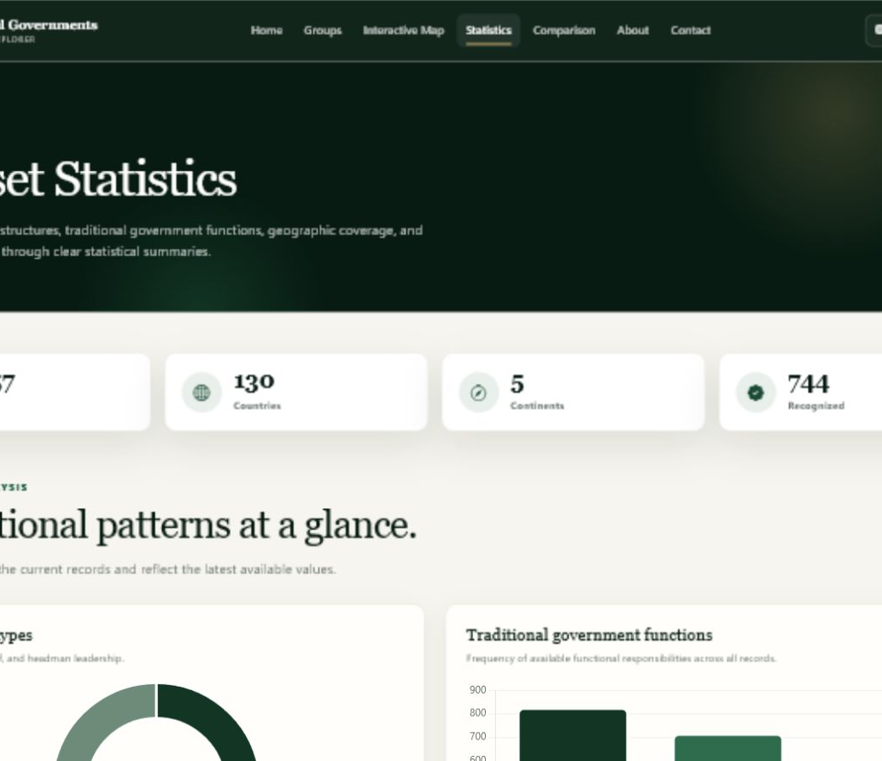
STAGE 4 · BACKEND
Aggregate SQL powers the statistics dashboard
COUNT, SUM, GROUP BY, ORDER BY, and LIMIT transform rows into research summaries.
backend-flask/routes/api.py · stats + top countries
01 @api.get("/stats")
02 def stats():
03 row = fetch_one("""
04 SELECT COUNT(DISTINCT country) AS total_countries,
05 COUNT(*) AS total_groups,
06 COALESCE(SUM(any_tpi = 1), 0) AS groups_with_tpi
07 FROM tradgov_groups
08 """)
09 return jsonify(success=True, data=row)
10
11 SELECT country, COUNT(*) AS total_groups
12 FROM tradgov_groups GROUP BY country
13 ORDER BY total_groups DESC LIMIT 10
COUNT
SUM
GROUP BY
LIMIT 10
34
Notes:
Explain the aggregates in simple terms. COUNT totals rows or distinct values, SUM counts records where any_tpi equals 1, COALESCE replaces a null total with zero, GROUP BY produces one row per country, and ORDER BY plus LIMIT selects the top ten. JavaScript requests /stats and /top-countries and renders the returned values into metrics and charts. Click 1: show /stats. Click 2: explain COUNT and SUM. Click 3: show top-country GROUP BY. Click 4: reveal the live chart result.
PowerPoint finalization: apply Morph transition to this slide (0.8 seconds, on click) so repeated objects transform smoothly from the previous slide.

Slide 35
STAGE 4 · BACKEND
Validation and error handlers keep failures understandable
The API returns a consistent success flag, message, and HTTP status instead of raw internal errors.
routes/api.py · validation + not found
200
Success
01 if re.fullmatch(r"\d+", text) is None:
02 raise BadRequest(
03 description=f"{field_name} must be a positive integer."
400
Invalid request
04 )
05
06 if requested_limit > 100:
404
Record / endpoint not found
07 raise BadRequest(description=
08 "limit cannot be greater than 100.")
09
500
Unexpected server error
10 if row is None:
11 return jsonify(success=False,
503
Database health check failed
12 message="Group not found."), 404
Unexpected exceptions are logged on the server; the browser receives a generic 500 message instead of internal details.
35
Notes:
Show how the project rejects non-digit, zero, negative, or excessively large positive-integer fields and caps limit at 100. A missing group returns a real 404 JSON response. app.py catches HTTP errors and unexpected exceptions; the latter are logged but hidden behind a generic message. Click 1: reveal integer validation. Click 2: reveal the limit rule. Click 3: reveal 404. Click 4: step through 200, 400, 404, 500, and 503.
PowerPoint finalization: apply Morph transition to this slide (0.8 seconds, on click) so repeated objects transform smoothly from the previous slide.

Slide 36
STAGE 4 · BACKEND
One page load completes the full request–response cycle
Actual example: opening the Groups Explorer
1
USER
2
JAVASCRIPT
3
FLASK ROUTE
4
PYTHON
opens groups.html
→
GET /groups?page=1&limit=100
→
groups() validates page + limit
→
builds count and SELECT queries
↙ RESPONSE RETURNS TO THE BROWSER
5
MYSQL
6
JSON
7
JAVASCRIPT
8
INTERFACE
returns dictionary rows
→
groups + pagination
→
normalizes all pages
→
renders filters and table
Frontend · presents information
Backend · processes and supplies information
Database · stores information
36
Notes:
Trace one real page load from beginning to end. The browser never connects directly to MySQL. JavaScript requests page 1 with limit 100, Flask validates and queries, MySQL returns rows, Flask returns exact groups and pagination JSON, JavaScript loads remaining pages, normalizes the records, and renders the explorer. Click 1: user action. Click 2: JavaScript request. Click 3: Flask route. Click 4: Python query preparation. Click 5: MySQL result. Click 6: JSON response. Click 7: JavaScript normalization. Click 8: updated interface. End with the three responsibility statements.
PowerPoint finalization: apply Morph transition to this slide (0.8 seconds, on click) so repeated objects transform smoothly from the previous slide.

Slide 37
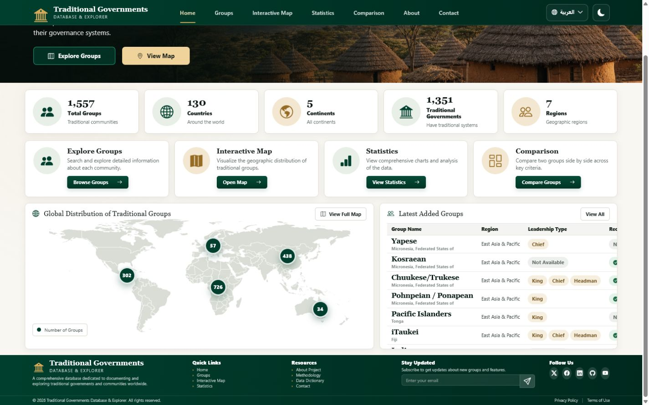
INTEGRATION
Four layers converge into one full-stack research website
Each layer has one responsibility and communicates through stable, inspectable boundaries.
HTML
CSS
JS
FLASK
+ MYSQL
+
+
+
→
semantic
structure
visual
design
browser
interaction
server processing
+ data storage
Responsive
six-page interface
Live
Flask + MySQL
Analytical
maps + charts
Inclusive
English + Arabic
37
Notes:
This is the full-stack synthesis. HTML provides meaning, CSS provides visual design, JavaScript manages browser interaction, and Flask plus MySQL process and store the live data. Click 1: reveal HTML. Click 2: add CSS. Click 3: add JavaScript. Click 4: add Flask and MySQL. Click 5: reveal the complete full-stack research website.
PowerPoint finalization: apply Morph transition to this slide (0.8 seconds, on click) so repeated objects transform smoothly from the previous slide.

Slide 38
FINAL RESULT
Traditional Governments
Database & Explorer
A complete full-stack research website with a responsive interface, Flask API, MySQL data, and bilingual exploration tools.
Flask
backend
MySQL
database
JSON
API
EN / AR
languages
Responsive frontend · search + filtering · maps + charts
Next: live full-stack website demonstration
38
Notes:
Close the development presentation and hand over to the live full-stack demonstration. Confirm the responsive frontend, Flask backend, MySQL database, JSON API, search and filtering, visualisations, and bilingual interface. Then open the website and show one complete request from the interface to the database and back.
PowerPoint finalization: apply Morph transition to this slide (0.8 seconds, on click) so repeated objects transform smoothly from the previous slide.

