Slide 1
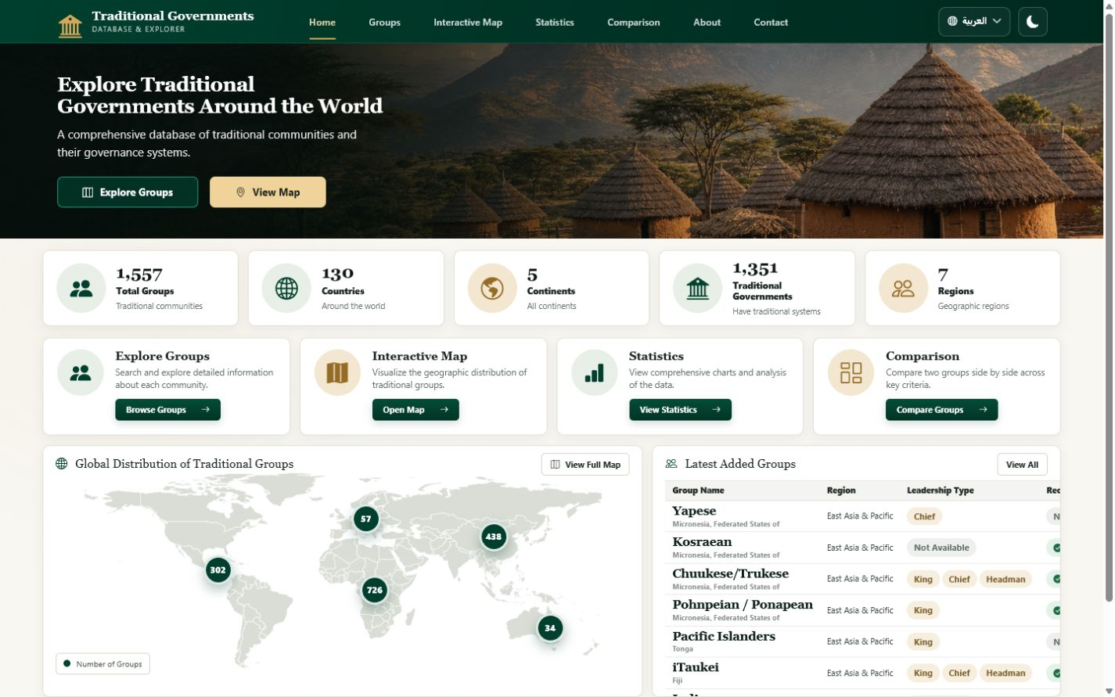
TRADITIONAL GOVERNMENTS DATABASE & EXPLORER
Traditional Governments
Database & Explorer
From blank browser to a complete, data-driven academic website
HTML5
CSS3
JavaScript
Bootstrap 5
01
Notes:
Introduce the project as an academic exploration platform, then frame the presentation as a development story: structure first, visual system second, interaction third, and finally the complete live website.

Slide 2
PROJECT FOUNDATION
Why this website exists
A structured research interface for discovering, analysing, and comparing traditional governance records.
01
02
03
DISCOVER
ANALYSE
COMPARE
Search 1,500+ group records across countries, continents, and regions.
Reveal patterns in leadership, functions, recognition, population, and geography.
Inspect complete records and compare two groups field by field.
Dataset fields span geography, population, leadership, selection methods, functions, councils, assemblies, and formal recognition.
02
Notes:
Explain the three user goals. Emphasize that the interface does not replace the dataset; it makes a complex research dataset understandable and navigable for students, researchers, and evaluators.

Slide 3
DEVELOPMENT ROADMAP
One implementation path, five visible stages
The presentation mirrors the actual construction sequence of the project.
01
02
03
04
05
DATA
STRUCTURE
STYLE
INTERACTION
EXPERIENCE
MySQL records
via Flask API
Semantic HTML
and page sections
CSS tokens, grids,
cards, responsive rules
API loading, filters,
charts, language, theme
Responsive bilingual
research website
Each layer is independent enough to maintain — and connected enough to create one coherent product.
03
Notes:
Use this slide as the roadmap for the rest of the presentation. The deck now follows the same direction as the arrows: HTML, CSS, JavaScript, and then the finished interface.

Slide 4
TECHNOLOGY STACK
A deliberately simple frontend stack
Standards-based technology keeps the project readable, portable, and easy to connect to data services.
HTML5
CSS3
JavaScript
Bootstrap 5
Structure
Presentation
Behaviour
Foundation
Semantic pages, navigation, sections, forms, tables, dialogs
Design tokens, component styling, responsive grids, dark mode, RTL
API loading, filtering, sorting, pagination, charts, preferences
Responsive utilities and consistent cross-device behaviour
Backend connection: Flask + MySQL through a stable JSON API contract
04
Notes:
Clarify that the presentation focuses on website development. Bootstrap supports the layout, while the custom CSS and JavaScript provide the project’s distinctive visual system and data-driven behaviour.

Slide 5
STAGE 1 · HTML
01
Begin with structure
Semantic HTML turns a blank browser into a navigable information architecture.
index.html · foundation
01 <!doctype html>
02 <header>…</header>
03 <main>…</main>
04 <footer>…</footer>
05
Notes:
Transition into the HTML stage. At this point the goal is not visual polish; it is to establish meaning, hierarchy, accessibility, and a stable structure that later layers can enhance.

Slide 6
STAGE 1 · HTML
The first render: a valid document, but almost no interface
The browser understands the page before it looks like the final product.
index.html · lines 1–14
localhost:5500/index.html
01 <!doctype html>
02 <html lang="en" dir="ltr">
Traditional Governments Database & Explorer
03 <head>
04 <meta charset="utf-8">
A blank semantic canvas
05 <meta name="viewport"
06 content="width=device-width">
07 <title>Traditional Governments…</title>
08 </head>
09 <body>
10 <main id="main-content"></main>
11 </body>
12 </html>
06
Notes:
Point out the metadata that makes the page robust: UTF-8, viewport scaling, document language and direction, and a meaningful title. These choices are invisible but essential.

Slide 7
STAGE 1 · HTML
Add the project message and first user actions
The hero establishes purpose and gives users two clear routes into the dataset.
index.html · lines 52–66
localhost:5500/index.html
01 <section class="home-hero">
02 <div class="home-hero-content">
Explore Traditional Governments Around the World
03 <h1>
04 <span>Explore Traditional</span>
05 <span>Governments Around the World</span>
06 </h1>
A comprehensive database of traditional communities and their governance systems.
07 <p>A comprehensive database…</p>
08 <a href="groups.html">Explore Groups</a>
Explore Groups View Map
09 <a href="#distribution-map">View Map</a>
10 </div>
11 </section>
07
Notes:
Explain how the hero is already functional without CSS: the heading communicates scope, the paragraph explains value, and the two anchor links create a usable navigation path.
PowerPoint finalization: apply Morph transition to this slide (0.8 seconds, on click) so repeated objects transform smoothly from the previous slide.

Slide 8
STAGE 1 · HTML
Build a reusable navigation shell
One shared navigation model connects every project page and preserves language and theme controls.
index.html · lines 18–47
localhost:5500/index.html
01 <header class="site-header">
Traditional Governments
02 <a class="brand" href="index.html">…</a>
03 <button id="navToggle">…</button>
Home Groups Interactive Map Statistics Comparison About Contact
04 <nav aria-label="Primary navigation">
05 <a href="index.html">Home</a>
06 <a href="groups.html">Groups</a>
Explore Traditional Governments Around the World
07 <a href="statistics.html">Statistics</a>
08 <a href="comparison.html">Comparison</a>
09 </nav>
10 <button id="languageSwitch">…</button>
11 <button id="themeSwitch">…</button>
12 </header>
08
Notes:
Discuss semantic navigation and accessibility. The toggle button is present for mobile, while language and theme buttons are placed in the same shared header across all pages.
PowerPoint finalization: apply Morph transition to this slide (0.8 seconds, on click) so repeated objects transform smoothly from the previous slide.

Slide 9
STAGE 1 · HTML
Turn the homepage into a dashboard of information blocks
Statistics, tools, map controls, and a latest-groups table are defined before any styling is applied.
index.html · lines 68–142
localhost:5500/index.html
01 <section class="home-stats">…</section>
Dataset summary
02 <section class="home-features">…</section>
03 <section class="home-lower-grid">
04 <article id="distribution-map">
05 <img src="world-map.svg">
06 <button data-continent="Africa">…</button>
Explore Groups Interactive Map Statistics Comparison
07 </article>
08 <article class="home-table-panel">
09 <table>
10 <tbody id="latestGroupsBody"></tbody>
World map image + continent buttons
Latest groups table
11 </table>
12 </article>
13 </section>
09
Notes:
Point out that the HTML already anticipates dynamic content: data-metric attributes receive summary values, map buttons carry continent keys, and table bodies have stable IDs for JavaScript rendering.
PowerPoint finalization: apply Morph transition to this slide (0.8 seconds, on click) so repeated objects transform smoothly from the previous slide.

Slide 10
STAGE 1 · HTML
HTML complete: the application has a full information architecture
Six pages reuse the same header, footer, language hooks, and data-oriented component patterns.
01
Home
02
Groups Explorer
03
Statistics
Summary · tools · map · latest records
Search · filters · table · detail dialog
Metrics · Chart.js visualisations
04
Comparison
05
About
06
Contact
Selectors · profiles · field comparison
Purpose · methodology · data dictionary
Project contact · validation feedback
Structure is finished. The next task is to give it a coherent visual language.
10
Notes:
Summarize the HTML stage. The project is now navigable, accessible, and prepared for dynamic data, but it still lacks hierarchy, brand identity, spacing, and responsive refinement.
PowerPoint finalization: apply Morph transition to this slide (0.8 seconds, on click) so repeated objects transform smoothly from the previous slide.

Slide 11
STAGE 2 · CSS
02
Create the visual system
CSS transforms semantic blocks into a premium academic interface — without changing the information architecture.
11
Notes:
Transition into CSS. The design direction is academic and restrained: deep forest green for authority, warm white for calm reading, and gold for selective emphasis.

Slide 12
STAGE 2 · CSS
Start with tokens, not isolated declarations
Shared variables make color, spacing, radius, shadow, and motion consistent across the entire multi-page site.
css/style.css · lines 6–27
PROJECT PALETTE
01 :root {
02 --forest-950: #071b12;
Forest 950
#071B12
03 --forest-800: #123524;
04 --gold-500: #c8a96a;
05 --warm-white: #f7f5ef;
Forest 800
#123524
06 --paper: #fffefa;
07 --ink: #1d2922;
Gold 500
#C8A96A
08 --muted: #69746d;
09 --shadow-sm: 0 8px 26px rgba(15,42,29,.065);
Warm White
#F8F7F3
10 --radius-md: 14px;
11 --transition: 180ms ease;
Paper
#FFFEFA
12 }
14 px radius · soft shadow · 180 ms transitions
12
Notes:
Explain that tokens reduce visual drift. A later theme change can be made at the root instead of editing every component. These exact colors come from the live project stylesheet.
PowerPoint finalization: apply Morph transition to this slide (0.8 seconds, on click) so repeated objects transform smoothly from the previous slide.

Slide 13
STAGE 2 · CSS
Transform the hero into the project’s visual anchor
Image, overlay, typography, and actions are layered deliberately to preserve readability.
css/home.css · hero rules
01 .home-hero {
02 min-height: 252px;
03 background-image:
04 linear-gradient(90deg, rgba(4,19,12,.96),
05 rgba(5,25,16,.56), rgba(5,25,16,.12)),
06 url('../assets/images/hero-village.png');
07 background-size: cover;
08 background-position: center 57%;
09 }
10 .home-hero h1 {
11 font-family: Georgia, serif;
12 color: #fff;
13 }
dark overlay
serif heading
two CTAs
13
Notes:
Describe the contrast strategy: the left-to-right overlay is strongest behind the copy and fades toward the village. The result communicates place and tradition without sacrificing legibility.
PowerPoint finalization: apply Morph transition to this slide (0.8 seconds, on click) so repeated objects transform smoothly from the previous slide.

Slide 14
STAGE 2 · CSS
Use grid rules that adapt instead of collapsing
The same content hierarchy is preserved from desktop through mobile.
css/home.css · grid + breakpoints
DESKTOP
01 .home-stats {
02 display: grid;
03 grid-template-columns: repeat(5, 1fr);
04 gap: 12px;
05 }
06 .home-lower-grid {
07 display: grid;
08 grid-template-columns: 1.42fr 1fr;
09 }
10 @media (max-width: 768px) {
MOBILE
11 .home-stats { grid-template-columns: 1fr 1fr; }
5 → 2 → 1 columns
12 .home-lower-grid { grid-template-columns: 1fr; }
13 }
14
Notes:
Explain that responsiveness is not only shrinking. The map and table become stacked panels, card grids reduce their column count, and controls remain large enough for touch interaction.
PowerPoint finalization: apply Morph transition to this slide (0.8 seconds, on click) so repeated objects transform smoothly from the previous slide.

Slide 15
STAGE 2 · CSS
Define one component language for cards, tables, and data states
Reusable surfaces make six pages feel like one product.
css/style.css · component layer
01 .surface, .home-panel {
1,557
Interactive Map
02 background: var(--paper);
03 border: 1px solid var(--line);
Total Groups
Visualize geographic distribution.
04 border-radius: var(--radius-md);
Traditional communities
Open Map →
05 box-shadow: var(--shadow-sm);
06 }
07 .data-table tbody tr:hover {
08 background: rgba(200,169,106,.08);
GROUP
COUNTRY
LEADERSHIP
RECOGNIZED
09 }
Ababda
Eritrea
Chief
Yes
10 .status-yes { color: var(--success); }
Abe/Abbe
Côte d’Ivoire
King · Chief
Yes
11 .status-no { color: var(--danger); }
Aikanã
Brazil
Not Available
No
15
Notes:
Show how the same surface treatment appears in stat cards, feature cards, tables, filters, chart panels, and comparison profiles. Consistency helps users transfer understanding between pages.
PowerPoint finalization: apply Morph transition to this slide (0.8 seconds, on click) so repeated objects transform smoothly from the previous slide.

Slide 16
STAGE 2 · CSS
Make interaction states visible and predictable
Buttons, form fields, focus rings, hover states, and status badges communicate what users can do.
css/style.css · states
BUTTONS
01 .home-btn {
02 border-radius: 8px;
Explore Groups
View Map
Reset filters
03 transition: transform var(--transition),
04 box-shadow var(--transition);
FORM CONTROLS
05 }
06 .home-btn:hover {
Search by group name…
All continents ▾
07 transform: translateY(-2px);
08 box-shadow: var(--shadow-md);
09 }
DATA STATES
10 input:focus, select:focus {
11 outline: 3px solid rgba(200,169,106,.25);
● Yes
● No
Not Available
12 border-color: var(--gold-500);
13 }
Visible focus · readable hover · clear feedback
16
Notes:
Emphasize accessibility and feedback. Hover is subtle, focus is explicit, and binary values are expressed as readable words rather than unexplained 1/0 codes.
PowerPoint finalization: apply Morph transition to this slide (0.8 seconds, on click) so repeated objects transform smoothly from the previous slide.

Slide 17
STAGE 2 · CSS
CSS result: the same HTML now reads as a coherent academic product
Brand, hierarchy, spacing, component rhythm, and responsiveness are all visible at once.
forest + gold identity
responsive cards
data-first layout
17
Notes:
Pause on the visual transformation. This screenshot is the real live project, not a mock-up. The interface is now polished, but the values and records still need JavaScript to become dynamic.
PowerPoint finalization: apply Morph transition to this slide (0.8 seconds, on click) so repeated objects transform smoothly from the previous slide.

Slide 18
STAGE 3 · JAVASCRIPT
03
Connect data and behaviour
JavaScript turns styled components into a searchable, filterable, bilingual, data-driven research application.
fetch
normalize
filter
render
persist
18
Notes:
Transition into JavaScript. The design already contains placeholders and stable IDs; JavaScript now supplies real API data, keeps application state, and responds to user input.

Slide 19
STAGE 3 · JAVASCRIPT
Load one API contract, then render every data surface
The frontend normalizes backend fields once and reuses the resulting state across pages.
js/script.js · API loading
01 async function loadApiData() {
02 const [stats, groups, continents] = await Promise.all([
Flask API
→
normalizeGroup
→
shared state
→
DOM renderers
03 apiRequest('/stats'),
04 apiRequest('/groups?page=1&limit=100'),
05 apiRequest('/continents')
06 ]);
ONE RESPONSE, MANY VIEWS
07 state.groups = groups.data.map(normalizeGroup);
08 renderHomeMetrics(stats.data);
Animated summary counters
Continent map totals
09 renderMapCounts(continents.data);
10 renderLatestGroups();
11 }
Latest-groups table
Charts + comparison selectors
19
Notes:
Explain the separation of concerns: fetching is centralized, fields are normalized into predictable names, and each page renderer consumes the same application state. This makes future database changes easier to manage.
PowerPoint finalization: apply Morph transition to this slide (0.8 seconds, on click) so repeated objects transform smoothly from the previous slide.

Slide 20
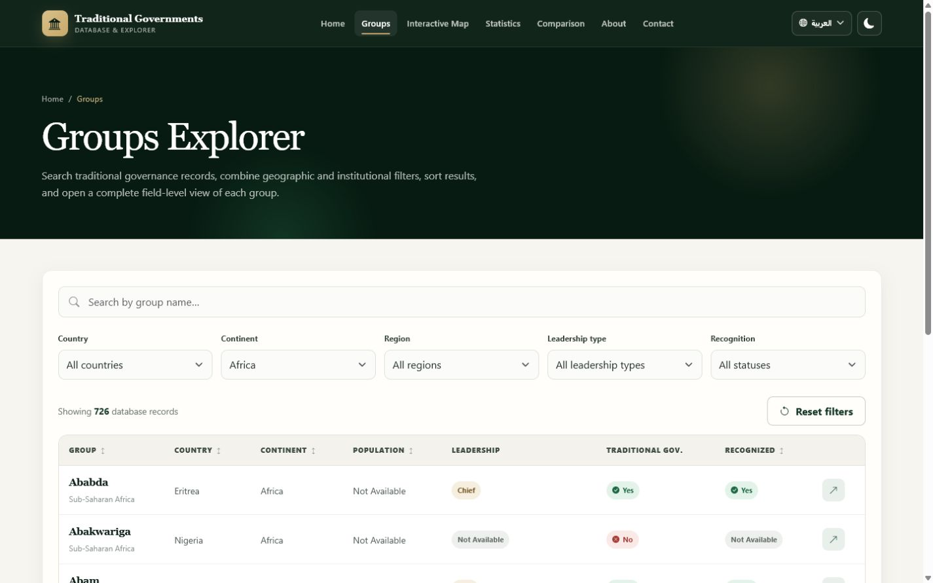
STAGE 3 · JAVASCRIPT
Turn user input into a live exploration workflow
Search, geographic filters, leadership, recognition, sorting, pagination, and URL state work together.
js/script.js · explorer controls
01 populateFilter('countryFilter', uniqueValues('Country'));
02 populateFilter('continentFilter', uniqueValues('Continent'));
03 applyExplorerQueryParameters();
04
05 controls.forEach(control => {
06 control.addEventListener('change', () => {
07 state.page = 1;
08 applyExplorerFilters();
09 updateExplorerQueryString();
10 });
11 });
URL: ?continent=Africa
726 matching records
20
Notes:
Walk through a concrete example: clicking the Africa map marker opens the explorer with continent=Africa in the URL, the select control is populated, and the table immediately shows the 726 matching API records.
PowerPoint finalization: apply Morph transition to this slide (0.8 seconds, on click) so repeated objects transform smoothly from the previous slide.

Slide 21
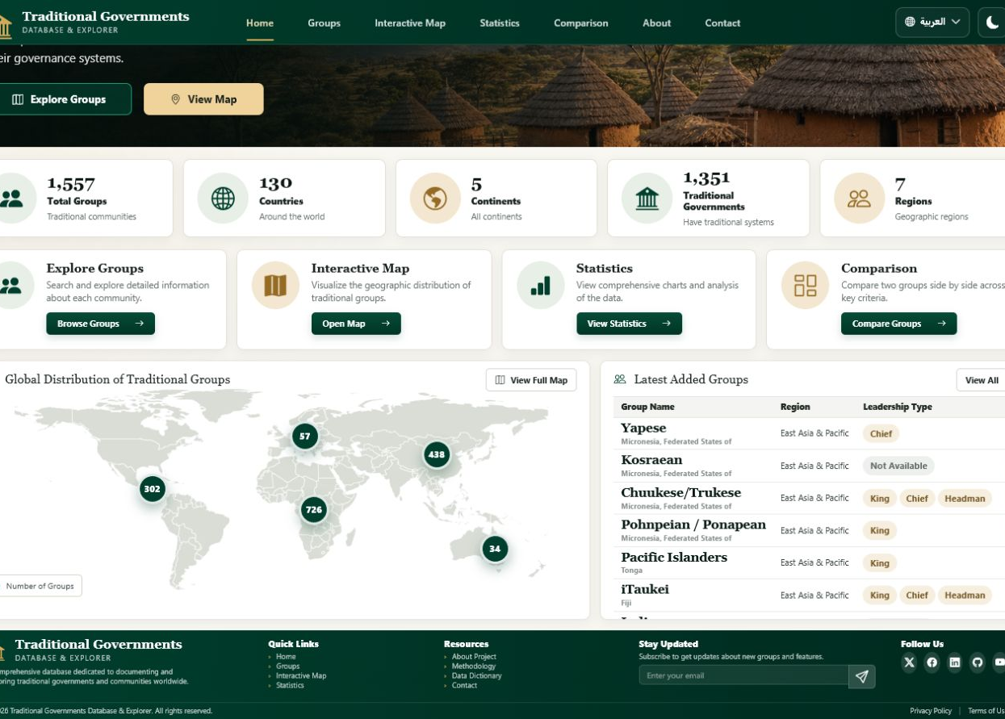
INTEGRATION
Three frontend layers converge into one user experience
Structure defines meaning, presentation creates clarity, and behaviour connects the live dataset.
HTML
CSS
JS
+
+
→
semantic structure
accessible controls
visual hierarchy
responsive system
API data
interactive state
Searchable
filters + URL state
Analytical
maps + charts
Inclusive
English + Arabic
Persistent
theme + language
21
Notes:
This is the synthesis slide. Reinforce that no single layer creates the application alone. The design remains maintainable because each layer has a clear responsibility and stable interfaces to the others.
PowerPoint finalization: apply Morph transition to this slide (0.8 seconds, on click) so repeated objects transform smoothly from the previous slide.

Slide 22
FINAL RESULT
Traditional Governments
Database & Explorer
A complete responsive research interface — built from semantic HTML, a consistent CSS system, and data-driven JavaScript.
1,557
live group records
5
continents
6
frontend pages
2
languages
Next: live website demonstration
22
Notes:
Close the development presentation and hand over to the live demonstration. The next action is to open the website and show the map markers, explorer filters, detail dialog, statistics charts, comparison view, Arabic RTL mode, and dark mode.
PowerPoint finalization: apply Morph transition to this slide (0.8 seconds, on click) so repeated objects transform smoothly from the previous slide.

