Slide 1
Power consumption and management using machine learning algorithms for lpwan networks
Presentation: Weak one
Prepared by : mussa Ebrahim
Neptune : q1dws7 Submited to: husam rajab
submission date: 11/10 /2019

Slide 2
INTRODUCTION
In this presentation the topics that will be discussed is what is internet of things (IOT), how they can be connected to the internet using different wireless technologies, and Among those wireless technologies I will explain LPWAN (Low power Wide area networks), there are a lot of competing technologies in the LPWAN space like NB-IOT, LoRa, Sigfox and others but we will be discussing about LoRa, the difference between LoRa and LoRaWAN low power wide area network technologies and who sets the rules and regulation of this wireless network communications.

Slide 3

IOT
IoT is a network of physical device that are connected to the internet and are able to talk to each other.
IoT can be connected to internet using different wireless technologies such as:
Short Range wireless communication
Cellular Communication
LPWAN Communication

Slide 4
Cellular Communication
5G
4G
3G
2G
Short-Range Wireless Communication
Wi-Fi
Bluetooth
BLE
NFC/RFID
wZigbee
Data Rate
LPWAN
NB-IOT
LoRa
Sigfox
Range

Slide 5
LORA
LoRa(Long Range) is LPWAN wireless technology where low powered sender transmit small data package(0.33kbps to 5.5kbps) to a receiver over long range distance
It is based on spread spectrum modulation techniques derived from chirp spread spectrum technology.
it was developed by Cycleo of Grenoble, France, and acquired by Semtech in 2012, a founding member of the LoRa Alliance (fastest growing technology alliance, a non profit association of more than 500 member companies

Slide 6
LORA RANGE
The range between LoRa sender and receiver depends on the environment, the buildings and materials used.
Environment | Range in kilometer(km)
Urban Areas(town and cities) | 2-5km
Rural Areas(Country Side) | 5-15km
Direct line of sight | >15km

Slide 7

Lora END NODE
A LoRa end node consists of 2 parts.
A radio module with antenna.
A microprocessor to process for example the sensor data.
End nodes are often battery powered.
A LoRa device (end node) has a wireless transceiver. If this device also has sensors, this device acts as a remote sensor. Such a device is called a mote, short for remote.

Slide 8
LORA GATEWAY
A LoRa gateway consists of 2 parts
A radio module with antenna.
A microprocessor to process the data.
Gateways are mains powered and connected to the Internet.
Multiple gateways can receive data from the same end node.
The gateways can listen to multiple frequencies simultaneously, in every spreading factor at each frequency
A gateway can handle hundreds of devices at the same time

Slide 9
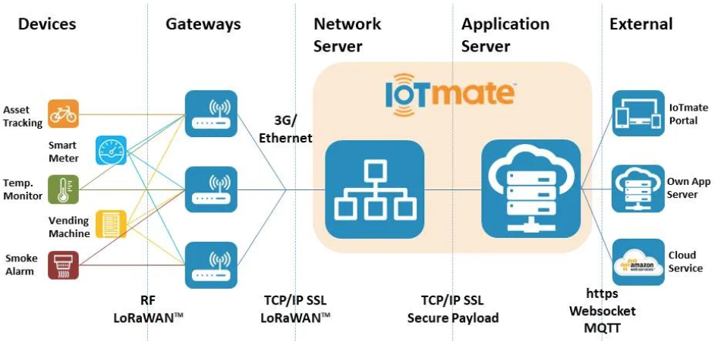
LORAWAN NETWORK
LoRaWAN network architecture is deployed in a star topology.
The communication between the end node and gateway is bidirectional which means the end node can send data to the gateway but it can also receive data from the gateway.

Slide 10
LORAWAN how it works
An end node broadcast its data to every gateway in its vicinity.
The gateways forward this packet to the network server.
The network server collects the messages from all gateways and filters out the duplicate data and determines the gateway that has the best reception.
The network server forwards the packet to the correct application server where the end user can process the sensor data.
Optionally the application server can send a response back to the end node. When a response is send, the network server receives the response and determines which gateway to use to broadcast the response back to the end node

Slide 11
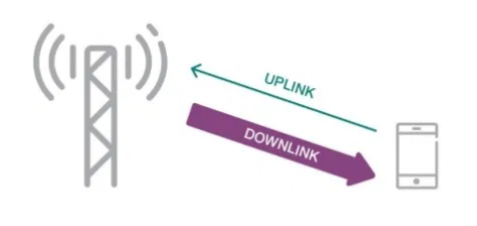
UPLINK AND DOWNLINK
When an end node transmits data to the gateway it is called an uplink.
When the gateway transmits data to the end node it is called a downlink

Slide 12
DIRECT COMMUNICATION BETWEEN LORA DEVICES
The LoRaWAN protocol does not support direct communication between end nodes.
If you want direct communication between LoRa devices without the use of gateways, use RadioHead Packet Radio library for embedded microprocessors. It provides a complete object-oriented library for sending and receiving packet sized messages via a variety of radios such as LoRa on a range of embedded microprocessors:

Slide 13
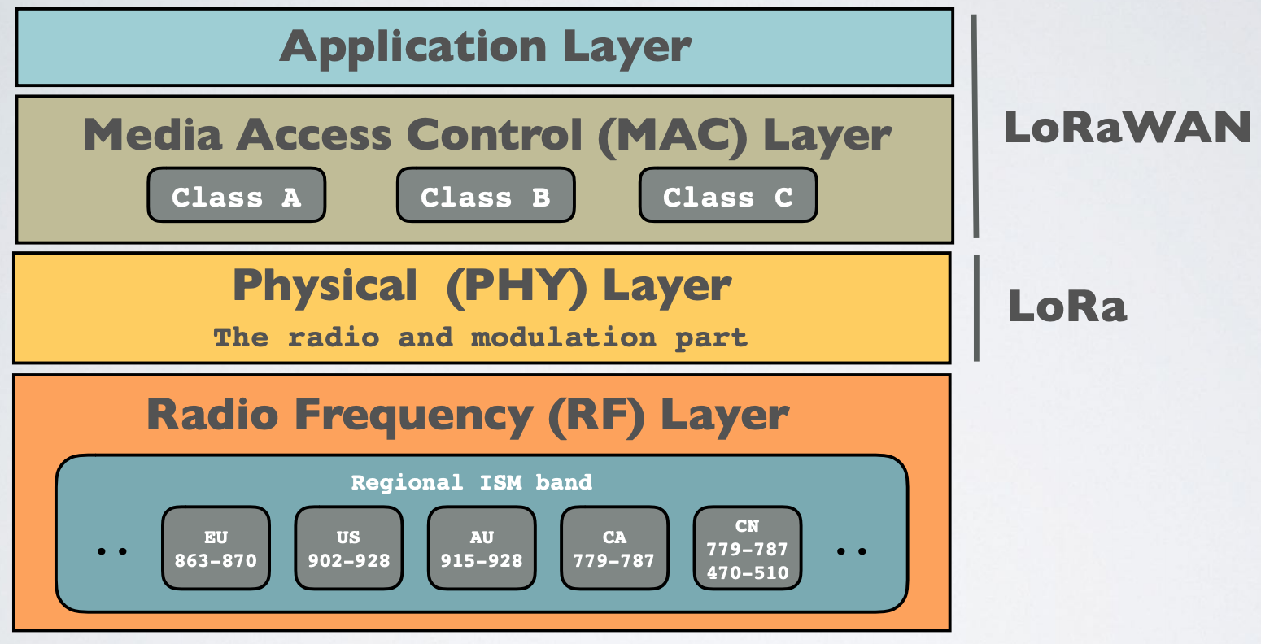
Lora protocol stack

Slide 14
Rules and regulations
Rules and regulation of wireless communication is set depending on the countries ISM band frequency and you can use the network depending on your countries ISM band frequency allocation.
If you want to buy LoRa development board, LoRa gateway or Radio module buy with the right frequency according to the country ISM band frequency otherwise you will break the rules and it will not work as well.
In ISM band anyone is allowed to use it and no license fee is required regarding this it have low data rate and a lots of interference because anyone can use this frequencies.

Slide 15
Ism BAND
Lora operates in unlicensed ISM(industrial, scientific and medical) radio band that are available world wide. E.g. In Hungary LoRaWAN operates in 863-870MHz frequency band.
Region | Frequency(MHz)
Asia | 433
Europe, India, Russia, Africa | 863-870
US | 902-928
Region | Frequency(MHz)
Australia | 915-928
Canada | 779-787
China | 779-787,470-510

Slide 16
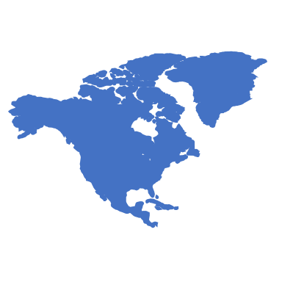
Etsi and fcc
ISM band can be used by anyone else, there must be rules set to reduce the signal interference otherwise it will be unusable. There are several organizations that manage radio spectrum to insure safe co-existence between all different radio technologies.
Few geographical areas where FTSI and FCC Regulatory domain used:-
ETSI (European Telecommunications Standard Institute) in Europe.
Netherland ( Uses ETSI as standard also can add additional rules).
china
FCC(Federal Communication Commission) in US.
USA
Australia

Slide 17
Ism band duty cycle
Operators can set additional rules other than ISM band, ETSI or FCC
For example in Europe when using the ISM band frequencies (863 MHz - 870 MHz) users must comply to the following rules:
For uplink, the maximum transmission power is limited to 25mW (14 dBm).
For downlink (for 869.525MHz), the maximum transmission power is limited to 0.5W (27 dBm)
There is an 0.1% and 1.0% duty cycle per day depending on the channel.
Besides these ISM band rules, the network operator (for example The Things Network) can also add additional restrictions.

Slide 18
THE THINGS NETWORK (TTN) FAIR USE (restriction)
If you use The Things Network (free public community LoRaWAN network), the following fair use policy applies:
01
The uplink airtime is limited to 30 seconds per day (24 hours) per node.
02
The downlink messages are limited to 10 messages per day (24 hours) per node

Slide 19
Time on air and duty cycle
When a signal is send from a sender it takes a certain amount of time before a receiver receives this signal, this time is called Time on Air (ToA).
Duty cycle is the proportion of time during which a component, device, or system is operated. The duty cycle can be expressed as a ratio or as a percentage.
In Europe there is 0.1% and 1% duty cycle per day depending on the channel:
For example : Duty Cycle =1% and ToA = 530ms => after sending a message, we have to wait 99x530ms = 52.47s before sending a new message.
Waiting time (ToA)
sender
Receiver

Slide 20
Thank you for your attention

