Slide 1
Comparison of LPWAN Wireless Networks
Prepared by : Mussa Ebrahim
Neptune code: Q1DWS7
Submitted to : Husam Rajab
Submission Date: 25/10/2019

Slide 2
Toc
NB-IOT
LTE-CAT-M1
LORAWAN
SIGFOX
Comparison
Conclusion

Slide 3
Introduction
Wile the number of connected devices continues to rise and expected to reach 125 billion by 2030 the maturing wireless technologies that supports them are also continuing to get good deal of attention globally, all LPWAN technologies are often pitted against one another in what’s portrayed as a race to the top But that’s not necessarily an accurate picture of the connectivity ecosystem. Each of these technologies will likely play an important role in the IoT space depending on the use case, so understanding the features and differences of each is critical,in this presentation i will explain each of the LPWAN networks and compare them depending on their cons and pros.

Slide 4
NB-IOT
NB-IoT is a cellular-grade wireless technology that uses OFDM modulation, the chips are more complex, but the link budgets are better. That means users get the high performance level associated with cellular connections, but at the cost of more complexity and greater power consumption.
It is message-based, similar to Sigfox and LoRa, but with a much faster modulation rate that can handle a lot more data than those technologies. But NB-IoT is not an IP-based communication protocol like LTE-M (another LPWA cellular technology associated with IoT applications)

Slide 5
Advantage
The coverage would be very good. NB-IoT devices rely on 4G coverage, so they would work well indoors and in dense urban areas.
It has faster response times than LoRa and can guarantee a better quality of service.
No limitation to output,highest download and upload rates(up to ten times higher than LoRa and sigfox.
There are several LTE network providers like vodafone,AT&T while LoRa and sigfox have only one providers

Slide 6
Drawbacks
Some of the design specifications for NB-IoT make it such that sending larger amounts of data down to a device is hard
Network and tower handoffs will be a problem, so NB-IoT is best suited for primarily static assets, like meters and sensors in a fixed location, rather than roaming assets.

Slide 7
LORA
LoRa is a non-cellular modulation technology for LoRaWAN.
Those two terms LoRa and LoRaWAN are not interchangeable: LoRaWAN is the standard protocol for WAN communications and LoRa is used as a wide area network technology.
LoRa represents a good radio network for IoT solutions and has better link budgets than other comparable radio technologies. if you want to connect to LoRaWAN networks or use LoRa at all you need to deploy your own network gateway. Which is an advantage setting up your own gateway creates a completely separate and secure network
It utilises licence free ISM network.

Slide 8
Advantage
LoRa has range of 16 kilometres even in the wilderness and underground
It is perfect for single-building applications
You can set up and manage your own network.
LoRa is a good option if you need bidirectionality, for example, command-and-control functionality, because of the symmetric link.
LoRa devices work well when they are in motion, which makes them useful for tracking assets on the move, such as shipments.
LoRa devices have longer battery life than NB-IoT devices.

Slide 9
Drawbacks
LoRaWAN uses unlicensed spectrum. In Europe this means a 1% duty cycle, which limits the volume and frequency of traffic, as well as the ability of the base station to control the network and send traffic down
LoRaWAN networks interfere when more than one is operated in an area at the same time and as number operation increases also packet losses and collision increases.
It has lower data rates than NB-IoT
It has a longer latency time than NB-IoT
It requires a gateway to work (which also, in many cases, is an advantage).
It have legal limit on data usage so you may not transmit more than 12 bytes per hour.

Slide 10
SIGFOX
SigFox is founded in 2009 it is a french company based it uses proprietary technology, an example of using a slow modulation rate to achieve a more extended range. Due to this design choice, SigFox is an excellent option for applications where the system only needs to send small, infrequent bursts of data without frequent communication,
Like LoRa Sigfox utilises Licence free ISM network which means others can use this network for free which affects the performance of this technology by slowing down the data transfer rate, Data usage is limited to 12 bytes per hour.
Sigfox is uplink only. Though limited downlink is possible, it has a different link budget and is very restricted.

Slide 11
Advantage
It consumes a low amount of power
It works well for simple devices that transmit infrequently, because it sends very small amounts of data very slowly.
It supports a wide coverage area in the areas where it is located.

Slide 12
Drawbacks
It is not deployed everywhere, so it won’t work for a large number of use cases currently.
Communication is better headed up from the endpoint to the base station. It has bidirectional functionality, but its capacity from the base station back to the endpoint is constrained, and you’ll have less link budget going down than going up.
Mobility is difficult with sigfox devices.

Slide 13
LTE-M (CAT-M1)
LTE-M stands for Long Term Evolution for Machine-Type Communications. It is mainly developed to fulfill cellular IoT device objectives such as low device cost, deep coverage, longer battery life, higher cell capacity and so on
LTE-M, also known as LTE Cat M1, is a variant of the existing 4G networks and it is comparable to NB-IoT. Compared to the other LTE networks, LTE-M is available for a wider bandwidth, although it offers reduced coverage. LTE-M is designed to frequently transmit data at a lower speed than what is common for 4G networks.

Slide 14
Advantage
LTE-M is comparable to NB-IOT. It offers a larger bandwidth so you can transmit more data, at the cost of slightly limited coverage.
LTE-M cellular technologies can transfer larger amounts of data than NB-IoT, Sigfox and LoRaWAN technologies and have fastest speed of transmission.
As it uses TCP/IP, the network can be connected to any server. And offers fastest Data rate.
It supports capacity to accommodate large number of devices per cell.
It is easy to deploy and it is interoperable with LTE networks.

Slide 15
Drawbacks
LTE-M has high power consumption and least network coverage but growing

Slide 16
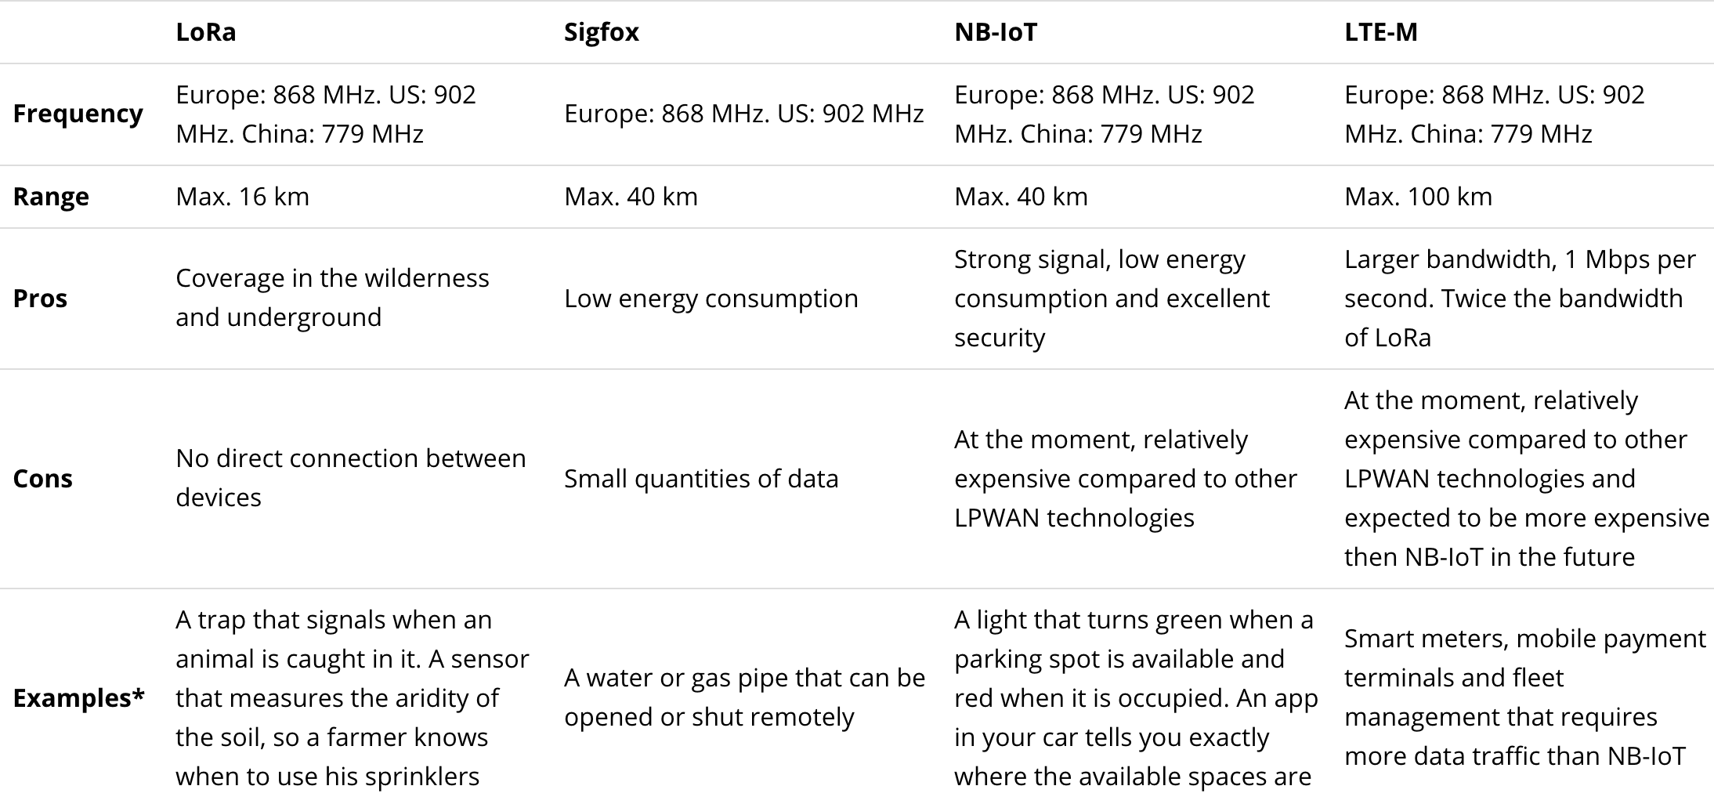
Comparison

Slide 17
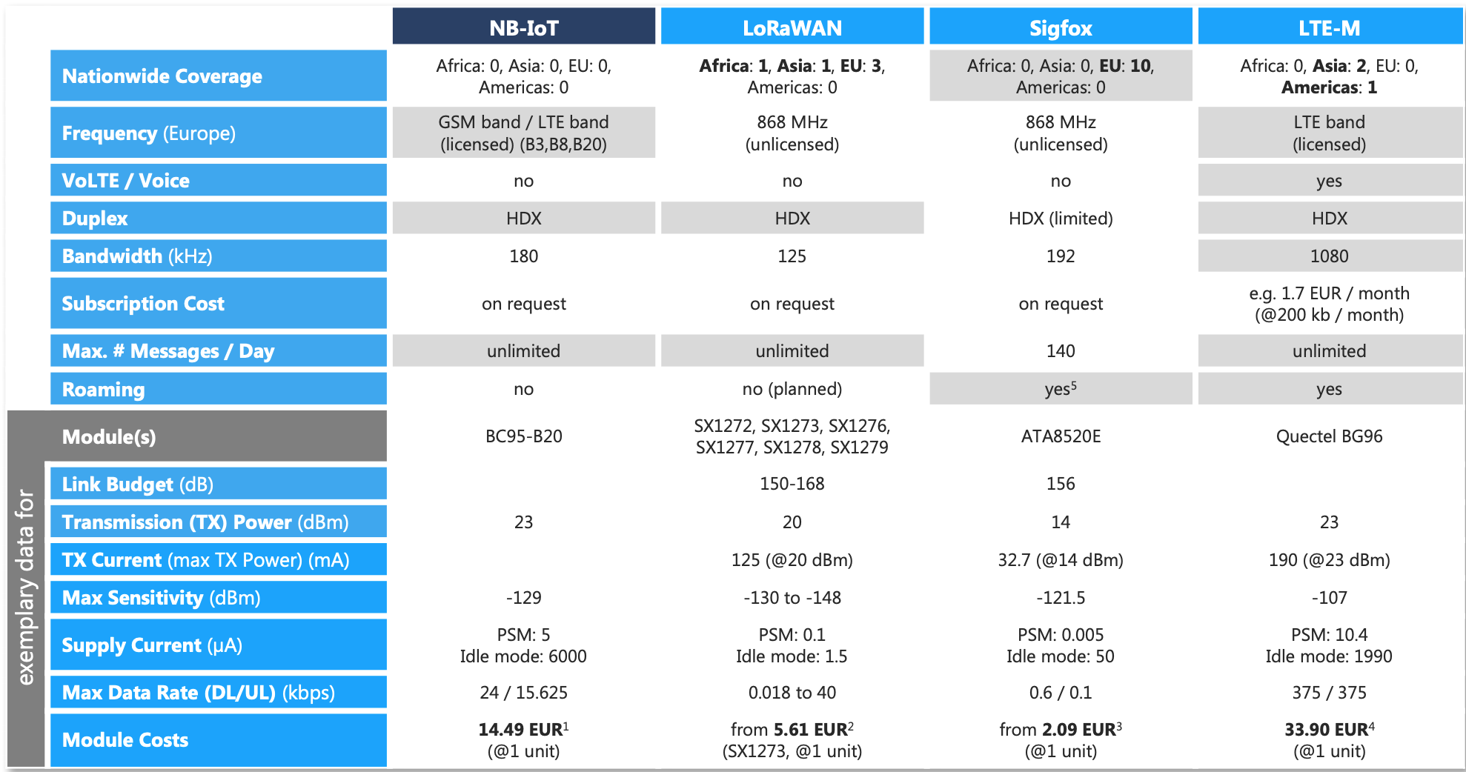

Slide 18
Conclusion
After considering all this in my opinion among this LPWAN networks one can be more preferable than the other depending on the use case which means depending on what you need them for (requirements).
Technologies like LoRa will most likely be best used for “discrete” applications like smart buildings or campuses, where mobile network connectivity is not needed
LTE-M have higher data rates, which is important for data-rich use-cases. For instance, patient monitoring devices would likely require real-time communication leaving LTE-M as the clear winner. However, an application like pipeline monitoring would likely work with sending batch communication and therefore either NB-IoT or LTE-M could be used.

Slide 19
Conclusion
Another example where either technology could be used would be a smart city application, like waste management, where sensors report on how full a city dumpster is. You don’t need up to the second alerts on this type of information you can receive updates periodically. Plus, there’s very little data to report at any given time. For these types of applications, you have the flexibility to choose based on regional availability or pricing.
For larger areas like farms, campuses or cities, where small- volume data transmissions are needed self-contained LPWANs are the perfect answer(LoRaWAN and SigFox) . when talking about covering regional areas and across boundaries, a cellular protocol like NB-IOT or Cat-M may look increasingly practical.

Slide 20
Thank you for your attention!!

