Slide 1
Power Consumption and Management using Machine Learning Algorithms for LPWAN Networks
Prepared by: Mussa Ebrahim
Neptune code: Q1DWS7
Submitted to: Hussam Rajab
Submission Date: 24/10/2019

Slide 2
Toc
Link budget and Link margin
EIRP and ERP
RSSI and SNR
Carrier frequency and bandwidth
Modulation type and chirp spread spectrum

Slide 3
Overview
In this presentation i will be explaining how the signal goes from the transmitter to the receiver depending on the transmission power, receiving power, the losses on mid, cable loss, gains in the antena, how the receiver demodulate the modulated carrier signal then recover the original message or signal, get the value of Link budget,Link margin And i will roughly discuss about modulation type and chirp spread spectrum, RSSI and SNR.

Slide 4
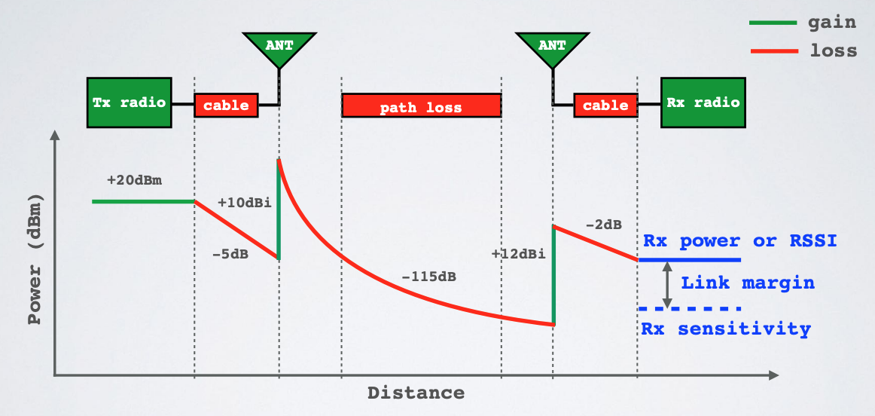
LINK BUDGET AND LINK MARGIN

Slide 5
LINK BUDGET AND LINK MARGIN
A simple link budget equation looks like this: Received Power = Transmitted Power + Gains − Losses For example: Received Power = 20 - 5 + 10 - 115 + 12 - 2 = -80 dBm
The receiver sensitivity is the lowest power level at which receiver can receive or demodulate the signal. For example: Receiver sensitivity = -90 dBm
The link margin is the difference between the received power and receiver sensitivity. Link margin = Received power - Receiver sensitivity Link margin in dBm Received power in dBm Receiver sensitivity in dBm

Slide 6
LINK BUDGET AND LINK MARGIN
If the link margin is too big, or too small, corrective actions can be applied to ensure the system will operate satisfactorily.
The link margin must be positive (Received Power > Receiver sensitivity) and should be at least a few dB for the receiver to successfully demodulate the signal.
LoRa receivers are very sensitive and are offering a sensitivity down to -148 dBm due to the use of Chirp Spread Spectrum.

Slide 7
EIRP AND ERP
The Effective Isotropic Radiated Power (EIRP) is the total power radiated by a hypothetical isotropic antenna in a single direction.
EIRP= Tx power (dBm) + antenna gain (dBi) - cable loss (dBm)
The Effective Radiated Power (ERP) is the total power radiated by an actual antenna relative to a half-wave dipole rather than a theoretical isotropic antenna.
ERP = Tx power (dBm) + antenna gain (dBd) - cable loss (dBm)
What is the purpose of EIRP and ERP
RF transmitting systems must adhere to certain rules set by the regulatory bodies such as FCC or ETSI.
One of these rules: radio devices must not exceed certain ERP or EIRP values set by these regulatory bodies.

Slide 8
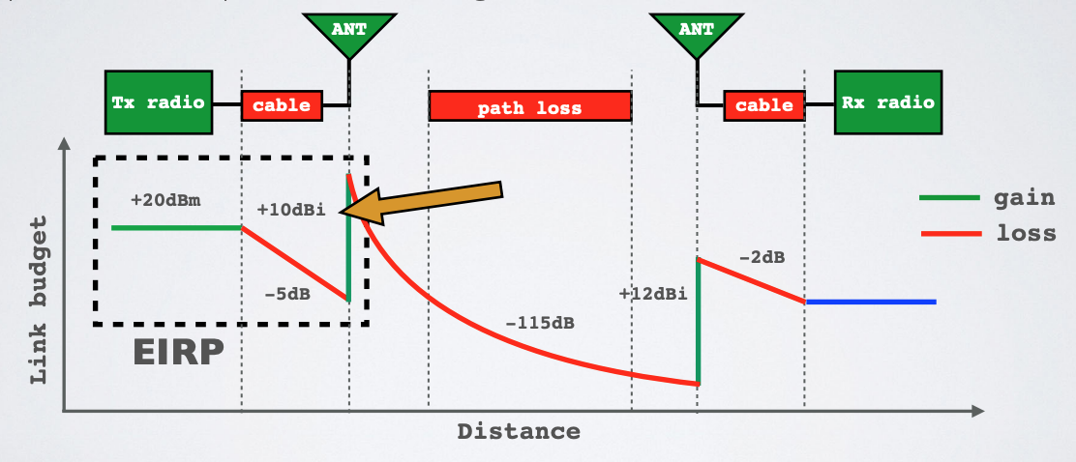
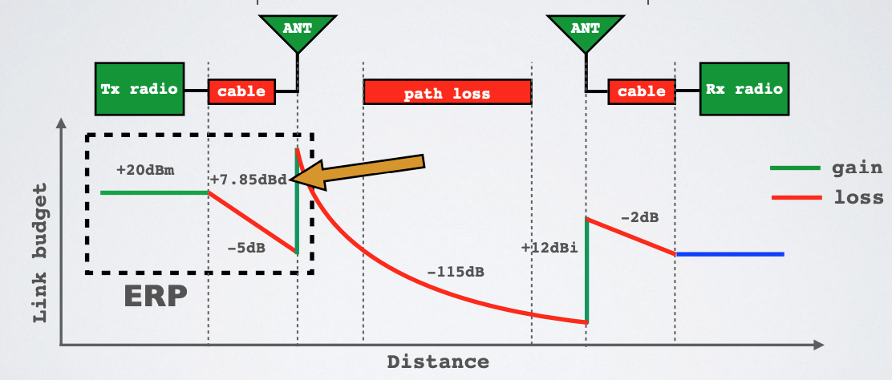
EIRP and ERP
EIRP

Slide 9
RSSI
The Received Signal Strength Indication (RSSI) is the received signal power in milliwatts and is measured in dBm. This value can be used as a measurement of how well a receiver can “hear” a signal from a sender
The RSSI is measured in dBm and is a negative value. The closer to 0 the better the signal is.
Typical LoRa RSSI values are:
RSSI minimum = -120 dBm.
If RSSI=-30dBm: signal is strong.
If RSSI=-120 dBm: signal is weak.

Slide 10
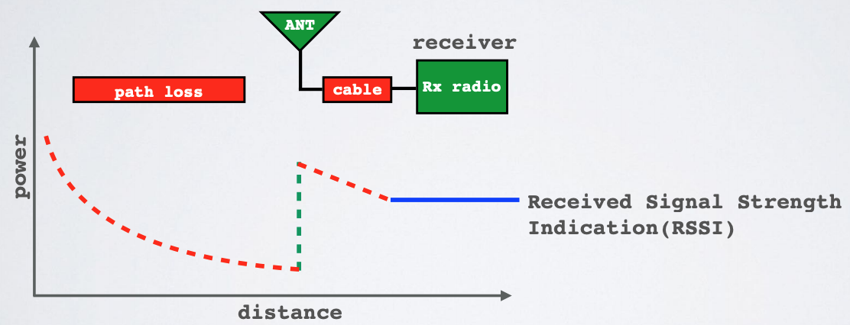
RSSI

Slide 11
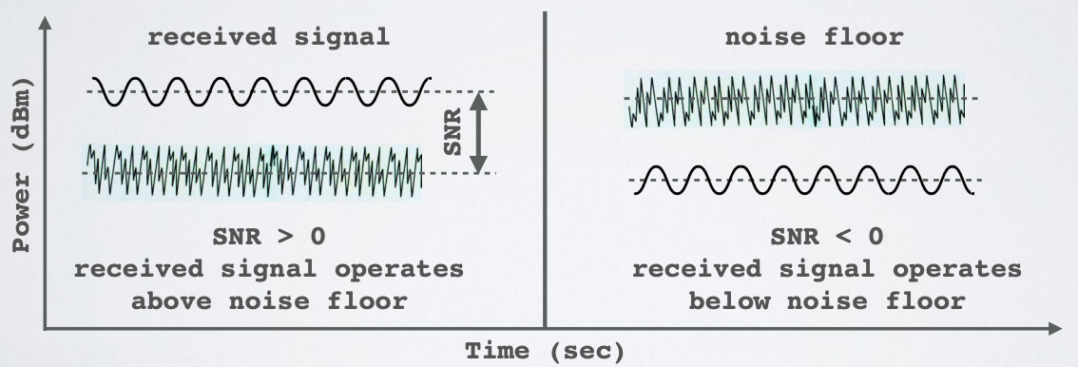
SNR
Signal-to-Noise Ratio (SNR) is the ratio between the received power signal and the noise floor power level.
The noise floor is an area of all unwanted interfering signal sources which can corrupt the transmitted signal and therefore re-transmissions will occur.

Slide 12
LoRa SNR
Normally the noise floor is the physical limit of sensitivity, however LoRa works below the noise level.
Typical LoRa SNR values are between: -20dB and +10dB
A value closer to +10 dB means the received signal is less corrupted.
LoRa can demodulate signals which are -7.5 dB to -20 dB below the noise floor

Slide 13
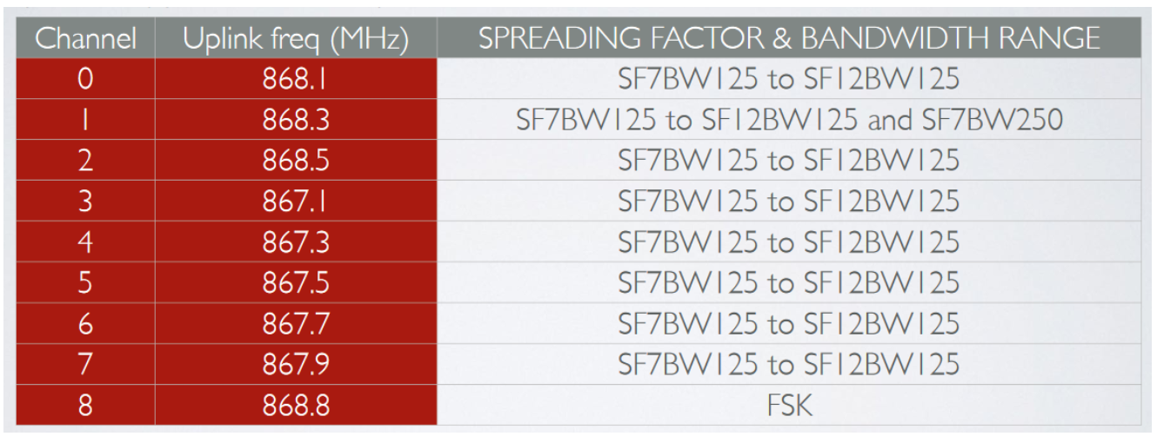
Frequencies
LoRaWAN uses frequencies for ISM band, LoRaWAN frequencies used in europe (TTN freq. plan: EU863-870 ISM band chanal frequencies)

Slide 14
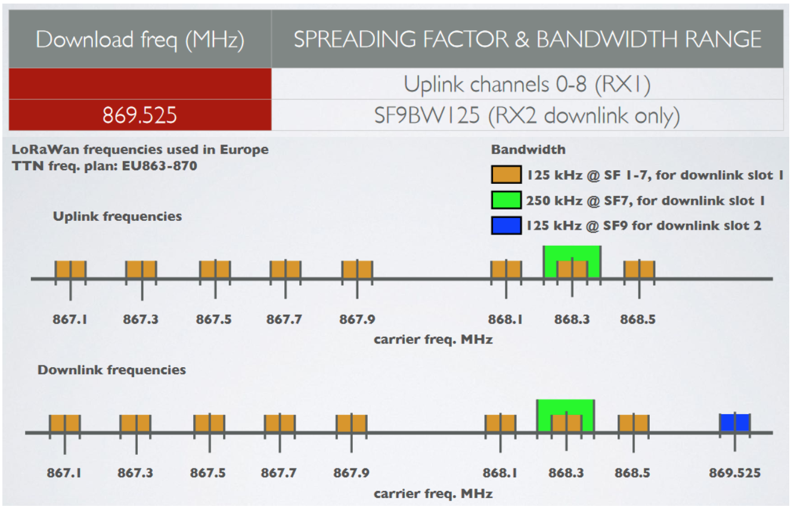
EU863-870 ISM Band Channel Frequencies
Downlink : same as uplink with an additional one :

Slide 15
EU863-870 ISM Band Channel Frequencies
Europe uses the EU 863-870 ISM band, according to the LoRaWAN Regional Parameters document every EU868MHz end device must implement the following default channels:
868.10 MHz, bandwidth = 125 kHz
868.30 MHz, bandwidth = 125 kHz
868.50 MHz, bandwidth = 125 kHz and additional 5 frequencies.
LoRaWAN only uses the following bandwidth ranges: 125 kHz, 250 kHz and 500 kHz.
Which of these 3 ranges are actual used depends on the region or frequency plan.
For example in Europe only the bandwidths 125kHz and 250 kHz are used.

Slide 16
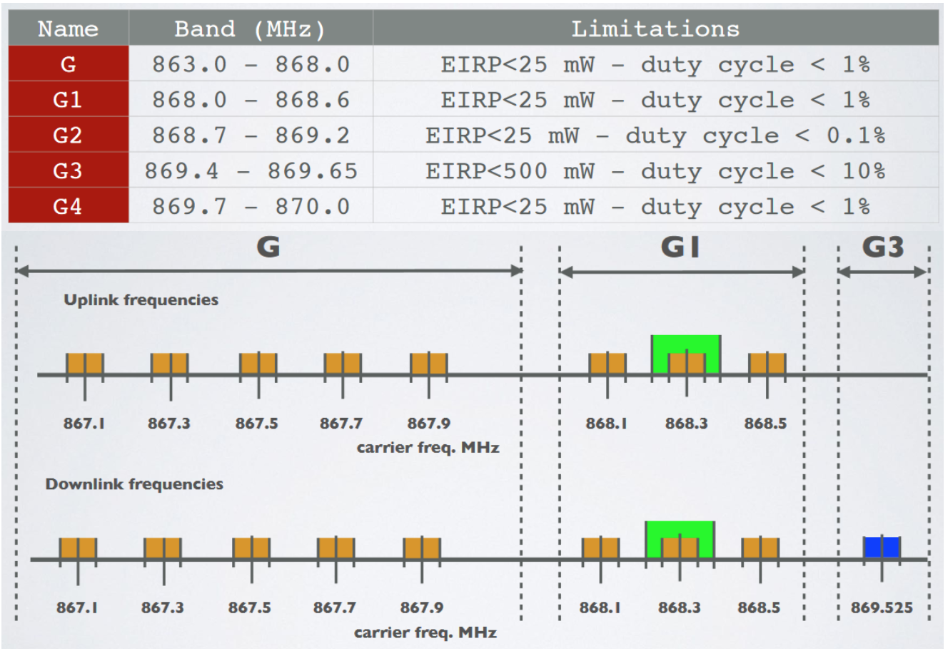
ETSI Sub Bands 863-870
ETSI divides the 863-870 MHz band (referenced “G”) into 5 sub-bands: G, G1, G2, G3 and G4. Each sub band has different constraints in term of ERP, duty cycle and channel bandwidth.

Slide 17
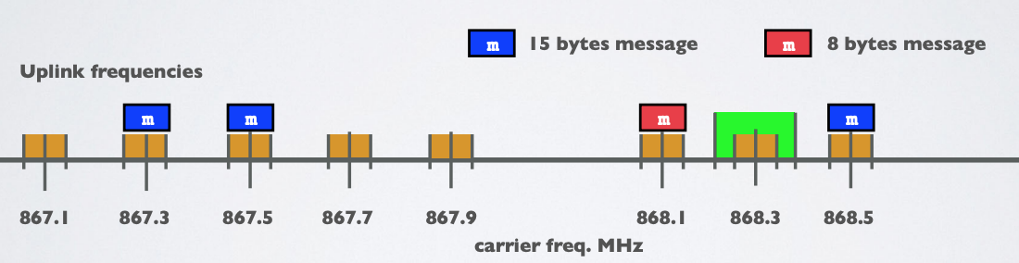
Changing Frequencies for every transmission
An end device changes channel in a pseudo-random fashion for every transmission. Changing frequencies makes the system more robust to interferences. For example in Europe for uplink transmissions 8 different frequencies are used.

Slide 18
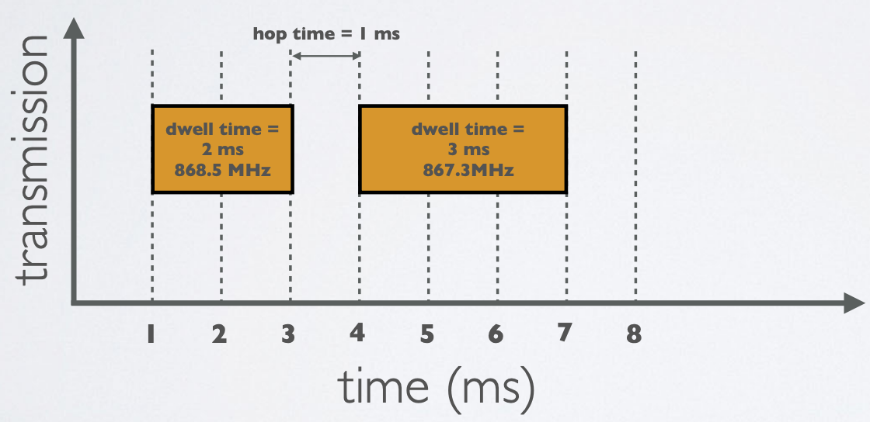
Dwell Time and HOP Time
Dwell time (or transmit time) is the amount of time needed to transmit on a frequency.
Hop time is the amount of time needed to change from one frequency to another in which the radio is not transmitting

Slide 19
Thank you for your attention!!

