Slide 1
Chapter 3 Control Statements
Selection Statements
  Using if and if...else
  Nested if Statements
  Using switch Statements
  Conditional Operator
Repetition Statements
  Looping: while, do-while, and for
  Nested loops
  Using break and continue

Slide 2
Selection Statements
if Statements
switch Statements
Conditional Operators

Slide 3
if Statements
if (booleanExpression) {
statement(s);
}
Example:
if ((i > 0) && (i < 10)) {
System.out.println("i is an " +
"integer between 0 and 10");
}

Slide 4
Caution
Adding a semicolon at the end of an if clause is a common mistake.
if (radius >= 0);
{
area = radius*radius*PI;
System.out.println(
"The area for the circle of radius " +
radius + " is " + area);
}
This mistake is hard to find, because it is not a compilation error or a runtime error, it is a logic error.
This error often occurs when you use the next-line block style.
Wrong

Slide 5
The if...else Statement
if (booleanExpression) {
statement(s)-for-the-true-case;
}
else {
statement(s)-for-the-false-case;
}

Slide 6
if...else Example
if (radius >= 0) {
area = radius*radius*PI;
System.out.println("The area for the “
+ “circle of radius " + radius +
" is " + area);
}
else {
System.out.println("Negative input");
}

Slide 7
Multiple Alternative if Statements
if (score >= 90)
grade = ‘A’;
else
if (score >= 80)
grade = ‘B’;
else
if (score >= 70)
grade = ‘C’;
else
if (score >= 60)
grade = ‘D’;
else
grade = ‘F’;
if (score >= 90)
grade = ‘A’;
else if (score >= 80)
grade = ‘B’;
else if (score >= 70)
grade = ‘C’;
else if (score >= 60)
grade = ‘D’;
else
grade = ‘F’;

Slide 8
Note
The else clause matches the most recent if clause in the same block. For example, the following statement
int i = 1; int j = 2; int k = 3;
if (i > j)
if (i > k)
System.out.println("A");
else
System.out.println("B");
is equivalent to
int i = 1; int j = 2; int k = 3;
if (i > j)
if (i > k)
System.out.println("A");
else
System.out.println("B");

Slide 9
Note, cont.
Nothing is printed from the preceding statement. To force the else clause to match the first if clause, you must add a pair of braces:
int i = 1;
int j = 2;
int k = 3;
if (i > j) {
if (i > k)
System.out.println("A");
}
else
System.out.println("B");
This statement prints B.

Slide 10

Nested if Statements
Example 3.1 Using Nested if Statements
This program reads in number of years and loan amount and computes the monthly payment and total payment. The interest rate is determined by number of years.
TestIfElse

Slide 11
switch Statements
switch (year) {
case 7: annualInterestRate = 7.25;
break;
case 15: annualInterestRate = 8.50;
break;
case 30: annualInterestRate = 9.0;
break;
default: System.out.println(
"Wrong number of years, enter 7, 15, or 30");
}

Slide 12
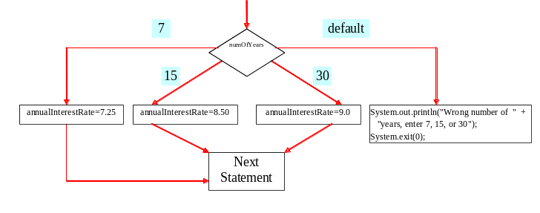
switch Statement Flow Chart

Slide 13
switch Statement Rules
The switch-expression must yield a value of char, byte, short, or int type and must always be enclosed in parentheses.
The value1, ..., and valueN must have the same data type as the value of the switch-expression. The resulting statements in the case statement are executed when the value in the case statement matches the value of the switch-expression. (The case statements are executed in sequential order.)
The keyword break is optional, but it should be used at the end of each case in order to terminate the remainder of the switch statement. If the break statement is not present, the next case statement will be executed.

Slide 14
switch Statement Rules, cont.
The default case, which is optional, can be used to perform actions when none of the specified cases is true.
·
The order of the cases (including the default case) does not matter. However, it is a good programming style to follow the logical sequence of the cases and place the default case at the end.

Slide 15
Caution
Do not forget to use a break statement when one is needed. For example, the following code always displays Wrong number of years regardless of what numOfYears is. Suppose the numOfYears is 15. The statement annualInterestRate = 8.50 is executed, then the statement annualInterestRate = 9.0, and finally the statement System.out.println("Wrong number of years").
switch (numOfYears) {
case 7: annualInterestRate = 7.25;
case 15: annualInterestRate = 8.50;
case 30: annualInterestRate = 9.0;
default: System.out.println("Wrong number of years");
}

Slide 16
Conditional Operator
if (x > 0) y = 1
else y = -1;
is equivalent to
y = (x > 0) ? 1 : -1;
Ternary operator
Binary operator
Unary operator

Slide 17
Conditional Operator
if (num % 2 == 0)
System.out.println(num + “is even”);
else
System.out.println(num + “is odd”);
System.out.println(
(num % 2 == 0)? num + “is even” :
num + “is odd”);

Slide 18
Conditional Operator, cont.
(booleanExp) ? exp1 : exp2

Slide 19
Repetitions
while Loops
do-while Loops
for Loops
break and continue

Slide 20
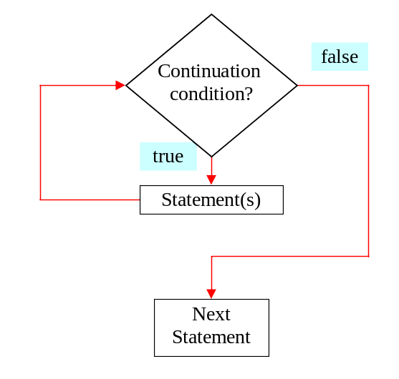
while Loop Flow Chart
while (continuation-condition) {
// loop-body;
}

Slide 21
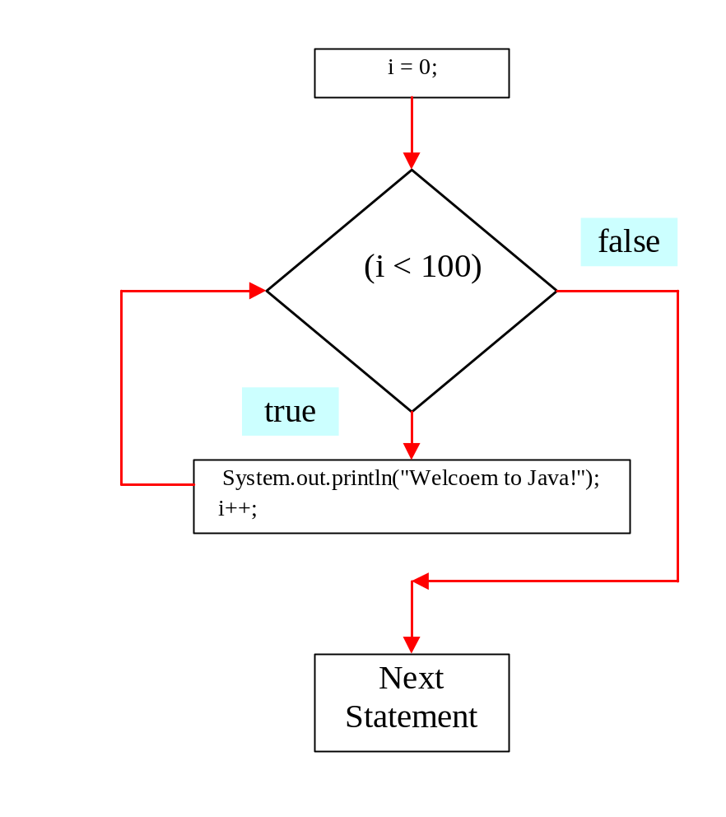
while Loop Flow Chart, cont.
int i = 0;
while (i < 100) {
System.out.println(
"Welcome to Java!");
i++;
}

Slide 22
Example 3.2: Using while Loops
TestWhile.java
TestWhile

Slide 23
Caution
Don’t use floating-point values for equality checking in a loop control. Since floating-point values are approximations, using them could result in imprecise counter values and inaccurate results. This example uses int value for data. If a floating-point type value is used for data, (data != 0) may be true even though data is 0.
// data should be zero
double data = Math.pow(Math.sqrt(2), 2) - 2;
if (data == 0)
System.out.println("data is zero");
else
System.out.println("data is not zero");

Slide 24
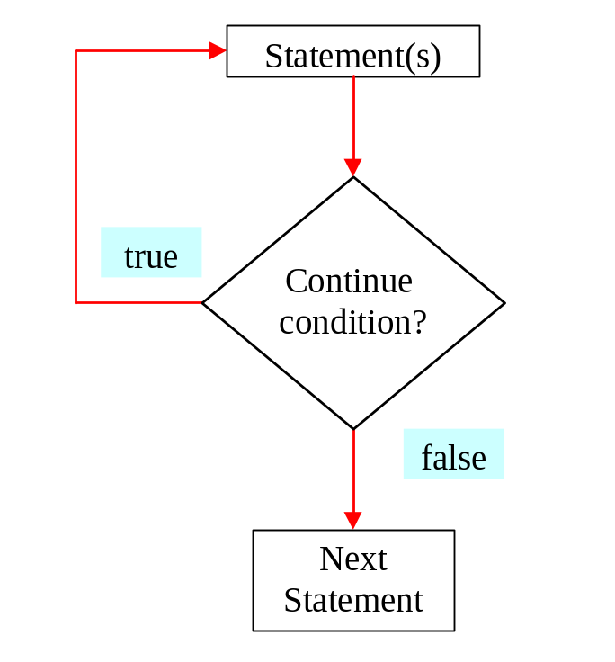
do-while Loop
do {
// Loop body;
} while (continue-condition);

Slide 25
for Loops
for (initial-action; loop-continuation-condition; action-after-each-iteration) {
//loop body;
}
int i = 0;
while (i < 100) {
System.out.println("Welcome to Java! ” + i);
i++;
}
Example:
int i;
for (i = 0; i < 100; i++) {
System.out.println("Welcome to Java! ” + i);
}

Slide 26
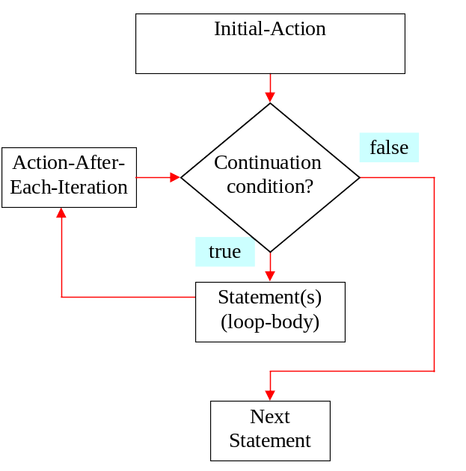
for Loop Flow Chart
for (initial-action;
loop-continuation-condition;
action-after-each-iteration) {
//loop body;
}

Slide 27
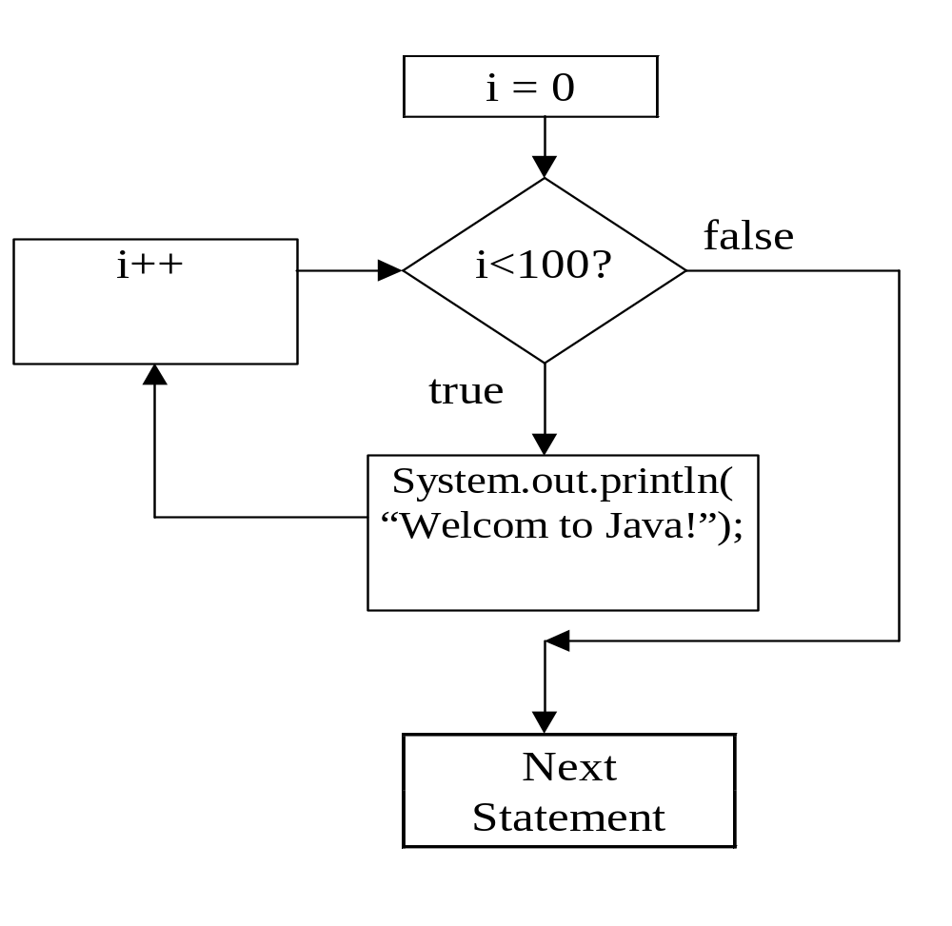
for Loop Example
int i;
for (i = 0; i<100; i++) {
System.out.println(
"Welcome to Java");
}

Slide 28
for Loop Examples
Examples for using the for loop:
Example 3.3: Using for Loops
TestSum
Example 3.4: Using Nested for Loops
TestMulTable

Slide 29
Which Loop to Use?
The three forms of loop statements, while, do, and for, are expressively equivalent; that is, you can write a loop in any of these three forms.
I recommend that you use the one that is most intuitive and comfortable for you. In general, a for loop may be used if the number of repetitions is known, as, for example, when you need to print a message 100 times. A while loop may be used if the number of repetitions is not known, as in the case of reading the numbers until the input is 0. A do-while loop can be used to replace a while loop if the loop body has to be executed before testing the continuation condition.

Slide 30
Caution
Adding a semicolon at the end of the for clause before the loop body is a common mistake, as shown below:
for (int i=0; i<10; i++);
{
System.out.println("i is " + i);
}
Wrong

Slide 31
Caution, cont.
Similarly, the following loop is also wrong:
int i=0;
while (i<10);
{
System.out.println("i is " + i);
i++;
}
In the case of the do loop, the following semicolon is needed to end the loop.
int i=0;
do {
System.out.println("i is " + i);
i++;
} while (i<10);
Wrong
Correct

Slide 32
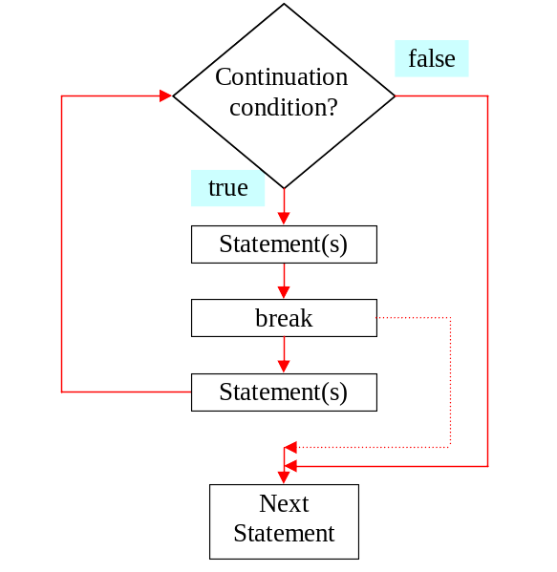
The break Keyword

Slide 33
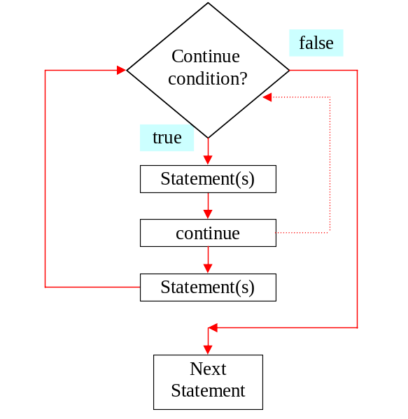
The continue Keyword

Slide 34
Using break and continue
Examples for using the break and continue keywords:
Example 3.5: TestBreak.java
TestBreak
Example 3.6: TestContinue.java
TestContinue

Slide 35
Example 3.7
Finding the Sales Amount
You have just started a sales job in a department store. Your pay consists of a base salary and a commission. The base salary is $5,000. The scheme shown below is used to determine the commission rate.
Sales Amount Commission Rate
$0.01–$5,000 8 percent
$5,000.01–$10,000 10 percent
$10,000.01 and above 12 percent
Your goal is to earn $30,000 in a year. Write a program that will find out the minimum amount of sales you have to generate in order to make $30,000.
FindSalesAmount
Run

Slide 36
Example 3.8
Displaying a Pyramid of Numbers
In this example, you will use nested loops to print the following output:
1
212
32123
4321234
543212345
Your program prints five lines. Each line consists of three parts. The first part comprises the spaces before the numbers; the second part, the leading numbers, such as 3 2 1 on line 3; and the last part, the ending numbers, such as 2 3 on line 3.
PrintPyramid
Run

Slide 37
Example 3.9
Displaying Prime Numbers
This example displays the first 50 prime numbers in five lines, each of which contains 10 numbers. An integer greater than 1 is prime if its only positive divisor is 1 or itself. For example, 2, 3, 5, and 7 are prime numbers, but 4, 6, 8, and 9 are not.
The problem can be broken into the following tasks:
For number = 2, 3, 4, 5, 6, ..., test whether the number is prime.
Determine whether a given number is prime.
Count the prime numbers.
Print each prime number, and print 10 numbers per line.
PrimeNumber
Run

