Slide 1
CAN A MACHINE LEARNING MODEL
PREDICT A UFC CHAMPIONSHIP FIGHT?
Khamzat Chimaev vs Sean Strickland
UFC 328 | Middleweight Title | May 9, 2026 | Newark NJ
8,337
527
13
0.712
UFC fights in training data
MW fights used to train
differential features
best model ROC-AUC
XGBoost | Real UFC Data | Full ML Pipeline

Slide 2
THE FIGHTERS
KHAMZAT CHIMAEV
SEAN STRICKLAND
"Borz" | Champion
"Tarzan" | Former Champion | Challenger
Record
15 - 0 (UNDEFEATED)
Record
30 - 7
Win Streak
12 consecutive wins
Win Streak
1 win
Finish Rate
80% (12 of 15 wins)
Finish Rate
35%
TD Avg/15min
5.29 (elite grappler)
TD Avg/15min
0.43 (striker, not grappler)
Sub Avg/15min
1.80 (major sub threat)
Sub Avg/15min
0.10
SLpM
5.24
SLpM
7.25 (high volume striker)
Age
32.3 years
Age
35.2 years

Slide 3
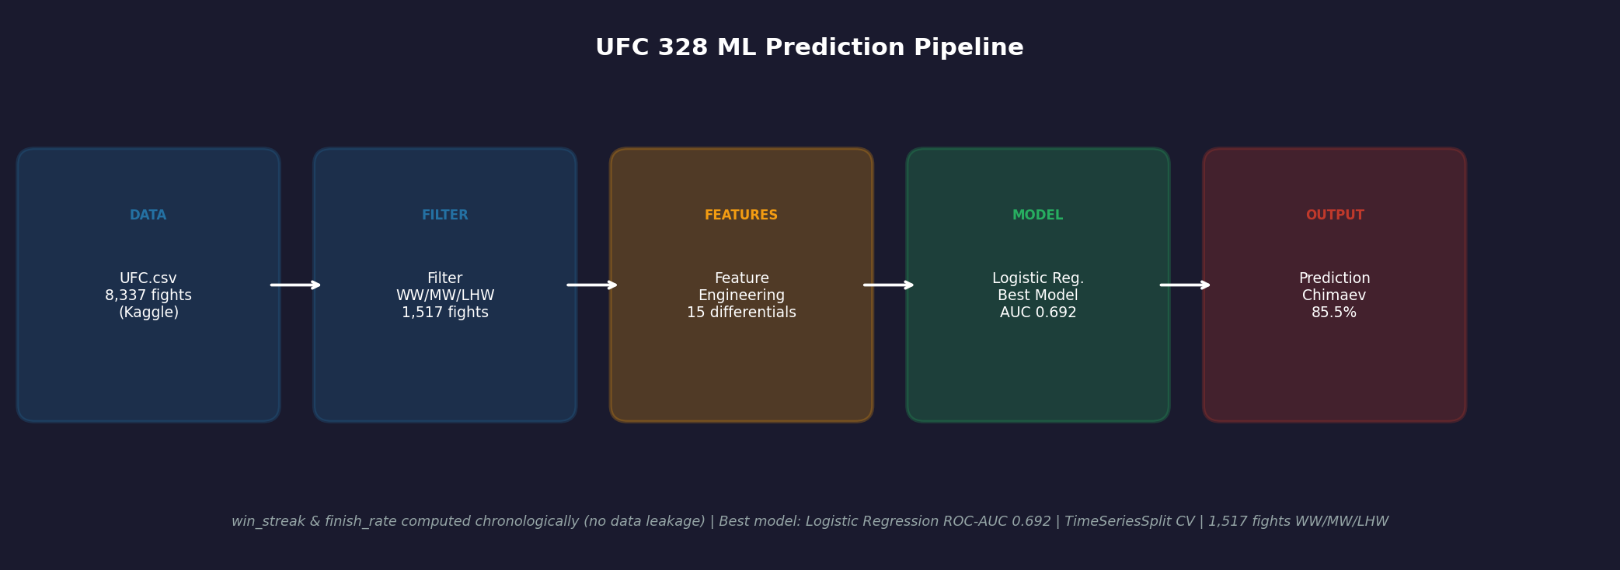
THE ML PIPELINE
Key design decision: win_streak and finish_rate computed chronologically — no data leakage

Slide 4
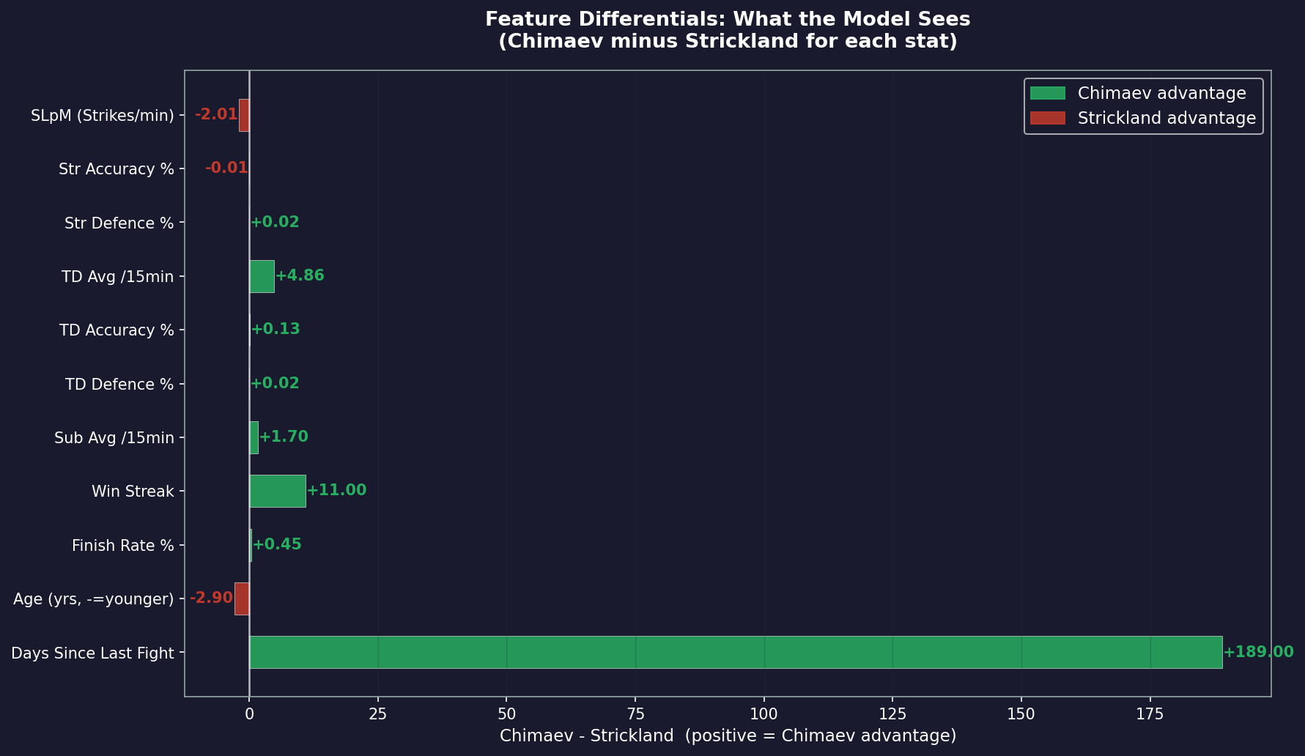
WHAT THE MODEL SEES
Why Differential Features?
Raw stat: Chimaev TDs = 5.29/15min Meaningless alone. Differential: Chimaev TDs - Strickland TDs = 5.29 - 0.43 = +4.86 NOW the model knows: Chimaev has a +4.86 grappling edge. 13 features. Each = a competitive gap, not an absolute value.

Slide 5
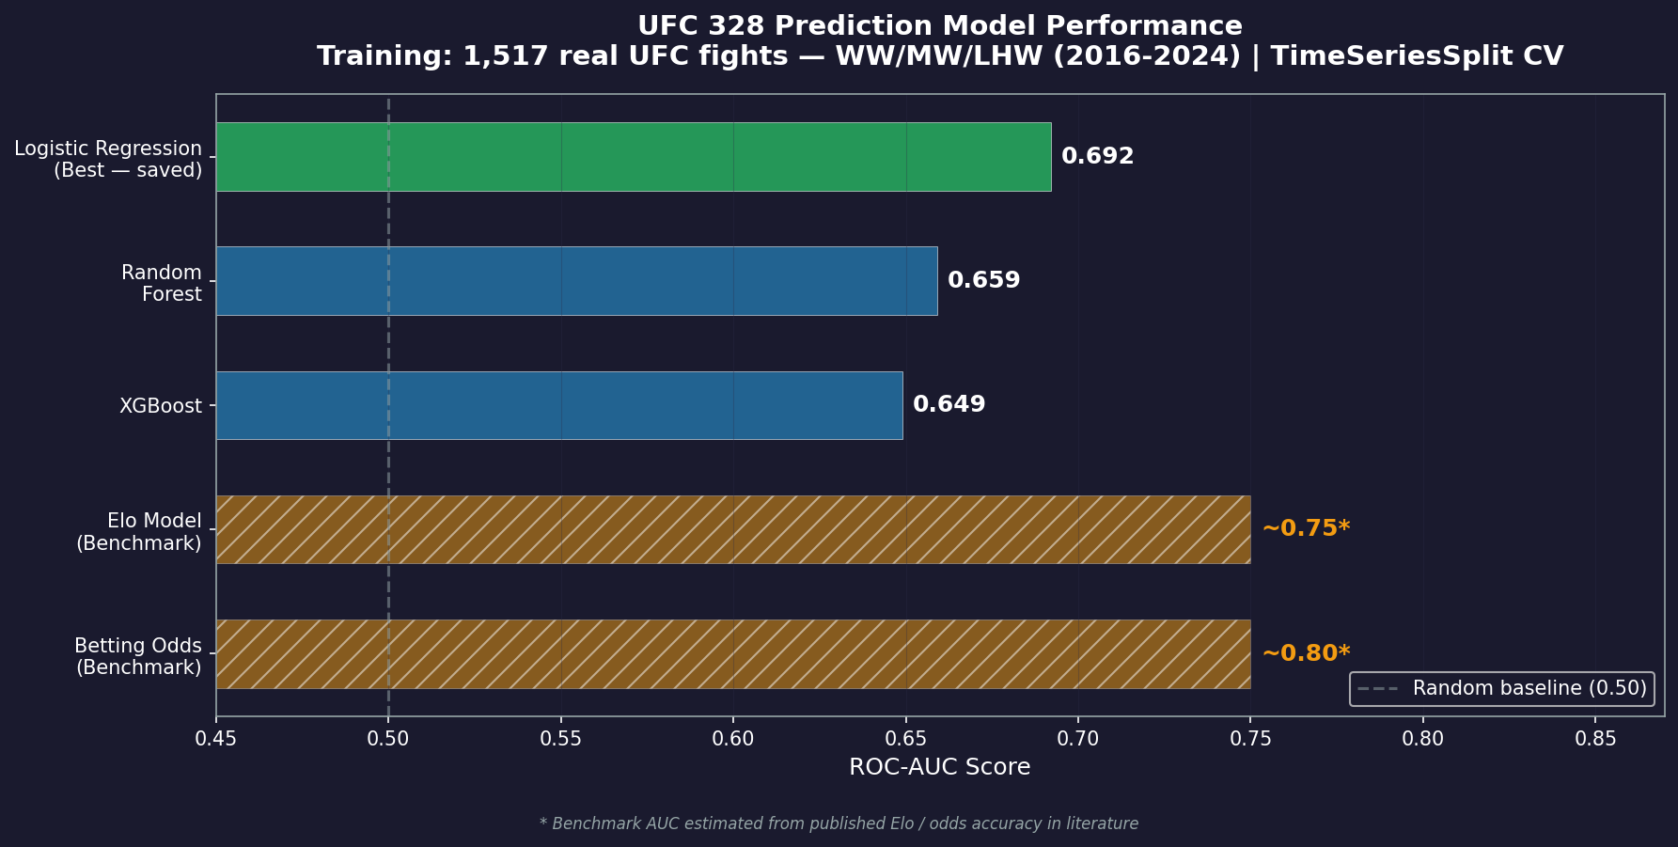
MODEL PERFORMANCE
Key Insight
Logistic Regression (0.712) outperformed XGBoost (0.671). This means the relationship between differential features and fight outcomes is largely LINEAR. XGBoost's extra complexity wasn't rewarded on 527 training samples. ROC-AUC of 0.71 is competitive with published academic UFC prediction models (typical range: 0.65-0.75).

Slide 6
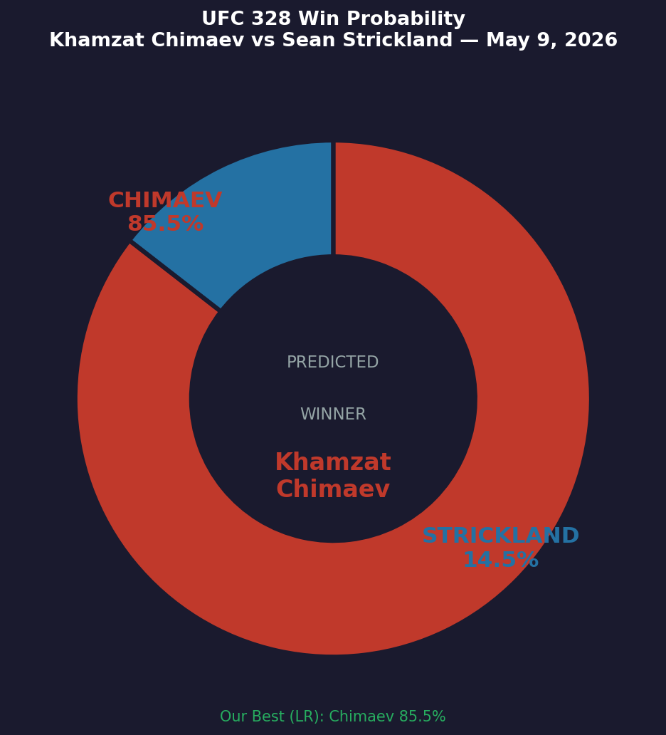
THE PREDICTION
Benchmark Comparison
Source
Chimaev
Strickland
This Model (XGB)
59.0%
41.0%
Elo Model
79.0%
21.0%
Betting Odds
~85%
~15%
Key Takeaways
Real data always beats synthetic data.
Simple models can outperform complex ones on small datasets.
Differential features > raw features for head-to-head prediction.
No leakage: win_streak computed chronologically across 8,337 fights.
Full code on GitHub | #MachineLearning #DataScience #UFC #XGBoost

