Slide 1



DISTRIBUTED PROGRAMMING & NETWORKING
MEDANALYTICA
A Platform to Empower Healthcare Decisions with Advanced Data Analysis
MAHDI ISLAM, MUSARRAT TABASSUM
MAIA 8
University of Cassino and Southern Lazio

Slide 2


Outline
Objective
Application Features
Must - Have
Should-Have
Could-Have
Environment and Technologies
Project Timeline

Slide 3
Objective
Develop a robust Healthcare Information Management System designed to streamline healthcare data management and enhance service delivery efficiency. This system will include advanced features such as AI-generated test results and predictive analysis to improve diagnostic accuracy and patient outcomes.

Slide 4
Application Features
Main page: Information about the system and service
Patient registration and management
Patient Login page
Doctor registration and management
Doctor Login page
User authentication and access control for doctors
Medical image upload system for patients
Must-Have

Slide 5
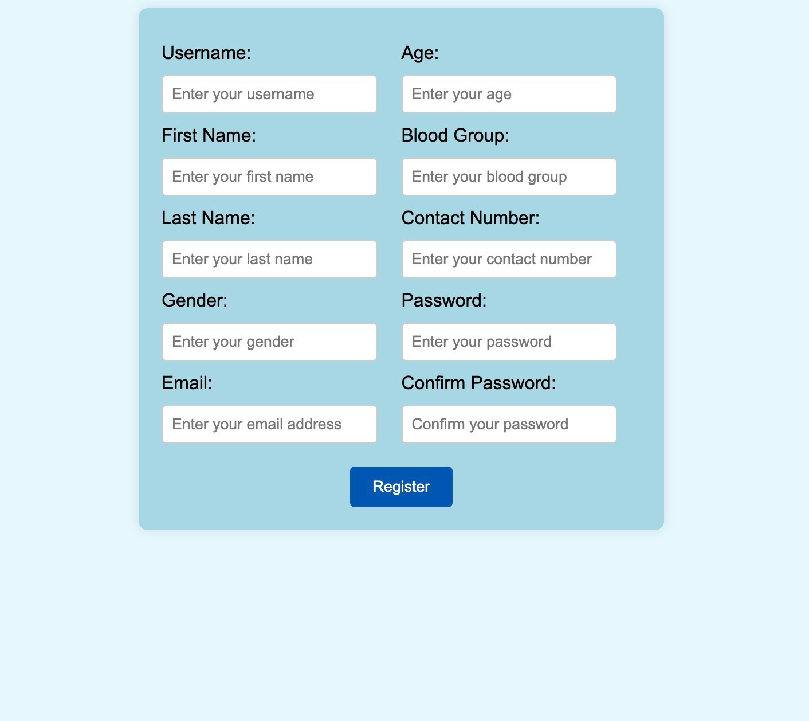
Must-Have
Patient Registration and Signup page: Patients can register or create new account.

Slide 6
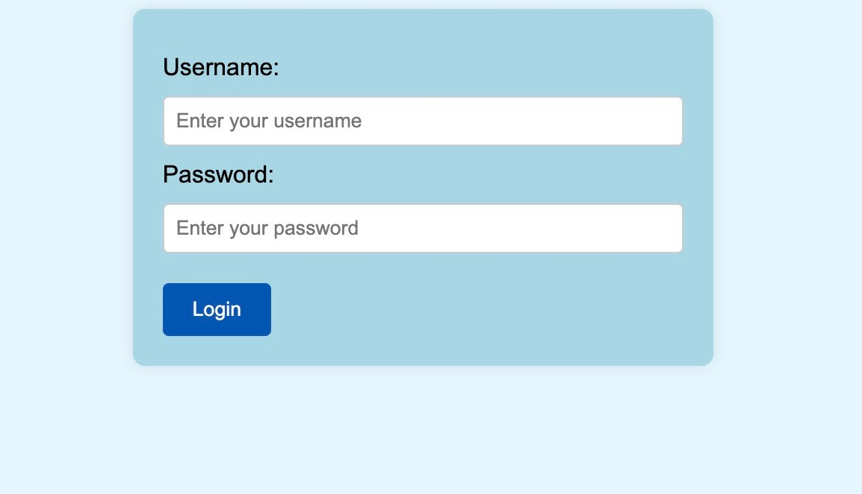
Must-Have
Patient Login page:
Patients can access their accounts.

Slide 7
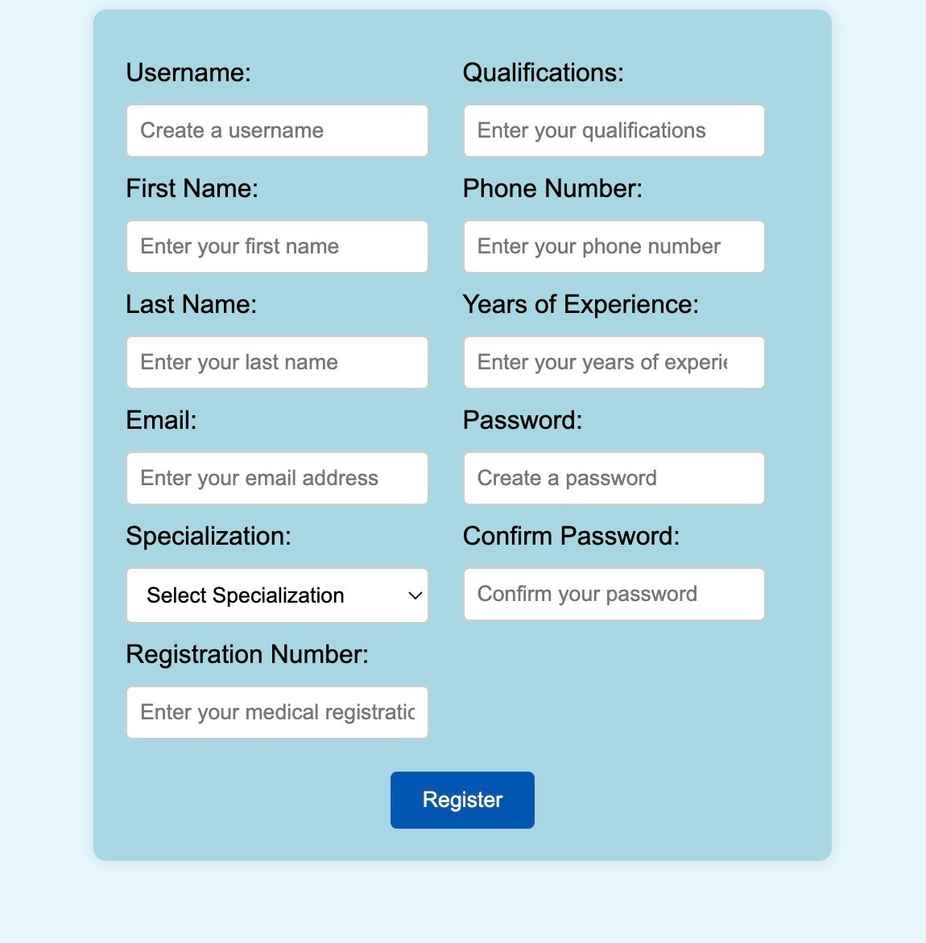
Must-Have
Doctor Registration and Signup page:
Doctors can register or create new account.

Slide 8
Must-Have
Doctor Login page:
Doctors can access their accounts.

Slide 9
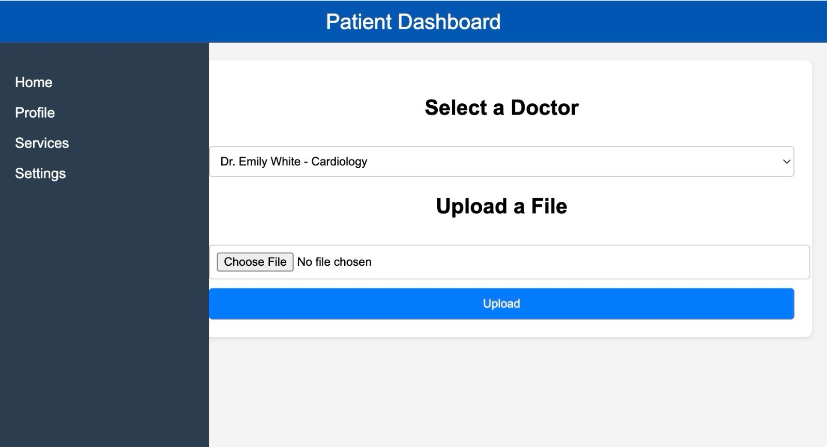
Must-Have
Medical image upload system for patients.
9

Slide 10
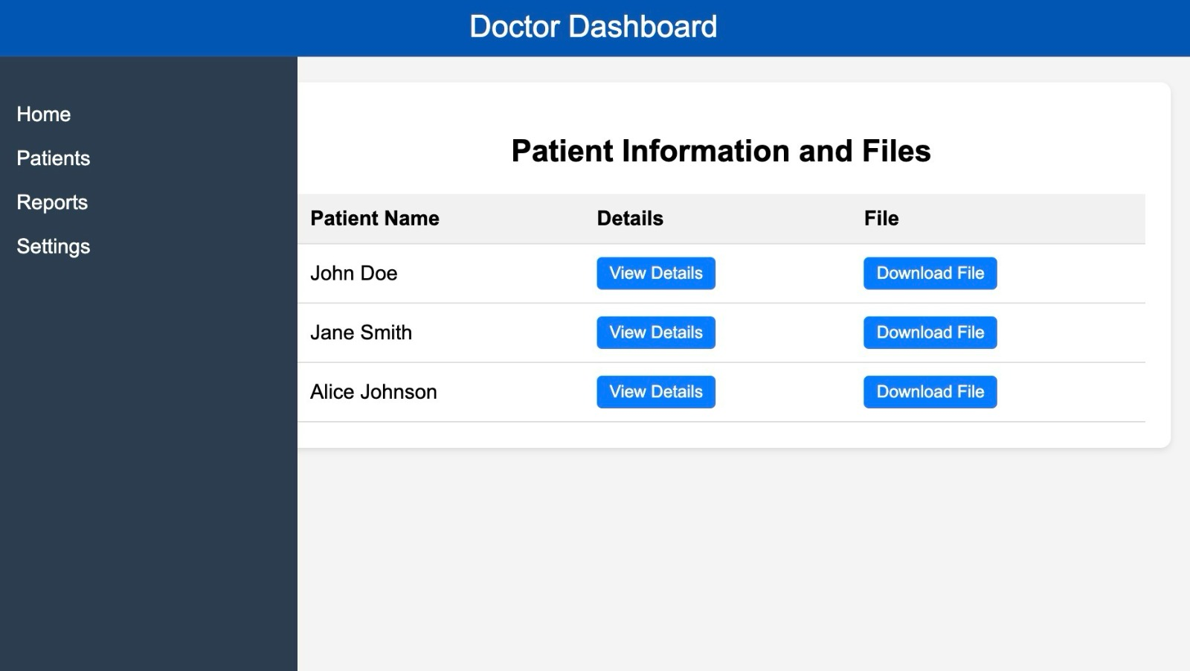
Must-Have
Doctor’s can see patients’ information; access to the medical images uploaded by the patients.
10

Slide 11
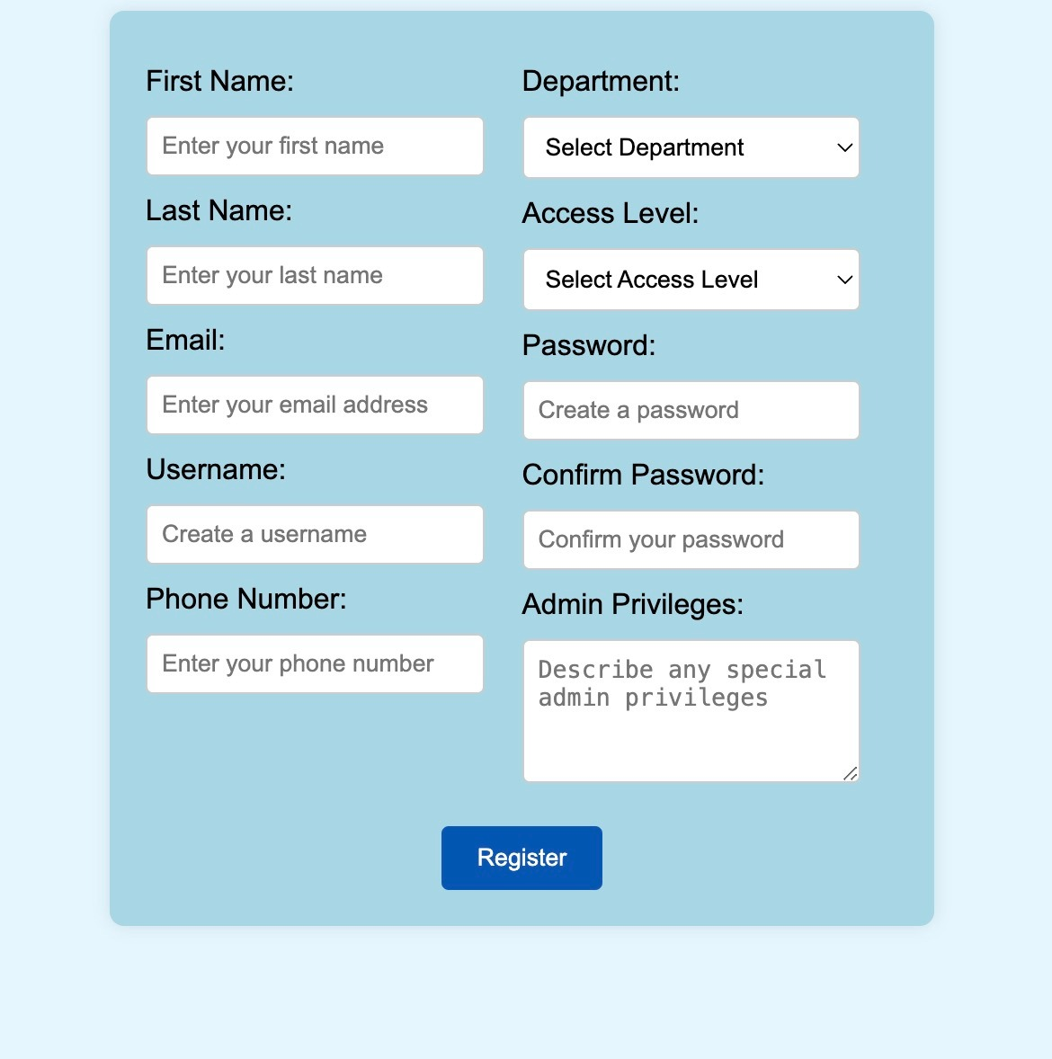
Must-Have
Admin Register Page
11

Slide 12
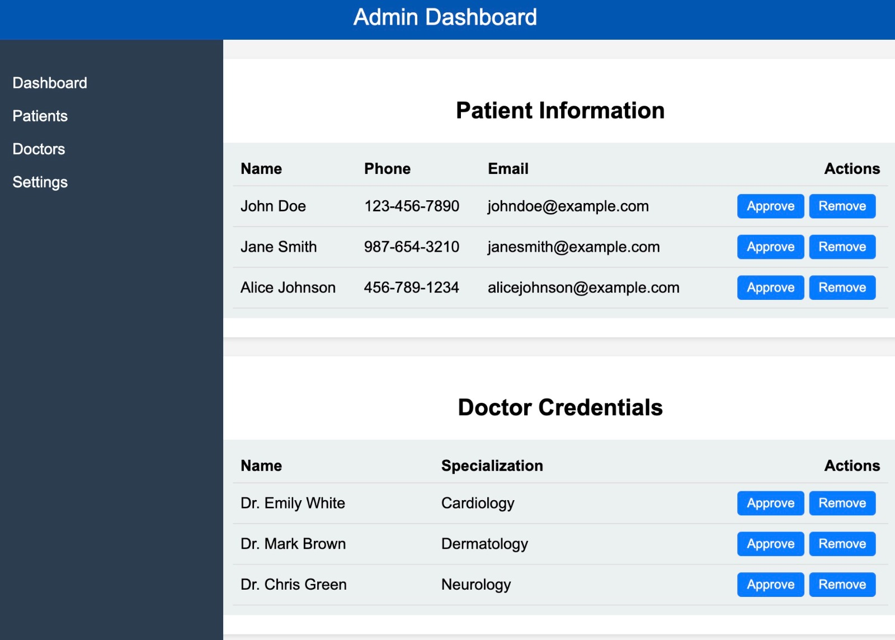
Must-Have
Admin Page
Admin can add and remove patients/users.
Can approve the doctor’s
request for account creation.
12

Slide 13
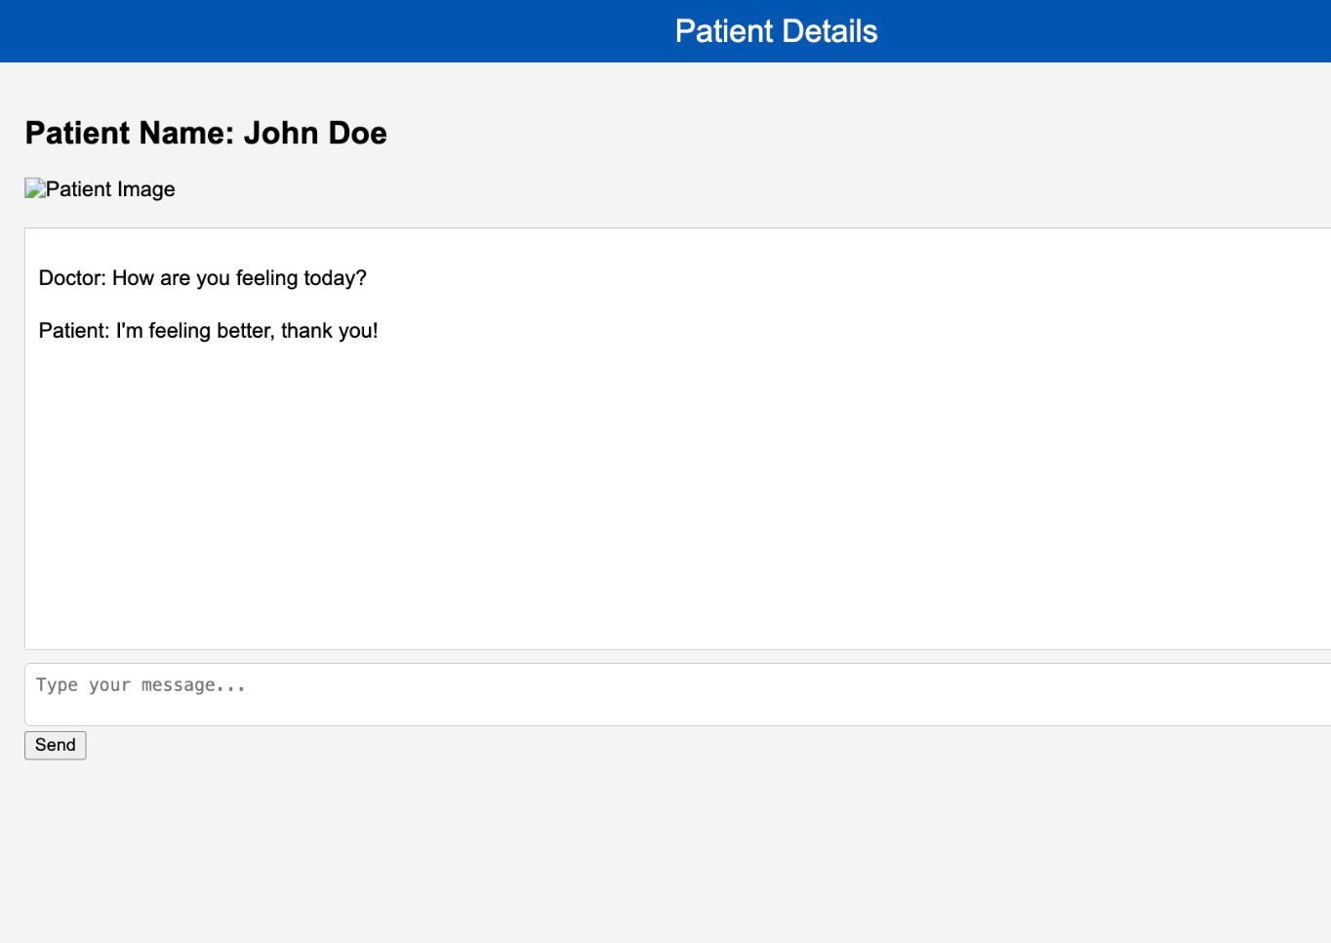
Should-Have
Doctors can contact patients regarding the test results and reports via messages;
13

Slide 14
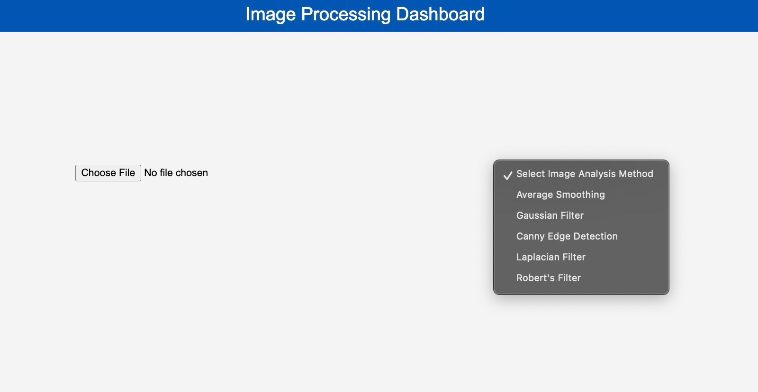
Should-Have
Analysis of the Medical images uploaded by the patients.
14\

Slide 15
Could-Have
Predictive analysis (AI) to improve diagnostic accuracy;
Cross checking the results with ground truth through doctors;
Generating prescription; reports(using AI) with treatment plan; medicine dose for patients.
15

Slide 16
Environment and Technologies
Client Side
HTML
CSS JavaScript
JSON
Server Side
Tomcat
JAVA
Struts2
Databases
My SQL
16

Slide 17
Project Timeline
Database management
Frontend & Backend development
June 01-07
May 17-23
Week 01
Week 02
Week 03
Week 04
May 24-31
June 08-15
Frontend & Backend development
Integration & testing
17

Slide 18
THANK YOU
18

