Slide 1
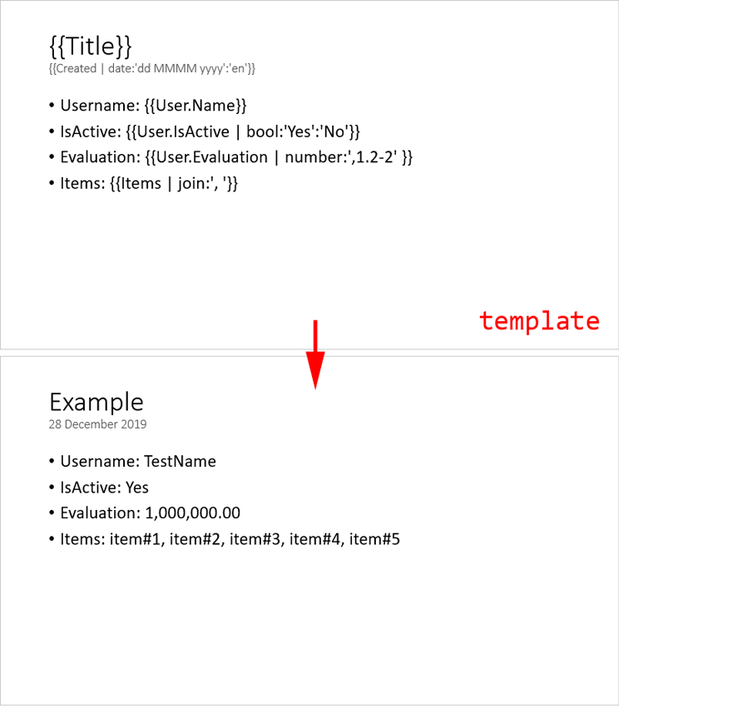
Example
Date: 06.03.2024 14:24

Slide 2
Example 06 March 2024
Username: TestName
IsActive: Yes
Evaluation: 1,000,000.00
Items: item#1, item#2, item#3, item#4, item#5
TestLink

Slide 3
Company #1 Employees list
Name | Email | Birthday
Employee #1 | emp1@company1.test | 1980-09-13
Employee #2 | emp2@company1.test | 1997-03-17
Employee #3 | emp3@company1.test | 1990-03-29
Employee #4 | emp4@company1.test | 1987-01-13
Employee #5 | emp5@company1.test | 1996-09-17
Employee #6 | emp6@company1.test | 1995-10-27
Employee #7 | emp7@company1.test | 1985-02-18
Employee #8 | emp8@company1.test | 1989-05-05

Slide 4
Company #2 Employees list
Name | Email | Birthday
Employee #1 | emp1@company2.test | 1997-05-19
Employee #2 | emp2@company2.test | 1980-09-28
Employee #3 | emp3@company2.test | 1987-10-17
Employee #4 | emp4@company2.test | 1984-05-05
Employee #5 | emp5@company2.test | 1986-01-17

Slide 5
Company #3 Employees list
Name | Email | Birthday
Employee #1 | emp1@company3.test | 1987-03-27
Employee #2 | emp2@company3.test | 1989-06-27
Employee #3 | emp3@company3.test | 1999-05-30
Employee #4 | emp4@company3.test | 1996-03-02
Employee #5 | emp5@company3.test | 1985-09-19
Employee #6 | emp6@company3.test | 1993-05-11
Employee #7 | emp7@company3.test | 1984-03-17

