Slide 1
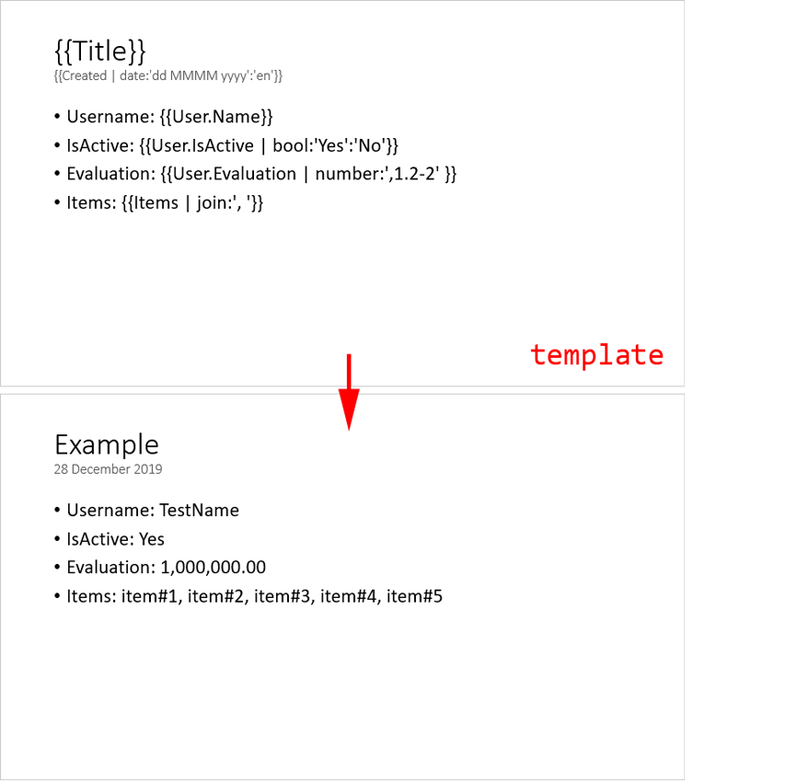

Example
Date: 23.09.2024

Slide 2
Example 23 September 2024
Username: TestName
IsActive: Yes
Evaluation: 1,000,000.00
Items: item#1, item#2, item#3, item#4, item#5
TestLink

Slide 3
Company #1 Employees list
Name | Email | Birthday
Employee #1 | emp1@company1.test | 1987-07-20
Employee #2 | emp2@company1.test | 1980-05-11
Employee #3 | emp3@company1.test | 1990-06-09
Employee #4 | emp4@company1.test | 1980-04-19
Employee #5 | emp5@company1.test | 1986-02-04
Employee #6 | emp6@company1.test | 1999-05-25
Employee #7 | emp7@company1.test | 1990-07-27
Employee #8 | emp8@company1.test | 1983-07-27
Employee #9 | emp9@company1.test | 1983-08-02

Slide 4
Company #2 Employees list
Name | Email | Birthday
Employee #1 | emp1@company2.test | 1980-09-07
Employee #2 | emp2@company2.test | 1988-07-14
Employee #3 | emp3@company2.test | 1996-11-21
Employee #4 | emp4@company2.test | 1989-04-24

Slide 5
Company #3 Employees list
Name | Email | Birthday
Employee #1 | emp1@company3.test | 1982-07-20
Employee #2 | emp2@company3.test | 1986-01-18
Employee #3 | emp3@company3.test | 1988-11-23
Employee #4 | emp4@company3.test | 1991-02-05
Employee #5 | emp5@company3.test | 1986-02-05
Employee #6 | emp6@company3.test | 1988-09-11
Employee #7 | emp7@company3.test | 1999-11-21
Employee #8 | emp8@company3.test | 1982-11-25

