Slide 1
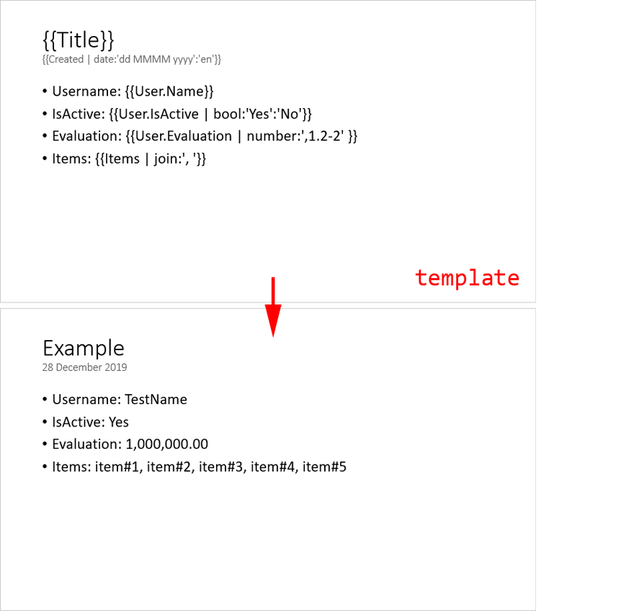
Example
Date: 20.09.2024

Slide 2
Example 20 September 2024
Username: TestName
IsActive: Yes
Evaluation: 1,000,000.00
Items: item#1, item#2, item#3, item#4, item#5
TestLink

Slide 3
Company #1 Employees list
Name | Email | Birthday
Employee #1 | emp1@company1.test | 1999-11-09
Employee #2 | emp2@company1.test | 1996-04-29
Employee #3 | emp3@company1.test | 1986-09-13
Employee #4 | emp4@company1.test | 1987-02-22
Employee #5 | emp5@company1.test | 1999-03-11
Employee #6 | emp6@company1.test | 1989-11-19
Employee #7 | emp7@company1.test | 1988-08-05

Slide 4
Company #2 Employees list
Name | Email | Birthday
Employee #1 | emp1@company2.test | 1990-04-06
Employee #2 | emp2@company2.test | 1992-08-25
Employee #3 | emp3@company2.test | 1990-04-19
Employee #4 | emp4@company2.test | 1994-11-12
Employee #5 | emp5@company2.test | 1980-10-21
Employee #6 | emp6@company2.test | 1994-10-22
Employee #7 | emp7@company2.test | 1984-06-08
Employee #8 | emp8@company2.test | 1988-11-02
Employee #9 | emp9@company2.test | 1983-02-03

Slide 5
Company #3 Employees list
Name | Email | Birthday
Employee #1 | emp1@company3.test | 1993-10-09
Employee #2 | emp2@company3.test | 1995-04-17
Employee #3 | emp3@company3.test | 1986-04-17
Employee #4 | emp4@company3.test | 1999-01-10
Employee #5 | emp5@company3.test | 1988-07-23

