Slide 1
Best place to start a new restaurant
Capstone Project

Slide 2
Introduction
The problem statement is that if a person is willing to start new business such as a restaurant in a specific city. The purpose of the project now is to show the person the best place to open gain more profit based on location advantages.
In order to start a new business, many factors should be taken into consideration. The main factor is the location of the place, so you can know the number of people in that location and if they spend money on restaurants
Another factor, is to check if there is similar restaurants in that location, because there will be a huge competition and there will be no much profits
So before a person should a start a new restaurant a person should have a full insight of the locality
In order to find the data mentioned above, foursquare location data services provides information on how the data can be retrieved and how that can be used to get the insights from the data to solve the problem

Slide 3
Data
The data required for this project by using the Wikipedia page : https://en.wikipedia.org/wiki/List_of_postal_codes_of_Canada:_M
We have the dataset which is having four columns postal code, borough, neighborhood, and lat,long of the neighborhoods. We can get the venues of that neighborhood by passing the lat and long of the neighborhood to the four square API

Slide 4
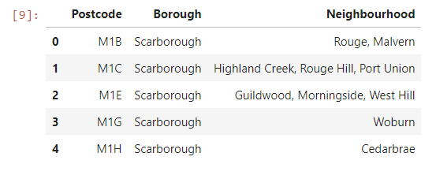
Data Cleaning
After scraping the data from the Wikipedia page using the beautiful soup, I then cleaned and created a data frame that contained the postal codes, boroughs, and neighborhoods.

Slide 5
Methodology
The main focus of this project is to identify the suitable place in which one can start a new restaurant in the city of Toronto.
The steps included in order to achieve our task are listed below.
Task 1: Retrieve the data of the Toronto city venues using the Foursquare API.
Task 2: Combine the venues of each neighborhood using K Means clustering algorithm.
Task 3: Get the top most venues of each location.
Task 4: Take the least venue where there are less number of restaurants available, so that one can get more profits because of less competition.
Task 5: The obtained Results can then be used to identify the suitable location for staring a new restaurant

Slide 6
Results
After doing all our analysis on exploring Toronto city, we got the places where there are less number of restaurants. These places can be used by the person who is planning to start a new business in the city of Toronto.
I used the less common places where the restaurants are available, so that one can use these places for starting a new restaurant

