Slide 1
Nauticana Cloud Applications

Slide 2
Nauticana Development Evolution
Nauticana Abstracted MVC Stack
Nauticana Cloud Applications
Nauticana Core Backend
Nauticana Web Frontend
Nauticana Mobile Frontend
Nauticana Core Cloud Backend
Nauticana Cloud Frontend
Spring boot
JPA
Hibernate
Abstracted MVC
RDBMS relation aware
Table based authorization
Super fast development
No REST
Man-hour Management
Runs on Oracle RDBMS, Solaris OS, Tomcat
ERP database
Functional authorization
Multi client
Business Service SLA
Runs on any RDBMS+Tomcat
Deployed on AWS EC2 and RDS instances
REST http services
RDBMS <-> JSON
Scenario based view
Multi object commit
Angular5 development
Scenario Based Components
NCB consumer services
Ionic mobile development
AWS Lambda Functions as Micro Services
Highly normalized RDBMS structure
Mobile First Angular Development
Minimal code foot print
- Everything abstracted, no repeating code
- Reusable Code Library
- OO principles respected both in backend and frontend
Near Zero Deployment Cost

Slide 3
Micro Services
Micro Services are good if;
There are isolated independent services
They are not complex
No concurrency requirements
Do NOT require complicated data structures
Do NOT need much computation resources
Data stored in simple No SQL storage
Can be deployed to serverless cloud services with Near Zero Cost
AWS Lambda
Google Cloud Functions
Frontend application can run on client environments with Near Zero Cost communicating cloud functions with simple JSON interfaces

Slide 4
Enterprise Requirements
In real world Enterprise Requirements
Functional requirements cannot be isolated from each other
There are
Complicated,
Tightly coupled,
Functionally dependent
A lot of business requirements
Ex: SAP ECC on Netweaver 7.5 has 106,000+ database tables
ACID requirements must be satisfied (Atomicity, Concurrency, Integrity, Durability)
Relational Theory addresses data requirements scientifically.
No SQL + Micro Services cannot address Enterprise Requirements solely.

Slide 5
Best of Breed
Use Micro Services to implement business functions while satisfying ACID requirements
Maintain subset of RDBMS as a NoSQL structure and respect Relation Theory
Use same code as
REST API back-end
AWS Lambda services
GCP Cloud Functions
Maintain minimum code footprint for huge Enterprise Systems

Slide 6








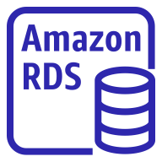
Simplified Architecture for AWS
AWS Cloud
Lambda
VPC
subnet
S3 bucket for
Angular Frontend static content
User
initial cost
= ~$10/month
$0.50/month
$0.17/1M call
(first 1M call free)
~$9.00/month
+
$0.115 per GB/month
~$0.04 per GB
/month

Slide 7
Simplified Architecture for GCP
AWS Cloud
Lambda
VPC
subnet
S3 bucket for
Angular Frontend static content
User
initial cost
= ~$10/month
$0.50/month
$0.17/1M call
(first 1M call free)
~$9.00/month
+
$0.115 per GB/month
~$0.04 per GB
/month

Slide 8
NCA Components
Component | Description | AWS Environment
NDB | Nauticana Database | AWS RDS (Any DB is ok)
NCB | Nauticana Core Back-end | AWS Lambda
NCF | Nauticana Cloud Frontend | Angular 9/10

Slide 9
Nauticana Database
Highly normalized (BCNF) relational database designed to satisfy business needs.
Each foreign key’s special meaning identified
Authorization objects and object actions
Roles and included authorizations
Menus and menu routing
Data access scenarios
Languages and text id ranslations are defined
Meta data of each table field analyzed for domain or table lookup.
Field display properties are identified

Slide 10
Nauticana Core Backend
Same code works for each “data access scenario”
Data transferred in JSON format
2 functions for all CRUD operations (get, post)
Additional lambda functions exist in Appendix
Same code used for REST API, AWS Lambda, Google Cloud Functions

Slide 11
Nauticana Cloud Frontend
Same code works for each data access scenario
Written Angular 9 / 10
Using PrimeNG to separate visual design completely from functional implementation
User interface look & feel is completely customizable
Static content served in AWS S3 buckets

Slide 12
Nauticana Cloud Applications
NCA has 13 modules
Basis
Accounting
Personnel
Material Management
Request Management
Sales
Procurement
Production Management
Equipment Maintenance
Shipment
Project Management
Helpdesk
Business Partner SLA

Slide 13
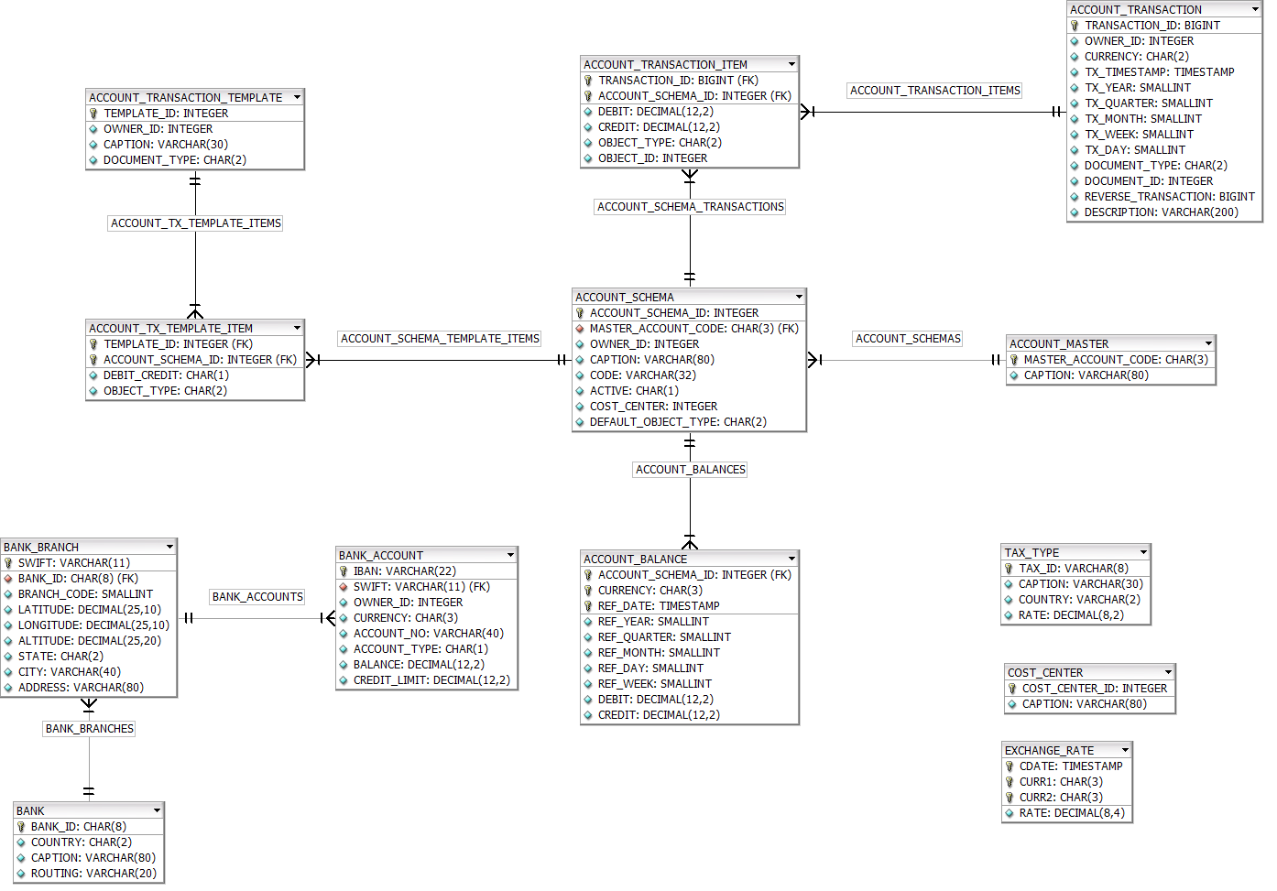
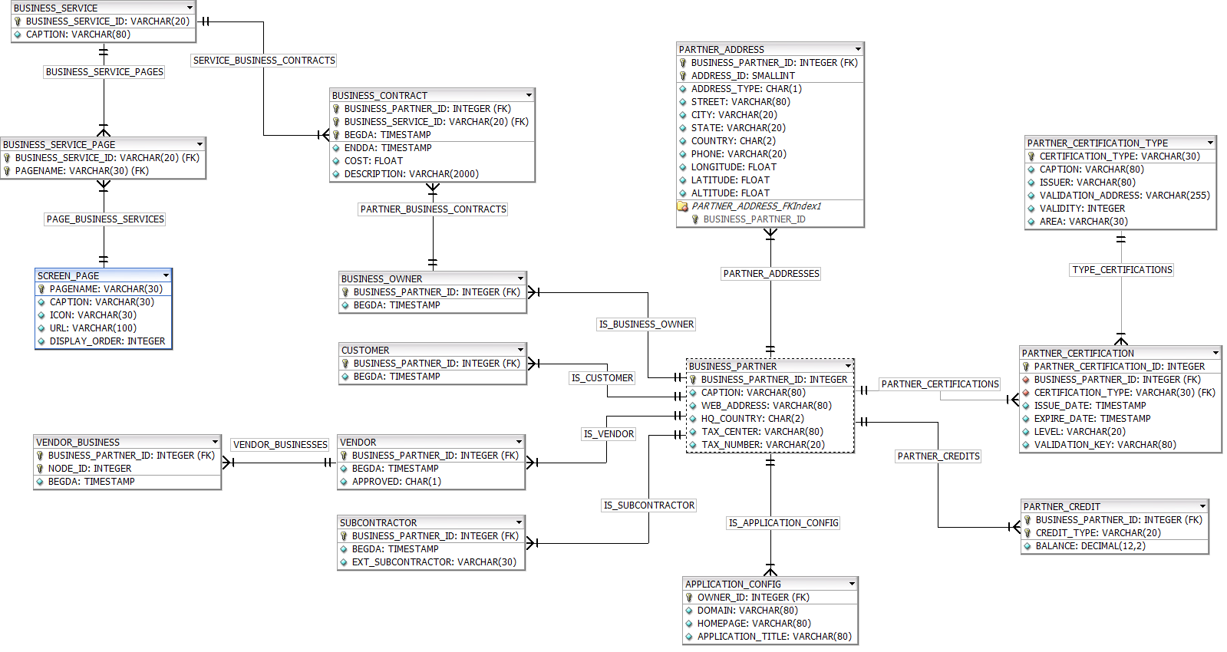
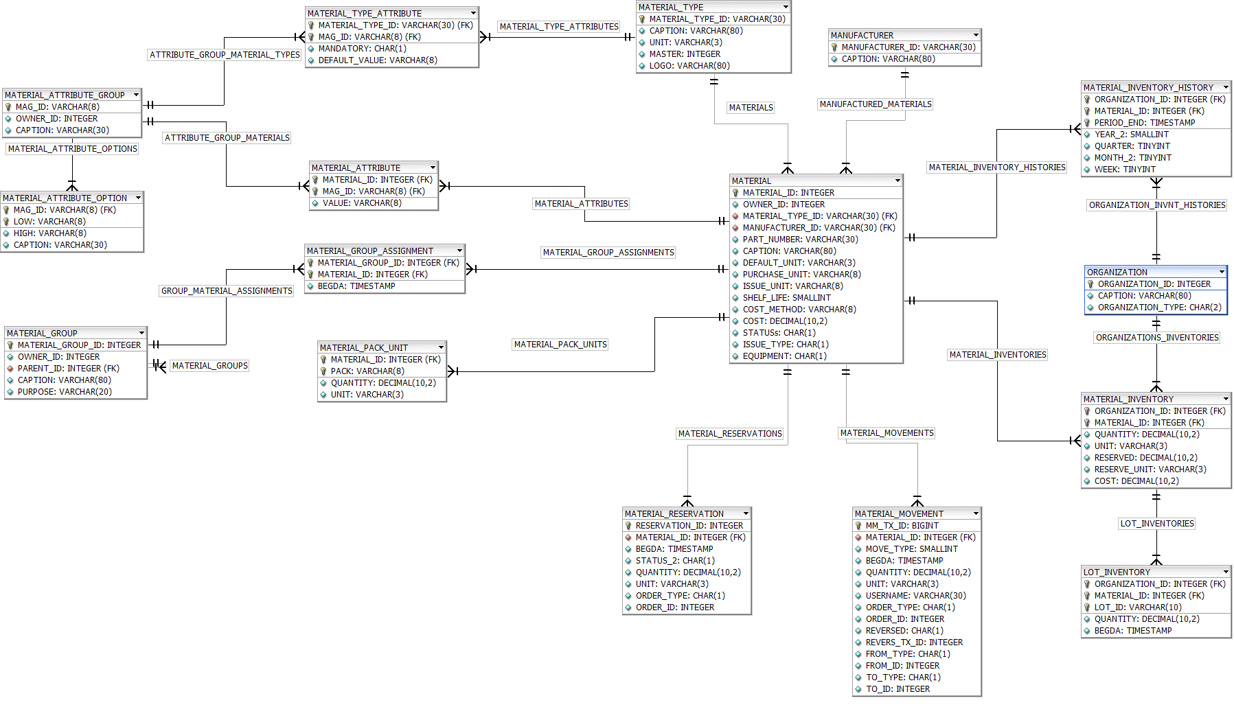
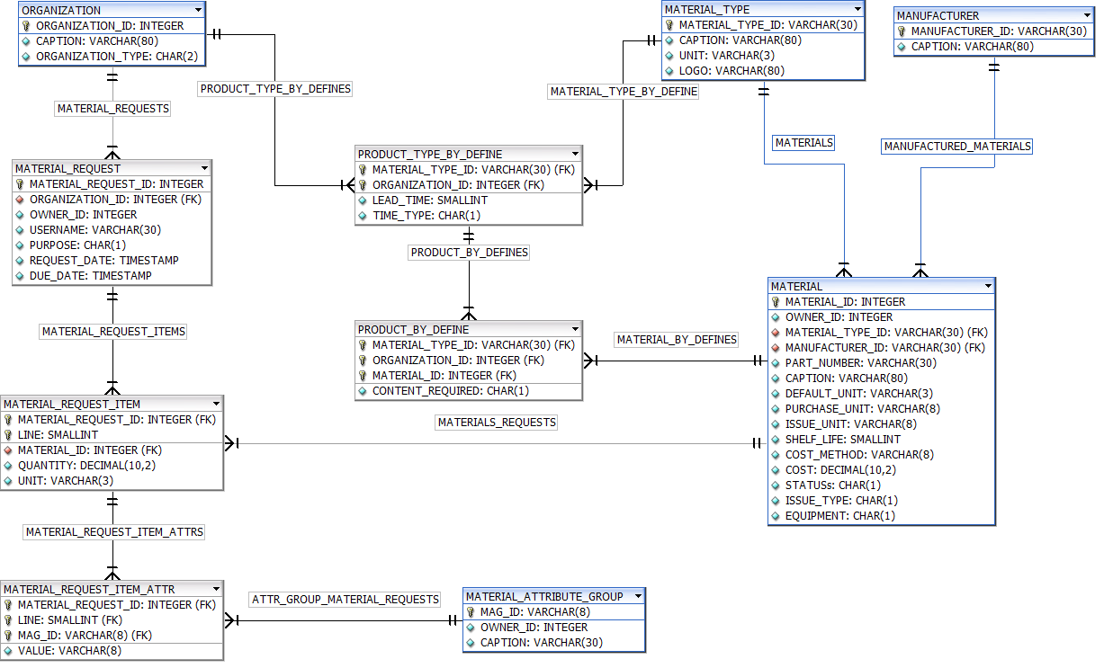
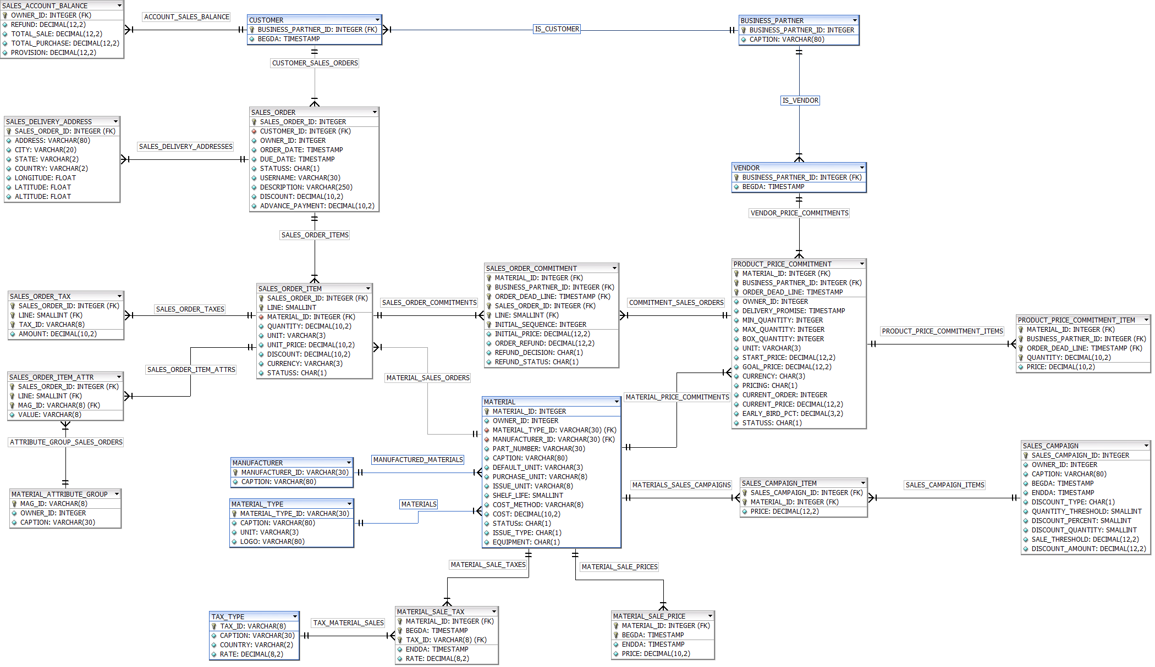
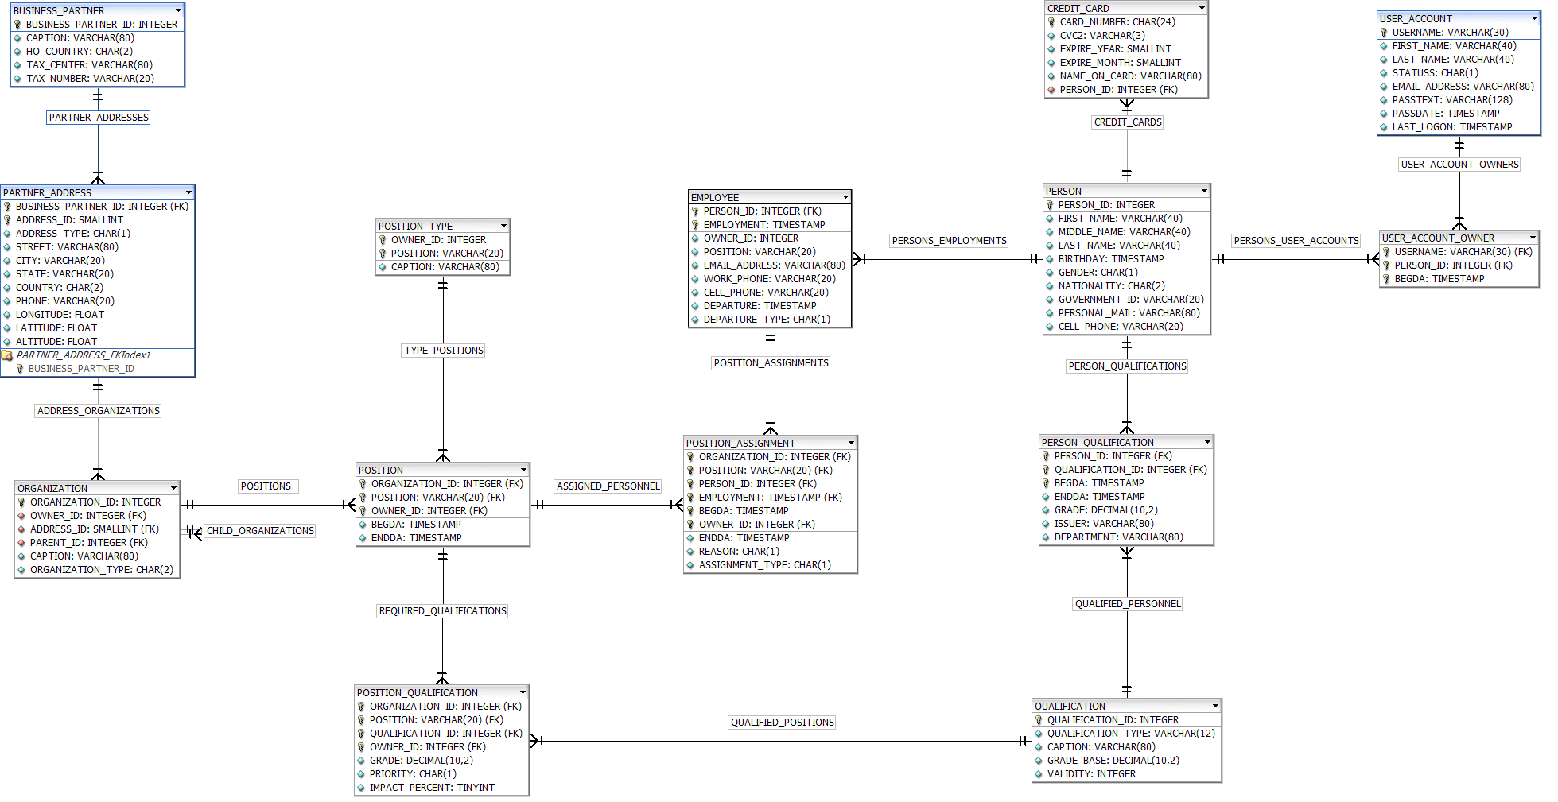
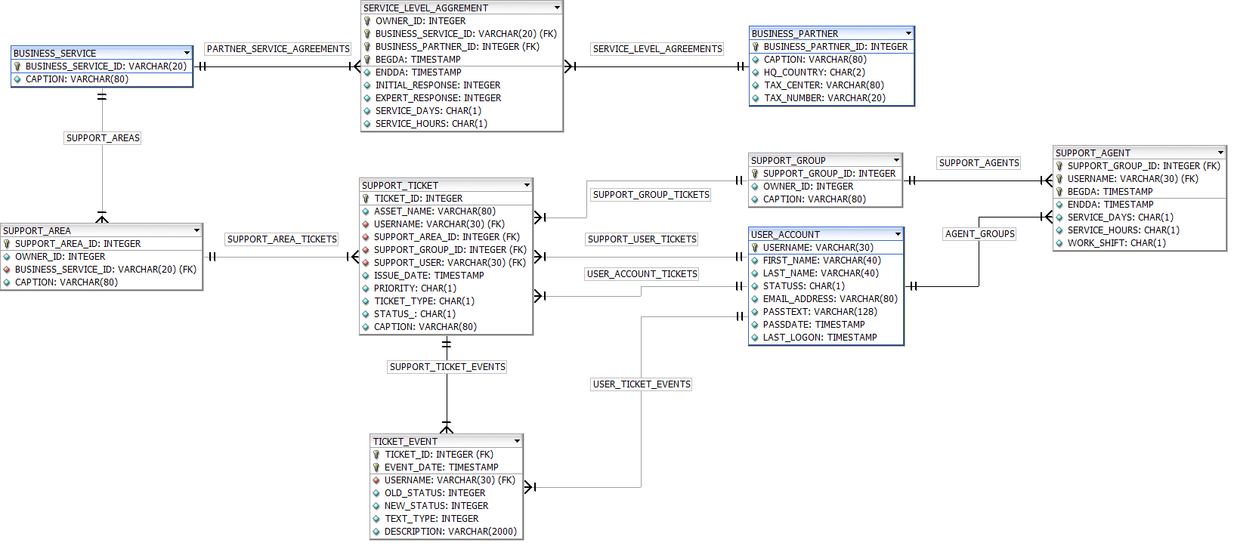
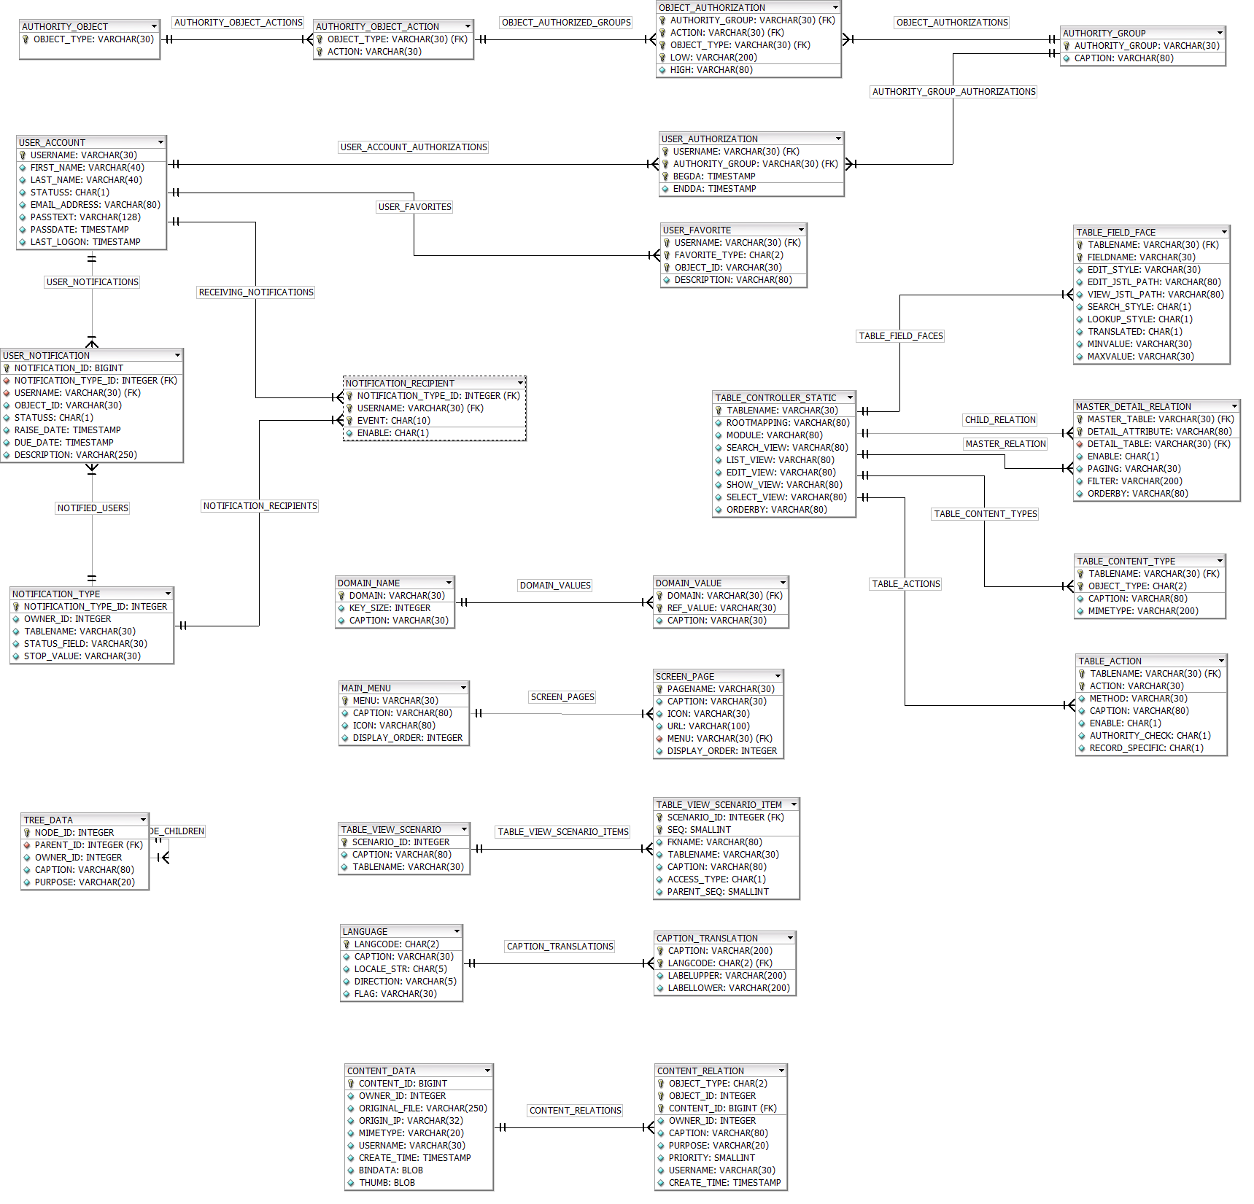
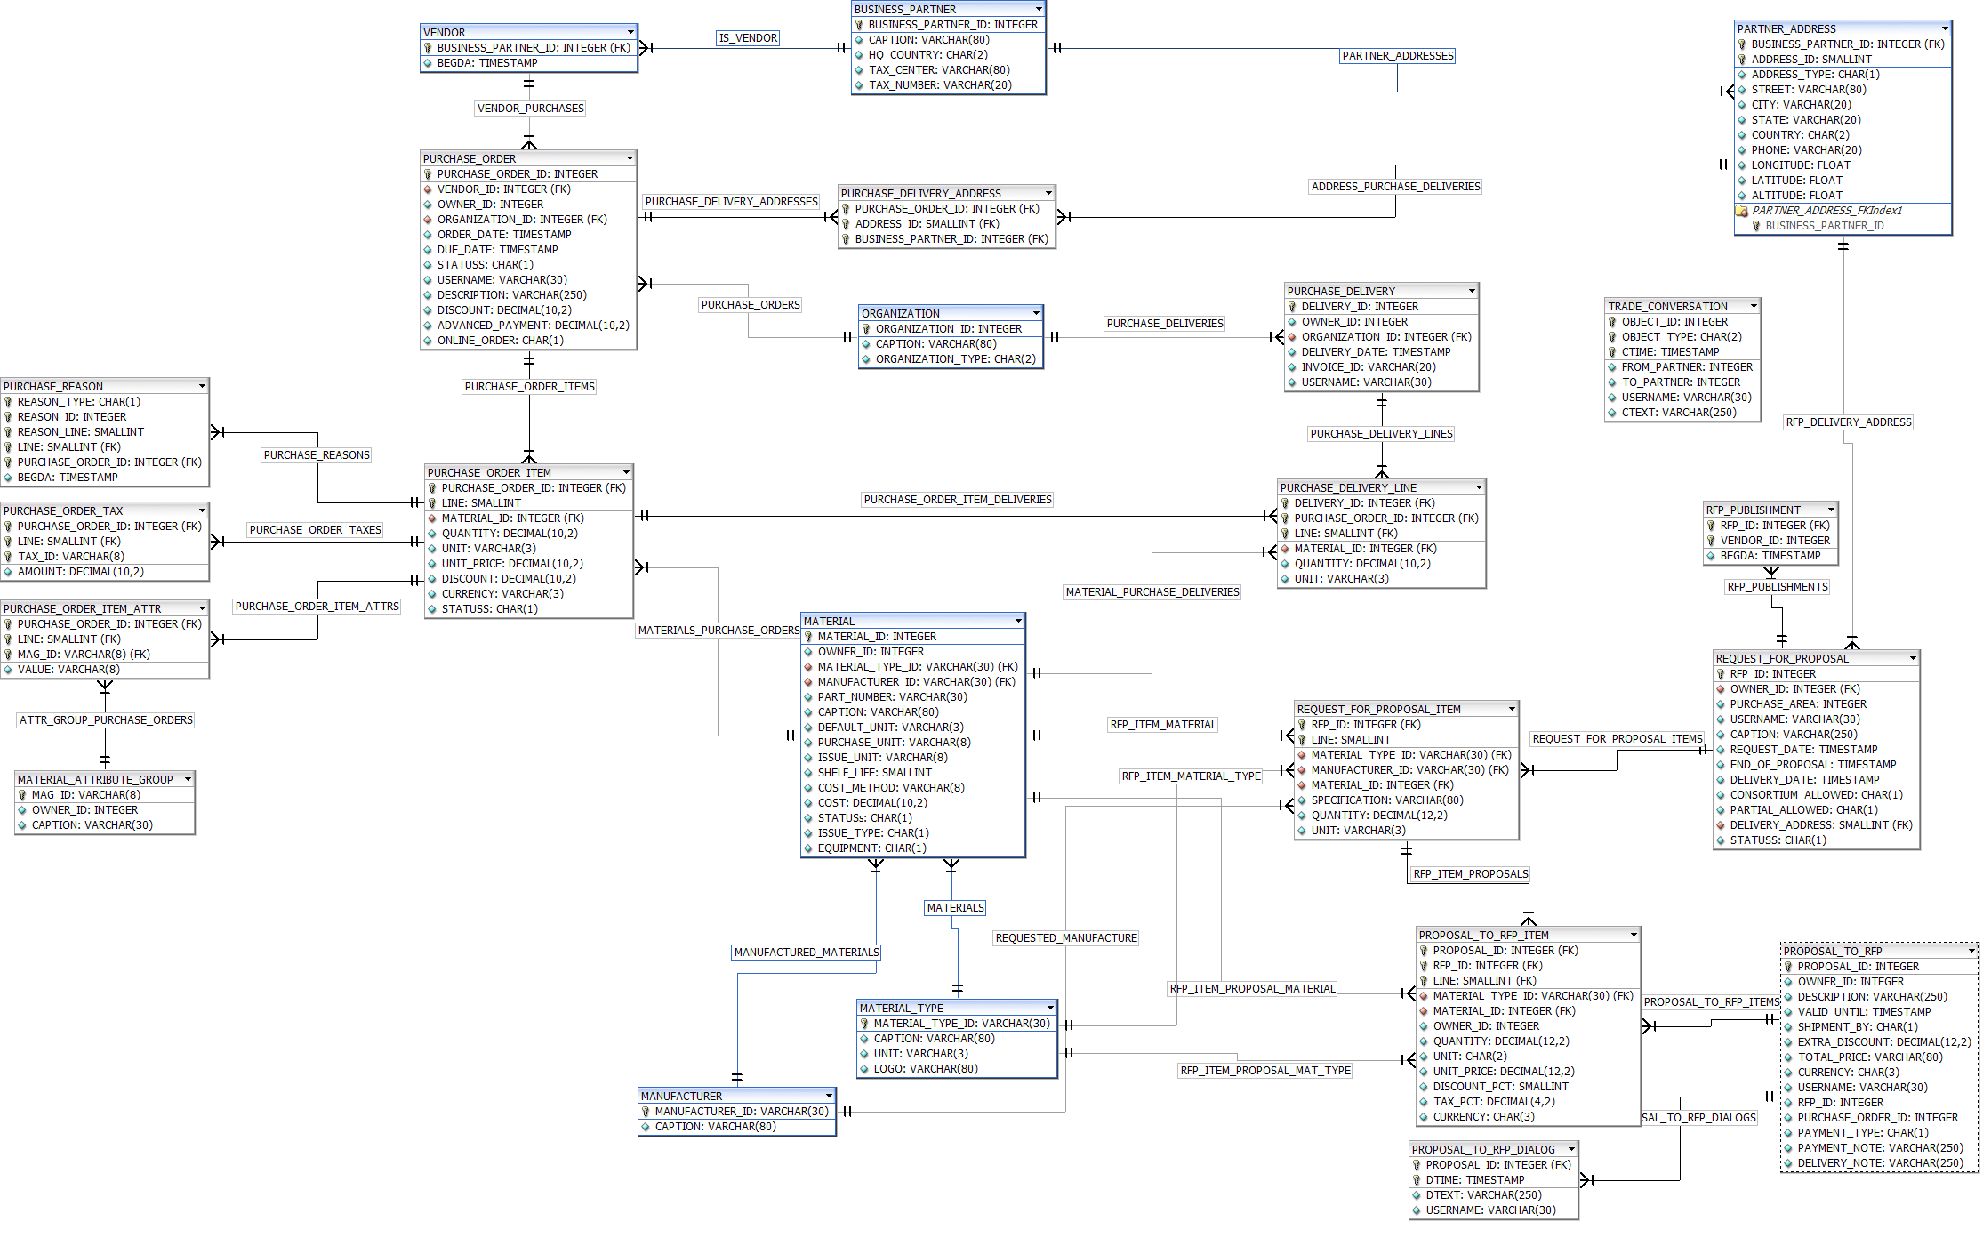
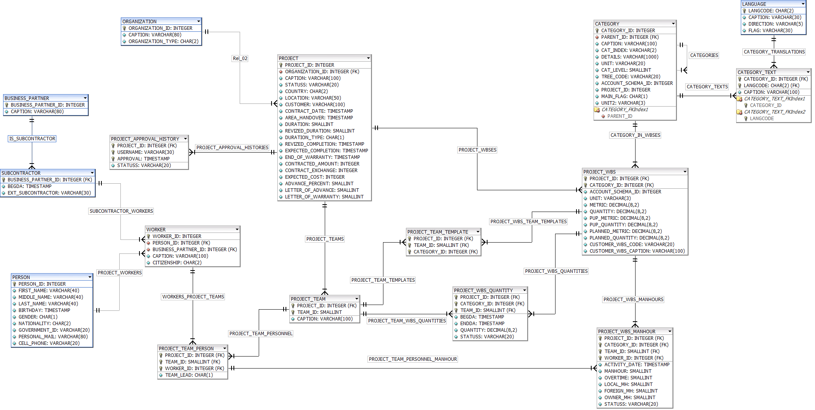
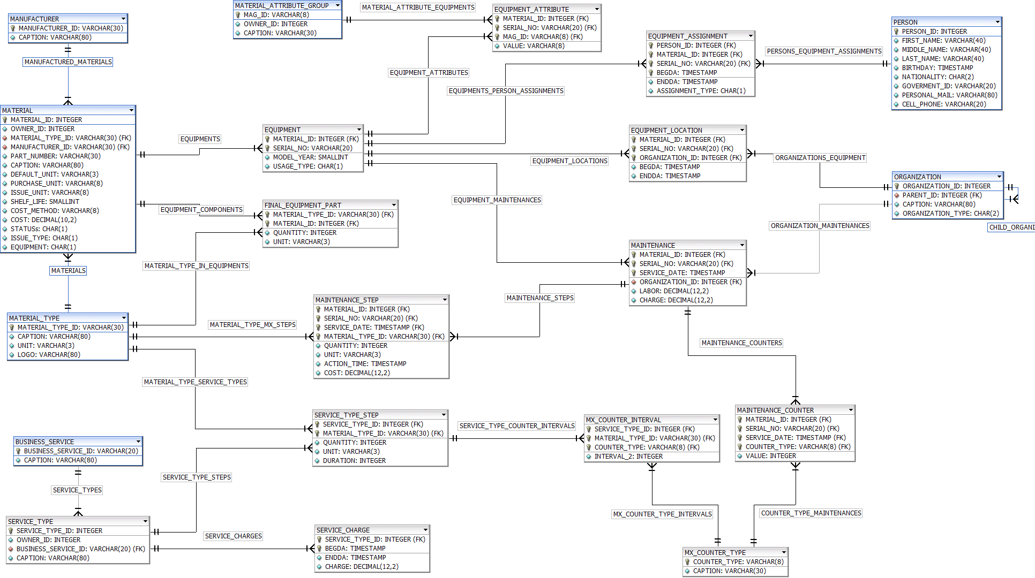
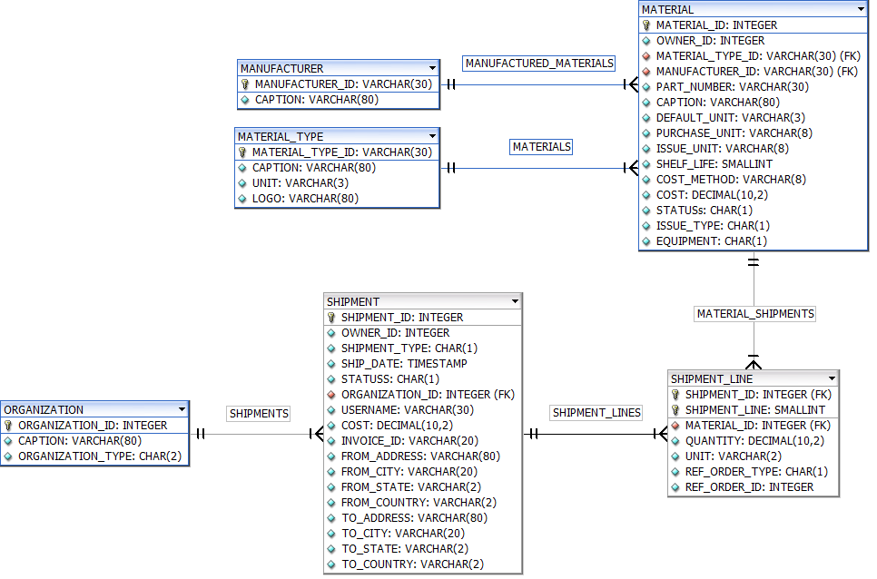
NCA Database Diagram Samples

Slide 14
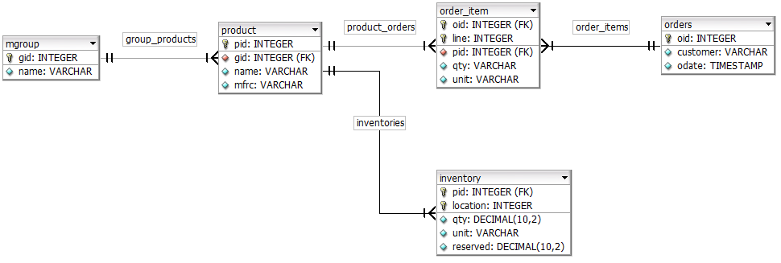
Scenario Based View
Requirements and Obstacles;
Data has different views based on functional requirement stand point
JPA does NOT know where to stop while generating JSON automatically
Irrelevant data causes application to freeze with expensive data access cost
Need to define access paths for each requirement

Slide 15
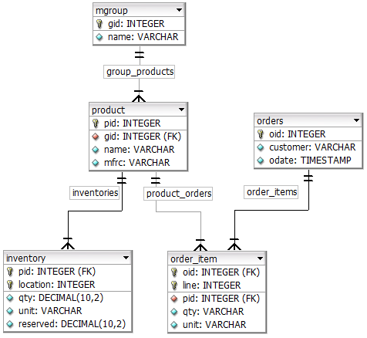
Possible Scenarios
All material groups with products
Order 183 with order items and related product data
Product 397 and inventories
Product 397 and awaiting orders
All inventories in location 261 with product data
All products

Slide 16
Sample Scenario on Same Data
All product groups with products
[{gid:1,
name:”shirts”,
group_products:[
{pid:1, gid:1, name:”shirt1”, mfrc:”vakko”},
{pid:2, gid:1, name:”shirt2”, mfrc:”beymen”}]},
{gid:2,
name:”shoes”,
group_products:[
{pid:3, gid:2, name:”shoe1”, mfrc:”nike”},
{pid:4, gid:2, name:”shoe2”, mfrc:”togo”}]}
]
Order 183 with order items and related product data
{oid:183,
customer:”Adam Smith”,
odate:”2017-12-12 14:32”
order_items:[
{oid:183, line:1,
qty:1, unit:EA,
product:{pid:1, gid:1, name:”shirt1”, mfrc:”vakko”}
},
{oid:183, line:1
qty:1, unit:EA
product:{pid:4, gid:2, name:”shoe2”, mfrc:”togo”}
}]
}

Slide 17
Scenario Definition
1st scenario: Material group with products
2nd scenario: Order with lines and related product data
Line | Parent | Caption | Tablename | Relation | Dir
1 |  | Product Groups | mgroup
2 | 1 | Products | product | group_products | L
Line | Parent | Caption | Tablename | Relation | Dir
1 |  | Order Details | orders
2 | 1 | Orders Items | order_item | order_items | L
3 | 2 | Product | product | product_orders | P
3rd Material with all details
Line | Parent | Caption | Tablename | Relation | Dir
1 |  | Product Details | product
2 | 1 | Group | mgroup | group_products | P
3 | 1 | Product Orders | order_item | product_orders | L
4 | 3 | Order | orders | order_items | P
5 | 1 | Inventories | inventory | inventories | L

Slide 18
Multi Object Commit
Frontend
Insert, update or delete data on multiple tables with multiple records in one Service Call
Less number of clicks and roundtrips
Backend
Get next value of sequence for new order id
Set order id of new child records with new id
Check multi-child consistencies
New Order
 | Order Id | (disabled)
 | Customer | _____________
 | Order date | __ /__ /____
Line | Product | Quantity | Unit
1 | Shirt1 | 1 | Each
2 | Shoe1 | 1 | Each
3 | Sock | 2 | Pack

Slide 19
Multi Object Display
New Order
 | Order Id | (disabled)
 | Customer | _____________
 | Order date | __ /__ /____
Line | Product | Quantity | Unit
1 | Shirt1 | 1 | Each
2 | Shoe1 | 1 | Each
3 | Sock | 2 | Pack
Multiple details separated by
tabs, sequential or ordered box displays
For parent key lookup,
select screen pops-up to choose
value from foreign key table.
Stores key but displays
text information
Items
Delivery address
Payment
For domain value lookup,
Dropdown list opens to chose
value from fixed value list.
Stores refvalue but displays
translated caption text

Slide 20
Back End Service
These Backend services can be deployed as Micro Services using
REST API
AWS Lambda Function
Google Cloud Function
https://<domainname>/getall?scenarioId=<id>
https://<domainname>/list?scenarioId=<id>
https://<domainname>/get?scenarioId=<id>&id=<id>
https://<domainname>/delete?scenarioId=<id>&id=<id>
https://<domainname>/put?scenarioId=<id>
https://<domainname>/route?scenarioId=<id>
https://<domainname>/classes
https://<domainname>/class?tableName=<id>
https://<domainname>/relations
https://<domainname>/login?username=..&passtext=..&langcode=<EN|DE|FR|TR|..>

Slide 21
t
c
n
n
?

