Slide 1
Coding Challenge
-Mustafa Khokhawala

Slide 2
The Ask
From the artifacts branch, use the voter-service-*.jar file and deploy it in the AWS environment
Automate the complete build out of the infrastructure along with the application dependencies
Make the application operational under

Slide 3
Solution Approach 1 – Cloudformation EC2
Design and develop the cloudformation template with the infrastructure components (vpc, subnets, ec2 instances etc)
Write a shell script / python program to trigger cloudformation through the AWS API
Write a python program to test the infrastructure by running the functional tests of the app (will need to research if there is a better way)
Note: As a part of the EC2 instance startup (using UserData) the application jar file will be downloaded from git and started using “java –jar voting-app”

Slide 4
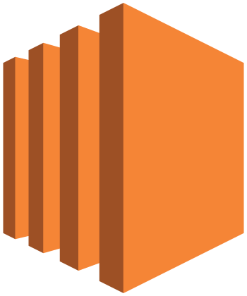

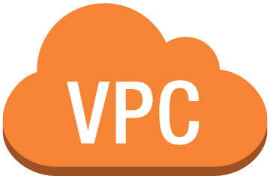
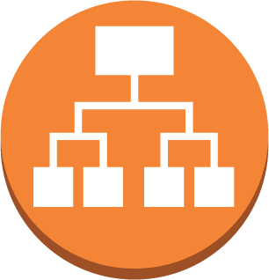

Draft schematic – Solution 1
Internet gateway
Availability Zone 1
Availability Zone 2
Public subnet 1
Public subnet 2
NAT
instance
Application Load Balancer
Private subnet 1
Private subnet 2
App
instance
App
instance
Auto Scaling group
VPC subnet
DB
instance
Notes:
1. Have left out the details of security groups, route tables etc. to reduce clutter. Will include a detailed diagram with the final submission.
2. MongoDB is not fault tolerant in this solution and will be as a single point of failure.

Slide 5
Solution Approach 2 – Cloudformation ECS
Design and develop the cloud formation template with the infrastructure components (vpc, subnets, ecs cluster, tasks)
Write a shell script / python program / Jenkins pipeline to
Download the jar file from git
Create a docker image using a Dockerfile
Push the Docker image to the ECS repo
Trigger cloudformation through the AWS API to build the ECS cluster, tasks etc
Write a python program to test the infrastructure by running the functional tests of the app (will need to research if there is a better way)
Note: The ECS repo will be pre-created either thru cloudformation or AWS API

Slide 6
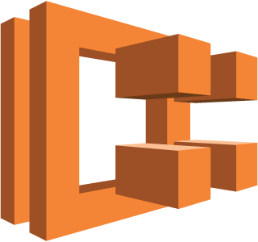

Draft schematic – Solution 2
Internet gateway
Availability Zone 1
Availability Zone 2
Public subnet 1
Public subnet 2
NAT
instance
Application Load Balancer
Private subnet 1
Private subnet 2
App container 1
DB container
App container 2
Auto Scaling group
Notes:
1. Have left out the details of security groups, route tables etc. to reduce clutter. Will include a detailed diagram with the final submission.
2. MongoDB is not fault tolerant and will be a single point of failure.

