Slide 1
Coding Challenge
-Mustafa Khokhawala

Slide 2
The Ask
From the artifacts branch, use the voter-service-*.jar file and deploy it in the AWS environment
Automate the complete build out of the infrastructure along with the application dependencies
Make the application operational under

Slide 3
Solution Approach 1 – CloudFormation EC2
Design and develop the cloudformation template with the infrastructure components (vpc, subnets, ec2 instances etc)
Write a shell script / python program to trigger cloudformation through the AWS API
Write a python program to test the infrastructure by running the functional tests of the app (will need to research if there is a better way)
Note: As a part of the EC2 instance startup (using UserData) the application jar file will be downloaded from git and started using “java –jar voting-app”

Slide 4



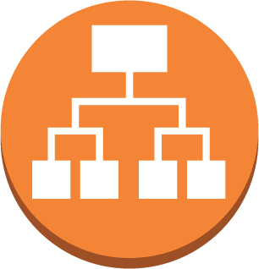

Draft schematic – Solution 1
Internet gateway
Availability Zone 1
Availability Zone 2
Public subnet 1
Public subnet 2
NAT
instance
Application Load Balancer
Private subnet 1
Private subnet 2
App
instance
App
instance
Auto Scaling group
VPC subnet
DB
instance
Notes:
1. Have left out the details of security groups, route tables etc. to reduce clutter. Will include a detailed diagram with the final submission.
2. MongoDB is not fault tolerant in this solution and will be as a single point of failure.

Slide 5
Solution Approach 2 – CloudFormation ECS
Design and develop the cloud formation template with the infrastructure components (vpc, subnets, ecs cluster, tasks)
Write a shell script / python program / Jenkins pipeline to
Download the jar file from git
Create a docker image using a Dockerfile
Push the Docker image to the ECS repo
Trigger cloudformation through the AWS API to build the ECS cluster, tasks etc
Write a python program to test the infrastructure by running the functional tests of the app (will need to research if there is a better way)
Note: The ECS repo will be pre-created either thru cloudformation or AWS API

Slide 6
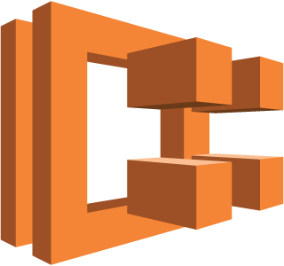

Draft schematic – Solution 2
Internet gateway
Availability Zone 1
Availability Zone 2
Public subnet 1
Public subnet 2
NAT
instance
Application Load Balancer
Private subnet 1
Private subnet 2
App container 1
DB container
App container 2
Auto Scaling group
Notes:
1. Have left out the details of security groups, route tables etc. to reduce clutter. Will include a detailed diagram with the final submission.
2. MongoDB is not fault tolerant and will be a single point of failure.

Slide 7
Solution Approach 1 – Real world
Approach
Decompose the cloud formation template into
Base infrastructure like VPC, Subnets, route tables etc. and Mongo DB EC2
Application infrastructure like load balancers, auto scaling groups and launch configurations
One time setup
Deploy the cloud formation template with the infrastructure components (vpc, subnets, route tables, security groups, load balancers and MongoDB)
For every deployment
Update the EC2 launch configuration to include the latest voter service jar and update the cf stack through a Jenkins CI pipeline

Slide 8
Solution Approach 2 – Real world
One time setup
Deploy the cloud formation template with the infrastructure components (vpc, subnets, route tables, security groups, clusters, load balancers and MongoDB)
Write a shell script / python program / Jenkins pipeline to
Download the jar file from git
Create a docker image using a Dockerfile
Push the Docker image to the ECS repo
Trigger cloudformation through the AWS API to build the ECS cluster, tasks etc
Write a python program to test the infrastructure by running the functional tests of the app (will need to research if there is a better way)
Note: The ECS repo will be pre-created either thru cloudformation or AWS API

