Slide 1



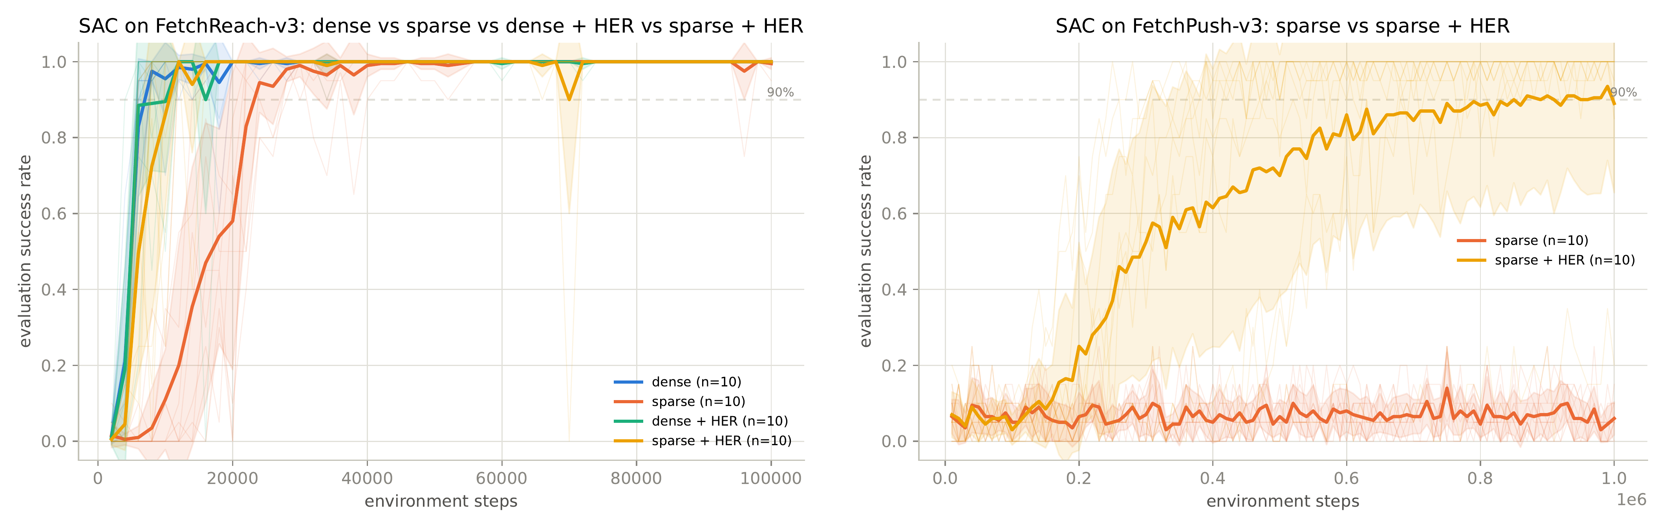
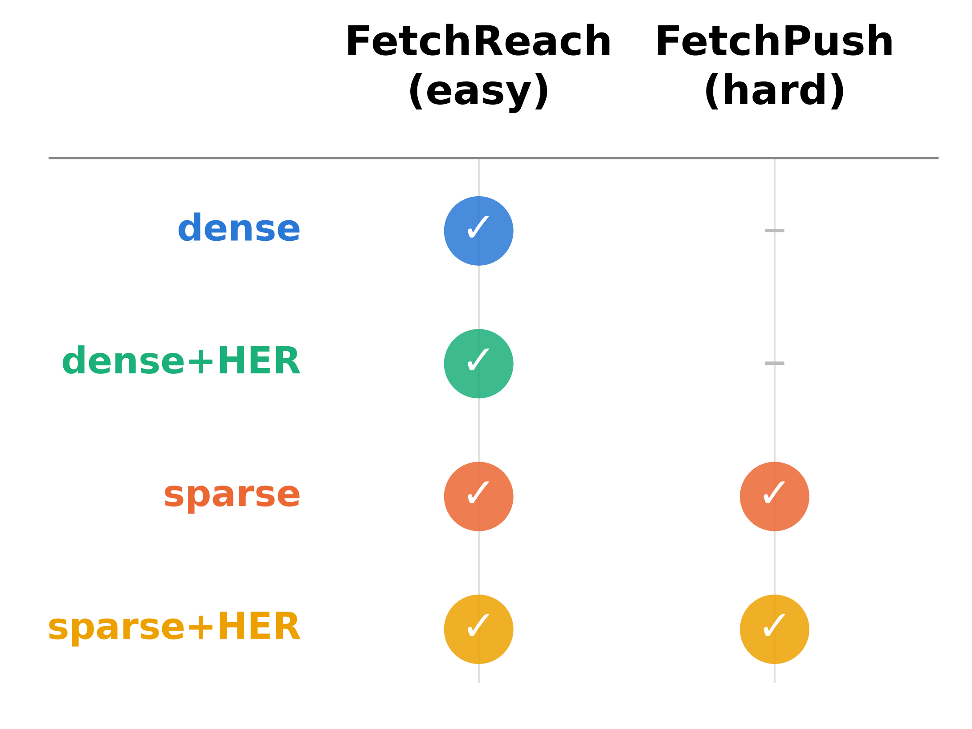
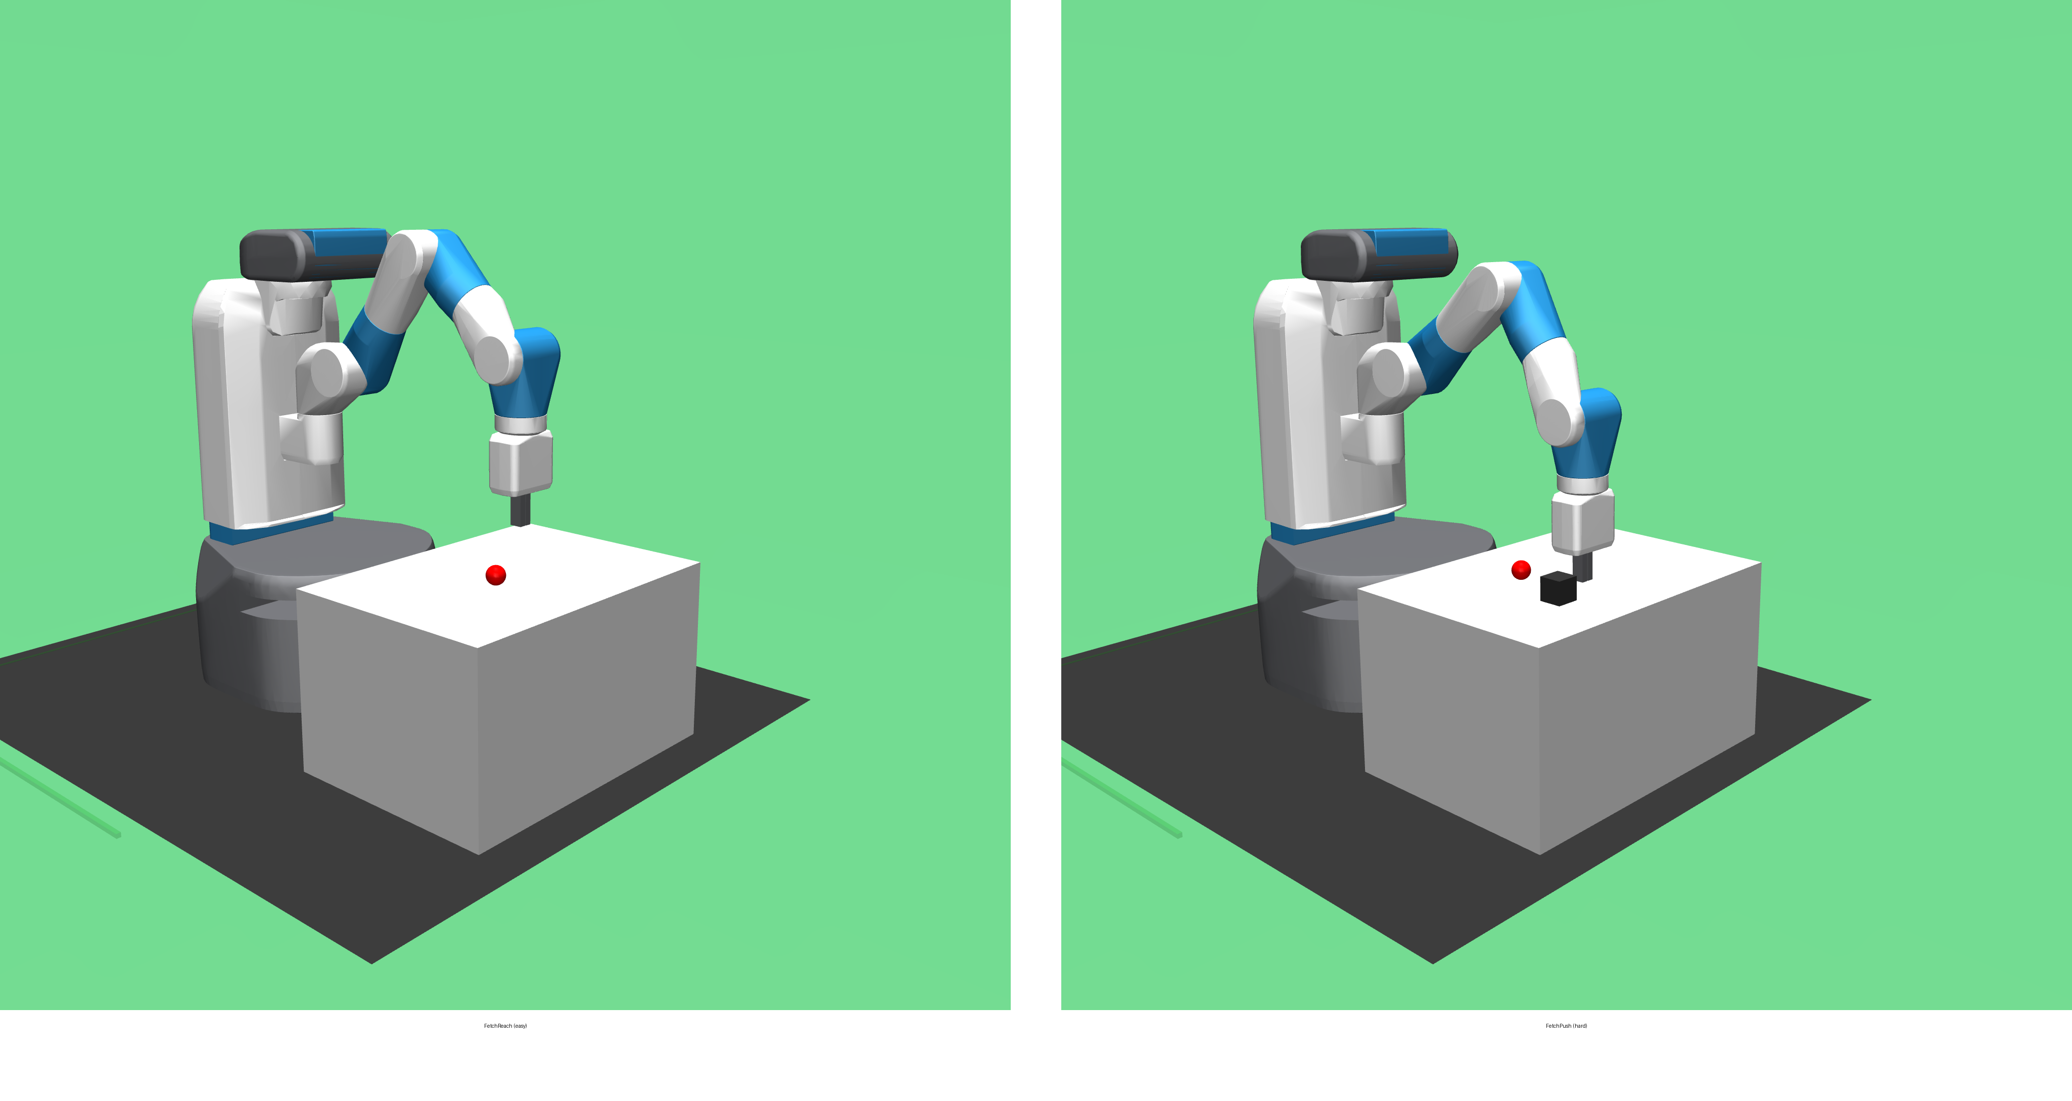
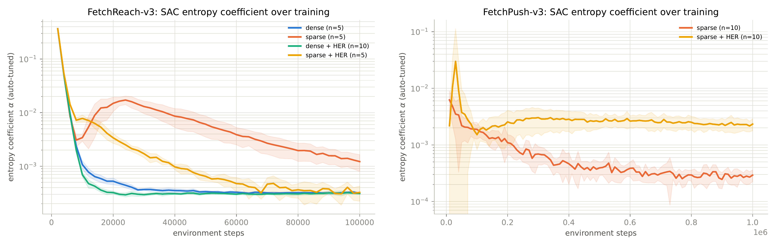
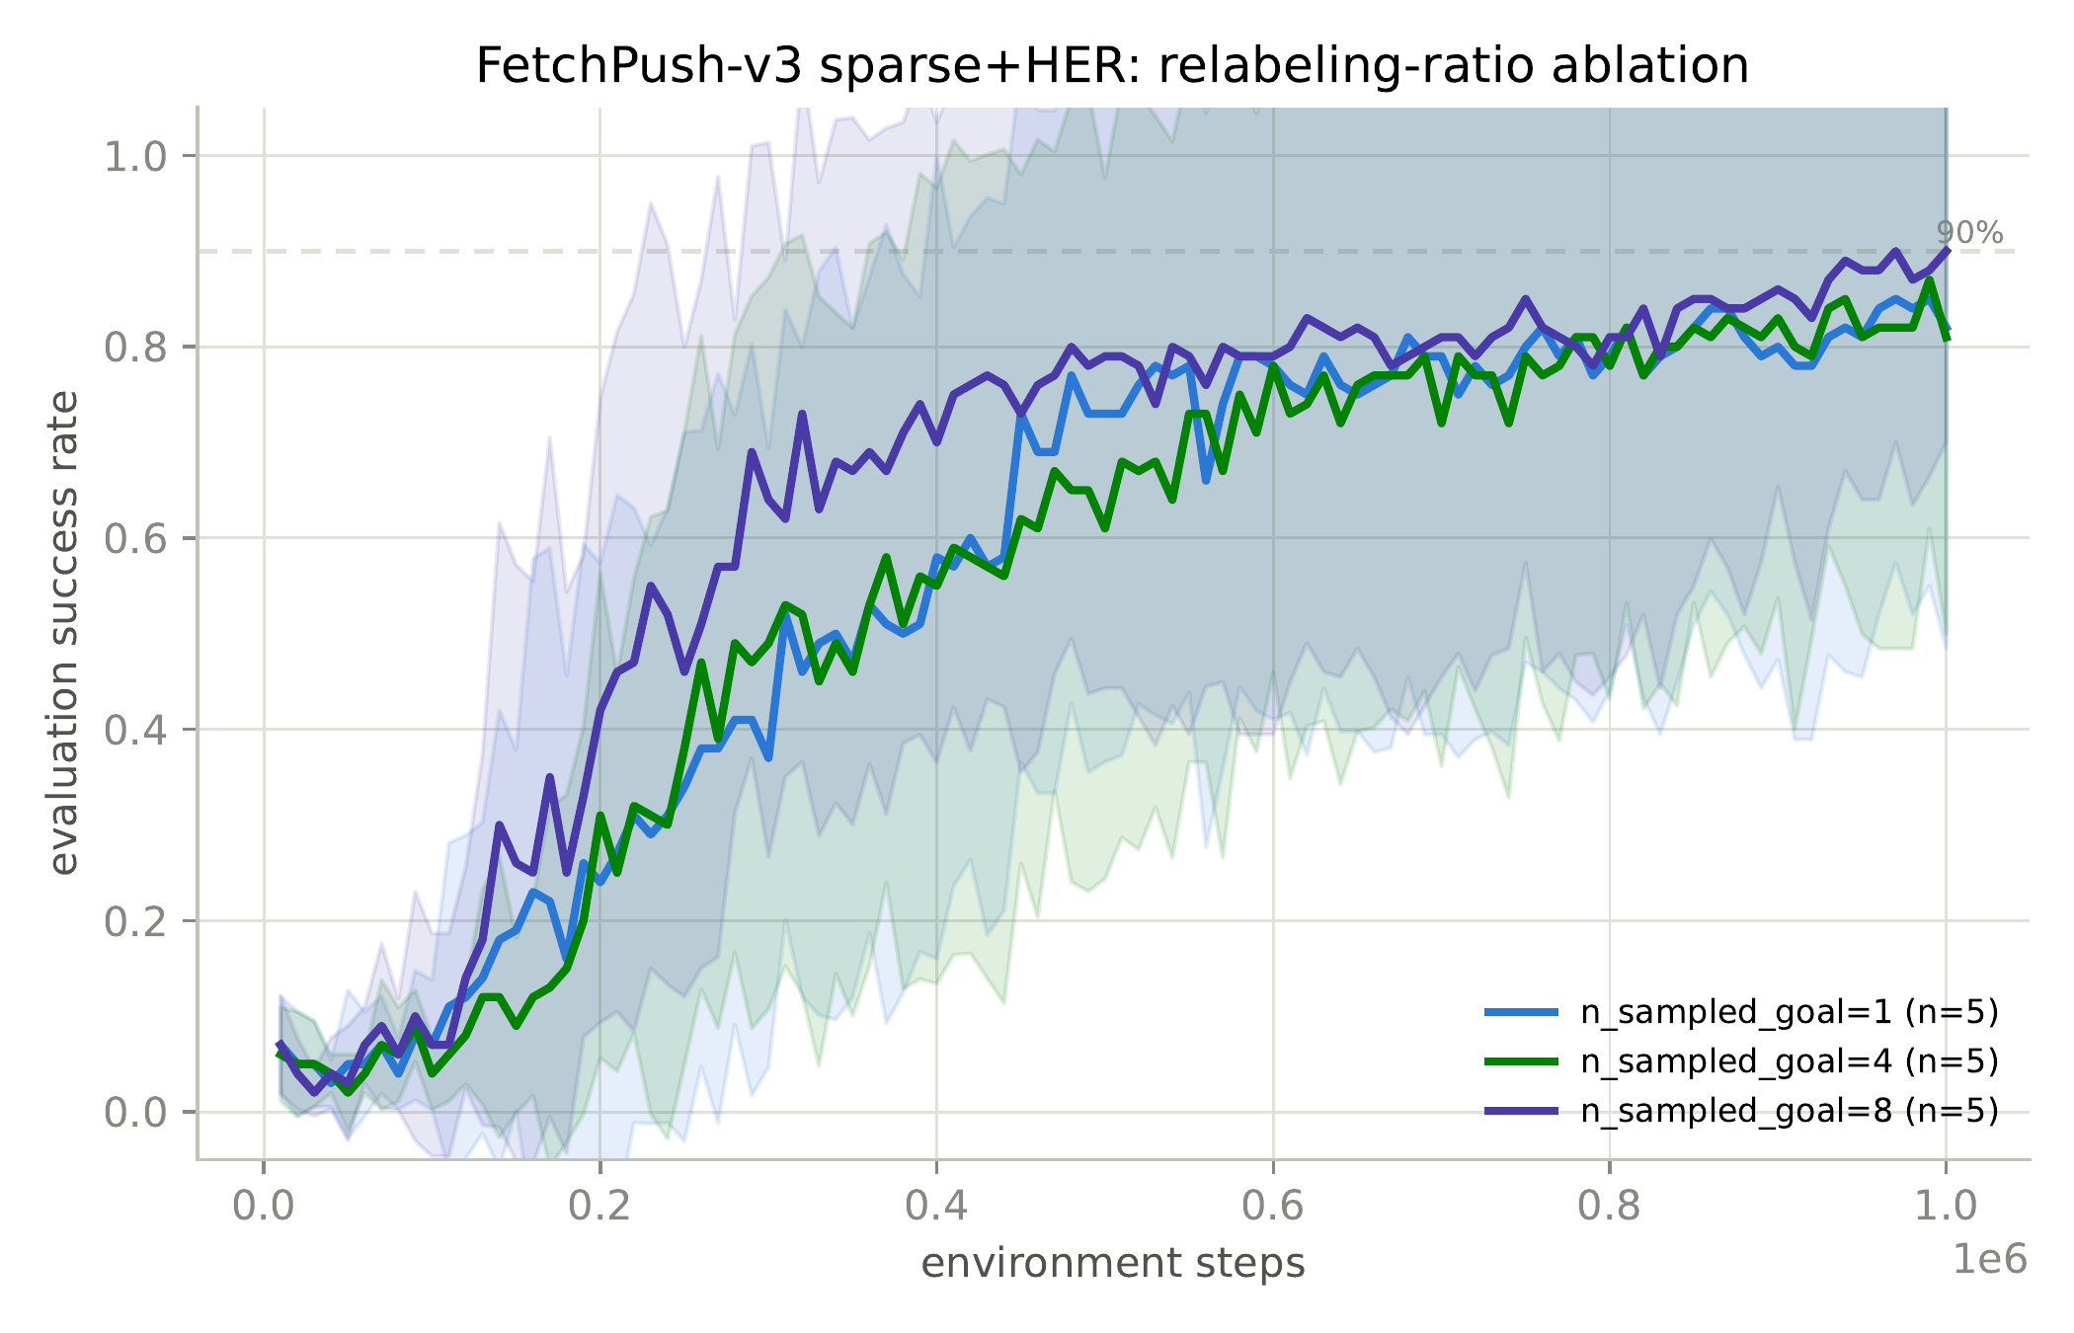

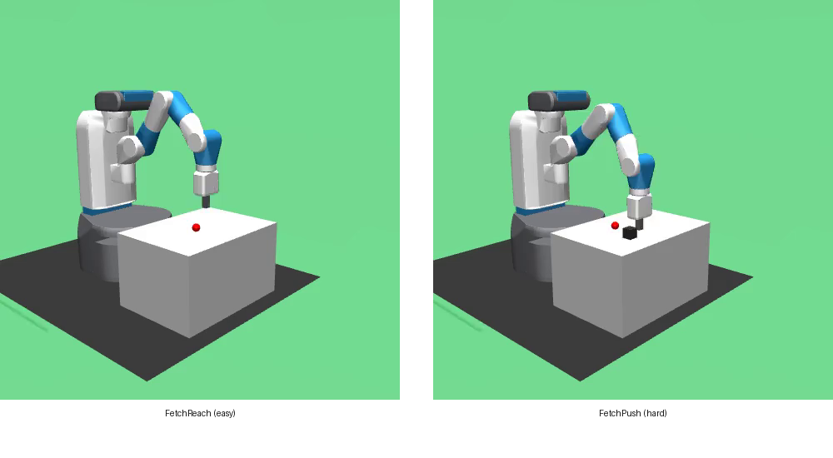
When and Why Does Hindsight Experience Replay Improve Soft Actor-Critic under Sparse Rewards?
Author(s): Mustafa Asfari, Mohammad Alkhozami
Poster Presentations in context of ADRL Lecture
TL;DR
Motivation & Problem Setting
1
1
2
HER turns SAC's sparse-reward failure into success — and the harder the task, the bigger the difference.
Motivation
Sparse, binary rewards are the most natural way to specify a robotic task — but they give the agent no signal on how to improve (Andrychowicz et al., 2017)
HER is known to help under sparse rewards — but when it matters most and why it works is unclear
Problem Setting
Does HER's benefit scale with task difficulty, and what training-dynamics mechanism drives it?
Approach
3
4 conditions (dense / dense+HER / sparse / sparse+HER) × 2 tasks: FetchReach (easy) vs FetchPush (hard)
SAC (Stable-Baselines3) + HerReplayBuffer, identical hyperparameters everywhere
70 runs total, 5–10 seeds/condition
Track SAC's entropy coefficient α + goal-distance distribution to probe the mechanism
Ablation: HER relabeling ratio n_sampled_goal ∈ {1, 4, 8}
Key Insights
4
Easy task: all 4 conditions succeed; HER just 2.75× faster
Hard task: sparse SAC never learns (5–6%); sparse+HER reaches 91% mean (99% median)
Why: without HER, α collapses ~21× before the task is solved (false convergence); with HER, α stays 8× higher → sustained exploration
More relabeling saturates, doesn't compound
Future Works
5
Cleaner curriculum metric (real-goal-only transitions) for Push
Test on a third, harder Fetch task
Formal significance testing across seeds
Code, data & full report
github.com/mustafa99705/-adrl-sac-her-fetchreach
References
Andrychowicz et al., Hindsight Experience Replay, NeurIPS 2017
Haarnoja et al., Soft Actor-Critic, ICML 2018

