Slide 1










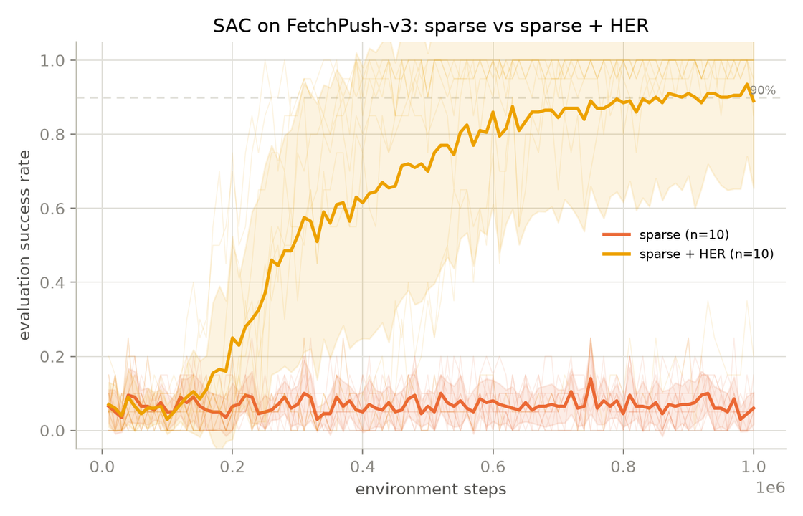
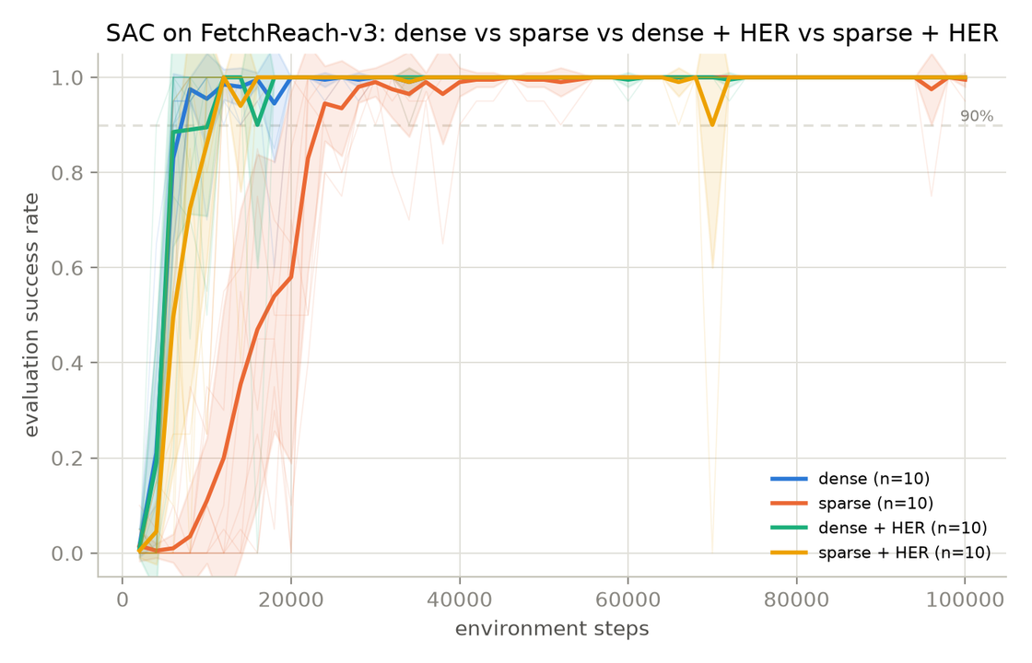
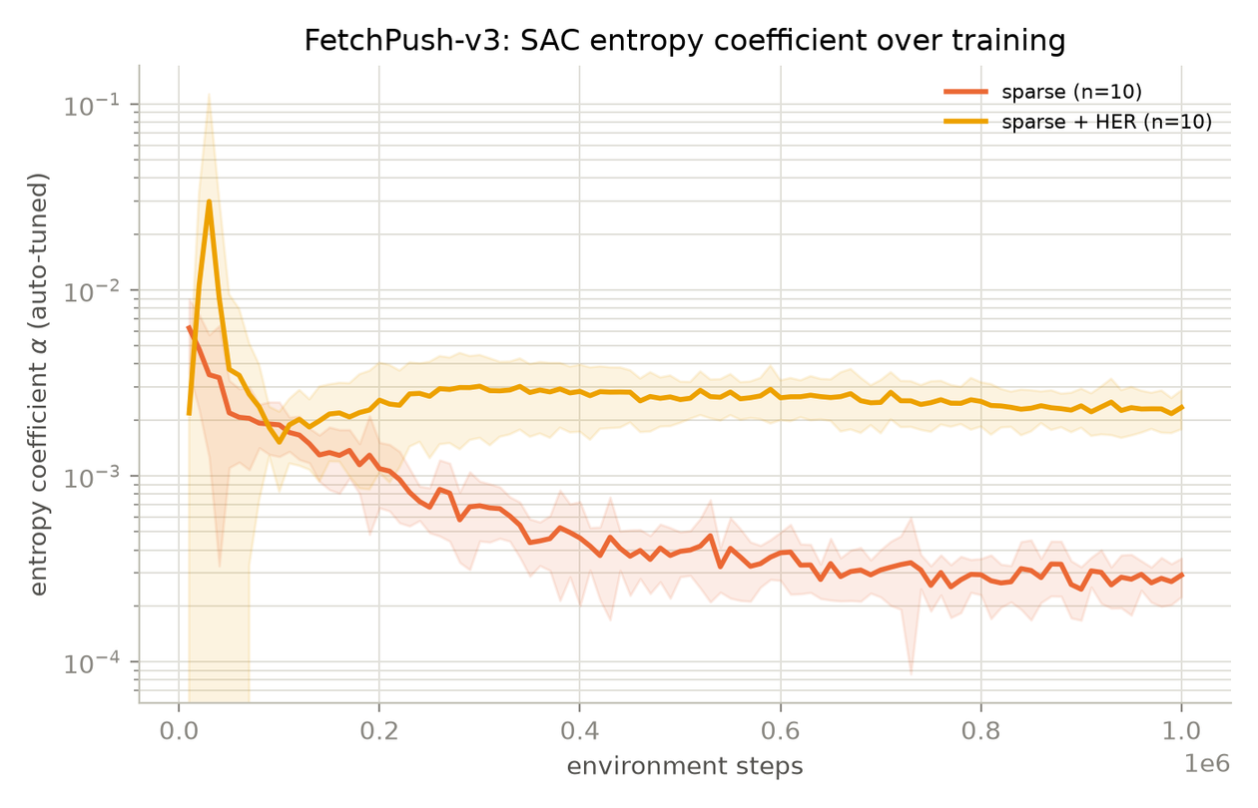
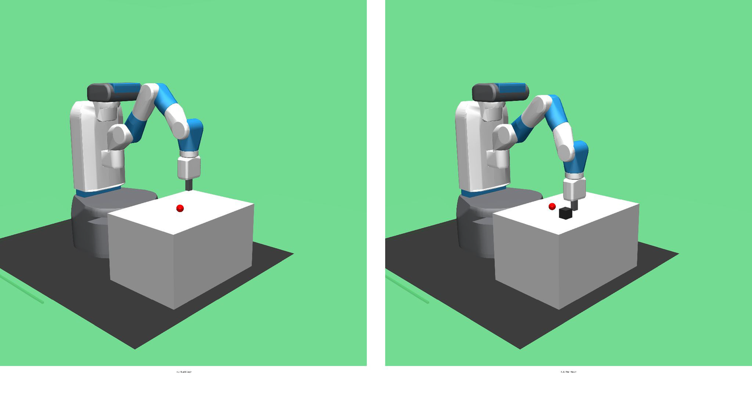
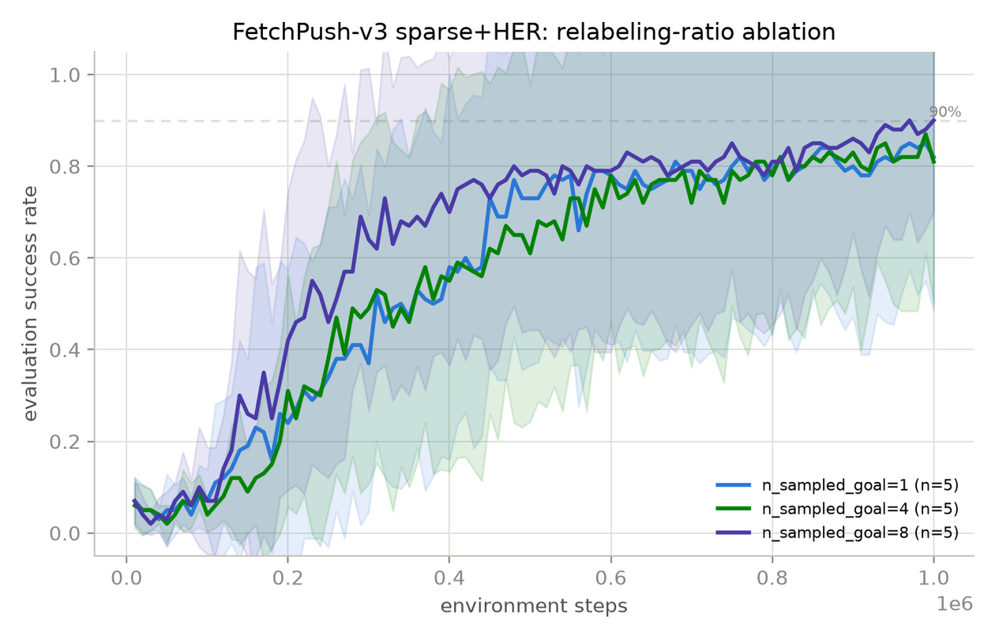

When and Why Does Hindsight
Experience Replay Improve Soft
Actor-Critic under Sparse Rewards?
Author(s): Mustafa Asfari, Mohammad Alkhozami
Poster Presentations in context of ADRL Lecture
TL;DR
1
TL;DR
2
Motivation & Problem Setting
sparse SAC
FetchReach
sparse SAC +HER
Motivation
Problem Setting
steps
22K
2.75× faster
steps
8K
Sparse rewards provide very little learning signal, which makes successful behavior hard to discover. [Andrychowicz et al., HER, 2017]
SAC can spend many steps learning from failed experiences.
HER reuses failed experiences by changing the goal to one that was actually reached.
Compare easy FetchReach-v3 vs. harder FetchPush-v3.
Compare sparse SAC vs. sparse SAC + HER.
Ask:
When does HER matter most?
Why does it help?
Does more relabeling always help?
sparse SAC
FetchPush
sparse SAC +HER
Mean final success
5.4%
Mean final success
90.7%
seeds reached ≥90% success without HER 0/10
seeds reached ≥90% success without HER 9/10
TL;DR
4
Key Insights
Approach
3
FetchReach-v3 (easy): 4 conditions [dense], [dense+HER], [sparse], [sparse+HER].
FetchPush-v3 (hard): 2 conditions [sparse], [sparse+HER].
SAC (Stable-Baselines3) + HerReplayBuffer, using the same hyperparameters across conditions.
70 main runs total, with 10 seeds per main condition and 5 seeds per ablation setting.
Track SAC’s entropy coefficient α and the goal-distance distribution to study the training dynamics.
HER ablation:
nsampled_goal ​∈ {1,4,8}
Key Insight 1: HER matters more on the harder task
HER is a modest speedup on FetchReach, but much more important on FetchPush.
Approach
Key Insight 2: HER is linked to healthier entropy dynamics
On FetchPush, SAC without HER becomes low-entropy while it is still failing.
FetchPush-v3
FetchReach-v3
Key Insight 3: More relabeling is not always better
Increasing HER relabeling helps mainly with speed, not final performance.
Future Works
5
Cleaner curriculum metric (real-goal-only
transitions) for Push
Test a harder Fetch task
Statistical significance across seeds
Code, data & full report
github.com/mustafa99705/-adrl-sac-her-fetchreach

