Slide 1
Comparative study between Cannon’s Algorithm and Simple B-B Partitioning for Matrix Multiplication
By - Mustafa Kapadia, Sahil Gandhi, Sarthak Kothari, Siddhant Benadikar

Slide 2
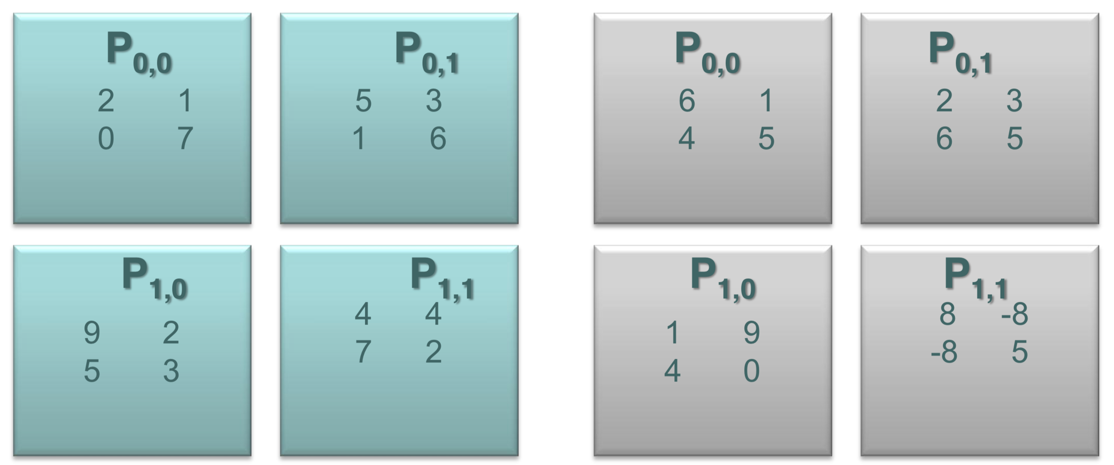
Cannon’s Algorithm – How does it work?

Slide 3
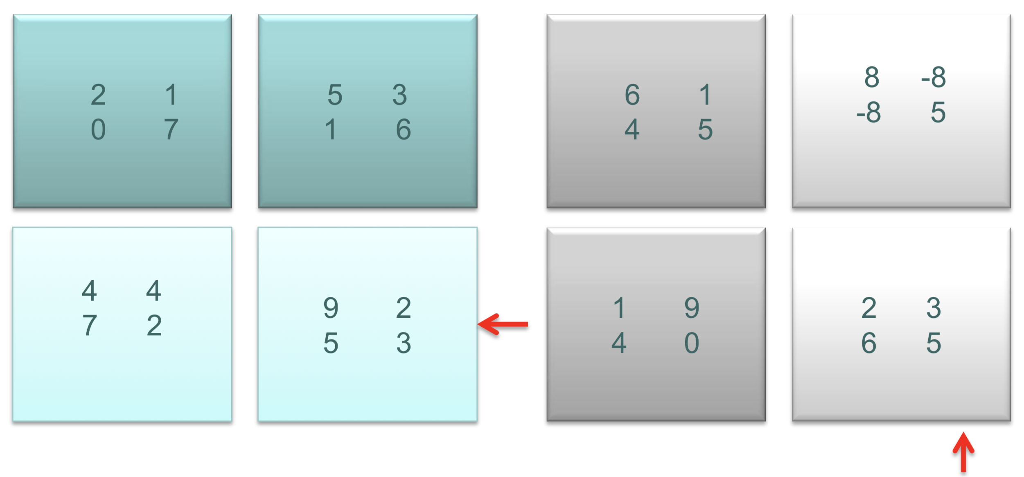
After Initial Alignment

Slide 4
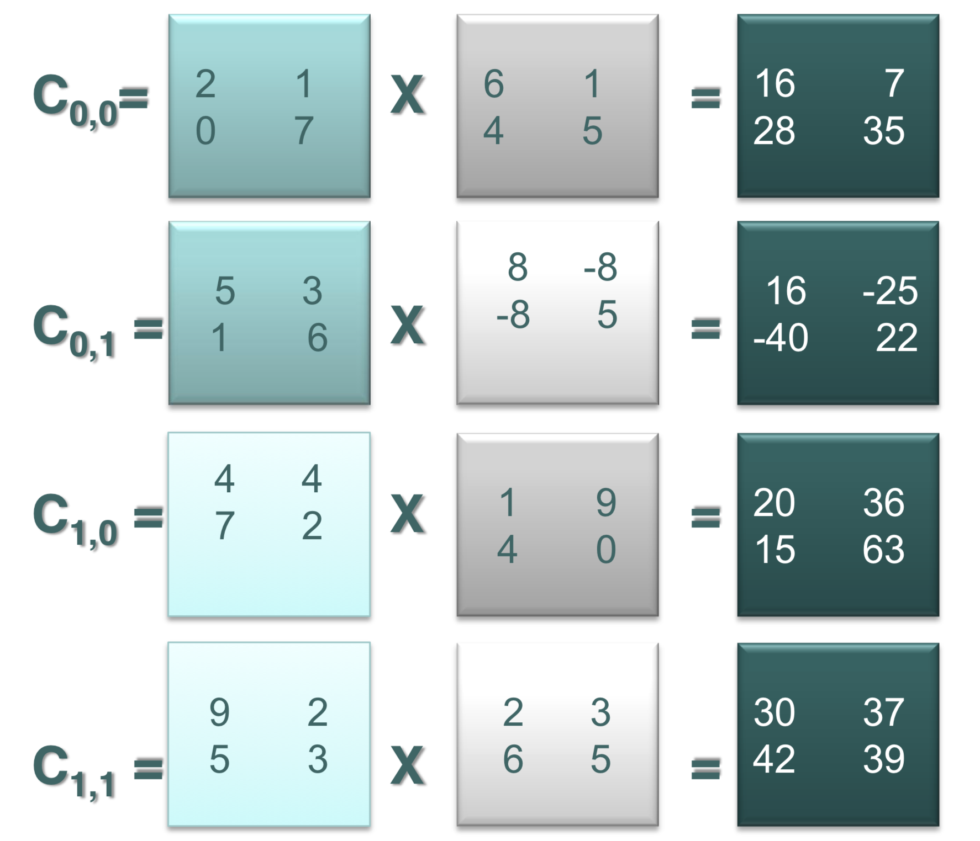
Local Matrix Multiplication for intermediate results

Slide 5
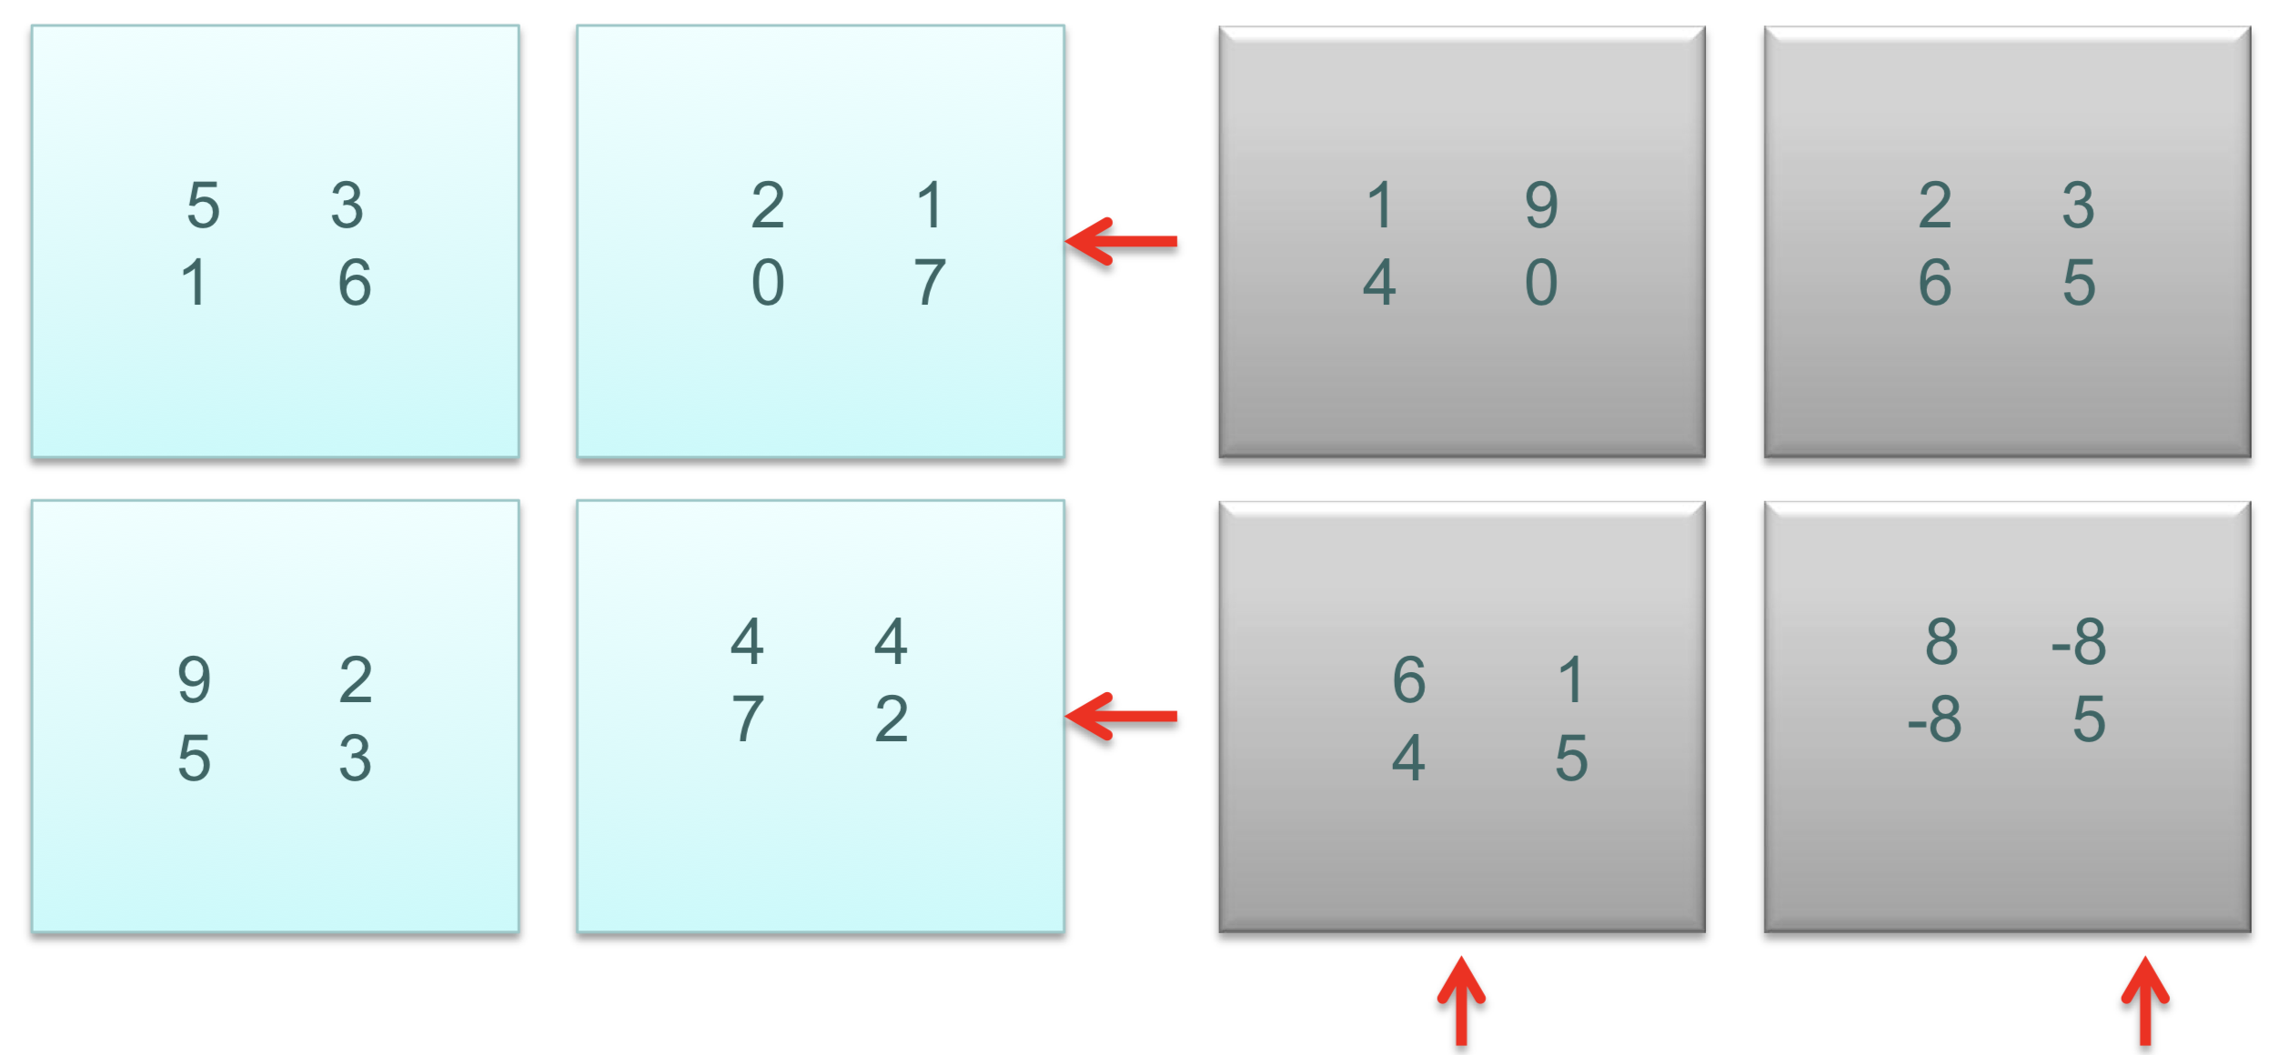
Phase 2 - Shift Left and Roll up

Slide 6
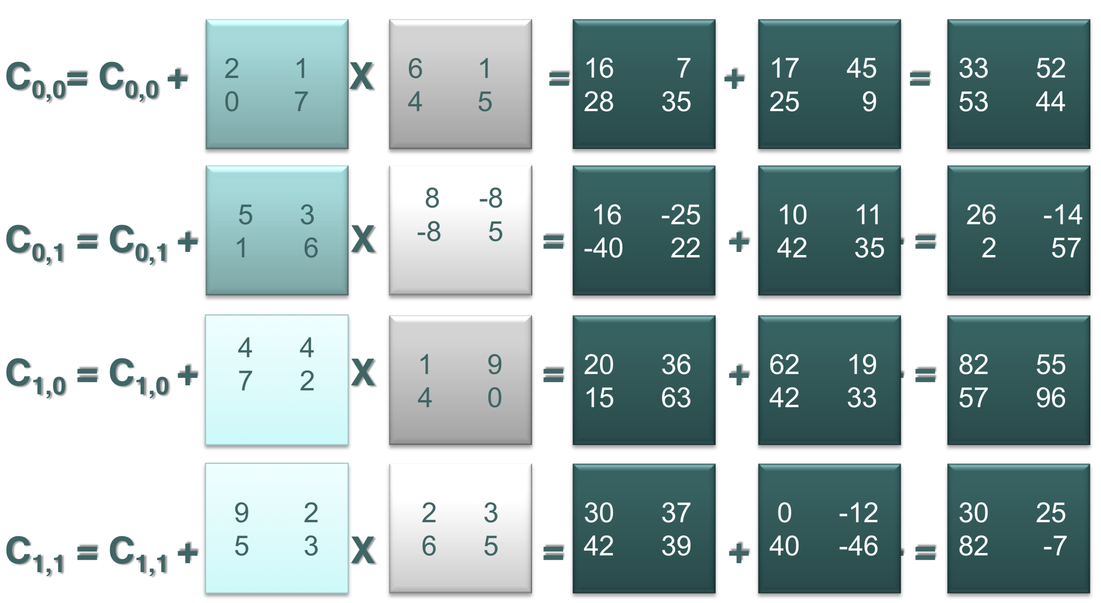
Perform Local Multiplication and add intermediate results

Slide 7
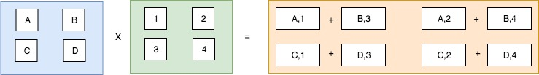
B-B Partitioning

Slide 8
What do they do well?
Cannon’s
No data duplication
Storage requirements remain constant and are independent of the number of processors
Simple B-B
Within a block, only data from a single matrix needs to be added to memory, if secondary sort is used
Unlike H-V or V-H an entire matrix row or column does not need to fit in memory

Slide 9
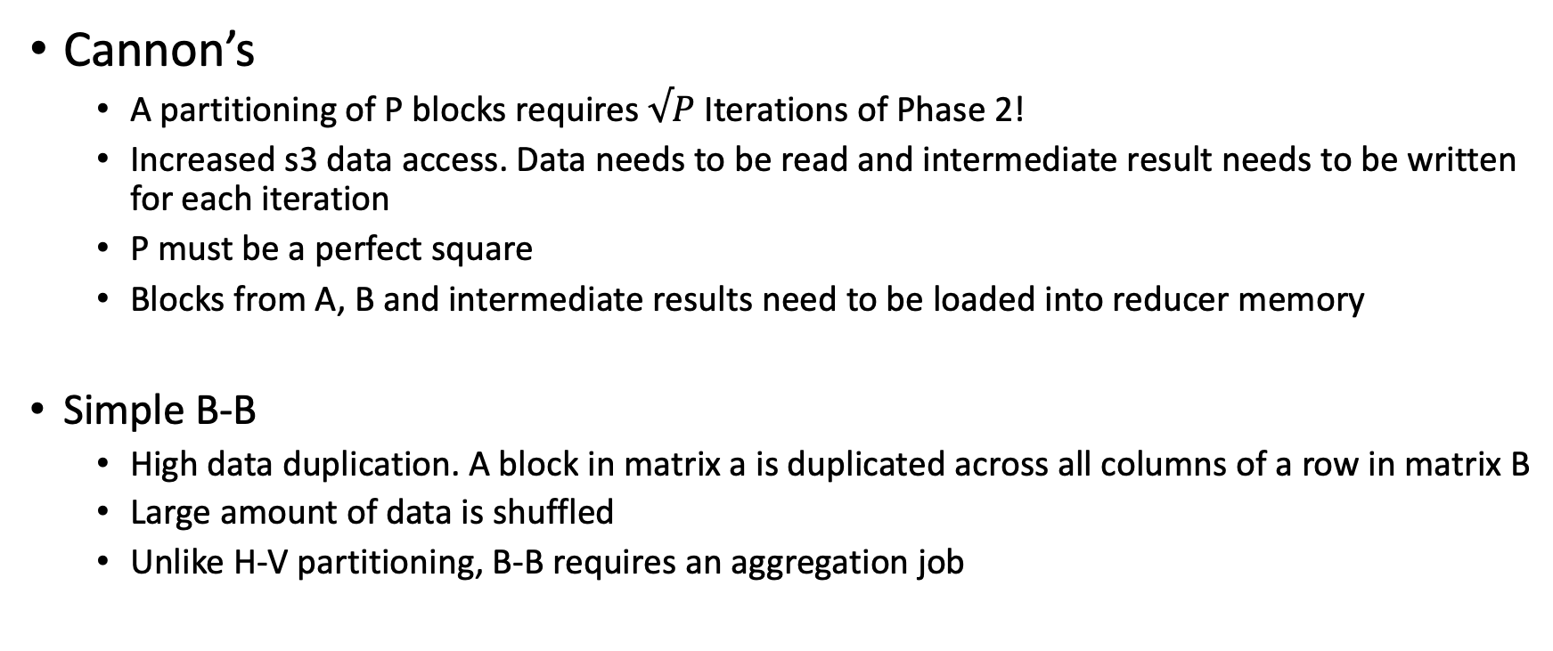
What’s the catch?
Cannon’s
A partitioning of P blocks requires $√P$ Iterations of Phase 2!
Increased s3 data access. Data needs to be read and intermediate result needs to be written for each iteration
P must be a perfect square
Blocks from A, B and intermediate results need to be loaded into reducer memory
Simple B-B
High data duplication. A block in matrix a is duplicated across all columns of a row in matrix B
Large amount of data is shuffled
Unlike H-V partitioning, B-B requires an aggregation job

