Slide 1

Hand Gesture-Based Actuation Using Computer Vision
Final Year Project Proposal Presentation
Ali Arslan. FA17-ECE-004
Usama Mustafa. FA17-ECE-042
Raja Nofil Hassan. FA17-ECE-033
Supervised By
Sir Dr. Haroon Ahmed Khan
Assistant Professor
Department of Electrical and Computer Engineering
COMSATS University Islamabad

Slide 2
Agenda of Presentation
Introduction
Literature Review
Problem Statement
Block Diagram
Expected Outcomes

Slide 3
Introduction
Machine Learning
Machine learning is the science of getting computers to act without being explicitly programmed.
Machine learning approaches
Supervised learning: The computer is presented with example inputs and their desired outputs, there is a labeled data and the algorithm trains on that data to map inputs to outputs.
Unsupervised learning: No labels are given to the learning algorithm, leaving it on its own to find structure in its input. Unsupervised learning can be a goal in itself (discovering hidden patterns in data) or a means towards an end (feature learning).
Reinforcement learning: A computer program interacts with a dynamic environment in which it must perform a certain goal (such as driving a vehicle or playing a game against an opponent). As it navigates its problem space, the program is provided feedback that's analogous to rewards, which it tries to maximize.

Slide 4
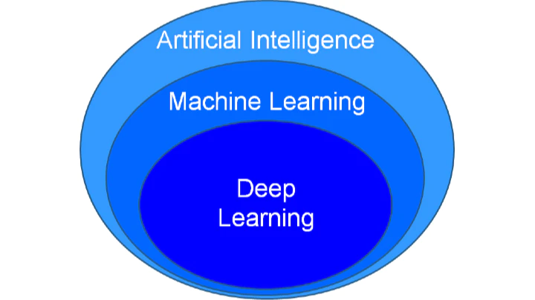
Introduction
Deep Learning
Deep Learning is a subfield of machine learning concerned with algorithms inspired by the structure and function of the brain called artificial neural networks.
Why Deep Learning?
When there is lack of domain understanding for feature introspection , Deep Learning techniques outshines other approaches. Deep Learning outperforms when it comes to complex scenarios such as image processing, natural language processing, and speech recognition.

Slide 5
Introduction
Hand Pose Estimation: After the evolution of cheaper depth sensing modules pose estimation started covering huge area of research having wide applications, hand pose estimation has also eliminated the traditional complex and expensive gloves for different use cases
Applications:
Gaming Industry
VR applications
VR based Supermarkets
New Modern cars Using For various control applications
Nuclear based applications to prevent radiation.

Slide 6
Introduction
Depth Cameras
Intel RealSense
Kinect
Applications
In recent years there is a huge rise in the applications as these sensors are getting common.
Action recognition
Gestures recognition
Sign language itepretation
Till the challenge is to achieve accurate and robust hand pose estimation with unmarked visual inputs, variation in hand poses, similar fingers in the depth visual inputs

Slide 7
James M. Rehg, T. K. (1994). Visual tracking of high DOF articulated structures: An application to human hand tracking. Eklundh JO. (eds) Computer Vision. 1. Geometric method 2. Non availability of Large Hand-pose datasets at that time. 3. More mathematical approaches were used rather then data driven approaches. 4.Limited number of state space i.e four states for finger, five for thumb. 5. 2 cameras for capturing feature measurement from their state model by input of state space.

Slide 8
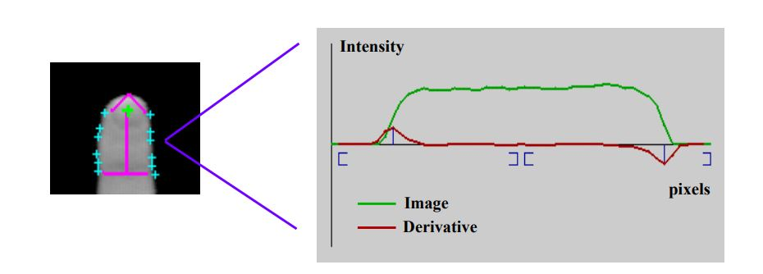
A single link tracker is shown along with its detected boundary points. One slice through the image of a finger is also depicted. Peaks in the derivative give the edge locations.

Slide 9
Literature Review
Many recent works focused on Convolution Neural Networks (CNN) (Ge L, 2019) for the 3D hand pose estimation and achieved good performance results as large datasets are readily available. .
Many researchers used these methods that feed the depth images to 2D CNNs that produce 3D joints. This method is not effective to achieve the real-time level of latency, as 2D CNNs are not sufficient for 3D hand pose estimation due to the lack of spatial information in three dimensions

Slide 10
Literature Review
Existing 2D CNN methods:
Regression of 3D hand features using 2D convolutional neural network is a very active area of research.
The work in (Jonathan Tompson, 2014) uses an neural network which estimates 2D location using direct and latent heat maps and 3D locations using vector representations.
Images of hands are fed to the encoder-decoder network, which produces heat maps and features separately, which are then concatenated .

Slide 11
Literature Review
Jonathan Tompson, M. S. (2014). Real-Time Continuous Pose Recovery of Human Hands Using Convolutional Networks. ACM Trans. Graph. 33, 5, Article 169 (August 2014), 10 pages. 1.Per pixel RDF ( Random Decision Forest) for segmentation from background. 2.Poor segmentation as compared to deep Learning Encoder-Decoder available now days. 3.Heat maps at output of neural network instead of 3d-joint locations 4. Input Image with 1 dimension only . After cropping and up sampling region of interest loss of information around corners can be easily observed.

Slide 12
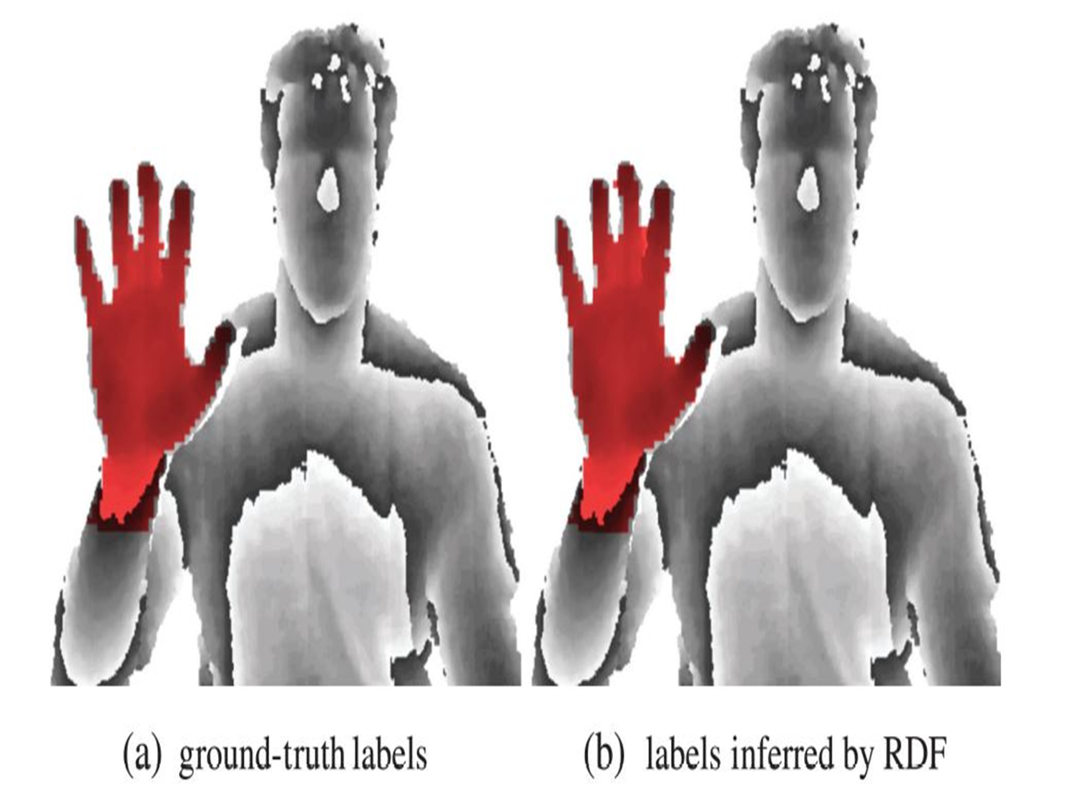
Literature Review

Slide 13
Literature Review
Existing 2D CNN methods:
Regression of 3D hand features using 2D convolutional neural network is a very active area of research.
The work in (Jonathan Tompson, 2014) uses an neural network which estimates 2D location using direct and latent heat maps and 3D locations using vector representations.
Images of hands are fed to the encoder-decoder network, which produces heat maps and features separately, which are then concatenated .

Slide 14
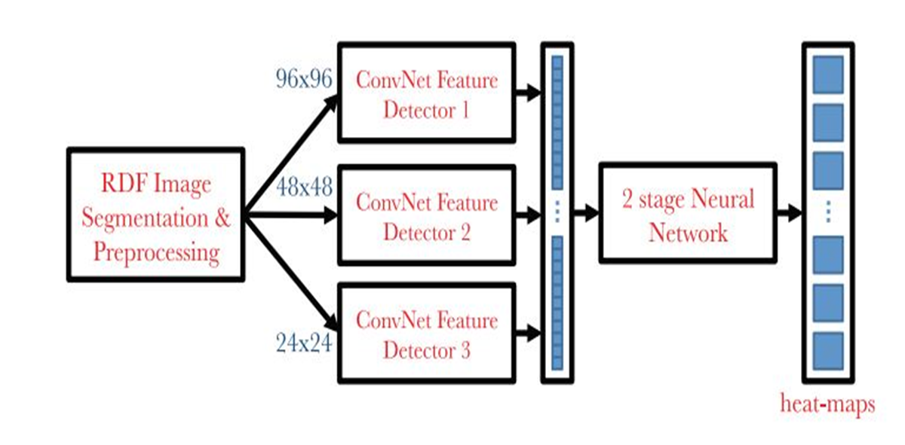
Literature Review
Neural Network

Slide 15
Literature Review
Existing deep learning methods
More recently, the AlexNet (Markus Oberweger, 2020) showed much better results, and deep learning is more and more involved as it produces accurate results and is simpler to implement
for real time consideration it does not work due to its huge latency and demanding compute capability.
Alexnet parameters : 61 Million

Slide 16
Existing 3D CNN methods For real time applications 3D convolutional neural networks look more promising (Ge L, 2019). 3D CNNs better represent 3D features, the network can be much simpler and smaller, thus resulting in reduced latency.
Literature Review

Slide 17
Ge L, L. H. (2019). Real-Time 3D Hand Pose Estimation with 3D Convolutional Neural Networks. IEEE Trans Pattern Anal Mach Intell, 956-970. 1. Converts Depth Data into volumetric Representation 2. Use Supervised and unsupervised methods 3. 3D CNN to capture more features along the 3rd dimension(depth)
Literature Review

Slide 18
Jonathan Tompson, M. S. (2014). Real-Time Continuous Pose Recovery of Human Hands Using Convolutional Networks. ACM Trans. Graph. 33, 5, Article 169 (August 2014), 10 pages. 1.Per pixel RDF ( Random Decision Forest) for segmentation from background. 2.Poor segmentation as compared to deep Learning Encoder-Decoder available now days. 3.Heat maps at output of neural network instead of 3d-joint locations 4. Input Image with 1 dimension only . After cropping and up sampling region of interest loss of information around corners can be easily observed.

Slide 19


Slide 20
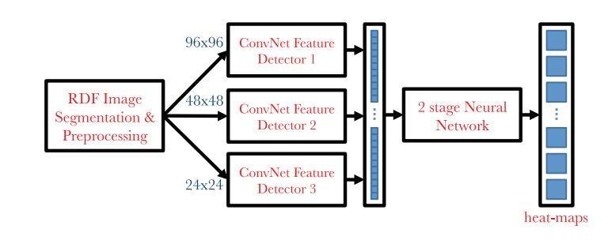
Neural Network

Slide 21
Existing deep learning methods More recently, the AlexNet (Markus Oberweger, 2020) showed much better results, and deep learning is more and more involved as it produces accurate results and is simpler to implement. But for real time consideration it does not work due to its huge latency and demanding compute capability. Alexnet parameters : 61 Million

Slide 22
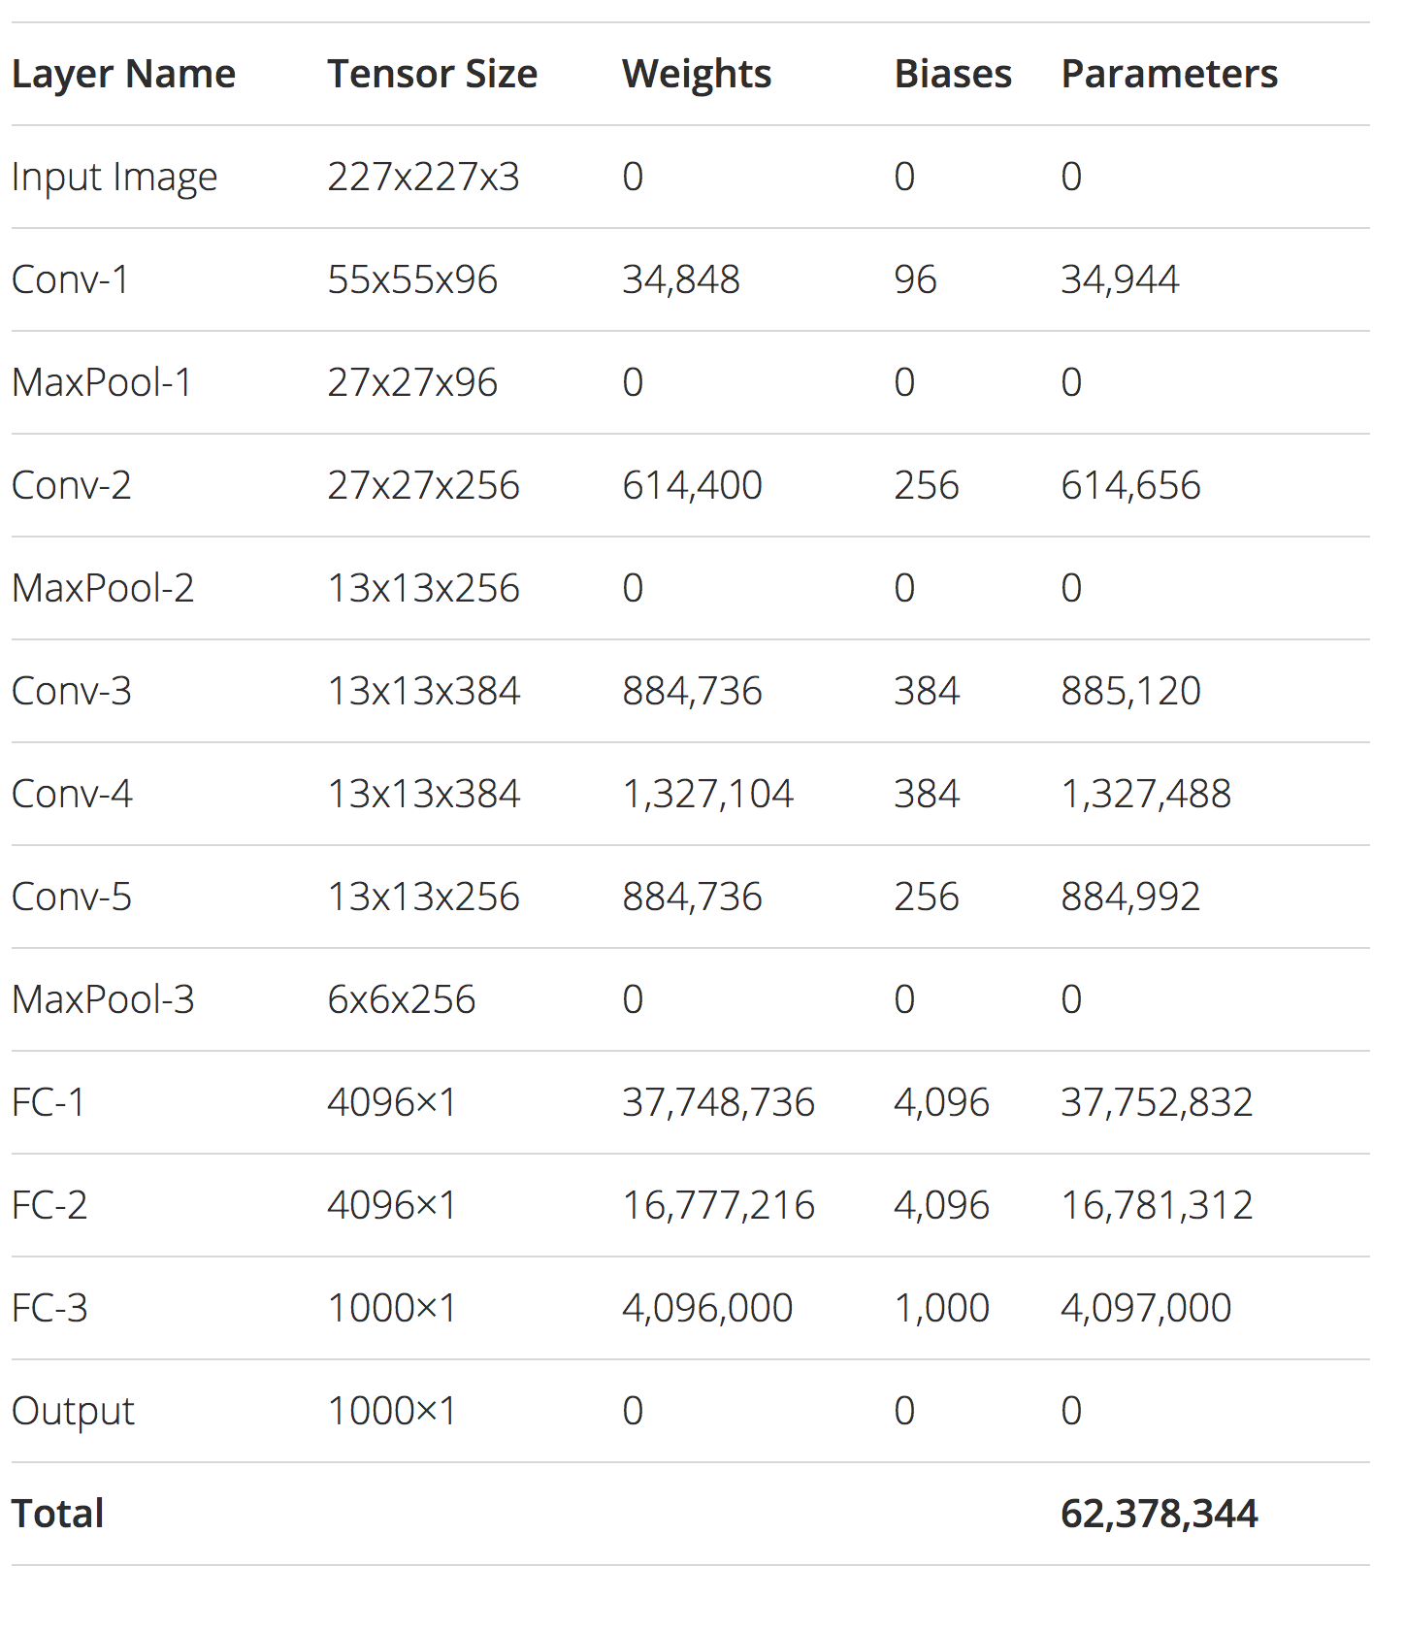
Alexnet

Slide 23
Existing 3D CNN methods: For real time applications 3D convolutional neural networks look more promising (Ge L, 2019). Due to the nature of 3D CNNs to better represent 3D features, the network can be much simpler and smaller, thus resulting in reduced latency.

Slide 24
Ge L, L. H. (2019). Real-Time 3D Hand Pose Estimation with 3D Convolutional Neural Networks. IEEE Trans Pattern Anal Mach Intell, 956-970. 1. Converts Depth Data into volumetric Representation 2. Use Supervised and unsupervised methods 3. 3D CNN to capture more features along the 3rd dimension(depth)

Slide 25
3D convolution vs 2D convolution 1. 3D CNN's are used when you want to extract features in 3rd Dimensions(DEPTH) 2. kernel movement is now 3-Dimensional causing a better capture of dependencies within the 3 dimensions 3. 3D convolution computationally more expensive but performs better on 3 dimensional data.

Slide 26
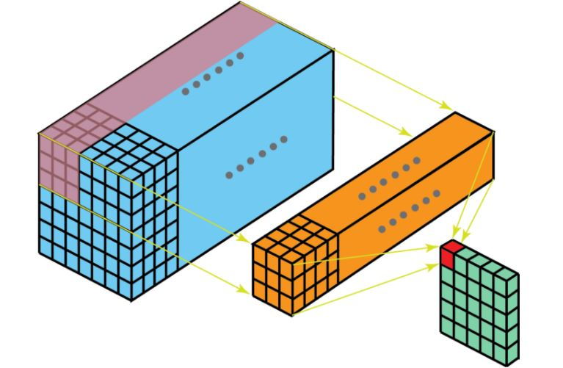
2-dimensional convolution

Slide 27
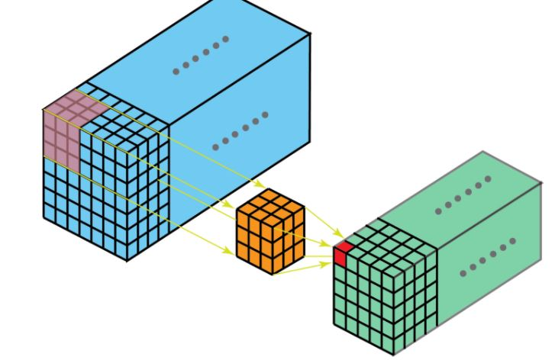
3-dimensional convolution

Slide 28
3 D convolution is more computationally expensive then 2D convolution but it capture more depth features with less filters as compared to 2D CNN
Literature Review

Slide 29
Problem Statement 1.Increased accuracy is achieved at cost of more computation complexity. 2.Increase computation complexity may stop system from running at real runtime. 3. RGB images and 2D CNN are unable to exploit 3D spatial information

Slide 30
Previous research
Ge L, L. H. (2019). Real-Time 3D Hand Pose Estimation with 3D Convolutional Neural Networks. IEEE Trans Pattern Anal Mach Intell, 956-970.
The 3D CNN based hand pose estimation approach is much effective because 3D CNN fully utilizes the three-dimensional nature of depth images. The work in (Ge L, 2019) used 3D CNNs which capture the 3D spatial structure from the segmented data extracted from the depth images, from which a 3D point cloud of the hand is encoded as 3D volumes storing the Accurate Truncated Signed Distance Function (TSDF). The output is in 3D volumetric representation by applying the dimensionality reduction techniques (PCA)
Model shown in next slide

Slide 31
Overview of research Ge.L 2019
Input TSDF
3D Locations of 14 hand joints
Neural Network 1
Lower 3D embedding
Neural Network 2

Slide 32
Model by (Ge.L 2019)
INPUT TSDF
Output
Dense layer
1024
Dense
layer
4096
CONV3D(96) (5,5,5)
Maxpool3d
Maxpool3d
Conv 3d(192)
(3,3,3)
Maxpool 3d
Conv 3d(384)
(3,3,3)

Slide 33

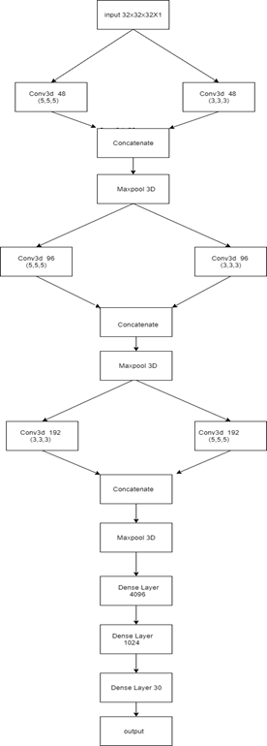
Modification proposed by us:
The model proposed by us showed better performance while benchmarking.
It had more diverse features at every stage allowing to capture different features
At each layer same number of filters were used as (Ge.L 2019) but 5x5 and 3x3 filters whose output was concatenated allowing improved results

Slide 34
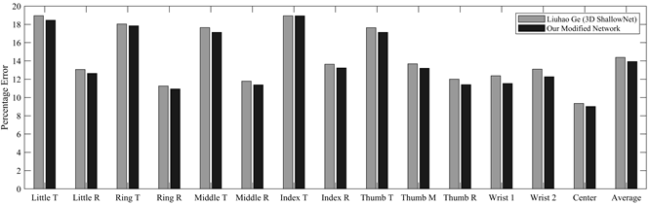
Benchmarking both models results Mean percentage error of each joint on hand. The error of both original shallow network (gray) and our modified network (black) representing the accuracy of 3D CNN approach. (T: Tip, R: Root, M: Middle)

Slide 35
Dataset
Usama mustafe please add dataste details

Slide 36
What are Hyperparameters ?
Hyperparameters are the variables which determines the network structure(Eg: Number of Hidden Units) and the variables which determine how the network is trained(Eg: Learning Rate).
Hyperparameters are set before training(before optimizing the weights and bias).

Slide 37
Further Optimization by HPO
SEARCH SPACE :
The search space of the neural network producing lower dimension embedding from 3D volumes only consisted of neurons of the last two layers the search space was reduced due to heavy cost of training the neural network
The search space of neural network producing 3D 14 hand joints from lower embedding consisted of:
No of hidden layers, Learning rate , Optimizer , No of neurons in each layer

Slide 38
Why not all combinations be tried ?
Due to heavy computation cost all the possible combinations for could not be explored one would need a super computer for it
The 3D CNN HPO was done on subset of data on GTX 1080 with 2 hours of time on each configuration.

Slide 39
Mathematical approximation ( surrogate function )
A surrogate model is an engineering method used when an outcome of interest cannot be easily directly measured, so a model of the outcome is used instead

Slide 40

Surrogate Functions chosen by us:
Tree Parzen estimator
TPE is a sequential model-based optimization (SMBO) approach. TPE builds a model by applying Bayes rule. The probability for achieving y loss with x parameters is given by:
Base sampler
This sampling technique brings balance of both the worlds by applying both relative sampling and independent sampling. The relative sampling determines the value of multiple hyperparameters so correlation could be determined between them

Slide 41
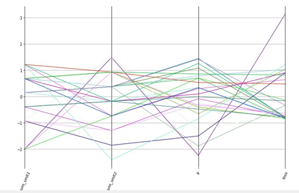
Parallel coordinate graph Shows parallel coordinate graph of Hyperparameter optimization of model producing 14, 3D coordinates from lower embedding

Slide 42
Results HPO
The best architecture for producing 3D Embeddings by HPO achieved had two layers, First layer with 2816 nodes and second layer with 2304 nodes with learning rate of 0.000731
The best 3D CNN network achieved was 4096 neurons in the last two hidden layers with Adamax optimizer and learning rate of 0.00014.

Slide 43
Curriculum Learning
Curriculum learning describes a type of learning in which you first start out with only easy examples of a task and then gradually increase the task difficulty.

Slide 44

Classification strategy
The Error for classification was MAE. Samples with loss less then 0.05 were classified in easy category. Samples with loss between 0.05 and 0.10 were classified into Intermediate category. Samples with loss above then 0.10 were classified into Difficult category

Slide 45
Project Description (Modules, Block Diagram etc.)
Depth sensor
Pre-processing
Our Model (3D CNN)
Post Processing
API formation

Slide 46
Depth-Sensor 1.Kinect: Kinect (codenamed Project Natal during development) is a line of motion sensing input devices produced by Microsoft and first released in 2010. The technology includes a set of hardware originally developed by PrimeSense, incorporating RGB cameras, infrared projectors and detectors that mapped depth through either structured light or time of flight calculations, and a microphone array

Slide 47
Pre-processing: 1. Getting data from Kinect Infrared Sensor 2. Depth base filtering 3. Removing Noise ( filtering) 4. Converting Data into volumetric Representation.

Slide 48
3D CNN: 1. Make optimizations in the 3D CNN Architecture in Ge L, L. H. (2019). 2. Benchmark our architecture and one purposed in Ge L, L. H. (2019).

Slide 49
API 1.Resolve Input from Kinect. 2. Build Project(DLL) files of the whole project. 3. Manage dependencies and compatibility on the system on which API is to be used. 4. Porotype the API and test it on different Hardware and Operating System configuration

Slide 50







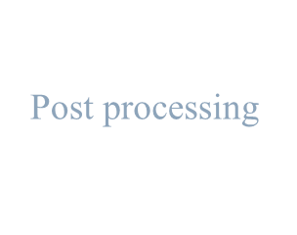






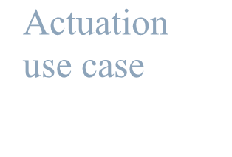

Project Description (Problem Statement, Block Diagram etc.)
Input from Kinect
Pre- Processing
3D CNN model
Post processing
Application
Actuation
3D joint
use case
programming
interface (API)
locations

Slide 51
Expected Outcomes of the Project
To achieve an accurate and less latent prediction of hand poses using 3D information from Infrared sensor.
The regression of hand-joints could lead to various applications in VR and E-gamming Industry.
Producing a research-based outcome showing improvement from previous machine learning methods.
Development of a generalized API for a real time actuation applications.

Slide 52
Bibliography
Ge L, L. H. (2019). Real-Time 3D Hand Pose Estimation with 3D Convolutional Neural Networks. IEEE Trans Pattern Anal Mach Intell, 956-970.
Hengkai Guo, G. W. (2017). Region Ensemble Network: Improving Convolutional Network for Hand Pose Estimation. IEEE International Conference on Image Processing (ICIP).
Huang, Y. W. (2001). Hand modeling, analysis and recognition. IEEE Signal Processing Magazine, vol. 18, no. 3, 51-60.
James M. Rehg, T. K. (1994). Visual tracking of high DOF articulated structures: An application to human hand tracking. Eklundh JO. (eds) Computer Vision.
Jonathan Tompson, M. S. (2014). Real-Time Continuous Pose Recovery of Human Hands Using Convolutional Networks. ACM Trans. Graph. 33, 5, Article 169 (August 2014), 10 pages.
Markus Oberweger, P. W. (2020). Generalized Feedback Loop for Joint Hand-Object Pose Estimation. IEEE Trans. Pattern Anal. Mach. Intell. 42, 8 (Aug. 2020).

Slide 53
Tentative Project Schedule / Gantt Chart

