Slide 1

Hand Gesture-Based Actuation Using Computer Vision
Final Year Project Proposal Presentation
Ali Arslan. FA17-ECE-004
Usama Mustafa. FA17-ECE-042
Raja Nofil Hassan. FA17-ECE-033
Supervised By
Sir Dr. Haroon Ahmed Khan
Assistant Professor
Department of Electrical and Computer Engineering
COMSATS University Islamabad

Slide 2
Agenda of Presentation
Introduction
In recent years after the introduction of cheaper depth cameras such as Intel RealSense, Kinect. Challenges for pose estimation tending towards many solutions and real-time 3D hand pose estimation has instigated a lot of research attention in recent years (Huang, 2001). In 1994 the first efforts to tackle the problems were made (James M. Rehg, 1994). There are many applications such as action recognition, gesture recognition, and sign language interpretation. Till the challenge is to achieve accurate and robust hand pose estimation with unmarked visual inputs, variation in hand poses, similar fingers in the depth visual inputs

Slide 3
James M. Rehg, T. K. (1994). Visual tracking of high DOF articulated structures: An application to human hand tracking. Eklundh JO. (eds) Computer Vision. 1. Geometric method 2. Non availability of Large Hand-pose datasets at that time. 3. More mathematical approaches were used rather then data driven approaches. 4.Limited number of state space i.e four states for finger, five for thumb. 5. 2 cameras for capturing feature measurement from their state model by input of state space.

Slide 4
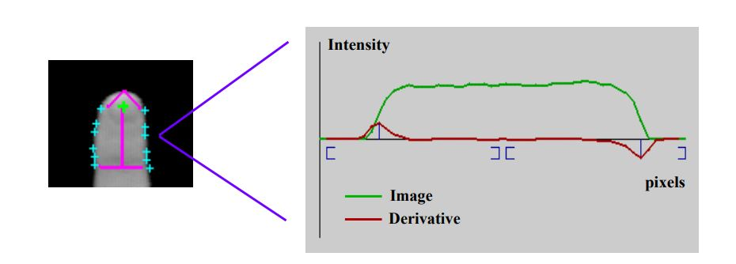
A single link tracker is shown along with its detected boundary points. One slice through the image of a finger is also depicted. Peaks in the derivative give the edge locations.

Slide 5
Literature Review Many recent works focused on Convolution Neural Networks (CNN) (Ge L, 2019) for the 3D hand pose estimation and achieved good performance results as large datasets are readily available. Many researchers used these methods that feed the depth images to 2D CNNs that produce 3D joints. This method is not effective to achieve the real-time level of latency, as 2D CNNs are not sufficient for 3D hand pose estimation due to the lack of spatial information in three dimensions

Slide 6
Existing 2D CNN methods: Regression of 3D hand features using 2D convolutional neural network is a very active area of research. The work in (Jonathan Tompson, 2014) uses an neural network which estimates 2D location using direct and latent heat maps and 3D locations using vector representations. Images of hands are fed to the encoder-decoder network, which produces heat maps and features separately, which are then concatenated

Slide 7
Jonathan Tompson, M. S. (2014). Real-Time Continuous Pose Recovery of Human Hands Using Convolutional Networks. ACM Trans. Graph. 33, 5, Article 169 (August 2014), 10 pages. 1.Per pixel RDF ( Random Decision Forest) for segmentation from background. 2.Poor segmentation as compared to deep Learning Encoder-Decoder available now days. 3.Heat maps at output of neural network instead of 3d-joint locations 4. Input Image with 1 dimension only . After cropping and up sampling region of interest loss of information around corners can be easily observed.

Slide 8
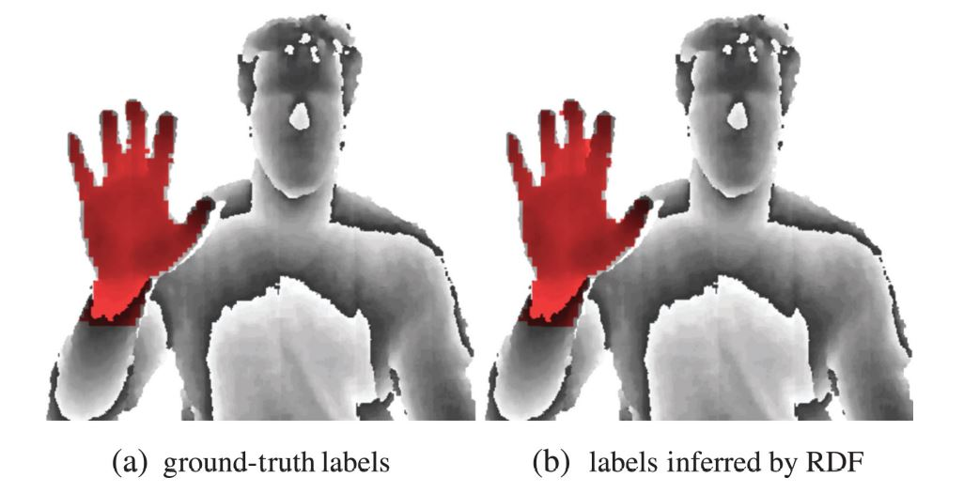

Slide 9
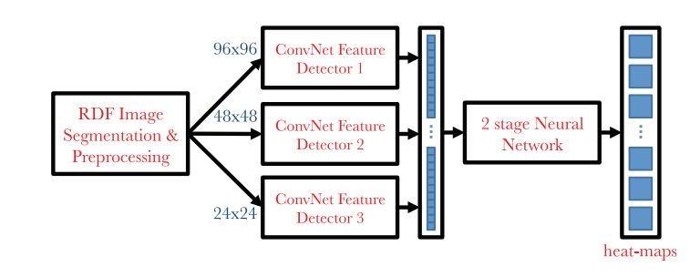
Neural Network

Slide 10
Existing deep learning methods More recently, the AlexNet (Markus Oberweger, 2020) showed much better results, and deep learning is more and more involved as it produces accurate results and is simpler to implement. But for real time consideration it does not work due to its huge latency and demanding compute capability. Alexnet parameters : 61 Million

Slide 11
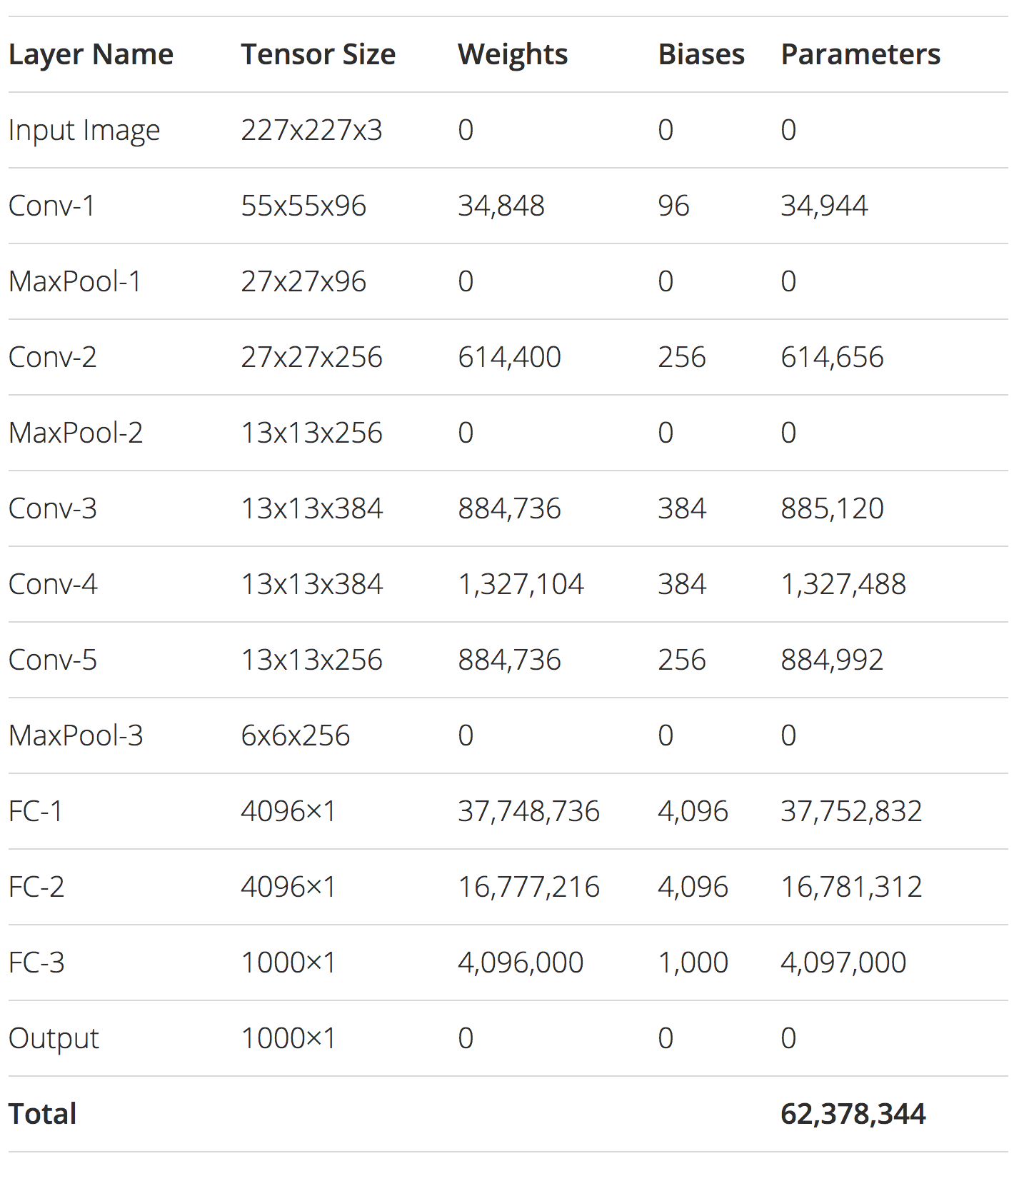
Alexnet

Slide 12
Existing 3D CNN methods: For real time applications 3D convolutional neural networks look more promising (Ge L, 2019). Due to the nature of 3D CNNs to better represent 3D features, the network can be much simpler and smaller, thus resulting in reduced latency.

Slide 13
Ge L, L. H. (2019). Real-Time 3D Hand Pose Estimation with 3D Convolutional Neural Networks. IEEE Trans Pattern Anal Mach Intell, 956-970. 1. Converts Depth Data into volumetric Representation 2. Use Supervised and unsupervised methods 3. 3D CNN to capture more features along the 3rd dimension(depth)

Slide 14
3D convolution vs 2D convolution 1. 3D CNN's are used when you want to extract features in 3rd Dimensions(DEPTH) 2. kernel movement is now 3-Dimensional causing a better capture of dependencies within the 3 dimensions 3. 3D convolution computationally more expensive but performs better on 3 dimensional data.

Slide 15
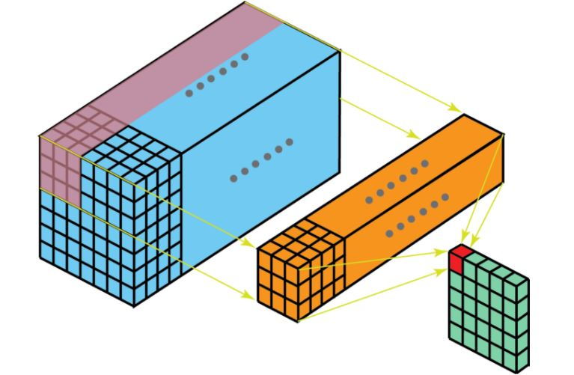
2-dimensional convolution

Slide 16
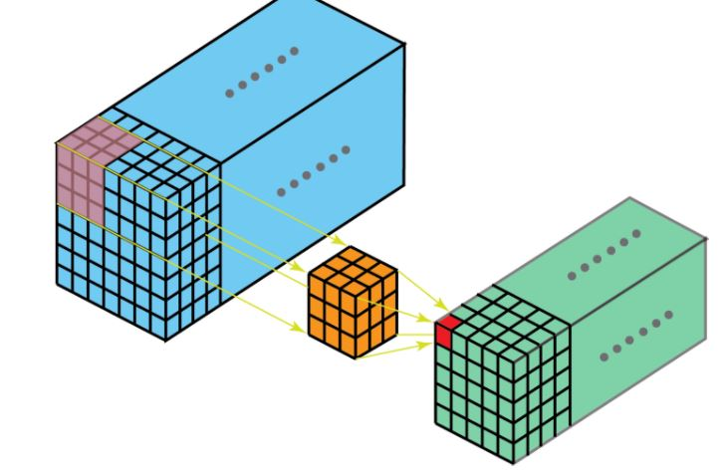
3-dimensional convolution

Slide 17
3 D convolution is more computationally expensive then 2D convolution

Slide 18
But it will capture more depth features with less filters as compared to 2D CNN.

Slide 19
Problem Statement 1.Increased accuracy is achieved at cost of more computation complexity. 2.Increase computation complexity may stop system from running at real runtime. 3. RGB images and 2D CNN are unable to exploit 3D spatial information

Slide 20
Project Description (Modules, Block Diagram etc.)
Depth sensor
Pre-processing
Our Model (3D CNN)
Post Processing
API formation

Slide 21
Depth-Sensor 1.Kinect: Kinect (codenamed Project Natal during development) is a line of motion sensing input devices produced by Microsoft and first released in 2010. The technology includes a set of hardware originally developed by PrimeSense, incorporating RGB cameras, infrared projectors and detectors that mapped depth through either structured light or time of flight calculations, and a microphone array

Slide 22
Pre-processing: 1. Getting data from Kinect Infrared Sensor 2. Depth base filtering 3. Removing Noise ( filtering) 4. Converting Data into volumetric Representation.

Slide 23
3D CNN: 1. Make optimizations in the 3D CNN Architecture in Ge L, L. H. (2019). 2. Benchmark our architecture and one purposed in Ge L, L. H. (2019).

Slide 24
API 1.Resolve Input from Kinect. 2. Build Project(DLL) files of the whole project. 3. Manage dependencies and compatibility on the system on which API is to be used. 4. Porotype the API and test it on different Hardware and Operating System configuration

Slide 25














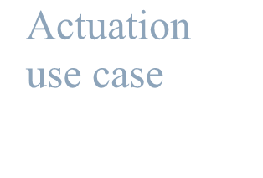

Project Description (Problem Statement, Block Diagram etc.)
Input from Kinect
Pre- Processing
3D CNN model
Post processing
Application
Actuation
3D joint
use case
programming
interface (API)
locations

Slide 26
Expected Outcomes of the Project
To achieve an accurate and less latent prediction of hand poses using 3D information from Infrared sensor.
The regression of hand-joints could lead to various applications in VR and E-gamming Industry.
Producing a research-based outcome showing improvement from previous machine learning methods.
Development of a generalized API for a real time actuation applications.

Slide 27
Bibliography
Ge L, L. H. (2019). Real-Time 3D Hand Pose Estimation with 3D Convolutional Neural Networks. IEEE Trans Pattern Anal Mach Intell, 956-970.
Hengkai Guo, G. W. (2017). Region Ensemble Network: Improving Convolutional Network for Hand Pose Estimation. IEEE International Conference on Image Processing (ICIP).
Huang, Y. W. (2001). Hand modeling, analysis and recognition. IEEE Signal Processing Magazine, vol. 18, no. 3, 51-60.
James M. Rehg, T. K. (1994). Visual tracking of high DOF articulated structures: An application to human hand tracking. Eklundh JO. (eds) Computer Vision.
Jonathan Tompson, M. S. (2014). Real-Time Continuous Pose Recovery of Human Hands Using Convolutional Networks. ACM Trans. Graph. 33, 5, Article 169 (August 2014), 10 pages.
Markus Oberweger, P. W. (2020). Generalized Feedback Loop for Joint Hand-Object Pose Estimation. IEEE Trans. Pattern Anal. Mach. Intell. 42, 8 (Aug. 2020).

Slide 28
Tentative Project Schedule / Gantt Chart

