Slide 1
Mechanical Earthworm
Mustafa Bhadsorawala
Raja Panchal
Prof. Nandkumar Gilke
K.J Somaiya College of Engineering
Team Bheet
ID- 4941406713

Slide 2
Farmers
In India the state of a farmer is pitiful to say the least.
They work for hours on end performing manual labour for very scant returns in the end.
A lot of farmers are abandoning their profession to take up better paying jobs. If this continues there won’t be a enough farmers left.
Hence, The Mechanical Earthworm.

Slide 3
Mechanical Earthworm
It is a tiny robot that works harmoniously with dozens of its kind.
It can be used individually or in a whole group collectively to accomplish a task like ploughing, irrigating, fertilizing the field.
The goal of our designing was to keep it modular.
Easy replacement, repairing, servicing and maintenance.
A modular design will also allow different manufacturers to come up with new segments and new applications.

Slide 4
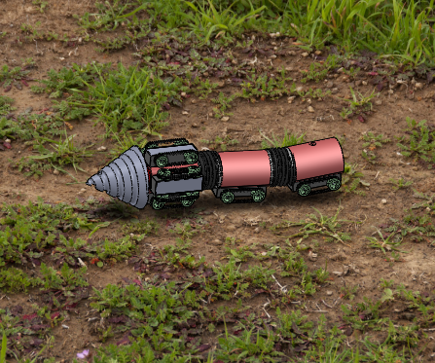

Slide 5
Structure
Segments
While conceptualizing we designed the earthworm to be completely modular.
The Mech Earthworm, just like an earthworm, is made up of segments.
Each segment contributes towards a certain operation.
Drill (Mandatory)
Motor Segment (Mandatory)
Electronic/Sensor Segment (Mandatory)
Fertilizer Segment (Optional)
Irrigation Segment (Optional)
Battery Segment (Mandatory)
Drive Segment (Mandatory)

Slide 6
1st Seg
Body
Electronics Segment
Fertilizer/Irrigation Segment

Slide 7
Battery Segment
Drive
Bellows
Electronic Connector

Slide 8
This slide is intentionally left empty. Video content to be inserted.

Slide 9
Mechanism
Each Segment of the Mech Earthworm performs a particular task.
The First Segment is responsible for steering the earthworm in 3D space.
Each alternative segment is provided with a drive with motors so as to provide forward and reverse motion as well as providing the feed to the drill.
The Segments are connected to each other using rigid links that enable turning in small radius.
The worm can travel up till a depth of 12 inches below ground, which is the more than the maximum ploughing done by tractors.

Slide 10
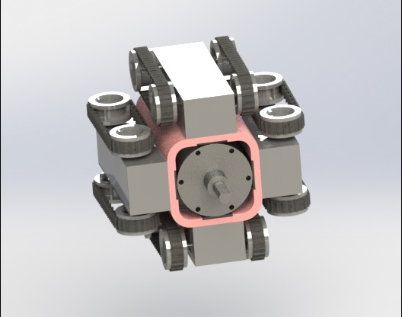
First Segment
Four drives are used to help change the direction of the earthworm.
To turn right the two motors on the side and opposite to one another work together, one slowing down the other speeding up and therefore causing the turn.
These calculations can be preprogramed into the microcontroller while manufacturing.

Slide 11
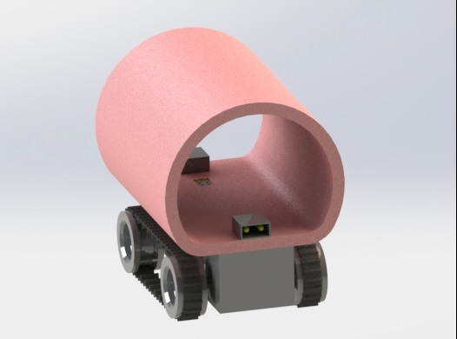
Drive
The wheels are connected through continuous silicon rubber tracks to provide grip in different types of soils.
Parallel drives work together to provide more power.
It can also work in reverse.
Each drive has a wheelbase of 50mm and wheels of 20mm diameter.
It has a motor of specification- 12V 5Kg-cm 30RPM

Slide 12
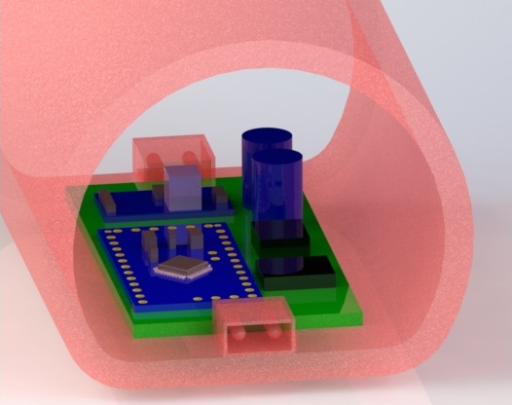
Sensors and Microcontroller
All the instructions are programmed into the micro controller.
A magnetic sensor is added to provide information about the physical location in 3D space.
A communication chip to communicate with the main computer and other earthworms.
Other Sensors like Humidity sensor and pH sensor can be added.

Slide 13
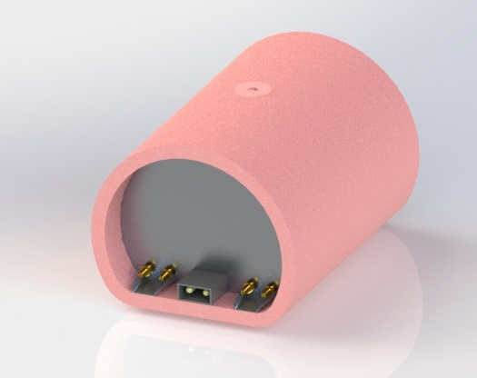
Irrigation/Fertilizer Segment
This segment is a general design and can be used for both purposes.
An aluminium tank is used to store the contents.
A hole at the top to fill and empty the contents of the tank.
A stopper is provided at the top to block the hole once the tank is refilled.
Nozzles are attached at the rear which release the liquid.

Slide 14
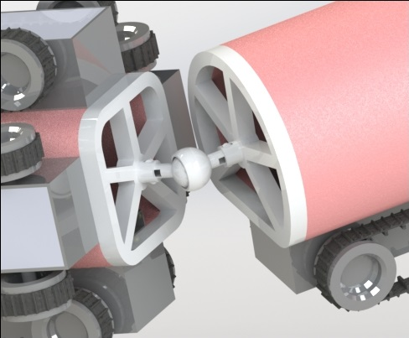
Linkage
Plastic frames are attached at the ends of each segment.
They are snap fit and therefore can be easily attached and detached.
The spokes that radiate from the centre act as suspension.
A ball and socket joint provides a large degree of rotation that allows a small radius of turning.

Slide 15
Additional Features
For charging of the earthworms Solar charging docks can be placed at various location on the farm. After reaching a certain battery level the Mech earthworms can go there and refill their charge.
A visual programming software will be provided to the farmers. The software will have a simple user interface and will not need knowledge of any programming language.
A red LED light will be placed on the electronic segment so as to send SOS signals in case of getting trapped or battery dying down.
As it is a modular design 3rd party manufacturers can come up with newer segments.

Slide 16
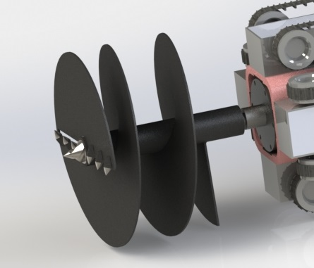
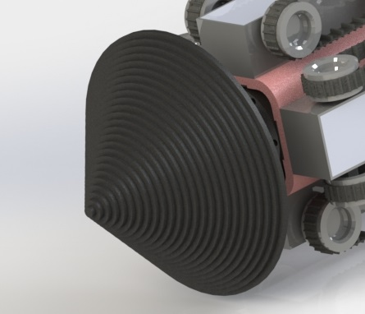
Alternative Design Considerations

Slide 17
Costing of Mech Earthworm

Slide 18
Parts | Sub Parts | Material | Cost | Units
Body |  | HDPE | 15 | 3 | 45
Drill |  | AISI 321 SS | 500-1000 |  | 500
Drive
 | Hub | HDPE | 5 | 6 | 30
 | Plate | HDPE | 2 | 6 | 12
 | Shafts | HDPE | 4 | 12 | 48
 | Wheel | HDPE | 8 | 24 | 192
 | Rubber tracks | SI Rubber | 5 | 12 | 60
Link
 | Frame | PVC | 3 | 4 | 12
 | Links(joints) | PVC | 2 | 3 | 6
Electronics
Sensors | MPU |  | 200 | 1 | 200
 | Gyroscope + Accelerometer |  | 260 | 1 | 260
 | Magnetic |  | 120 | 1 | 120
Magnetic Connectors |  |  | 7 | 6 | 42
Battery |  |  | 600 | 2 | 1200
Tank |  |  | 50-100 |  | 50
Motor
 | Drill motor |  | 500 | 1 | 500
 | Drive motor |  | 150 | 6 | 900
Belows |  |  | 10 | 3 | 30
 |  | TOTAL |  |  | 4207

Slide 19
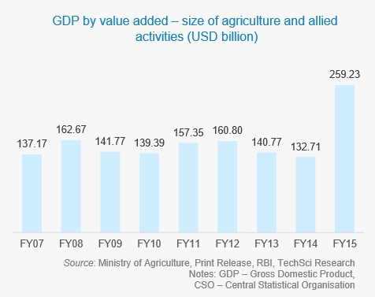
Market Availability

Slide 20
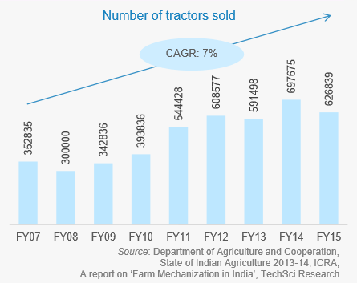

Slide 21
Mech Earthworm
Advantages
Disadvantage
The Mech Earthworm automated the process of ploughing, irrigating and fertilizing.
Due to less weight it does not cause soil compaction.
Can go deeper inside the soil rather than only ploughing on the surface, hence aerating the soil deep below.
Can be customized and made to work for specific tasks
It is time consuming
Not as powerful as a tractor
High initial investment
Battery Life

Slide 22
References
Soil compaction processes and their effects on the structure of arable soils and the environment-R. Horn, H. Domżżał, Anna Słowińska-Jurkiewicz, C. van Ouwerkerk - 1995
RELATIVE EFFECTS OF TRACTOR WEIGHT AND WHEEL-SLIP IN CAUSING SOIL COMPACTION- D.B. Davies, J.B. Finney, S.J. Richardson - 1973
Risks, Farmers’ Suicides and Agrarian Crisis in India: Is There a Way Out?- Srijit Mishra- Indian Journal of Agricultural Economics (2008)
Ministry of agriculture , TechSci research , IBEF

Slide 23
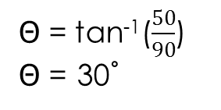
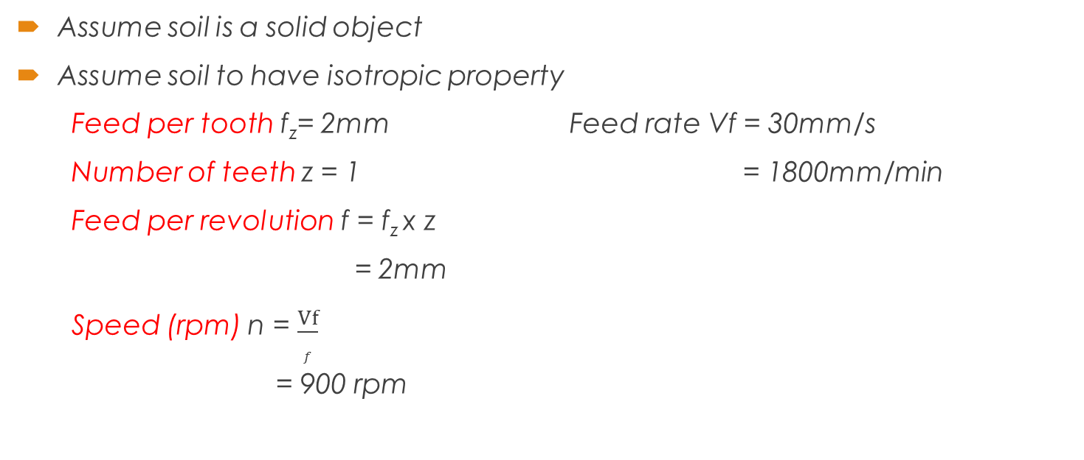
Drilling Torque Calculation
Assume soil is a solid object
Assume soil to have isotropic property
Feed per tooth f_{z}= 2mm Feed rate Vf = 30mm/s
Number of teeth z = 1 = 1800mm/min
Feed per revolution f = f_{z} x z
= 2mm
Speed (rpm) n = $\frac{Vf}{f}$
= 900 rpm
 = tan⁻¹($\frac{50}{90}$)
 = 30˚
Vf

Slide 24
Specific Cutting force k_{c1.1} = 400 kN/m² (Value from Mechanics of Machine Drilling)
= 0.40 N/mm²
Cut thickness h = f_{z} x sin
= 0.97128 mm
K_{c} = k_{c1.1}/ h^{mc} where mc = 0.25
= 0.4029 N/mm²
Torque T = (D_{c}² x k_{c} x f)/8000 where D_{c} = 100mm
= 1.0073 Nm
or
= 10.073 kgcm

Slide 25
Components
The motors and magnetic connectors used are selected by what is available in the market. The links of these are provided below.
http://rarecomponents.com/store/MTR002
http://www.nex-robotics.com/products/motors-and-accessories/dc-motors/60-rpm-side-shaft-37mm-diameter-high-performance-dc-gear-motor.html
httpwww.globalsources.com/gsol/I/Magnetic-connector/p/sm/1124702712.htm#1124702712://
https://www.alibaba.com/product-detail/Good-Quality-12-volt-Rechargeable-Battery_60411448999.html?spm=a2700.7724857.0.0.vZ8WR2
http://www.ebay.in/itm/152225865741?aff_source=Sok-Goog
http://www.ebay.in/itm/172219939324?aff_source=Sok-Goog

Slide 26
Thank You!

