Slide 1
ARU
Submarine trip
Istanbul Sabahattin Zaim University
Programming Language Lecture Project
Mustafa ARU - 30716006

Slide 2
Purpose?
Enjoy a dream adventure going underwater to 35 meters depth on board of a real submarine. Go for a once in a lifetime experience and discover the beautiful marine life and the underwater world of ARU Submarine! ... Then the submarine will start its decent into the deep sea for a real fantasy adventure trip.
Fun
Camp
Learning
Training
Swimming
Discovery
New Friends
Incredible experience
Competitive Advantages
New Team to discover the world

Slide 3

ARU Submarine
This is a wonderful experience for everyone visiting ARU Submarine. You will get to experience what you only dream about, when going underwater and staring into the crystal-clear Indian Ocean water and discovering the rich sea life deep underwater.

Slide 4
Some Rules
You should not be late
You can not smoke in that trip
You can not try to open the door during trip
You must sign an acceptance letter

Slide 5

Totally
Total Visitors
57,000,00
Weekly Visitors
7,000,00

Slide 6
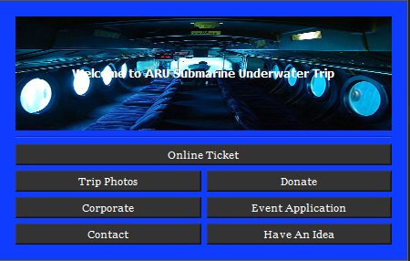
Home Page
You can choose what you want. Then another page will show up

Slide 7
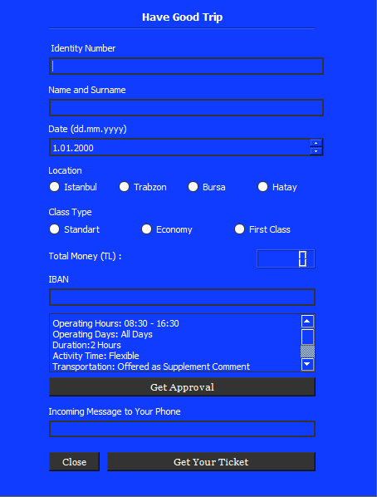
Get Your Ticket Page
You can choose your location and class type. Be sure to get confirmation after deciding on travel date

Slide 8
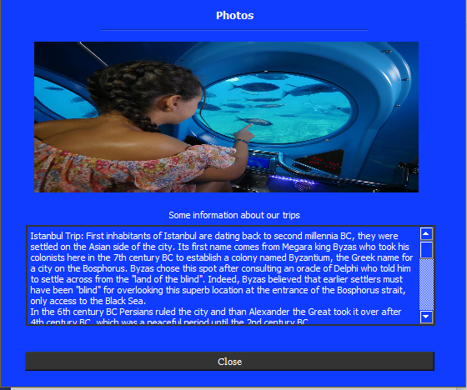
Photos Page
You can see some photos and history of that trip

Slide 9
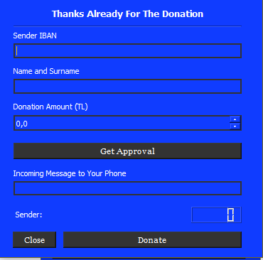
Donation Page
You can support us with your valuable donation

Slide 10
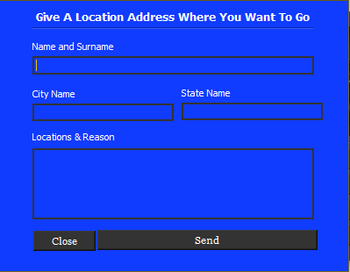
Trip Advice
You can add a location where you want

Slide 11
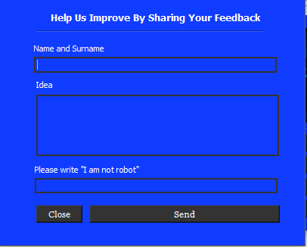
Have An Idea
You can add your idea to make us better

Slide 12
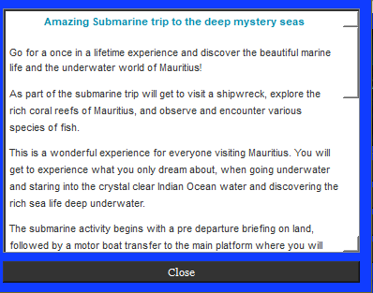
Corporate
You can see our corporate letter to know us

Slide 13
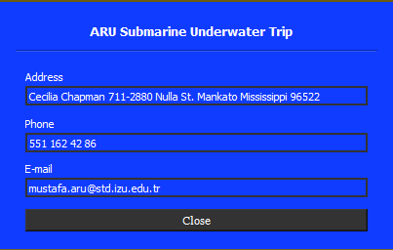
About Us
You can ask or call for technical problems

Slide 14
Thank you
Email: mustafa.aru@std.izu.edu.tr
github.com/mustafaberat/ARUSubmarine

