Slide 1
ARU
Submarine Trip
Istanbul Sabahattin Zaim University
Programming Language Lecture Project
Mustafa ARU - 30716006

Slide 2
Purpose?
Enjoy a dream adventure going underwater to 35 meters depth on board of a real submarine. Go for a once in a lifetime experience and discover the beautiful marine life and the underwater world of ARU Submarine! ... Then the submarine will start its decent into the deep sea for a real fantasy adventure trip.
Fun
Camp
Learning
Training
Swimming
Discovery
New Friends
Incredible experience
Competitive Advantages
New Team to discover the world

Slide 3

ARU Submarine
This is a wonderful experience for everyone visiting ARU Submarine. You will get to experience what you only dream about, when going underwater and staring into the crystal-clear Indian Ocean water and discovering the rich sea life deep underwater.

Slide 4
Some Rules
You should not be late
You can not smoke in that trip
You can not try to open the door during trip
You must sign an acceptance letter

Slide 5
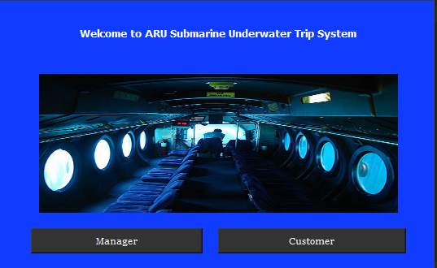
Page 1 – Manager&Customer – First step of hierarchy tree
The first page appears, defining whether the system will serve the customer or administrator
There are two buttons to go down the hierarchy tree.
5

Slide 6
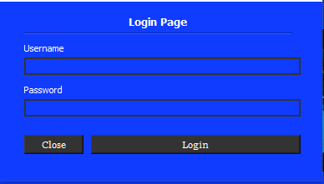
Page 2 – Manager – Are you a real manager?
If manager click “Manager” button, this page will appear to verify for security.
Importantly, this username and password information will be checked by the database.
This is the basic home page with two lineEdits and the Login Button.
6

Slide 7
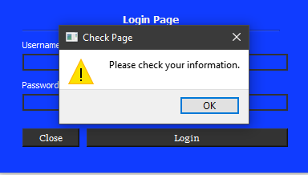
Page 3 – Manager – Opps wrong answer!
If the database does not include username and password that someone in from keyboard. The error will show by a new MessageBox
Also, other pages have the same protocol, but I will not show them all in that slide.
7

Slide 8
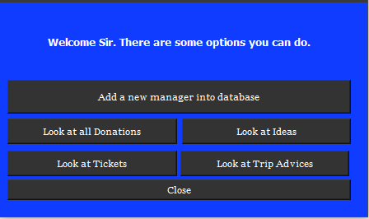
Page 4 – Manager –Welcome sir.
If the manager will write his username and password correctly, this page will appear manager to show some features that have own by only manager.
Manager can choose any button what he want in this page.
8

Slide 9
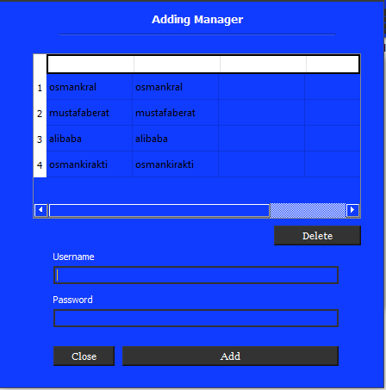
Page 4 – Manager – There are so many managers
If the manager want to add a new manager into database, this page will appear by button.
The first place that include all manager in the system. Manager can see them all because her is Manager.
Manager can delete another manager to remove the system after some managers leaved work.
9

Slide 10
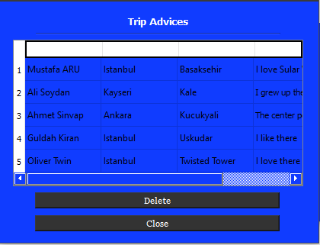
Page 5 – Manager – Look at Trip Advices
If the manager wants to see the trip advices that came from customers, he can do it in this page.
Manager also can delete advice that would include some bad commands.
Another button for closing the page
10

Slide 11
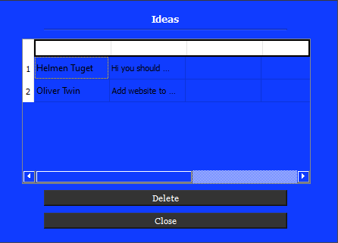
Page 6 – Manager – Look at General Ideas
If the manager wants to see the general advices or a new plan that came from customers, he can do it in this page.
Manager also can delete these ideas that would include some bad commands.
Another button for closing the page
11

Slide 12
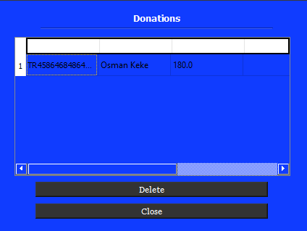
Page 7 – Manager – Look at donations, so few
If the manager wants to see the donation for the system or a new ship… that came from customers, he can do it in this page.
Manager also can delete these donations.
Another button for closing the page
12

Slide 13
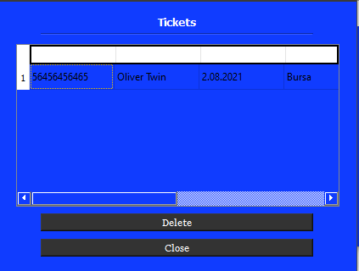
Page 8 – Manager – Look at taken tickets
If the manager wants to see the received tickets that bought by customers, he can do it in this page to see where people go usually.
The administrator can also delete these tickets that contain some bad weather forecasts, so an option is cancel of the trip
Another button for closing the page
13

Slide 14
Page 9 – Customer – Clicked Customer Button
If an income will be a customer, he must click in the Customer button to continue.
In this slide, I will show the path of customers also.
14

Slide 15
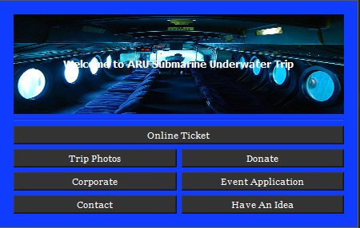
Page 10 – Customer –Just Click Them
If an income will be a customer, he must click in the Customer button he will see lots of options to do.
It is easy to understand what is the mean of buttons. Let’s start going inside them.
15

Slide 16
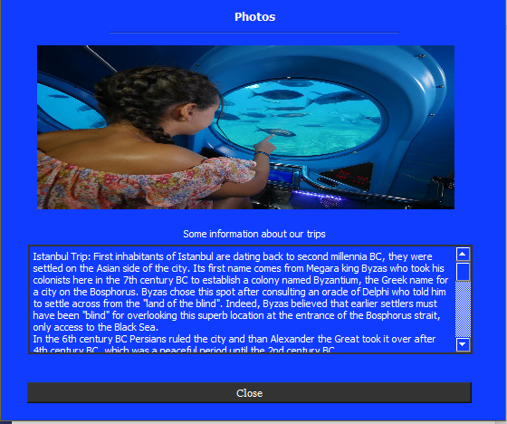
Page 11 – Customer – Do you know us?
If customer want to get knowledge about system or ARU Submarine company, he can click About Us button to see lots of information in the text.
It also contains our company’s privacy in that text.
After reading article, a customer will get some information about us.
16

Slide 17
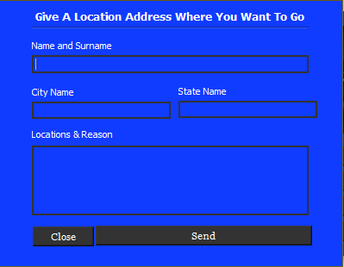
Page 12 – Customer – Where you want to go?
If customer want to go somewhere, but the system doesn’t include that place to trip, he can give that location address to adding the new path of trip.
These places will be evaluated by the manager. If it is an available option to go, he can add in Adding Trip page that showed in this presentation.
17

Slide 18
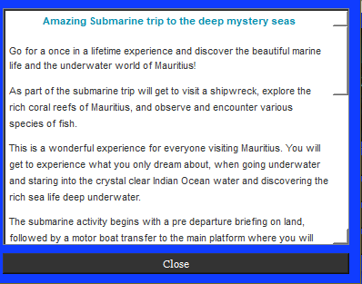
Page 13 – Customer – Why should I try it?
If customer want to get some reasons to trip under the seas, this page is a perfect for reading that article.
That article also include some healthy issues and our way to go to deep mystery seas.
Another button for closing that page because who would want to stay in the same page after reading, right?
18

Slide 19
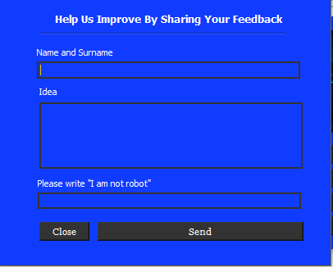
Page 14 – Customer – Give grade for us after trip
If customer want to give notes for ARU Submarine Trip company, this page is for them.
The customer can also give his idea for a new trip.
Verifying not robot is also in that page because some bots can DDOS in our system by using in that page.
After sending it, the customer will go to back page.
19

Slide 20
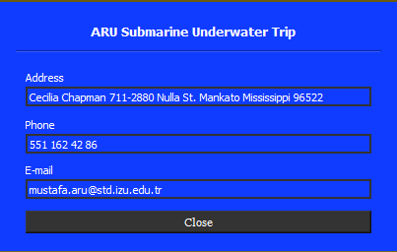
Page 15 – Customer – Type Message or Call Us
If customers want to type some message, call about the money or something, he can call our company, but he must know company’s address, phone number, email.
This page is for these customers who want to type or call the company.
20

Slide 21
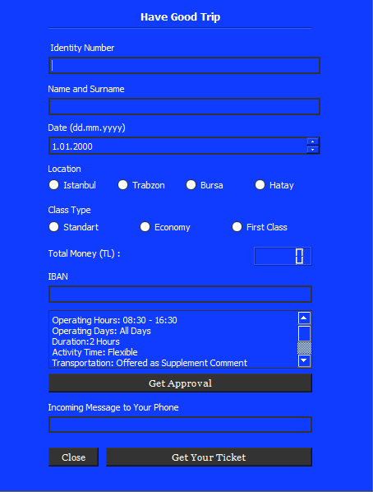
Page 16 – Customer – Get your ticket before trip
If customers want to join the trip, he must type his information in that page by lineEdits. This information will store in the databases such as ideas, donations, trip locations…
After choosing the location customer can choose his type like economy, first class etc…
After all he will be part of us.
21

Slide 22
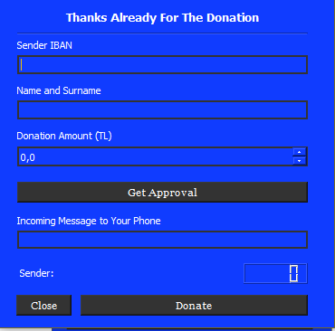
Page 17 – Customer – My favorite part ☺
If customers want to type some message, call about the money or something, he can call our company, but he must know company’s address, phone number, email.
This page is for these customers who want to type or call the company.
22

Slide 23
Thank you
Email: mustafa.aru@std.izu.edu.tr
github.com/mustafaberat/ARU-Submarine

