Slide 1
Particle Filter for Robust Target Tracking in Non-Gaussian Indoor Environments Mustafa Enes Özçelik Marmara University – Electrical and Electronics Engineering
EEE7023 Project Presentatıon
June 2026

Slide 2
Presentation Outline
Project Motivation & Problem Statement
System Models (Process & Measurement)
The Non-Gaussian Challenge
Filter Design: SIR Particle Filter
System Demonstration
Comparative Results & Error Metrics
Conclusion & Future Work

Slide 3
1. Project Motivation
Indoor Localization Challenges
− Multipath interference, signal shadowing, and Non-Line-of-Sight (NLOS) conditions.
Failure of Traditional Filters
− Standard Kalman Filters (KF, EKF, UKF) rely on Gaussian noise assumptions.
− Heavy-tailed, impulsive outliers cause complete filter divergence.
The Solution: Particle Filtering
− Sequential Monte Carlo method capable of handling arbitrary (non-Gaussian) probability density functions.

Slide 4
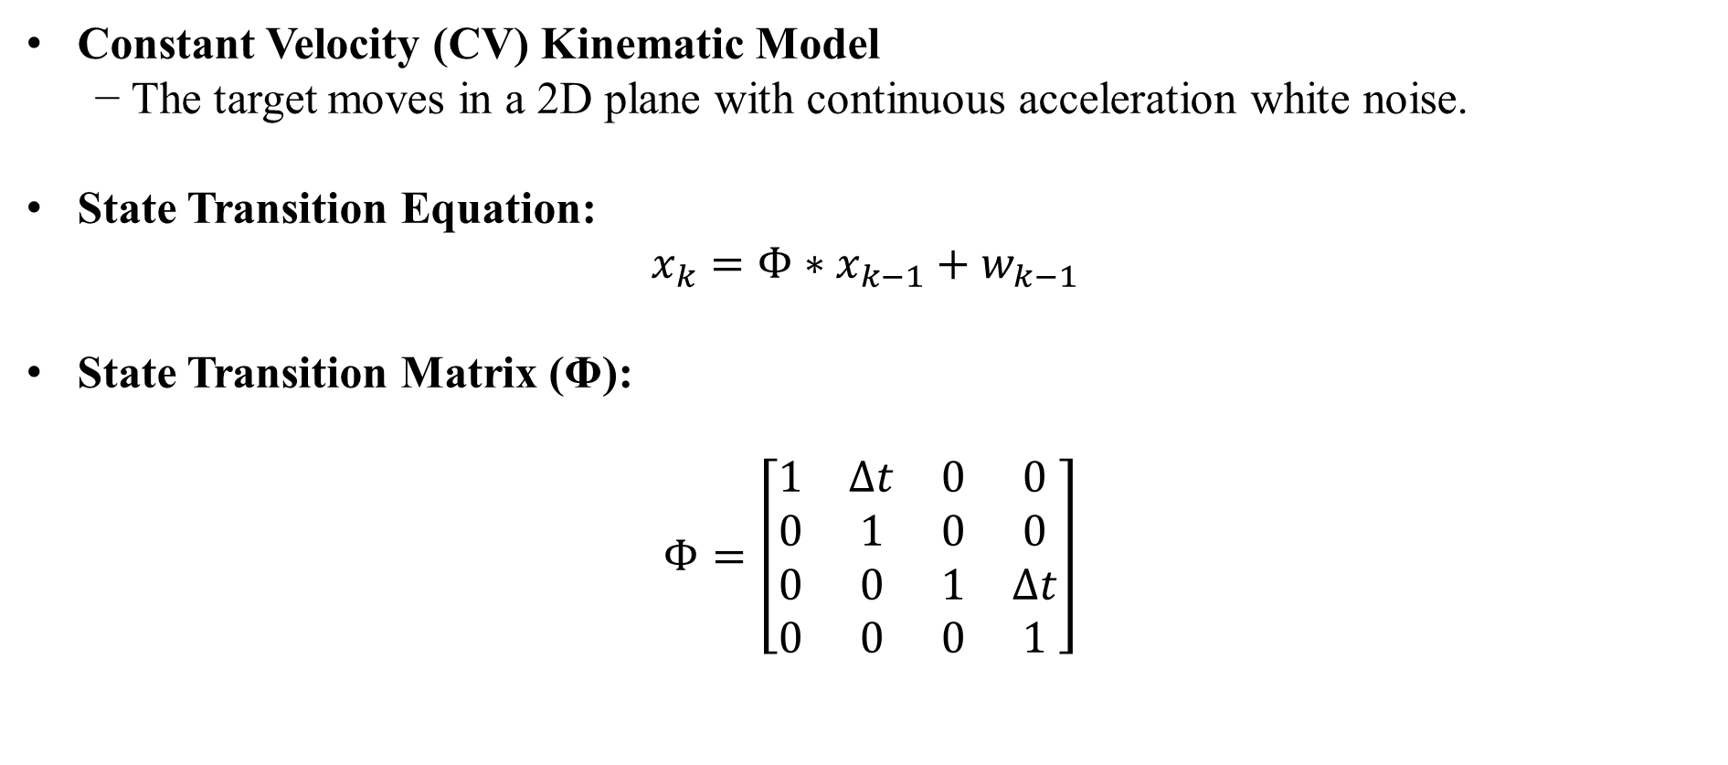
2. System Process Model
Constant Velocity (CV) Kinematic Model
− The target moves in a 2D plane with continuous acceleration white noise.
State Transition Equation:
$$x_{k}=Φ∗x_{k−1}+w_{k−1}$$
State Transition Matrix (Φ):
$$Φ=\left[\begin{matrix}1 & ∆t & 0 & 0 \\ 0 & 1 & 0 & 0 \\ 0 & 0 & 1 & ∆t \\ 0 & 0 & 0 & 1\end{matrix}\right]$$

Slide 5
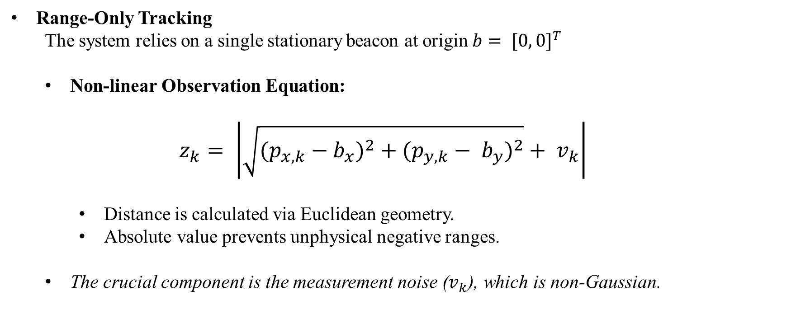
3. Measurement Model
Range-Only Tracking
The system relies on a single stationary beacon at origin $b= {[0, 0]}^{T}$
Non-linear Observation Equation:
$$z_{k}= \left|\sqrt{{(p_{x,k}−b_{x})}^{2} + {(p_{y,k}− b_{y})}^{2}} + v_{k}\right|$$
Distance is calculated via Euclidean geometry.
Absolute value prevents unphysical negative ranges.
The crucial component is the measurement noise ($v_{k}$), which is non-Gaussian.

Slide 6
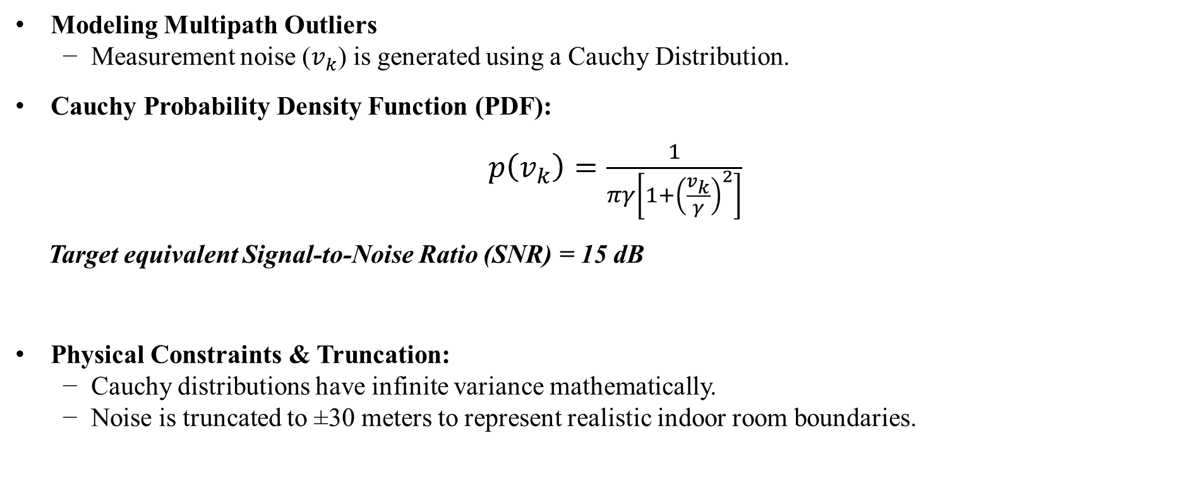
The Non-Gaussian Challenge
Modeling Multipath Outliers
− Measurement noise ($v_{k}$) is generated using a Cauchy Distribution.
Cauchy Probability Density Function (PDF):
$p\left(v_{k}\right)=\frac{1}{πγ\left[1+{\left(\frac{v_{k}}{γ}\right)}^{2}\right]}$
Target equivalent Signal-to-Noise Ratio (SNR) = 15 dB
Physical Constraints & Truncation:
− Cauchy distributions have infinite variance mathematically.
− Noise is truncated to ±30 meters to represent realistic indoor room boundaries.

Slide 7
4. Filter Design: SIR Particle Filter
Sequential Importance Resampling (SIR)
Represent continuous posterior state density using a swarm of N = 2000 discrete weighted samples (particles).
Key Steps in the Algorithm:
1. Initialization: Particles sampled around true state.
2. Prediction: Propagated through CV model.
3. Weight Update: Evaluating likelihood.
4. Resampling: Eliminating low-weight particles.

Slide 8
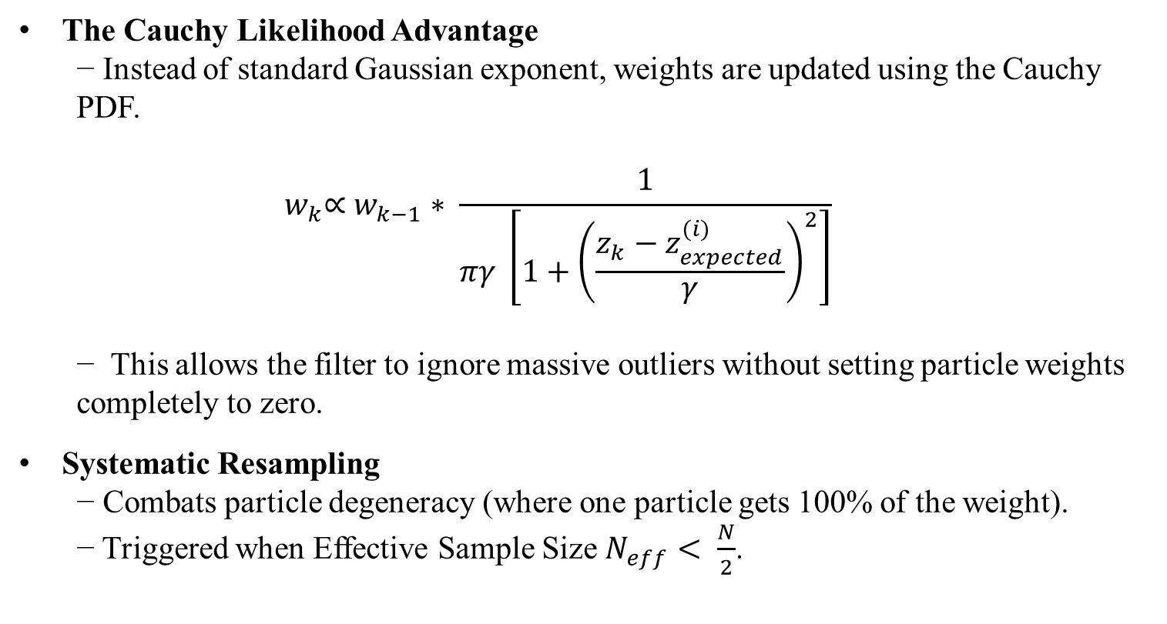
Filter Details: Weight Update & Resampling
The Cauchy Likelihood Advantage
− Instead of standard Gaussian exponent, weights are updated using the Cauchy PDF.
$$w_{k}\text{∝} w_{k−1}∗ \frac{1}{πγ \left[1+{\left(\frac{z_{k}−z_{expected}^{(i)}}{γ}\right)}^{2}\right]}$$
− This allows the filter to ignore massive outliers without setting particle weights completely to zero.
Systematic Resampling
− Combats particle degeneracy (where one particle gets 100% of the weight).
− Triggered when Effective Sample Size $N_{eff}< \frac{N}{2}$.

Slide 9
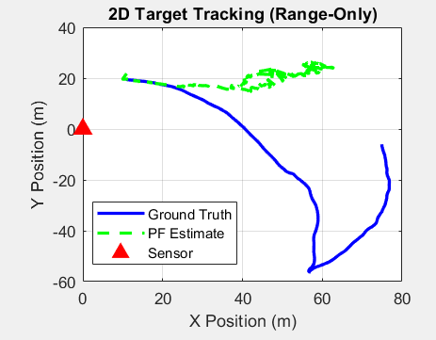
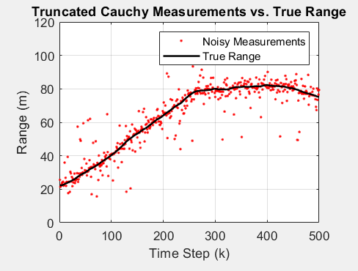

Slide 10
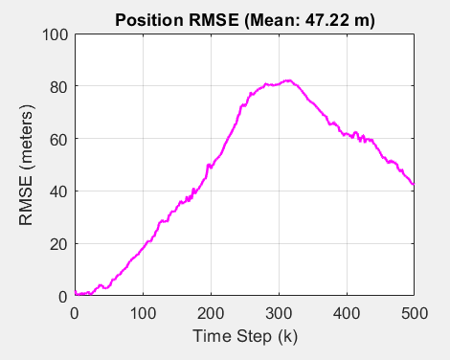
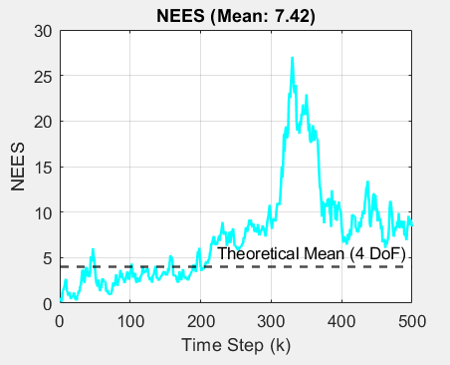
6. Comparative Results & Metrics
RMSE: Root Mean Square Error | NEES: Normalized Estimation Error Squared

Slide 11
Conclusion & Future Work
Conclusion
− SIR Particle Filter provides immense robustness in heavy-tailed (Cauchy) indoor noise.
− Successfully bypassed the divergence issues standard linear filters face under non-Gaussian conditions.
Future Work
− Resolving Angular Ambiguity:
Implementing a Trilateration network by adding two additional sensor anchors.
This will eliminate trajectory oscillations and bring position RMSE down to sub-meter accuracy.

