Slide 1
SMART CONTRACTs
MUSTAFA ERDOGAN

Slide 2

What are they ?
Smart contracts are simply programs stored on a blockchain that run when predetermined conditions are met.
Smart contracts deployed to blockchains render transactions traceable, transparent, and irreversible.
Smart contracts are self-executing lines of code with the terms of an agreement between buyer and seller automatically verified and executed via a computer network.

Slide 3

Why are they important?
Smart contracts allow developers to build a wide variety of decentralized apps and tokens. They’re used in everything from new financial tools to logistics and game experiences, and they’re stored on a blockchain like any other crypto transaction. Once a smart-contract app has been added to the blockchain, it generally can’t be reversed or changed .
Smart-contract-powered apps are often referred to as “decentralized applications” or “dapps” – and they include decentralized finance (or DeFi) tech that aims to transform the banking industry. DeFi apps allow cryptocurrency holders to engage in complex financial transactions — saving, loans, insurance — without a bank or other financial institution taking a cut and from anywhere in the world. Some of the more popular current smart-contract powered applications include:
Uniswap: A decentralized exchange that allows users, via smart contract, to trade certain kinds of crypto without any central authority setting the exchange rates.
Compound: A platform that uses smart contracts to let investors earn interest and borrowers to instantly get a loan without the need for a bank in the middle.
USDC: A cryptocurrency that is pegged via smart contract to the US dollar, making one USDC worth one U.S. dollar. UDDC is part of a newer category of digital money known as stablecoins.
So how would you use these smart contract-powered tools? Imagine you’re holding some Ethereum that you’d like to trade for USDC. You could put some Ethereum into Uniswap, which, via smart contract, can automatically find you the best exchange rate, make the trade, and send you your USDC. You could then put some of your USDC into Compound to lend to others and receive an algorithmically determined rate of interest — all without using a bank or other financial institution.
In traditional finance, swapping currencies is expensive and time consuming. And it isn't easy or secure for individuals to loan out their liquid assets to strangers on the other side of the world. But smart contracts make both of those scenarios, and a vast variety of others, possible.

Slide 4
How smart contract works?
Smart contracts were first proposed in 1994 by Nick Szabo, an American computer scientist who invented a virtual currency called "Bit Gold" in 1998, fully 10 years before the invention of bitcoin. In fact, Szabo is often rumored to be the real Satoshi Nakamoto, the anonymous inventor of bitcoin, which he has denied.
Szabo defined smart contracts as computerized transaction protocols that execute terms of a contract. He wanted to extend the functionality of electronic transaction methods, such as POS (point of sale), to the digital realm.
In his paper, Szabo also proposed the execution of a contract for synthetic assets, such as derivatives and bonds. Szabo wrote: "These new securities are formed by combining securities,very complex term structures for payments can now be built into standardized contracts and traded with low transaction costs, due to computerized analysis of these complex term structures.’’

Slide 5
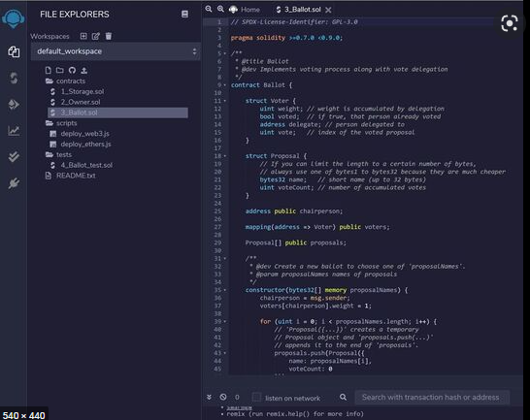
Currently, Ethereum is the most popular smart contract platform, but many other cryptocurrency blockchains (including EOS, Neo, Tezos, Tron, Polkadot, and Algorand) can run them.
Smart contracts are written in a variety of programming languages (including Solidity, Web Assembly, and Michelson). On the Ethereum network, each smart contract’s code is stored on the blockchain, allowing any interested party to inspect the contract’s code and current state to verify its functionality.

Slide 6
A smart contract can be created and deployed to a blockchain by anyone. Their code is transparent and publicly verifiable, which means that any interested party can see exactly what logic a smart contract follows when it receives digital assets.
Each computer on the network (or “node”) stores a copy of all existing smart contracts and their current state alongside the blockchain and transaction data.
When a smart contract receives funds from a user, its code is executed by all nodes in the network in order to reach a consensus about the outcome and resulting flow of value. This is what allows smart contracts to securely run without any central authority, even when users are making complex financial transactions with unknown entities.
To execute a smart contract on the Ethereum network, you will generally have to pay a fee called “gas” (so named because these fees keep the blockchain running).
Once deployed onto a blockchain, smart contracts generally can’t be altered, even by their creator. (There are exceptions to this rule.) This helps ensure that they can’t be censored or shut down.

Slide 7

                THANK YOU

