Slide 1
Heuristic 2
Top to bottom approach

Slide 2
Heuristic 2
Basic idea
Iteration with sub-mixed integer programming.
More integer variables, more time the algorithm will take. We can make iterative procedures to optimize the objective function with less integer variables.
In our model, we have binary variable: access_indicator, link_indicator and server_indicator. But when we fix link_indicator and access_indicator to binary variables, the server_indicator will be binary automatically.
So we fix link_indicator to be binary, and get ‘binary’ access_indicator iteratively. During the iteration, we add more constraints to the model according to the output of each iteration to gradually get the mixed integer solution.
Notes:
(constrain flow to route at most one path)

Slide 3
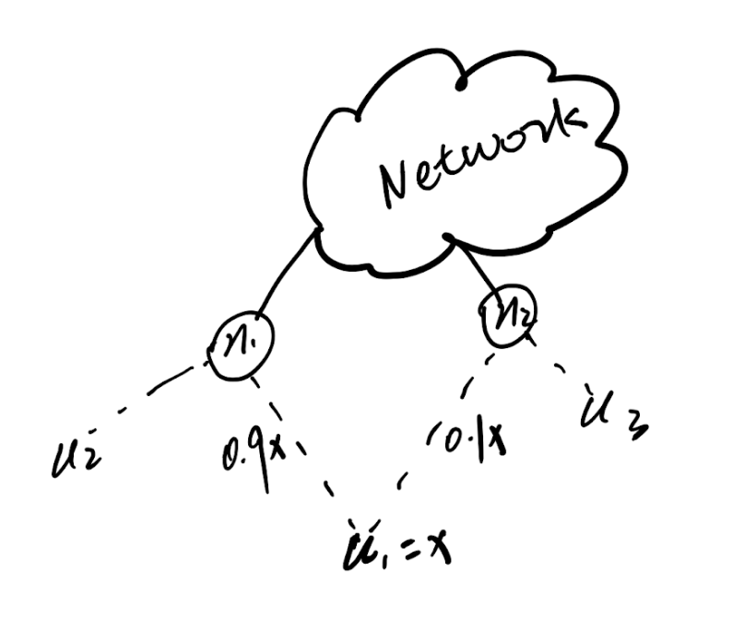
Heuristic 2
Algorithm
The most intuitive idea is to fix access_indicator =1 as soon as they become 1 in the iterative procedure.
How about < 1?
Increase 0.9 to 1?
(may cause infeasible solution)

Slide 4
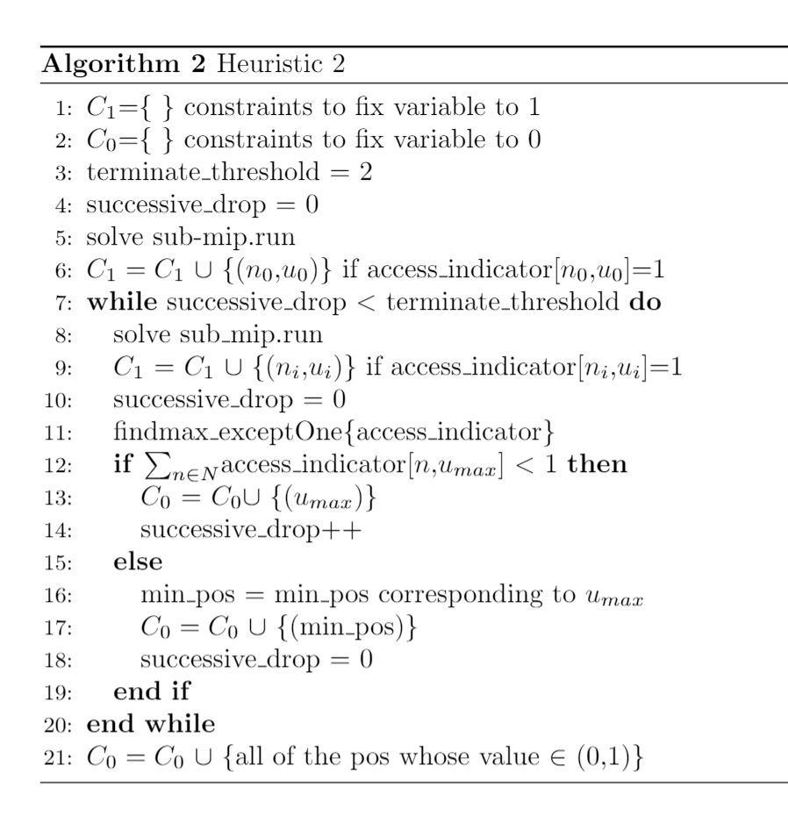
Heuristic 2
Algorithm here
Idea:
Try to increase these majority part of flow to one by reducing the minority to zero, which will guarantee the feasible solution.
If majority of u_i came to 1 → Fix to 1.
If not, sum(all flow of user i) < 1 → drop off
Successive drop off will terminate the iteration.
Notes:
Because it has relatively the higher probability to became 1

Slide 5
Heuristic 2
Two important properties:
Property 1: We just drop off user x if and only if it has the lowest value on the access node of the flow’s majority part.
Property 2:For these user who is not drop off. If the shortest path can not accommodate this user, it will choose the second shortest path. If the second shortest path can not do either, then the third …

Slide 6
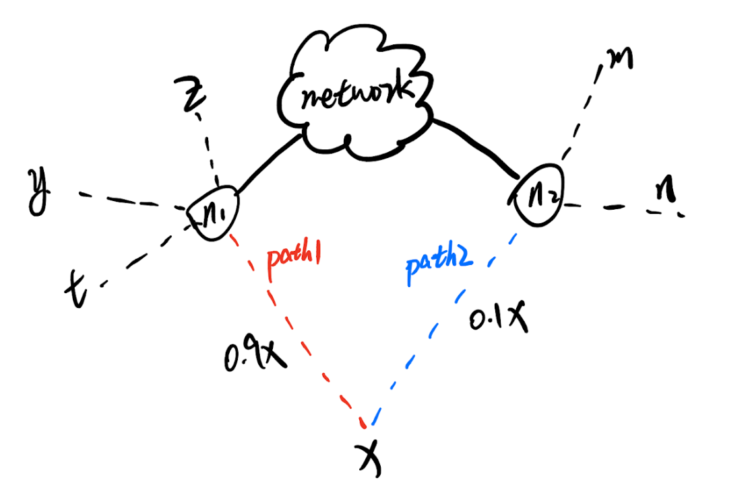
Heuristic 2
Sketch proof on two splits:
Two cases:
Path1 is the SP:
X.v = min{V_n1}
Decrease 0.1x to 0, then due to X.v = min{V_n1}, 0.9x can not increase(not infect y,z,t).
sum{flow of user x}<1 drop off in the future iteration. →property 1
Path 2 is the SP:
X.v = min{V_n2}
if X.v = max{V_n1}
decrease 0.1x to 0 will have 0.9x→ (0.9+0.1)x →property 2
if X.v = min{V_n1}
decrease 0.1x to 0 will not infect y,z,t .Then 0.9x will be kept and drop off in the future iteration. → property 1
else(y.v<z.v<x.v<t.v)
decrease 0.1x to 0 will lead to 0.9x→(0.9x+wx)
First result: 0.9x→ (0.9+0.1)x →property 2
Second result: w<0.1(after remove y and z on node1→
X.v = min{V_n1}) →(0.9x+wx)<1→
drop off→property 1
Split happens when the available shortest path(SP) can not fully accommodate one user.
In our model:
Each node can serve at least one service. Due to each node can serve all services, so service type does not matter for node. The value of each service matters. →Only the Higher value flow effects the lower value flow
Figure here

Slide 7
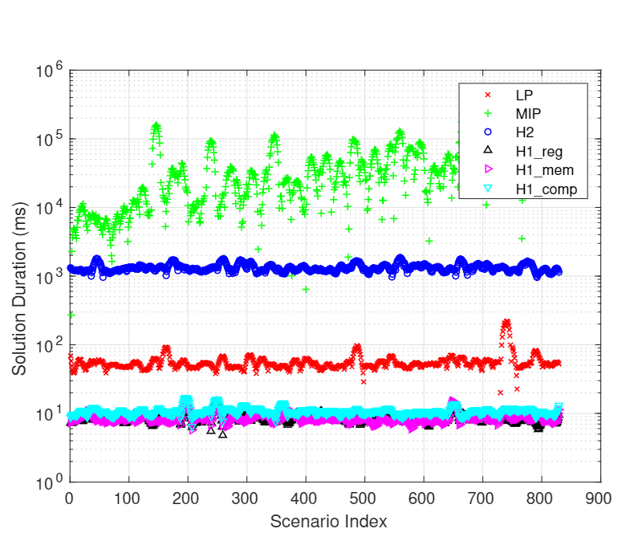
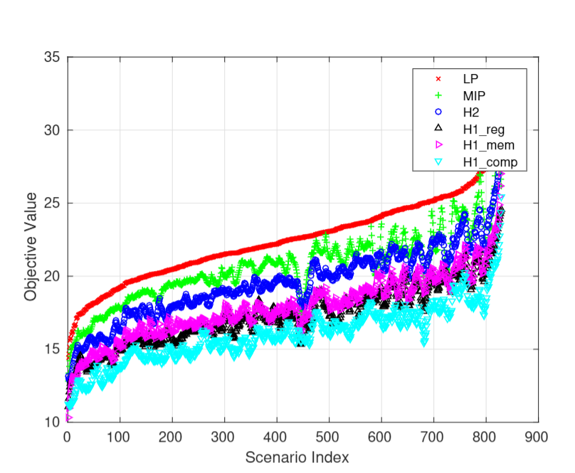
Heuristic 2
Experiments

Slide 8
Heuristic 2
Summary
Pros:
Achieve good approximation for mixed integer programming with much less computation.
Solution duration is much more stable than mip’s.
Adjustable(parameters, terminate condition)
Cons:
Still mixed integer programming in each iteration(LP in future work)

Slide 9
Thank you!
Q&A

