Slide 1
Project #2 Assignment
12.05.2020

Slide 2
Project #2 Assignment
28 instructions
R-format (11) : balrn, balrz, sll, srl, sllv, srlv, jmadd, jmor, jmsub, jalr, jr
I-format (13) : xori , andi, ori, bneal, bgez, bgezal, bgtz, blez, bltzal, bltz, jrs, jrsal, jpc
J-format (4) : baln, balz, balv, jal
especially, jump and branches

Slide 3
Project #2 Assignment
You must
determine which instructions are actual in the current ISA.
determine which instructions are already implemented in the ‘MIPS-lite’ processor.
design the revised single-cycle datapath and revised control units which make a processor that executes all your instructions.
implement “your” single cycle processor in Verilog HDL.
prepare a simulation for the demo

Slide 5
3 steps
RTL
Changes to the Datapath
Design the Control table(s)

Slide 6
3 aspects of control Instructions
the change of control is conditional or unconditional
a return address link is stored or not
which option for the target address is chosen

Slide 7
3 aspects of control Instructions
Conditionally equal
Conditionally less than
Conditionally greater than
Unconditional
Linked
Not Linked
Return address
Control
INSTRUCTIONS
Target address
Direct from Register
Indirect from Memory
PC-Relative
Pseudo-Direct

Slide 9
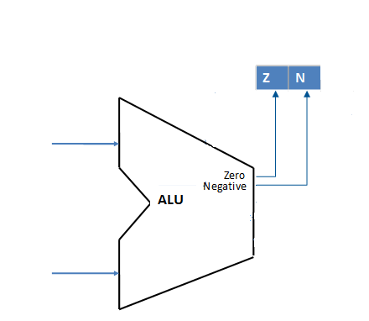
Status Register

Slide 10
Conditional change of control (branch)
instruction | syntax | Condition | branch address | link address
balrz | balrz $rs, $rd | if Status [Z] = 1 | PC ← R[rs] | R[rd] ← PC + 4
balrn | balrn $rs, $rd | if Status [N] = 1 | PC ← R[rs] | R[rd] ← PC + 4
balz | balz Target | if Status [Z] = 1 | Pseudo-direct address PC ← PC[31:28]||[25:0]||00 | R[31] ← PC + 4
bgez | bgez $rs, Label | if R[rs] >= 0 | PC-relative address PC ← PC+4+(Label << 2) | ---

Slide 11
Unconditional change of control
instruction | syntax | jump address | link address
jmor | jmor $rs,$rt | PC ← M[$rs|$rt] | ---
jalr | jalr $rs, $rd | PC ← $rs | R[rd] ← PC + 4
jrs | jrs $rs | PC ← M[$rs] | ---
jal | jal Target | PC ← {PC+4,(Target << 2)} | R[31] ← PC + 4

Slide 12
R-format
sllv $rd, $rt, $rs
I-format
xori $rt,$rs,Label
J-format
balz target
0 | rs | rt | rd | 0 | 4
6 5 5 5 5 6
4 | rs | rt | Label
6 5 5 16
24 | target
6 26

Slide 13
Control Units
Main
Control
Jump/ Brach
Control
Having a single Control Table is not that good.
Alternative:
Design three control tables
ALU Control

Slide 15
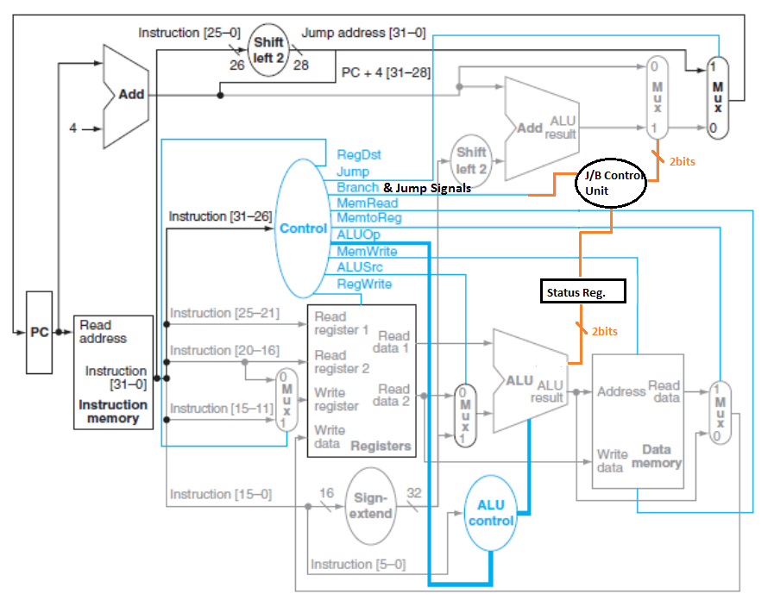

Slide 16
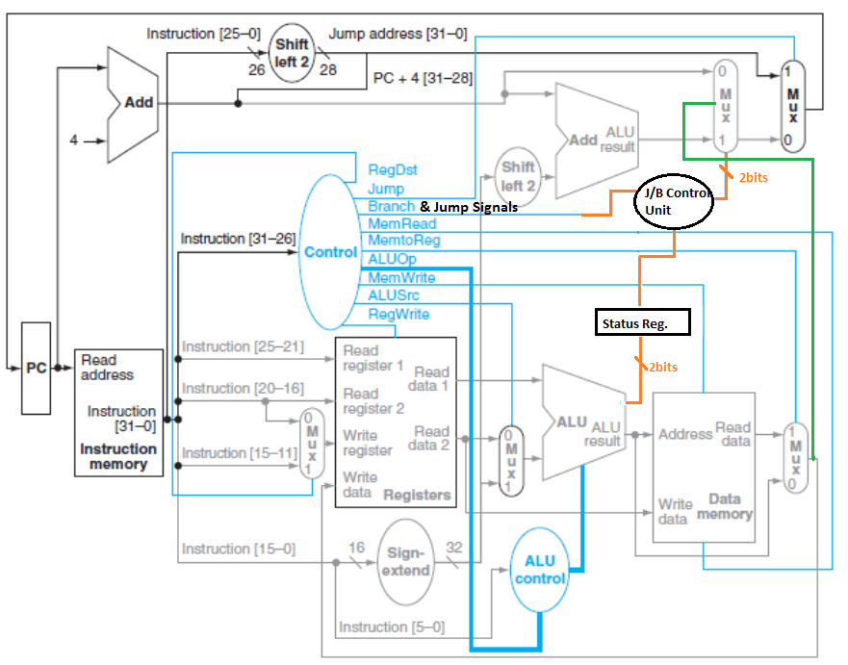

Slide 17
