Slide 1
Chapter 2 - Motivation and Tools
Page Number Title
1 Introduction
2 Historic motivation
3 ARPA
4 Packet switching
5 Internetworking
6 History and growth
7 Growth since 1981
8 Growth (logarithmic axis)
9 Probing the Internet

Slide 2
10 ping
11 ping (Example)
12 ping (Example)
13 traceroute
14 traceroute (Example)
15 traceroute (Example)
16 Web access to tools

Slide 3
Introduction
Motivation
Service
Tools for exploration

Slide 4
Historic motivation
Early computers were expensive
  Large footprint
  Centralized
Programs took a long time to run
Couldn't afford to put computers everywhere

Slide 5
ARPA
Advanced Research Projects Agency initiated project to connect researchers with computers
Adopted new technology:
  Packet switching
  Internetworking
Resulted in system for remote access to expensive resources

Slide 6
Packet switching
Data transmitted in small, independent pieces
Source divides outgoing messages into packets
Destination recovers original data
Each packet travels independently
Includes enough information for delivery
May follow different paths
Can be retransmitted if lost

Slide 7
Internetworking
Many (mutually incompatible) network technologies
No one technology appropriate for every situation
Internetworking glues together networks of dissimilar technologies with routers
Result is virtual network whose details are invisible

Slide 8
History and growth
ARPAnet began in late 1960s (not using TCP/IP)
TCP/IP developed in late 1970s
ARPAnet switched to TCP/IP in early 80s
Start of Internet
  Few hundred computers
  Few tens of networks

Slide 9
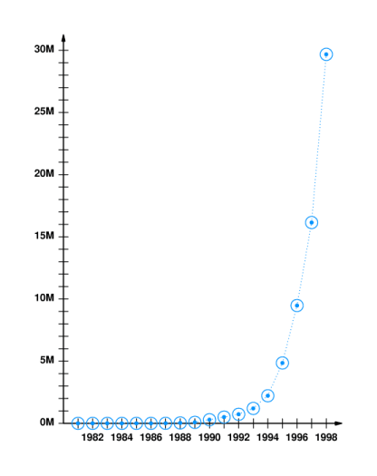
Growth since 1981

Slide 10
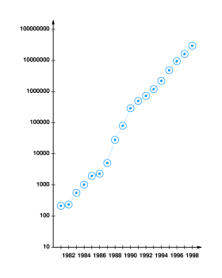
Growth (logarithmic axis)

Slide 11
Probing the Internet
Two tools:
  ping - sends message that is echoed by remote computer
  traceroute - reports path to remote computer

Slide 12
ping
Sends packet to remote computer
Remote computer replies with echo packet
Local computer reports receipt of reply
% ping merlin.cs.purdue.edu
merlin.cs.purdue.edu is alive

Slide 13
ping (Example)
Can arrange to send multiple packets
Reports round trip time
% ping -s www.bucknell.edu 100 5
PING web.bucknell.edu: 100 data bytes
108 bytes from web.bucknell.edu (134.82.6.6): icmp_seq=0. time=8. ms
108 bytes from web.bucknell.edu (134.82.6.6): icmp_seq=1. time=5. ms
108 bytes from web.bucknell.edu (134.82.6.6): icmp_seq=2. time=3. ms
108 bytes from web.bucknell.edu (134.82.6.6): icmp_seq=3. time=2. ms
108 bytes from web.bucknell.edu (134.82.6.6): icmp_seq=4. time=2. Ms
----web.bucknell.edu PING Statistics----
5 packets transmitted, 5 packets received, 0% packet loss
round-trip (ms) min/avg/max = 2/4/8

Slide 14
ping (Example)
% PING merlin.cs.purdue.edu: 100 data bytes
108 bytes from merlin.cs.purdue.edu (128.10.2.3): icmp_seq=0. time=64. ms
108 bytes from merlin.cs.purdue.edu (128.10.2.3): icmp_seq=1. time=58. ms
108 bytes from merlin.cs.purdue.edu (128.10.2.3): icmp_seq=2. time=55. ms
108 bytes from merlin.cs.purdue.edu (128.10.2.3): icmp_seq=3. time=63. ms
108 bytes from merlin.cs.purdue.edu (128.10.2.3): icmp_seq=4. time=54. ms
----merlin.cs.purdue.edu PING Statistics----
5 packets transmitted, 5 packets received, 0% packet loss
round-trip (ms) min/avg/max = 54/58/64

Slide 15
traceroute
Sends series of packets along path to destination
  Each successive packet identifies next router along path
  Uses expanding ring search
Reports list of packets

Slide 16
Traceroute (Example)
% traceroute www.bucknell.edu
traceroute to web.bucknell.edu (134.82.6.6), 30 hops max, 40 byte packets
1 DanaRout-p13-s56.eg.bucknell.edu (134.82.56.254) 8 ms 5 ms 5 ms
2 CCSServB-p1p17-s254.bucknell.edu (134.82.254.3) 4 ms 7 ms 4 ms
3 web.bucknell.edu (134.82.6.6) 3 ms 3 ms 3 ms

Slide 17
traceroute (Example)
traceroute merlin.cs.purdue.edu
traceroute to merlin.cs.purdue.edu (128.10.2.3), 30 hops max, 40 byte packets
1 CCSServC (134.82.7.254) 2 ms 1 ms 1 ms
2 134.82.254.253 (134.82.254.253) 2 ms 2 ms
3 ms 3 12.127.210.89 (12.127.210.89) 22 ms 20 ms 20 ms
4 gr1-a3100s5.wswdc.ip.att.net (192.205.34.9) 20 ms 20 ms 20 ms
5 Hssi2-1-0.GW1.DCA1.ALTER.NET (157.130.32.21) 20 ms 20 ms 20 ms
6 104.ATM2-0.XR2.DCA1.ALTER.NET (146.188.161.30) 21 ms 39 ms 20 ms
7 194.ATM2-0.TR2.DCA1.ALTER.NET (146.188.161.146) 20 ms 20 ms 20 ms

Slide 18
8 101.ATM6-0.TR2.CHI4.ALTER.NET (146.188.136.109) 40 ms 41 ms 56 ms
9 198.ATM7-0.XR2.CHI4.ALTER.NET (146.188.208.229) 41 ms 41 ms 41 ms
10 194.ATM8-0-0.GW1.IND1.ALTER.NET (146.188.208.165) 63 ms 66 ms 51 ms
11 purdue-gw.customer.alter.net (157.130.101.106) 56 ms 54 ms 54 ms
12 cisco-cs-atm.gw.purdue.edu (128.210.252.21) 66 ms 65 ms 63 ms
13 merlin.cs.purdue.edu (128.10.2.3) 68 ms 84 ms 63 ms

Slide 19
Web access to tools
ping
traceroute

