Slide 1
Chapter 2a – Network Programming and Applications
Page Number Title
1 Introduction
2 Network Communication
3 Client-server computing
4 Communication paradigm
5 An example application program interface
6 An intuitive look a the API
7 Definition of the API
8 Code for an Echo application
9 Code for an Chat application
10 Code for a Web application
11 Summary

Slide 2
Introduction
Computer networks from a programmer’s point of view.
A brief outline of the network facilities available to a programmer.
Applications uses a network.
A Programmer can create Internet application software without understanding the underlying network technology or communication protocols.

Slide 3
Network communication
Although a data transfers data from one point to other, the network itself is passive.
The network neither generates nor understand the data being sent.
All data processing is performed by application program.
  The pairs uses the network merely to exchange messages.
  Such as a data base client accesses to the central data base
  The application on the remote computer sends a request to the application running on the database computer.
  Only two application understands the messages format and meaning.

Slide 4
Client server computing
How can a pair of a programs find each other as large as Internet?
The Internet uses a straight mechanism.
  One application starts first and waits for the other applications to contact it.
  The second application must know the location where the first application is waiting.
This is know as the client-server paradigm or as client server computing.
The program waits for contact is called a server and the program that initiates contact is known as a client.
In the Internet, a location is given by pairs of identifiers:
  (computer,application)

Slide 5
The computer identifies the computer on which the server is running and application identifies a particular application program on that computer.
Human uses alphabetic names and network software includes a software that translates each name to a corresponding binary number automatically
Because the network understand binary values but human.

Slide 6
Communication paradigm
Most Internet follows same the basic sequence of operations when they communicate.
  The server application start first, and waits for contact from a client
  The client contacts the server by specifying its location and requesting communication
  The client and server exchanges messages
  After they finish sending data, the client and sever each send an end-of-file to terminate communication.

Slide 7
An example application program interface
So fat we discussed the interaction between two applications.
We will now consider detailed implementation.
Computer scientist uses the term Application Program Interface (API) to describe set of operations available to an application programmer.
The API specifies the arguments for each operation as well as the semantic.
Figure 3.1 list seven function than an application can call.

Slide 8
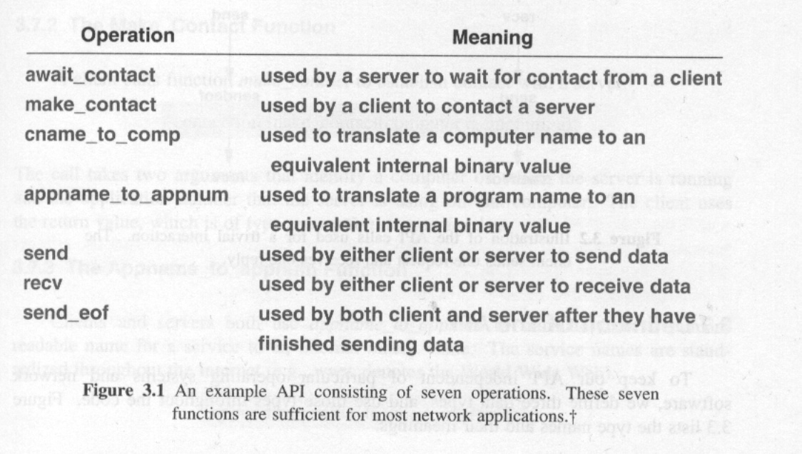
Figure 3.1

Slide 9
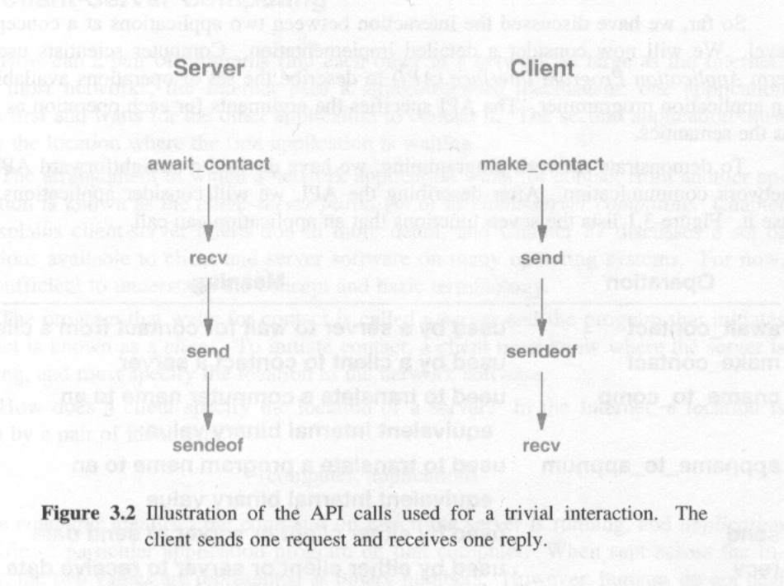
An intuitive look at the API
The figure illustrates the sequence of API calls that a client and server make for a typical interaction.

Slide 10
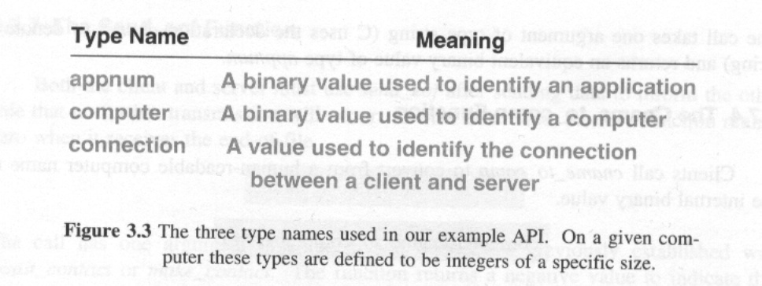
Definition of the API
To keep the (in this reference book) API independent of particular operating system and network software, three data types are defined and these types is used throughout the code.
Figure 3.3 lists the type names and their meanings.

Slide 11
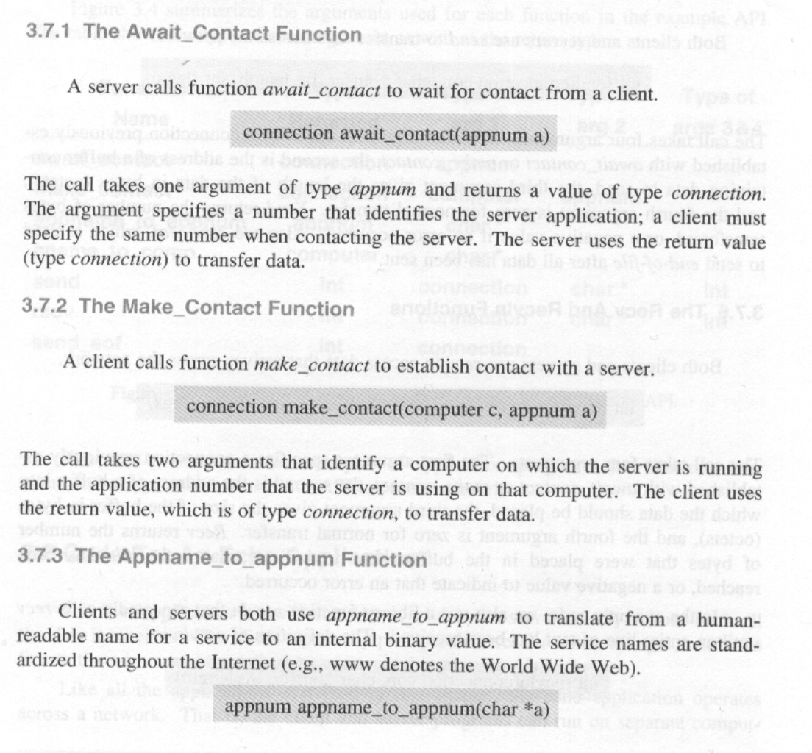
Page 21, wait, make, appname,

Slide 12
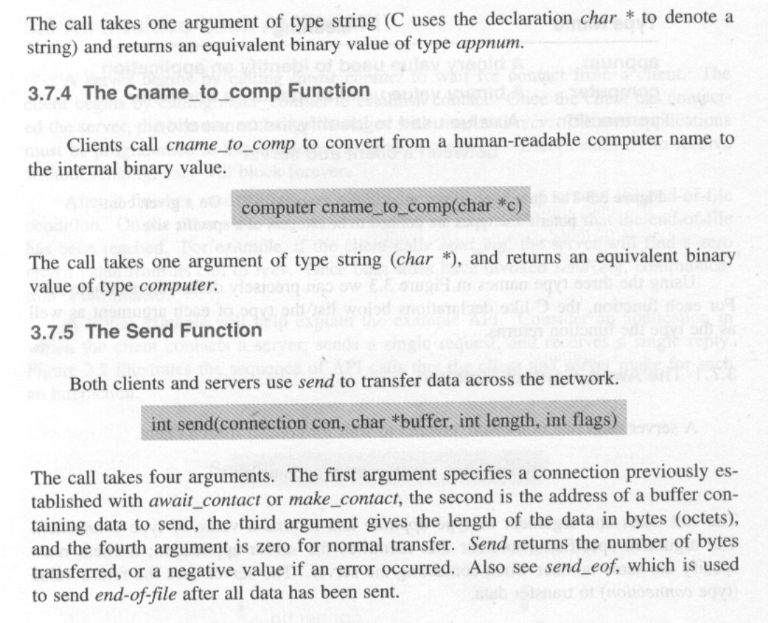
Page 22, cname, send,

Slide 13
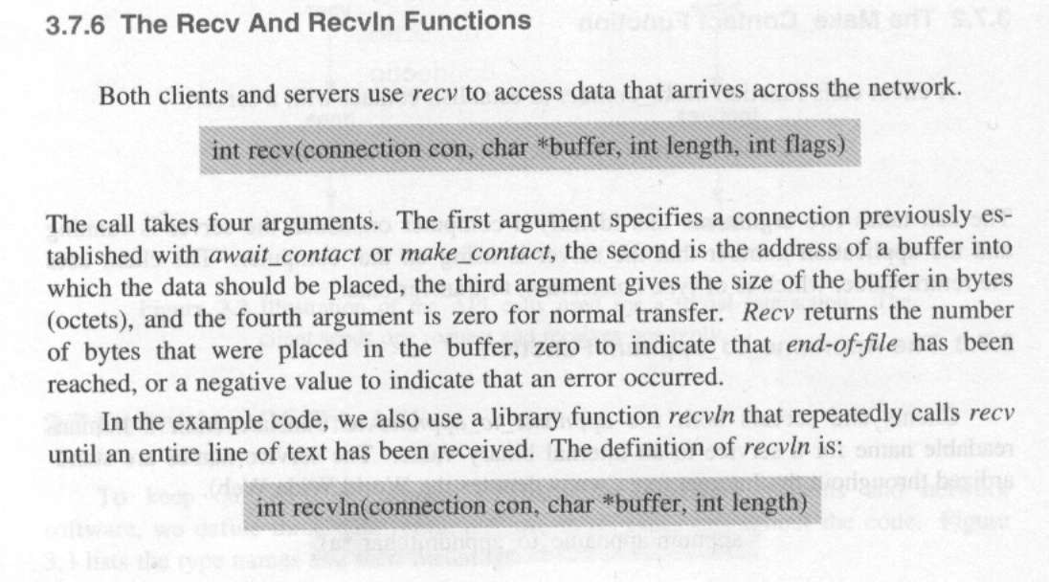
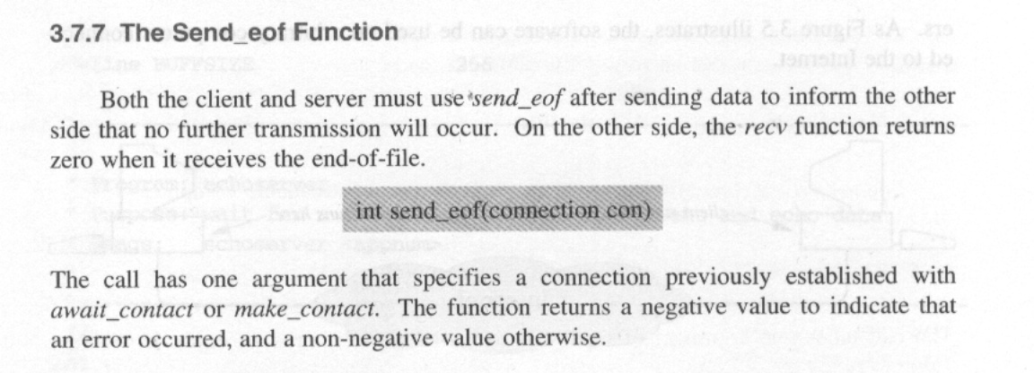
Page, 22,23, send, send_eof

Slide 14
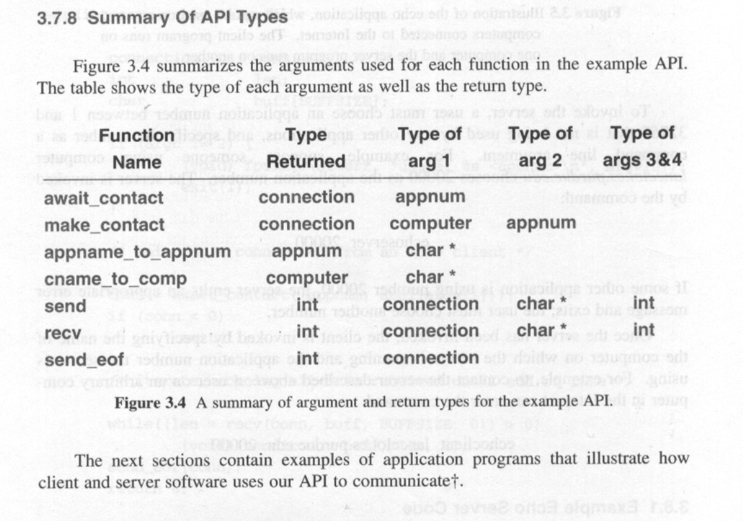
Page 23, Summary of API Types

Slide 15
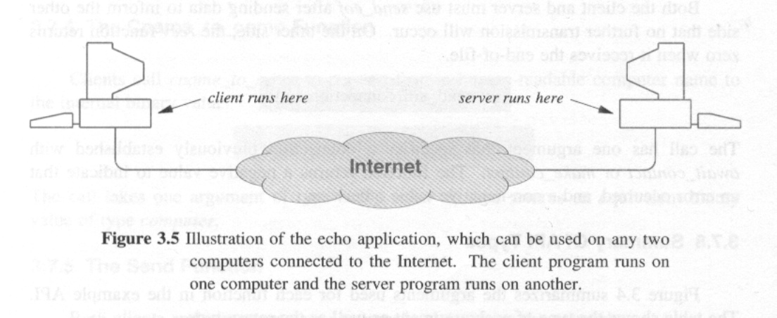
Code for and echo application
Figure 3.5 illustrates, the software can be used on arbitrary computer connected top the Internet

Slide 16
Chose an application number between 1 to 32767 that is not being used by any other applications,
Specify the number as a command line argument.
Computer lancelot.cs.purde.edu chooses 20000 as the application number.
The sever is invoked by the command:
  echoserver 20000
  In some other application is using number 20000, the server emits an appropriate error message and exist, the user must chose another number.
A user on an arbitrary computer contact to the sever:
Enters command
  echoclient lancelot.cs.purde.edu 20000

Slide 17
Code for a chat application
Suppose a user on computer exatclibur.cs.purde.edu runs the server.
  Charserver 25000
A user on another computer can invoke the client, which contacts the server:
  chatclient exatclibur.cs.purde.edu 25000
The server begins by waiting for contact from the client.
It enters a loop in which it obtains and displays a line of text from the client, prompts the local user, read a line of input from the keyboard, and sends the line to the client side.
The clients begins by contacting the server.
Once communication has been established, the client also enters a loop. Does the same as server.
This continues until end-of-file.

Slide 18
Code for a Web application
The final example application we will consider consist of a client and server for the World Wide Web.
To run the server a user chooses an application number and invokes the server program.
  User on merlin.cs.purde.edu chooses the application number 27000
The server can be invoked with the command:
  webserver 27000
As usual the client specify a computer a path name, and an application number
  webclient merlin.cs.purdue.edu /index.html 27000
A commercial browser instead of the webclient enters the URL:
  http://merlin.cs.purdue.edu:2700/index.html

Slide 19
The client code extremely simple – after establishing communication with the web server it send a request, which must have the form:
  GET /path HTTP/1.0 CRLF CRLF
Where path denotes the name of an item such as index.html, and CRLF denotes the two characters carriage returns and line feed.
After sending the request, the clients revives and prints output from the server.
The web server is more complex
In addition to reading and parsing a request, the server must send both a header and data in the response.
The header consist of several lines that are terminated by carriage return and linefeed characters.

Slide 20
The header lines are of the form:
  HTTP/1.0 status status_string CRLF
  Server: CNAI Demo Server CRLF
  Content-Length: datasize CRLF
  Content-Type: text/html CRLF
  CRLF
If a request is incorrectly formed the server generates a 400 error message.
If the item specified in the request cannot be found, the server generates a 404 message.

Slide 21
Summary
A network application can be created an the application operates across the global Internet.
Here high level function are used (that is the Application Program Interface API).
The API contains only seven primitives.
The API is sufficient to construct software that correctly interoperates with commercial software.

