Slide 1
Chapter 5 - Long-Distance Communication
Page Number Title
1 Long-distance communication
2 Sending signals long distances
3 Oscillating signals
4 Encoding data with a carrier
5 Types of modulation
6 Examples of modulation techniques
7 Encoding data with phase shift modulation
8 Hardware for data transmission
9 Full duplex communication
10 Modems

Slide 2
11 Other types of modems
12 Leased serial data circuits
13 Optical, radio and dialup modems
14 Dialup modems
15 Operation of dialup modems
16 Carrier frequencies and multiplexing
17 Multiplexing
18 Spread spectrum multiplexing
19 Time division multiplexing
20 Summary

Slide 3
Long-distance communication
Encoding used by RS-232 cannot work in all situations
  Over long distances
  Using existing systems like telephone
Different encoding strategies needed

Slide 4
Sending signals long distances
Electric current becomes weaker as it travels on wire
Resulting signal loss may prevent accurate decoding of data
Signal loss prevents use of RS-232 over long distances

Slide 5
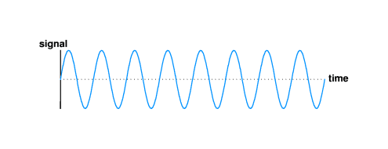
Oscillating signals
Continuous, oscillating signal will propagate farther than electric current
Long distance communication uses such a signal, called a carrier
Waveform for carrier looks like:
Carrier can be detected over much longer distances than RS-232 signal

Slide 6
Encoding data with a carrier
Modifications to basic carrier encode data for transmission
Technique called modulation
Same idea as in radio, television transmission
Carrier modulation used with all types of media - copper, fiber, radio, infrared, laser

Slide 7
Types of modulation
Amplitude modulation - strength, or amplitude of carrier is modulated to encode data
Frequency modulation - frequency of carrier is modulated to encode data
Phase shift modulation - changes in timing, or phase shifts encode data

Slide 8
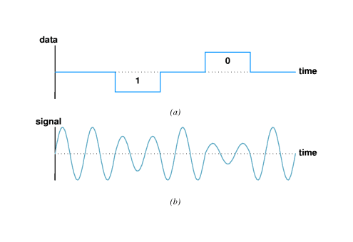
Examples of modulation techniques
Amplitude modulation:

Slide 9
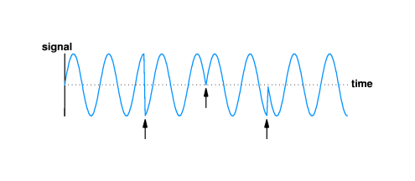
Phase shift modulation:

Slide 10
Encoding data with phase shift modulation
Amount of phase shift can be precisely measured
  Measures how much of sine wave is "skipped"
  Example shows 1/2 and 3/4 cycle

Slide 11
Each phase shift can be used to carry more than one bit; in example, four possible phase shifts encode 2 bits:
  00 - no shift
  01 - 1/4 phase
  10 - 1/2 phase
  11 - 3/4 phase
Thus, each phase shift carries 2 bits
Data rate is twice the baud rate

Slide 12
Hardware for data transmission
Modulator encodes data bits as modulated carrier
Demodulator decodes bits from carrier
Data transmission requires modulator at source and demodulator at destination

Slide 13
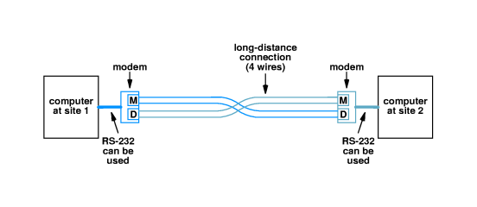
Full duplex communication
Most systems provide for simultaneous bidirectional, or full duplex, transmission
Requires modulator and demodulator at both endpoints:

Slide 14
Long-distance connection is called 4-wire circuit
Modulator and demodulator typically in single device called a modem (modulator/demodulator)

Slide 15
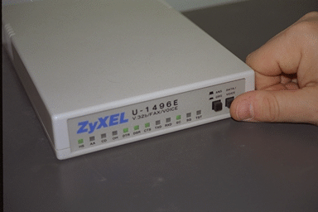
Modems
If external to computer, RS-232 can be used between modem and computer

Slide 16
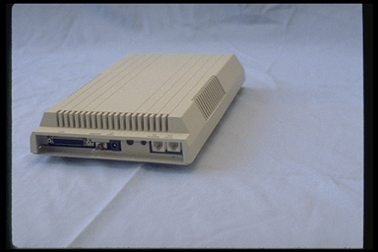
If internal, direct bus connection used

Slide 17
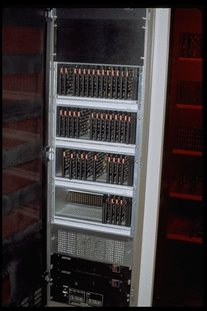
Can also be rack-mounted

Slide 18
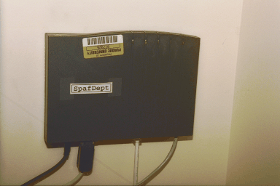
Other types of modems
ISDN modem

Slide 19
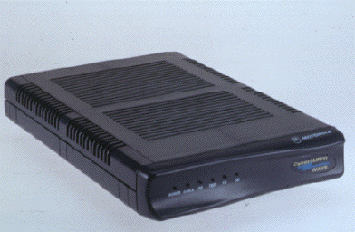
Cable modem (front)

Slide 20
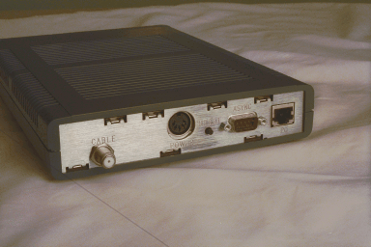
Cable modem (rear) with coax connector for cable and 10Base-T connnector

Slide 21
Leased serial data circuits
Organizations often include 4-wire circuits in network
Within a site - on a campus - organization can install its own 4-wire circuits
Telephone company supplies off-campus wires
  Telephone cables have extra wires (circuits) for expansion
  Telephone company lease right to use wires to organization
  Organization uses modems for data transfer
Called serial data circuit or serial line
Operates in parallel with (but not connected to) telephone circuits

Slide 22
Optical, radio and dialup modems
Modems used with other media in addition to dedicated data circuits
Special form of encoding/decoding transducers that use modulation for data encoding
  Glass - data encoded as modulated light beam
  Radio - data encoded as modulated radio signal
  Dialup - data encoded as modulated sound
Dialup modem connects to ordinary phone line

Slide 23
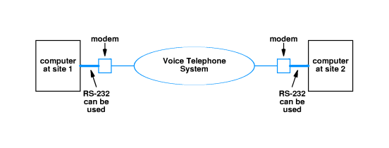

Slide 24
Dialup modems
Circuitry for sending data
Circuitry to mimic telephone operation
  Lifting handset
  Dialing
  Replacing handset (hanging up)
  Detect dial tone
Full duplex on one voice channel
  Different carrier frequencies for each direction
Filters eliminate interference

Slide 25
Operation of dialup modems
Receiving modem waits for call in answer mode
Other modem, in call mode:
  Simulates lifting handset
  Listens for dial tone
  Sends tones (or pulses) to dial number
Answering modem:
  Detects ringing
  Simulates lifting handset
  Sends carrier
Calling modem:
  Sends carrier
Data exchanged

Slide 26
Carrier frequencies and multiplexing
Multiple signals with data can be carried on same medium without interference
  Allows multiple simultaneous data streams
  Dialup modems can carry full-duplex data on one voice channel
Example - multiple TV stations in air medium
Each separate signal is called a channel

Slide 27
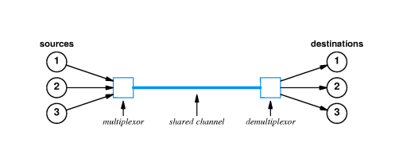
Multiplexing
Carrying multiple signals on one medium is called multiplexing

Slide 28
Frequency division multiplexing (FDM) achieves multiplexing by using different carrier frequencies
Receiver can "tune" to specific frequency and extract modulation for that one channel
  Frequencies must be separated to avoid interference
  Only useful in media that can carry multiple signals with different frequencies - high-bandwidth required

Slide 29
Spread spectrum multiplexing
Spread spectrum uses multiple carriers
Single data stream divided up and sent across different carriers
Can be used to bypass interference or avoid wiretapping

Slide 30
Time division multiplexing
Time division multiplexing uses a single carrier and sends data streams sequentially
Transmitter/receiver pairs share single channel
Basis for most computer networks used shared media - will give details in later chapters

Slide 31
summary
Long-distance communications use carrier and modulation for reliable communication
Modulator encodes data and demodulator decodes data
Can use amplitude, frequency or phase shift modulation
Multiple transmitter/receiver pairs can use multiplexing to share a single medium

