Slide 1
PART II
Packet Transmission
Chapter 6 Packets, Frames, And Error Detection 55
Chapter 7 LAN Technologies And Network Topology 73
Chapter 8 Hardware Addressing And Frame Type Identification 93
Chapter 9 LAN Wiring, Physical Topology, And Interface Hardware 111
Chapter 10 Extending LANs: Fiber Modems, Repeaters, Bridges, and Switches 127
Chapter 11 Long-Distance Digital Connection Technologies 145
Chapter 12 WAN Technologies And Routing 167
Chapter 13 Network Ownership, Service Paradigm, And Performance 189
Chapter 14 Protocols And Layering 203

Slide 2
Chapter 6 - Packets, Frames and Error Detection
Page Number Title
1 Shared communication media
2 Packets
3 Motivation
4 Dedicated network access
5 Packet switching access
6 Time-division multiplexing
7 Time-division multiplexing - example
8 Packets and frames
9 Frame formats

Slide 3
11 Other types of modems
12 Leased serial data circuits
13 Optical, radio and dialup modems
14 Dialup modems
15 Operation of dialup modems
16 Carrier frequencies and multiplexing
17 Multiplexing
18 Spread spectrum multiplexing
19 Time division multiplexing
20 Summary

Slide 4
10 Defining the framing standard
11 Frame format
12 Packet framing
13 Framing in practice
14 Transmitting arbitrary data
15 Data stuffing
16 Byte stuffing
17 Byte stuffing example
18 Transmission errors
19 Error detection and correction
20 Parity checking
21 Parity and error detection

Slide 5
22 Limitations to parity checking
23 Alternative error detection schemes
24 Checksums
25 Implementing checksum computation
26 Limitations to checksums
27 Cyclic redundancy checks
28 Hardware components
29 CRC hardware
30 Error detection and frames
31 Summary

Slide 6
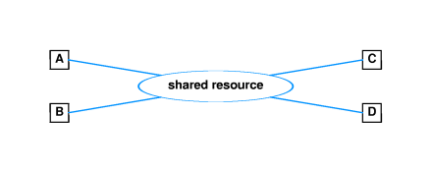
Shared communication media
Most network use shared media which interconnect all computers
However - only one source can transmit data at a time

Slide 7
Packets
Most networks divide into small blocks called packets for transmission
Each packet sent individually
Such networks are called packet networks or packet switching networks

Slide 8
Motivation
Coordination - helps transmitter and receiver determine which data have been received correctly and which have not
Resource sharing - allows multiple computers to share network infrastructure
Networks enforce fair use - each computer can only send one packet at a time

Slide 9
Dedicated network access
5MB file transferred across network with 56Kbps capacity will require 12 minutes:
5x10⁶ bytes * 8 bits/byte / 60 secs/minute * 56x10³ bits/second
= 11.9 minutes
All other computers will be forced to wait 12 minutes before initiating other transfers

Slide 10
Packet switching access
If file is broken into packets, other computers must only wait until packet (not entire file) has been sent
From previous example, suppose file is broken into 1000 byte packets
Each packet takes less than .2 seconds to transmit:
  1000 bytes * 8 bits/byte / 56x10³ bits/second
= .143 seconds

Slide 11
Other computer must only wait .143 seconds before beginning to transmit
Note:
  If both files are both 5MB long, each now takes 24 minutes to transmit
  BUT if second file is only 10KB long, it will be transmitted in only 2.8 seconds, while 5MB file still takes roughly 12 minutes

Slide 12
Time-division multiplexing
Dividing data into small packets allows time-division multiplexing
Each packet leaves the source and is switched onto the shared communication channel through a multiplexor
At the destination, the packet is switched through a demultiplexor to the destination

Slide 13
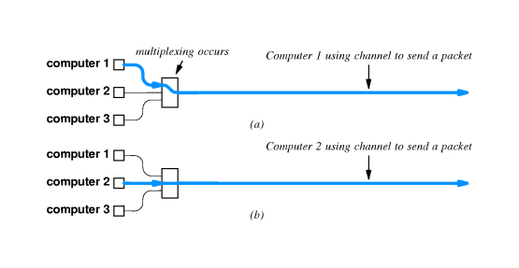

Slide 14
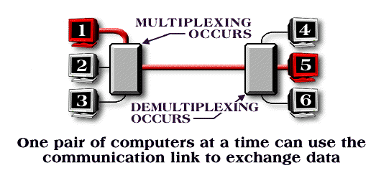
Time-division multiplexing - example

Slide 15
Packets and frames
Packet is ``generic'' term that refers to a small block of data
Each hardware technology uses different packet format
Frame or hardware frame denotes a packet of a specific format on a specific hardware technology

Slide 16
Frame formats
Need to define a standard format for data to indicate the beginning and end of the frame
Header and trailer used to ``frame'' the data

Slide 17
Defining the framing standard
Can choose two unused data values for framing
E.g., if data is limited to printable ASCII, can use
  ``start of header'' (soh)
  ``end of text'' (eot)
Sending computer sends soh first, then data, finally eot
Receiving computer interprets and discards soh, stores data in buffer and interprets and discards eot

Slide 18
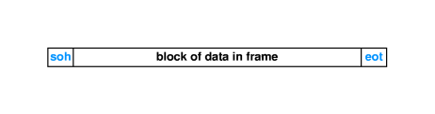
Frame format

Slide 19
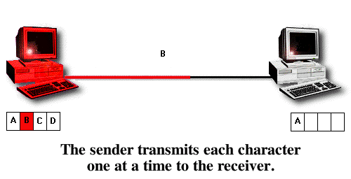
Packet framing

Slide 20
Framing in practice
Incurs extra overhead - soh and eot take time to transmit, but carry no data
Accommodates transmission problems:
  Missing eot indicates sending computer crashed
  Missing soh indicates receiving computer missed beginning of message
  Bad frame is discarded

Slide 21
Transmitting arbitrary data
Suppose system can't afford to reserve two special characters for framing
E.g., transmitting arbitrary 8-bit binary data
soh and eot as part of data will be misinterpreted as framing data
Sender and receiver must agree to encode special characters for unambiguous transmission

Slide 22
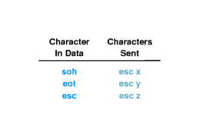
Data stuffing
Bit stuffing and byte stuffing are two techniques for inserting extra data to encode reserved bytes
Byte stuffing translates each reserved byte into two unreserved bytes
For example, can use esc as prefix, followed by x for soh, y for eot and z for esc:

Slide 23
Byte stuffing
Sender translates each reserved byte into the appropriate encoding pair of bytes
Receiver interprets pairs of bytes and stores encoded byte in buffer
Data still framed by soh and eot

Slide 24
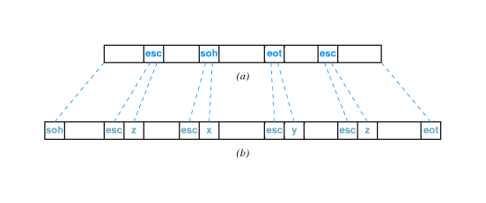

Slide 25
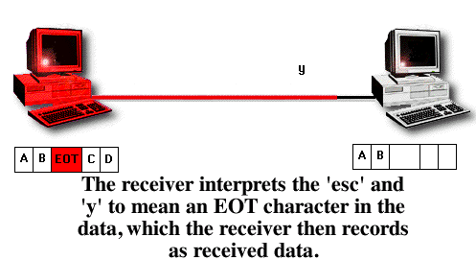
Byte stuffing example

Slide 26
Transmission errors
External electromagnetic signals can cause incorrect delivery of data
  Data can be received incorrectly
  Data can be lost
  Unwanted data can be generated
Any of these problems are called transmission errors

Slide 27
Error detection and correction
Error detection - send additional information so incorrect data can be detected and rejected
Error correction - send additional information so incorrect data can be corrected and accepted

Slide 28
Parity checking
Parity refers to the number of bits set to 1 in the data item
  Even parity - an even number of bits are 1
  Odd parity - an odd number of bits are 1
A parity bit is an extra bit transmitted with a data item, chose to give the resulting bits even or odd parity
  Even parity - data: 10010001, parity bit 1
  Odd parity - data: 10010111, parity bit 0

Slide 29
Parity and error detection
If noise or other interference introduces an error, one of the bits in the data will be changed from a 1 to a 0 or from a 0 to a 1
Parity of resulting bits will be wrong
  Original data and parity: 10010001+1 (even parity)
I ncorrect data: 10110001+1 (odd parity)
Transmitter and receiver agree on which parity to use
Receiver detects error in data with incorrect parity

Slide 30
Limitations to parity checking
Parity can only detect errors that change an odd number of bits
  Original data and parity: 10010001+1 (even parity)
  Incorrect data: 10110011+1 (even parity!)
Parity usually used to catch one-bit errors

Slide 31
Alternative error detection schemes
Many alternative schemes exist
  Detect multi-bit errors
  Correct errors through redundant information
Checksum and CRC are two widely used techniques

Slide 32
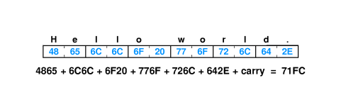
Checksums
Sum of data in message treated as array of integers
Can be 8-, 16- or 32-bit integers
Typically use 1s-complement arithmetic
Example - 16-bit checksum with 1s complement arithmetic

Slide 33
Implementing checksum computation
Easy to do - uses only addition
Fastest implementations of 16-bit checksum use 32-bit arithmetic and add carries in at end
Can also speed computation by unrolling loop and similar optimizations

Slide 34
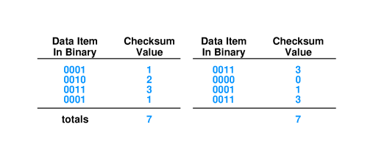
Limitations to checksums
May not catch all errors

Slide 35
Cyclic redundancy checks
Consider data in message as coefficients of a polynomial
Divide that coefficient set by a known polynomial
Transmit remainder as CRC
  Good error detection properties
  Easy to implement in hardware

Slide 36
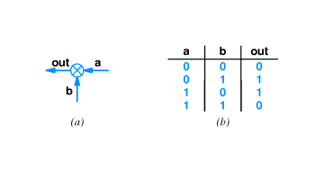
Hardware components

Slide 37
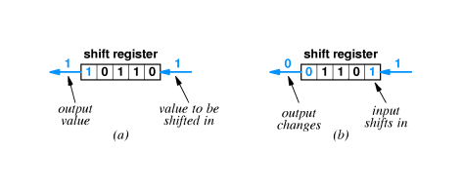

Slide 38
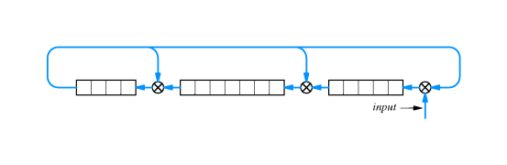
CRC hardware

Slide 39
Error detection and frames
Error detection typically done for each frame
Error in frame typically causes receiver to discard frame
Example - CRC sent after end of frame computed on data in frame

Slide 40
Summary
Computer networks divide data into packets
  Resource sharing
  Fair allocation
Hardware frames are specific to a particular hardware network technology
Each frame has a specific format that identifies the beginning and end of the frame
Error detection and correction is used to identify and isolate transmission errors

