Slide 1
Chapter 9 - LAN Wiring, Physical Topology and Interface Hardware
Page Number Title
1 Introduction
2 Speeds of LANs and computers
3 Network interface hardware
4 I/O interfaces
5 Network connector
6 NICs and network hardware
7 NIC and CPU processing
8 Connection between NIC and physical network
9 Thick Ethernet wiring

Slide 2
10 Thick Ethernet example
11 Connection multiplexing
12 Thin Ethernet wiring
13 Thin Ethernet wiring (continued)
14 Thin Ethernet wiring (continued)
15 Base-T
16 Hubs
17 Protocol software and Ethernet wiring
18 Comparison of wiring schemes
19 Comparison of wiring schemes (continued)
20 Topologies and network technologies
21 Other technologies
22 Technology translation
23 Summary

Slide 3
Introduction
Interface cards
  Why a separate card
  How to connect the interface to the computer
  What is a ``transceiver''?
LAN wiring schemes
Logical and physical topology

Slide 4
Speeds of LANs and computers
LAN data transmission speeds are typically ``fast'' relative to CPU speeds
100MHz CPU could execute only one instruction for each bit on a 100Mhz Ethernet
LAN speeds are defined independent of any specific processor speeds
  Allows for mix of attached systems
  New computers can be attached without affecting LAN speeds

Slide 5
Network interface hardware
CPU can't process data at network speeds
Computer systems use special purpose hardware for network connection
Typically a separate card in the backplane
Network adapter card or network interface card (NIC)
Connector at back of computer then accepts cable to physical network

Slide 6
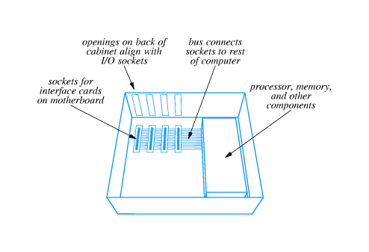
I/O interfaces

Slide 7
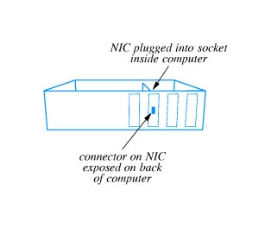
Network connector

Slide 8
NICs and network hardware
NIC is built for one kind of physical network
  Ethernet interface can't be used with token ring
  ATM interface can't be used with FDDI
Some NICs can be used with different, similar hardware
  Thick, thin and 10Base-T Ethernet
  10Mbps and 100Mbps Ethernet

Slide 9
NIC and CPU processing
NIC contains sufficient hardware to process data independent of system CPU
  Some NICs contain separate microprocessor
  Includes analog circuitry, interface to system bus, buffering and processing
Looks like any other I/O device to system CPU
  System CPU forms message request
  Sends instructions to NIC to transmit data
  Receives interrupt on arrival of incoming data

Slide 10
Connection between NIC and physical network
Two alternatives:
  NIC contains all circuitry and connects directly to network medium
  Cable from NIC connects to additional circuitry that then attaches to the network medium
Thin Ethernet vs. 10Base-T
Both are Ethernet; network technology not limited to one style of connection

Slide 11
Thick Ethernet wiring
Uses thick coax cable
AUI cable (or transceiver or drop cable connects from NIC to transceiver
AUI cable carries digital signal from NIC to transceiver
Transceiver generates analog signal on coax
Wires in AUI cable carry digital signals, power and other control signals

Slide 12
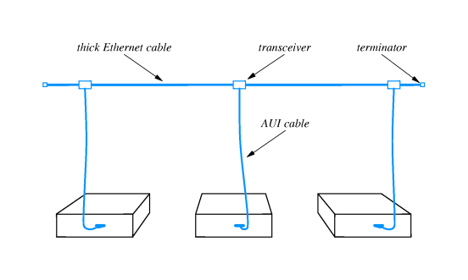
Thick Ethernet example
Thick Ethernet also requires termination to avoid signal reflectance

Slide 13
Connection multiplexing
In some circumstances, transceivers may be inconvenient; e.g., workstations in a lab
Connection multiplexor connects multiple computers to a single transceiver
  Each computer's AUI cable connects to connection multiplexor
  One AUI from multiplexor to Ethernet coax

Slide 14
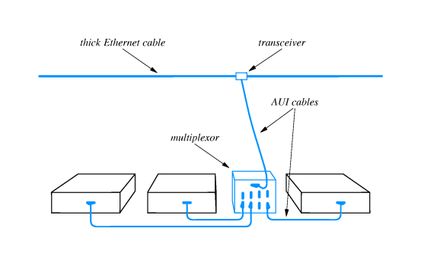
Connection multiplexor completely invisible to attached computers

Slide 15
Thin Ethernet wiring
Uses thin coax that is cheaper and easier to install than thick Ethernet coax
Transceiver electronics built into NIC; NIC connects directly to network medium
Coax cable uses BNC connector

Slide 16
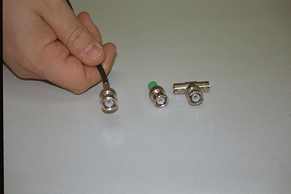

Slide 17
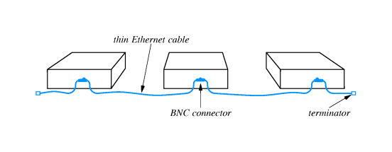
Thin Ethernet wiring (continued)
Coax runs directly to back of each connected computer
T connector attaches directly to NIC

Slide 18
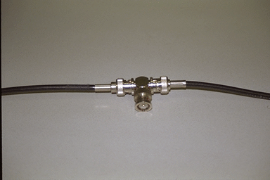

Slide 19
Thin Ethernet wiring (continued)
Useful when many computers are located close to each other
May be unreliable - any disconnection disrupts entire net

Slide 20
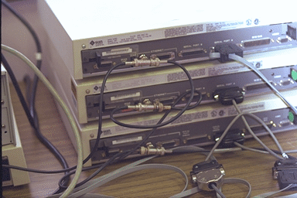

Slide 21
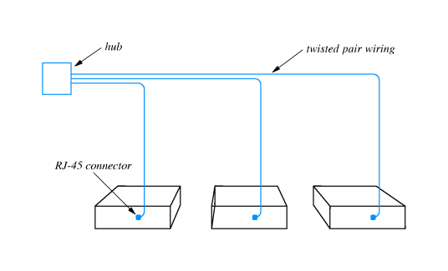
10Base-T
Variously called 10Base-T, twisted pair or TP Ethernet
Replaces AUI cable with twisted pair cable
Replaces thick coax with hub

Slide 22
Hubs
Extension of connection multiplexing concept
Sometimes called ``Ethernet-in-a-box''
Effectively a very short Ethernet with very long AUI cables
Can be connected into larger Ethernets

Slide 23
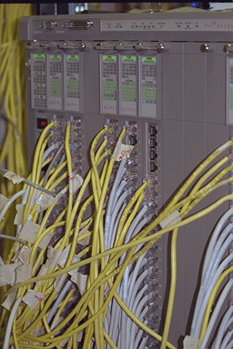

Slide 24
Protocol software and Ethernet wiring
All wiring technologies use identical Ethernet specification
  Same frame format
  Same CSMA/CD algorithms
Can mix different technologies in one Ethernet
NICs can provide all three connection technologies
(Figure)
Protocol software can't differentiate among wiring technologies

Slide 25
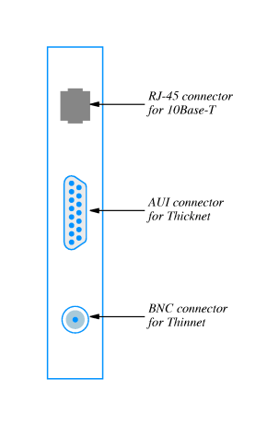

Slide 26
Comparison of wiring schemes
Separate transceiver allows computer to be powered off or disconnected from network without disrupting other communication
Transciever may be located in an inconvenient place
Finding malfunctioning transceiver can be hard
Thin coax takes minimum of cable
Disconnecting one computer (or one loose connection) can disrupt entire network
Hub wiring centralizes electronics and connections, making management easier
Bottom line - 10Base-T most popular because of cost

Slide 27
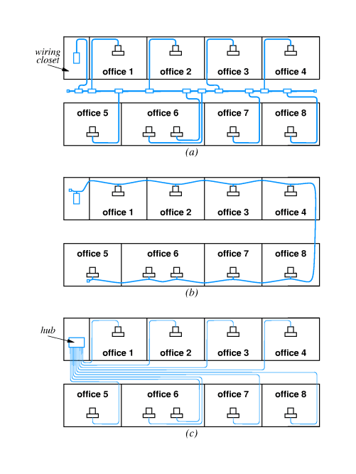
Comparison of wiring schemes (continued)

Slide 28
Topologies and network technologies
10Base-T network topology is a bus; wiring topology is a star
Token ring network topology is a ring; wiring topology is a star
Remember to distinguish between logical and physical topologies

Slide 29
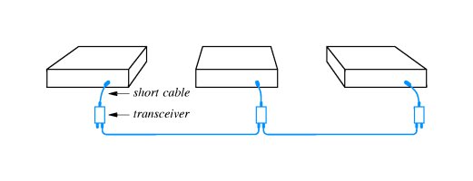
Other technologies
AppleTalk uses bus wiring with coax cable between transceivers
AppleTalk can also use hub technology or spare wires in 4-wire phone cable

Slide 30
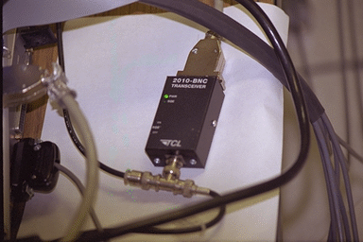
Technology translation
Adapters can translate between some network technologies
  Ethernet AUI-to-thinnet
Ethernet AUI-to-10Base-T adapters

Slide 31
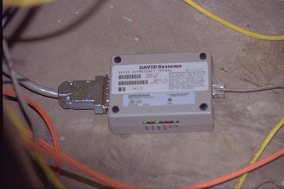
AppleTalk to phone wire

Slide 32
Summary
Network interface card (NIC) connects computer system to network
  NIC operates independently; is fast enough to keep up with network
  Typically uses interrupts to interact with CPU
Many physical wiring schemes are available for logical network topology
10Base-T is a logical bus and a physical star

