Slide 1
Chapter 11 - Long-Distance Digital Connection Technologies
Page Number Title
1 Introduction
2 Digital telephony
3 Digitizing voice
4 Example
5 Sampling parameters
6 Synchronous communication
7 Using digital telephony for data delivery
8 Conversion for digital circuits
9 Using DSU/CSU
10 Telephone standards

Slide 2
11 Intermediate capacity
12 Higher capacity circuits
13 About the terminology
14 SONET
15 Getting to your home
16 ISDN
17 DSL
18 ADSL technology
19 Adaptive transmission
20 Other DSL technologies
21 Cable modem technologies
22 Features of cable modems
23 Upstream communication
24 Alternatives
25 Summary

Slide 3
Introduction
Previous technologies cover "short" distances
Can extend over short distances
Need to cover longer distances - e.g., Bucknell to New York
Will call this technology WAN - Wide Area Network
Two categories:
  Long distance between networks
  "Local loop"

Slide 4
Digital telephony
Telephone system spans long distances
Digital telephony improved long distance service:
  Better quality
  More connections in wire

Slide 5
Digitizing voice
Problem: encode analog audio signal as digital data
Solution:
  Sample audio signal at periodic intervals
  Convert to digital using A-to-D converter
  Send data over wire
  Reconvert to audio using D-to-A converter

Slide 6
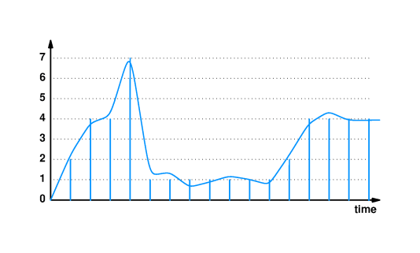
Example

Slide 7
Sampling parameters
Want to carry signals up to 4000Hz
Select sample rate of 8000Hz
Each sample is in range 0-255 (8 bits)
Standard called Pulse Code Modulation (PCM)

Slide 8
Synchronous communication
Converting back to audio requires data be available "on time"
Digital telephony systems use clocking for synchronous data delivery
Samples not delayed as traffic increases

Slide 9
Using digital telephony for data delivery
So, digital telephony can handle synchronous data delivery
Can we use that for data delivery?
Ethernet frame != 8-bit PCM synchronous
Need to convert formats.

Slide 10
Conversion for digital circuits
To use digital telephony for data delivery:
  Lease point-to-point digital circuit between sites
  Convert between local and PCM formats at each end
Use a Data Service Unit/Channel Service Unit (DSU/CSU) at each end
  CSU - manages control functions
    DSU - converts data

Slide 11
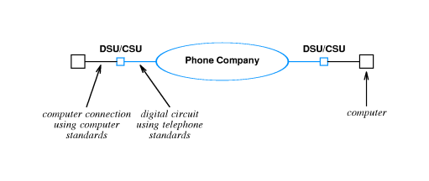
Using DSU/CSU

Slide 12
Telephone standards
Name
Bit Rate
Voice Circuits
-
0.064 Mbps
1
T1
1.544 Mbps
24
T2
6.312 Mbps
96
T3
44.736 Mbps
672

Slide 13
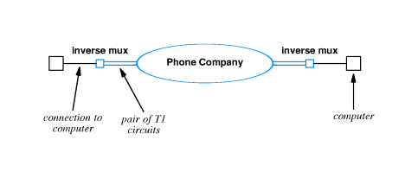
Intermediate capacity
Price does not go up linearly with speed
$$ for T3 < $$ for 28 * T1
...however, if all you need is 9 Mbps, $$ for T3 > $$ for 6 * T1
Solution: combine multiple T1 lines with inverse multiplexor

Slide 14
Higher capacity circuits
Standard name
Optical name
Bit rate
Voice circuits
STS-1
OC-1
51.840 Mbps
810
STS-3
OC-3
155.520 Mbps
2,430
STS-12
OC-12
622.080 Mbps
9,720
STS-24
OC-24
1,244.160 Mbps
19,440
STS-48
OC-48
2,488.320 Mbps
38,880

Slide 15
About the terminology
T-standards define underlying bit rate, Digital Signal Level standards (DS standards) define:
  how to multiplex calls
  effective bit rates
  T1 line transmit data at DS-1 rate
Synchronous Transport Signal (STS) standards define high speed connections over copper, Optical Carrier (OC) standard are for fiber
C suffix indicates concatenated:
  OC-3 == three OC-1 circuits at 51.84 Mbps
  OC-3C == one 155.52 Mbps circuit

Slide 16
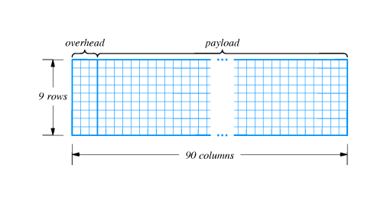
SONET
Synchronous Optical Network (SONET) defines how to use high-speed connections
  Framing: STS-1 uses 810 bytes per frame
Encoding: Each sample travels as one octet in payload

Slide 17
Payload changes with data rate
  STS-1 transmits 6,480 bits in 125 microseconds (== 810 octets)
  STS-3 transmits 19,440 bits in 125 microseconds (==2,430 octets)

Slide 18
Getting to your home
Local loop describes connection from telephone office to your home
Sometimes called POTS (Plain Old Telephone Service)
Legacy infrastructure is copper
Other available connections include cable TV, wireless, electric power

Slide 19
ISDN
Provides digital service (like T-series) on existing local loop copper
Three separate circuits, or channels
  Two B channels, 64 Kbps each; == 2 voice circuits
  One D channel, 16 Kbps; control
Often written as 2B+D; called Basic Rate Interface (BRI)
Slow to catch on
  Expensive
  Charged by time used
  (Almost) equaled by analog modems

Slide 20
DSL
DSL (Digital Subscriber Line) is a family of technologies
  Sometimes called xDSL
  Provides high-speed digital service over existing local loop
One common form is ADSL (Asymmetric DSL)
  Higher speed into home than out of home
  More bits flow in ("downstream") than out ("upstream")
ADSL maximum speeds:
  6.144 Mbps downstream
  640 Kbps upstream

Slide 21
ADSL technology
Uses existing local loop copper
Takes advantage of higher frequencies on most local loops
Can be used simultaneously for POTS

Slide 22
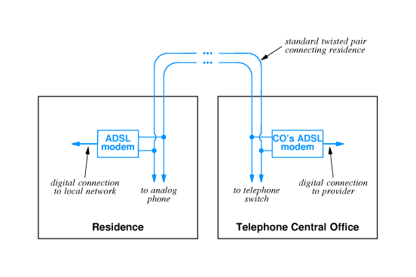

Slide 23
Adaptive transmission
Individual local loops have different transmission characteristics
  Different maximum frequencies
  Different interference frequencies
ADSL uses FDM
  286 frequencies
  255 downstream
  31 upstream
  2 control
Each frequency carries data independently
  All frequencies out of audio range
  Bit rate adapts to quality in each frequency

Slide 24
Other DSL technologies
SDSL (Symmetric DSL) provides divides frequencies evenly
HDSL (High-rate DSL) provides DS1 bit rate both directions
  Short distances
  Four wires
VDSL(Very high bit rate DSL) provides up to 52 Mbps
  Very short distance
  Requires Optical Network Unit (ONU) as a relay

Slide 25
Cable modem technologies
Cable TV already brings high bandwidth coax into your house
Cable modems encode and decode data from cable TV coax
  One in cable TV center connects to network
  One in home connects to computer

Slide 26
Features of cable modems
Bandwidth multiplexed among all users
Multiple access medium; your neighbor can see your data!
Not all cable TV coax plants are bidirectional

Slide 27
Alternatives
Satellite
"Fiber to the curb'

Slide 28
Summary
WAN links between sites use digital telephony
  Based on digitized voice service
  Several standard rates
  Requires conversion vis DSU/CSU
Local loop technologies
  ISDN
  xDSL
  Cable modem
  Satellite
  Fiber to the curb

