Slide 1
Chapter 12 - WAN Technologies and Routing
Page Number Title
1 Introduction
2 Characterizations of networks
3 Differences between LAN and WAN
4 Packet switches
5 Connections to packet switches
6 Packet switches as building blocks
7 Store and forward
8 Store and forward example
9 Physical addressing in a WAN
10 Next-hop forwarding

Slide 2
11 Choosing next hop
12 Source independence
13 Hierarchical address and routing
14 WAN architecture and capacity
15 Routing in a WAN
16 Modeling a WAN
17 Route computation with a graph
18 Redundant routing information
19 Default routes
20 Building routing tables
21 Computation of shortest path in a graph
22 Weighted graph
23 Synopsis of Djikstra's algorithm
24 Distance metrics
25 Dynamic route computation

Slide 3
26 Distributed route computation
27 Vector-distance algorithm
28 Vector-distance algorithm (continued)
29 Link-state routing
30 Comparison
31 Examples of WAN technology
32 Summary

Slide 4
Differences between LAN and WAN
Satellite bridge can extend LAN across large distances
Still cannot accommodate arbitrarily many computers
WAN must be scalable to long distances and many computers

Slide 5
Packet switches
To span long distances or many computers, network must replace shared medium with packet switches
  Each switch moves an entire packet from one connection to another
  A small computer with network interfaces, memory and program dedicated to packet switching function

Slide 6
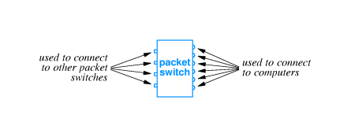
Connections to packet switches
Packets switches may connect to computers and to other packet switches
Typically high speed connections to other packets switches, lower speed to computers
Technology details depend on desired speed

Slide 7
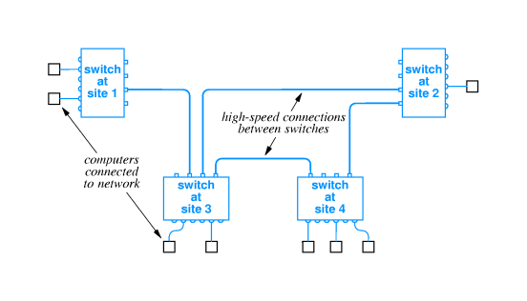
Packet switches as building blocks
Packet switches can be linked together to form WANs

Slide 8
WANs need not be symmetric or have regular connections
Each switch may connect to one or more other switches and one or more computers

Slide 9
Store and forward
Data delivery from one computer to another is accomplished through store-and-forward technology
  Packet switch stores incoming packet
  ... and forwards the packet to another switch or computer
Packet switch has internal memory
  Can hold packet if outgoing connection is busy
  Packets for each connection held on queue

Slide 10
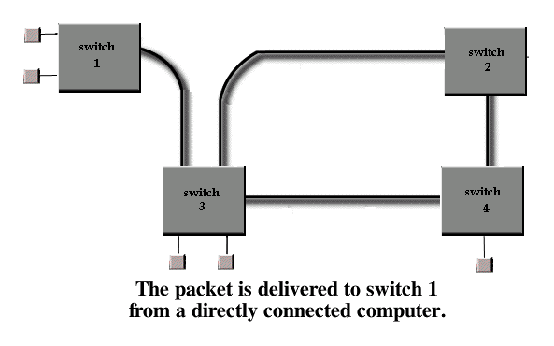
Store and forward example

Slide 11
Physical addressing in a WAN
Similar to LAN
  Data transmitted in packets (equivalent to frames)
  Each packet has format with header
  Packet header includes destination and source addresses
Many WANs use hierarchical addressing for efficiency
  One part of address identifies destination switch
  Other part of address identifies port on switch

Slide 12
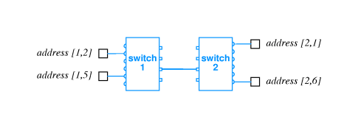

Slide 13
Next-hop forwarding
Packet switch must choose outgoing connection for forwarding
  If destination is local computer, packet switch delivers computer port
  If destination is attached another switch, this packet switch forwards to next hop through connection to another switch
Choice based on destination address in packet

Slide 14
Choosing next hop
Packet switch doesn't keep complete information about all possible destination
Just keeps next hop
So, for each packet, packet switch looks up destination in table and forwards through connection to next hop

Slide 15
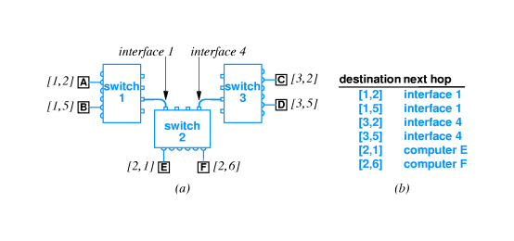

Slide 16
Source independence
Next hop to destination does not depend on source of packet
Called source independence
Allows fast, efficient routing
Packet switch need not have complete information, just next hop
  Reduces total information
  Increases dynamic robustness - network can continue to function even if topology changes without notifying entire network

Slide 17
Hierarchical address and routing
Process of forwarding is called routing
Information is kept in routing table
Note that many entries have same next hop

Slide 18
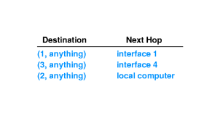
In particular, all destinations on same switch have same next hop
Thus, routing table can be collapsed:

Slide 19
WAN architecture and capacity
More computers == more traffic
Can add capacity to WAN by adding more links and packet switches
Packet switches need not have computers attached
Interior switch - no attached computers
Exterior switch - attached computers

Slide 20
Routing in a WAN
Both interior and exterior switches:
  Forward packets
  Need routing tables
Must have:
  Universal routing - next hop for each possible destination
  Optimal routes - next hop in table must be on shortest path to destination

Slide 21
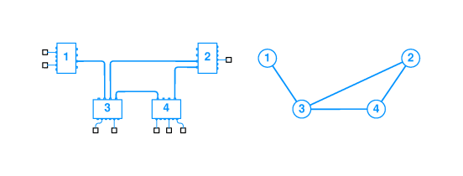
Modeling a WAN
Use a graph:
  Nodes model switches
  Edges model direct connections between switches
Captures essence of network, ignoring attached computers

Slide 22
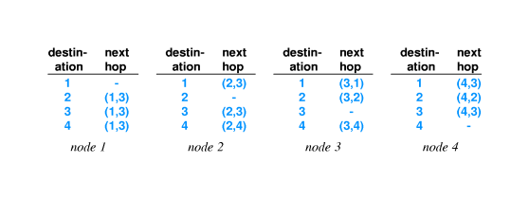
Route computation with a graph
Can represent routing table with edges:
Graph algorithms can be applied to find routes

Slide 23
Redundant routing information
Notice duplication of information in routing table for node 1:
Switch 1 has only one outgoing connection; all traffic must traverse that connection
Extrapolate to Bucknell and Internet

Slide 24
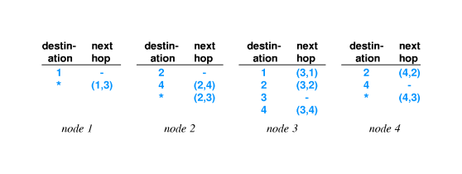
Default routes
Can collapse routing table entries with a default route
If destination does not have an explicit routing table entry, use use the default route:
Use of default route is optional (see node 3)
Extrapolate to Bucknell

Slide 25
Building routing tables
How to enter information into routing tables:
  Manual entry - initialization file
  Dynamically - through runtime interface
How to compute routing table information:
  Static routing - at boot time
  Dynamic routing - allow automatic updates by a program
Static is simpler; doesn't accommodate changes to network topology
Dynamic requires additional protocol(s); can work around network failures

Slide 26
Computation of shortest path in a graph
Assume graph representation of network at each node
Use Djikstra's algorithm to compute shortest path from each node to every other node
Extract next-hop information from resulting path information
Insert next-hop information into routing tables

Slide 27
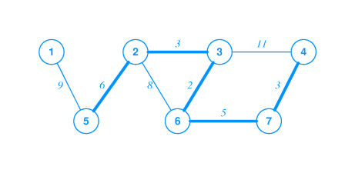
Weighted graph
Djikstra's algorithm can accommodate weights on edges in graph
Shortest path is then the path with lowest total weight (sum of weights of all edges)
Shortest path not necessarily fewest edges (or hops)

Slide 28
Synopsis of Djikstra's algorithm
Keep data structure with list of nodes and weights of paths to those nodes
Use infinity to represent a node in the set S of nodes for which a path has not yet been computed
At each iteration, find a node in S, compute the path to that node, and delete the node from S

Slide 29
Distance metrics
Weights on graph edges reflect "cost" of traversing edge
  Time
  Dollars
  Hop count (weight == 1)
Resulting shortest path may not have fewest hops

Slide 30
Dynamic route computation
Network topology may change dynamically
  Switches may be added
  Connections may fail
  Costs for connections may change
Switches must update routing tables based on topology changes

Slide 31
Distributed route computation
Pass information about network topology between nodes
Update information periodically
Each node recomputes shortest paths and next hops
Inject changes into routing tables

Slide 32
Vector-distance algorithm
Local information is next-hop routing table and distance from each switch
Switches periodically broadcast topology information
Other switches update routing table based on received information

Slide 33
Vector-distance algorithm (continued)
In more detail:
• Wait for next update message
• Iterate through entries in message
• If entry has shorter path to destination:
•
o Insert source as next hop to destination
o Record distance as distance from next hop to destination PLUS
o distance from this switch to next hop
o
•

Slide 34
Link-state routing
Separates network topology from route computation
Switches send link-state information about local connections
Each switch builds own routing tables
  Uses link-state information to update global topology
  Runs Djikstra's algorithm

Slide 35
Comparison
Vector-distance algorithm
  Very simple to implement
  May have convergence problems
  Used in RIP
Link-state algorithm
  Much more complex
  Switches perform independent computations
  Used in OSPF

Slide 36
Examples of WAN technology
ARPANET
  Began in 1960s
  Funded by Advanced Research Projects Agency, an organization of the US Defense Department
  Incubator for many of current ideas, algorithms and internet technologies
  See Where Wizards Stay Up Late
X.25
  Early standard for connection-oriented networking
  From ITU, which was originally CCITT
  Predates computer connections, used for terminal/timesharing connection

Slide 37
Frame Relay
  Telco service for delivering blocks of data
  Connection-based service; must contract with telco for circuit between two endpoints
  Typically 56Kbps or 1.5Mbps; can run to 100Mbps
SMDS - Switched Multi-megabit Data Service
  Also a Telco service
  Connectionless service; any SMDS station can send a frame to any other station on the same SMDS "cloud"
  Typically 1.5-100Mbps
ATM - Asynchronous Transfer Mode
  Designed as single technology for voice, video, data, ...
  Low jitter (variance in delivery time) and high capacity
  Uses fixed size, small cells - 48 octets data, 5 octets header
  Can connect multiple ATM switches into a network

Slide 38
Summary
WAN can span arbitrary distances and interconnect arbitrarily many computers
Uses packet switches and point-to-point connections
Packets switches use store-and-forward and routing tables to deliver packets to destination
WANs use hierarchical addressing
Graph algorithms can be used to compute routing tables
Many LAN technologies exist

