Slide 1
Chapter 12a – Connection-Oriented Networking and ATM
Page Number Title
1 Introduction
2 A Single, Global Network
3 ISDN and ATM
4 ATM Design and Cells
5 Connection-Oriented Services
6 VPI/VCI
7 Labels and Label Switching
8 An Example Trip Through an ATM Network
9 Permanent Virtual Switches
10 Switched Virtual Circuits

Slide 2
11 Quality of Service
12 The Motivation for Cells and Label Switching
13 ATM Data Transmission and AAL5
14 Critique of ATM
15 Summary

Slide 3
Introduction
Previously LAN and WAN technologies are described.
This chapter introduces a technology that was designed to fill both role.
This chapter presents a technical overview and explain underlying motivation.
Also introduces connection-oriented packet switching paradigm.
  First establish communication,
  Then send data,
  And finally terminate the communication.

Slide 4
A Single, Global Network
Voice communication (percentage in all communication) is decreasing, profit margin would decreasing over time.
On the other hand, data communication is increasing.
And then Telecom companies decided the network to carry traffic other than voice.
Their goals are;
  Universal service. The new network should all subscribers around the world, and any pair of subscribers should be able to communicate.

Slide 5
(Continue)
  Support for all uses. The new network should also offer subscribers voice, video, and data services. Moreover, the infrastructure should be sufficiently general to handle uses that might arise.
  Single Unified Infrastructure. The new network should not be formed from multiple technologies. Instead, it should consist of a single underlying infrastructure that includes support for all services. In particularly, the network should be capable of serving as a LAN and a WAN.
  Service Guaranties. The new network should perform with the same reliability and efficiency a existing networks. More important, it should offer the same delivery guaranties that voice and video networks offers.
  Support for low-cost devices. The new network should allow user to connect small, low cost devices such as ATM telephones. Because they have minimal processing power and memory, such devices depend on the network to deliver data in order to without loss or delay.

Slide 6
ISDN and ATM
One of the network satisfy these goals is Integrated Services Digital Network (ISDN).
Now ISDN is relatively expensive than dialup modems for moderate data speed.
And has not gain universal acceptance.
So second more compressive technology developed to satisfy its goals.
Asynchronous Transfer Mode (ATM), this technology handles must higher speed and offer many more services.

Slide 7
ATM Design and Cells
ATM designer faced a difficult challenge because three intended uses (Voice, video, and data) have different sets of requirements.
Voice and video requite low delay and low jitter (low variance in delay) the voice and audio maybe delivered smoothly.
Video require a substantially higher data rate than audio.
Most data networks introduces jitter as they handle packets; delay depends on the number of stations that are tempting to send data. And this changes in time (few or many station tempts).
Contention also rise the delay because some stations are failing and trying again.

Slide 8
Packet size also has same effect on jitter.
PCM produces an 8-bits audio sample every 125 micro seconds (digital voice standard).
If underlying network uses a packet size greater than 4000 octets, a sender must delay for one or more than half a second while accumulating enough samples to fill packets. Such delay intolerable.
Another problem is echo cancellation; echo cancellation only works when delays are low. The speaker does not want to hear his voice again then a echo cancellation is needed.
To achieve high speed, low delay, low jitter and echo cancellation, ATM technology divides all data into small fixed size packet called cells.
Each ATM cell contains exactly 53 octets: 5 octets of header information and 48 octets of data.

Slide 9
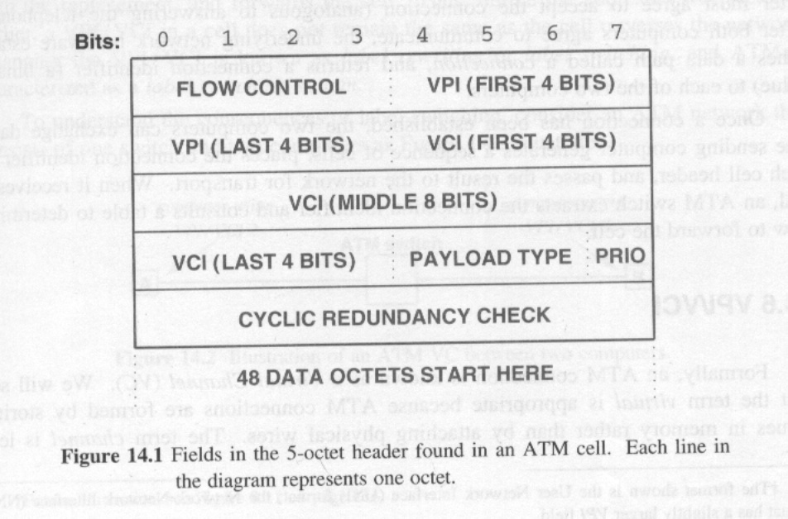
The figure 14.1 illustrates the format of an ATM cell.

Slide 10
VPI and VCI are presented in the header.
Other feels are 8-bits CRC.
The fields labeled PRIO is a cell loss Priority bit that identifies if a packet can be discarded when the network becomes congested.
Larger cell is optimum for data and small cells optimum for voice.
ATM is neither optimal for voice or data.
For data transfer ten percent header overhead is high. (compare with Ethernet 1500 to 14 octets).
This header overhead is called as cell tax.

Slide 11
Connection-Oriented Services
ATM uses connection-oriented service paradigm.
  Establish connection (analogous to dialing up a telephone). Established path called connection.
  Transfer data (Exchange data). Connection identifier in each cell is used. (Switch extract the connection identifiers and consult a table to determine to forward the cell.
  Terminate connection.

Slide 12
VPI/VCI
Formally, and ATM connection is known a a Virtual Channel (VC). Because ATM stores values in memory the than by attaching a physical wire.
Some times Virtual Circuit is used.
VC is 24 bits identifiers that is divide into two parts
  The first part, a Virtual Path Identifier (VPI) specifies the path The VC follows through the network. VPI is 8 bits long.
  The second part, a Virtual Channel Identifier (VCI) specifies a single VC within the path. A VCI is 16 bits long.
Network hardware can use the hierarchy to group multiple channel together but, computer views both parts as a single VPI/VCI.

Slide 13
Labels and Label Switching
An ATM network is formed from one or more hardware devices known as ATM switches.
An ATM switch has Multiple attachment points; to user’s computer, to another switch. (a typical ATM network:Computers and a switch).
These point are known as ports.
ATM switch changes the VPI/VCI in each cell it handles.
Each switch has a forwarding table.
Each entry in the table corresponds to possible VPI/VCI for a given port.

Slide 14
The switch uses the VPI/VCI in an incoming cell to locate an entry in its forwarding table.
In addition to the number of physical port over which cell will be sent, the table entry contains a replacement VPI/VCI.
The switch rewrites the VPI/VCI in the cell header with the replacement, and forwards the cell.
Thus unlike the addresses we discussed earlier, a VPI/VCI in a cell does not remain the same as the cell traverse the network.
Changing the VPI/VCI is known as label rewriting or label switching, And ATM switching is characterized a label switching system.
This is illustrated in figure 14.2

Slide 15
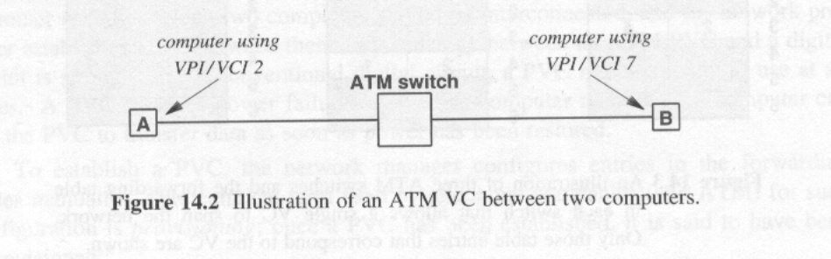
Figure 14.2.
The switch assigned VPI/VCI 2 to computer A and VPI/VCI to computer B.
The switch receives VPI/VCI 2 , changes it to VPI/VCI 7 before forwarding the cell to B, and vice versa.
An ATM switch used label switching to rewrite the connection identifier ;(VPI/VCI) in each cell it forwards. Two computers using a given VC usually have different VPI/VCI values.

Slide 16
An Example Trip Through an ATM Network
For large ATM networks the forwarding tables in a series of switches must be coordinated to create path through network.
Figure 14.3 illustrates a set of three ATM switches. Two interfaces exist; 1 and 2.
Computer S uses VPI/VCI 3 and computer R VPI/VCI 6.
The forwarding tables specify that the VPI/VCI be changed to 4 which A does before forwarding the cell out interface 2 to switch B. And so on.
As a cell pass through an ATM network, the identifier at each switch. The forwarding tables in all switches must be coordinated to define meaningful paths through the network from one computer to another.

Slide 17
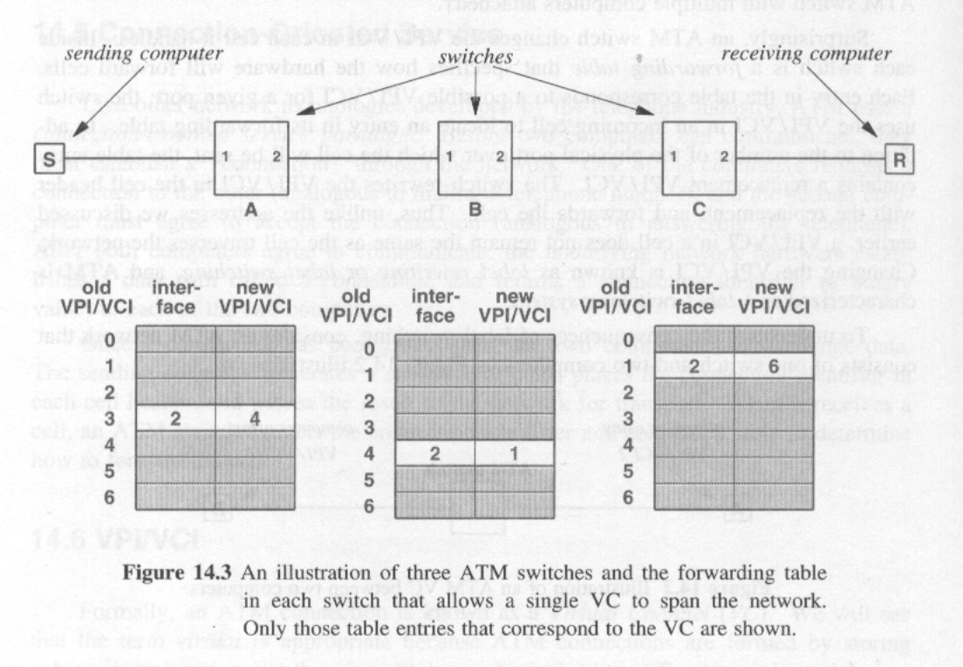
Figure 14.3

Slide 18
Permanent Virtual Switches
How and when these entries in an ATM forwarding table filled in?
How these entries coordinated across a large number of switches to ensure that they are correct?
A digital circuit survives computer crashes and even power failures; the circuit can be used again immediately after power has been restored.
ATM offers facilities similar to leased lines; subscriber can request an ATM network provider to establish a permanent virtual channel (PVC).
The customer specifies which computers should be connected and network provider established a VC between them.

Slide 19
PVC remains readily to use all times.
Survives power failures as well as computer reboots.
To establish a PVC, the network manager configures the entries in the forwarding tables manually.
The technical term used by telephone companies for such configurations is provisioning; once a PVC has been established it said it has been provisioned.
Correct provisioning requires two steps.
  First, the network manager determines a complete path along the path requested.
  Second, the manager must chose a VPI/VCI to used for each step along the path and must configure each adjacent pairs of switches .

Slide 20
The ability of ATM to swap labels at each switch make provisioning easy because an ATM cell does not need to contain the same VPI/VCI globally.
Manager fill in the forwarding table entries.

Slide 21
Switched Virtual Circuits
A VC created dynamically is a Switched Virtual Channel (SVC).
To create an SVC, a computer interacts with the ATM stitch to which it attaches. The computer sends a connection request to the switch.
Software on the switch automatically finds a path through the ATM network to destination, and send requests along the path.
Each pair of ATM switches along the path communicates to chose a VPI/VCI to use for the VC and initialize their tables.
Once all switches along the path agree the connection is established and SVC is ready to use.

Slide 22
If any switch along the path does not agree to provide the VC, an error message is sent back and request is denied.
The SVC request is known as signaling.
ATM reserve a small set of VPI/VCI values for connection request and network control traffic.
PVC is established in advance (uses).

Slide 23
Quality of Service
To satisfy the need of audio and video users, ATM has facilities that allow subscriber to specify the Quality of Service (QoS) requirements for each communication.
ATM uses fine grain quality of service because it allows a subscriber to specify quantitative values ( at least 64kbps and the delay must be less than 500 ms or a vide might require 2Mbps throughput).
QoS specifications are given when the connection is established, and stay in effect until the connection terminated.
Once a request has been approved, the switch must reverse capacity as promised.

Slide 24
ATM channel does not behave like shared channel.
If a switch along the path does not meet the QoS, an error message is generated.
ATM has several basic ways to specify QoS requirements.
Both unopposed audio and video generate traffic at a fixed rate.
ATM defines a Constant Bit Rate (CBR) service to handle such traffic.
ATM also defines a Variable Bit Rate (VBR) service.
The transmission may be burst, with short period of intensive communication and separate long period of silence.
For such applications ATM defines an Available Bit Rate (ABR).
Traffic on ABR connection can use whatever the bandwidth.

Slide 25
The Motivation for Cells and Label Switching
Several questions arise. Why did ATM designers choose fixed-size cells instead of variable packets?
What the chief advantage of label switching and why ATM adopted it ?
The answers are the same: to achieve maximum data rates and satisfy QoS requirements.

Slide 26
Cells vs. Packets
Variable packet size may cause memory fragmentation; fixed size cell do not.
Variable-size packet require the hardware to accommodate largest possible incoming packets and to detect at the and of packet; The hardware can simply count the bits of a fixed cell.
The time required to transmit a variable-size packet depends on the length, interface hardware that transmit variable-size packets must interact with the switch.
Variable-size make it difficult to guarantee QoS, especially low jitter (because long packet transmission can not be interrupted).

Slide 27
Label switching vs. routings
Label switching is another technology that increases hardware speed and capacity.
Extraction of the VPI/VCI and table lookup can both be implemented directly in hardware: no CPU is required. This takes little time (to do).
So LAN replacement is possible, and ATM offers the capacity is about 2.4 Gbps.

Slide 28
ATM Data Transmission and AAL5
To accommodate a variety of applications, ATM defines a set of adaptation protocols, which can be through of a set of Application Program Interfaces (APIs).
Five adaptation protocols have been defined, only ATM Adaptation Layer 5 (AAL5) is used to send data.
AAL5 accepts a blocks of data divides the blocks into cells and transfers the cell across the ATM network.
On the receiving side, AAL5 accepts incoming cells and extracts the data and delivers the original blocks. (Segmentation and reassembly).
This is seen by user and user think that ATM is transferring variable-size packets.
ATM uses a protocol known as ATM Adaptation layer 5 to send and receive data. AAL5 accepts and delivers variable-size blocks of data,where each block can be up to 64 K octets long.

Slide 29
Critique of ATM
Although the goals of ATM are lofty, the technology has several drawbacks.;
  Expense; ATM networks significantly more expensive than alternatives (Many services offered and ATM can be used as LAN).
  Connection Setup latency; ATM’s connection-oriented paradigm introduces significant delays for distant communication.
  Cell tax; ATM headers is about %10.
  Specification of Service Requirements; All communication requires a computer to choose service parameters when establishing connection then transfer time depend on this.

Slide 30
(Continue).
  Lack of Efficient Broadcast; ATM are sometimes called Non Broadcast Multiple access (NBMA).
  Complexity of QoS; To quarantine QoS requires very complex computation.
  Assumptation of Homogeneity; ATM is designed to be a single, universal networking system. There is minimal provision for interoperating with other technologies.
ATM came when engineers announced Gigabit Ethernet.
IP has succeed sending Internet Protocol (IP) traffic over SONET. ATM also uses SONET but cell tax makes less useful it.

Slide 31
Summary
The phone companies created the Integrated Digital Network (ISDN) and Asynchronous Transfer Mode (ATM).
ATM is intended as universal networking technology that handles voice, video, and data transmission.
ATM uses connection-oriented paradigm
Creates VCs.
For connection one or more ATM switches are needed.
There are two types of ATM VCs: a PVC is created manually and survives power failures and an SVC is created on demand.
VC must specify QoS requirements.
Has not been widely accepted; (used as backbone, lack of interoperability with other networks and complex).

