Slide 1
Chapter 13 - Network ownership, service paradigm and performance
Page Number Title
1 Network ownership
2 Private network
3 Private network architecture
4 Managing private networks
5 Extending private networks
6 Public network
7 Virtual private network
8 Service paradigm
9 Connection-oriented service

Slide 2
10 Connectionless service
11 Comparions
12 Connection duration and persistence
13 Examples of service paradigms
14 Addresses and connection identifiers
15 Network performance characteristics
16 Network delay
17 Throughput
18 Relationship between delay and throughput
19 Delay-throughput product
20 Summary

Slide 3
Network ownership
Private network - owned by single organization or company
Public network - owned by common carrier (e.g., phone company)

Slide 4
Private network
Often LAN technology
Multiple LANs in a building or campus, linked together
Sometimes called intranet

Slide 5
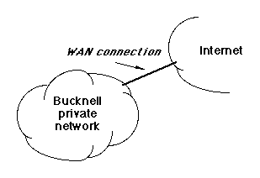
Private network architecture
Operates autonomously from other networks (e.g., Internet)
Usually includes one or few closely managed external connections
May restrict access at connections
Example - Bucknell

Slide 6
Managing private networks
Organization buys own equipment
Hires staff to design, implement, maintain and upgrade network
Responsible for all network management

Slide 7
Extending private networks
Large organizations may have multiple buildings or campuses
Can only install cables on own property
May contract for leased lines from common carrier
Example - UPS

Slide 8
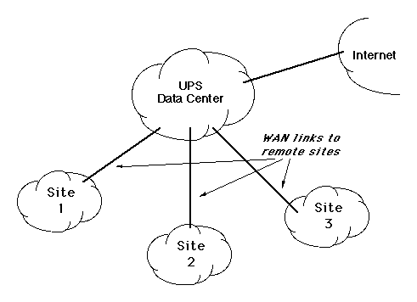

Slide 9
Public network
Operated by common carrier
May be telephone company or other organization that builds network out of leased lines
Multiple organizations subscribe and connect
Data transits public network to other organizations
Example - AT&T

Slide 10
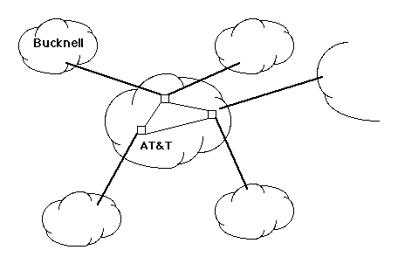

Slide 11
Virtual private network
VPN (Virtual Private Network) combines features of private and public networks
Limited to single organization
Uses public network for connectivity
Connections, sometimes called tunnels, connect sites
Each site sees tunnel as point-to-point link direct to another site
Cannot be access by other users of public network

Slide 12
Service paradigm
Connection-oriented - similar to telephone system; endpoints establish and maintain a connection as long as they have data to exchange
Connectionless - similar to postal system; endpoint puts data
to send into a packet and hands to network for delivery

Slide 13
Connection-oriented service
One endpoint requests connection from network
Other endpoint agrees to connection
Computers exchange data through connection
Typically stream interface
  Source delivers stream of data to network
  Network breaks into packets for delivery
Data transmission not necessarily continuous; like telephone, connection remains in place while no data transmitted
One endpoint request network to break connection when transmission is complete

Slide 14
Connectionless service
No connection necessary
Source of data adds destination information to data and delivers to network
Network delivers each data item individually

Slide 15
Comparions
Connection-oriented: accounting easier, application can learn of network problems immediately
Connectionless: less overhead, easier to implement network

Slide 16
Connection duration and persistence
Connections can be made on-demand or set up permanently
  Switched connection or switched virtual circuit
  Permanent connectionor provisioned virtual circuit
Permanent connections
  Originally hard-wired
  Now configured at system init time
Switched connections
  Computer maintains permanent connection to network
  Network makes connection on demand

Slide 17
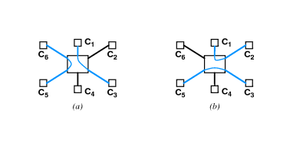
Internal components are switches; network is a switched data network

Slide 18
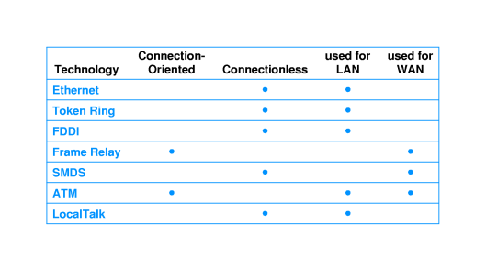
Examples of service paradigms

Slide 19
Addresses and connection identifiers
Address is a complete, unique identifier
Connectionless delivery requires address on each packet
Connection-oriented delivery can use a shorthand that identifies the connection rather than the destination
ATM - 160-bit address, 28-bit connection identifier
  Connection identifier includes:
  12-bit virtual path identifier (VPI)
  16-bit virtual circuit identifier (VCI)
  Connection identifier local to each computer
  May be different in different parts of the ATM switch

Slide 20
Network performance characteristics
Delay
Throughput
Delay-throughput product

Slide 21
Network delay
Delay is measure of time for data to transit network
Propagation delay - time to travel across medium
Switching delay - time for network component (hub, bridge, packet switch) to forward data
Access delay - time to get control of medium (CSMA/CD, token)
Queuing delay - time enqueued in packet switches

Slide 22
Throughput
Throughput measures rate at which data can be transmitted in network
  300 bps (bits per second) - old modems
  1 gps (gigabit [10⁹] bits per second) - fastest today
Bandwidth - limit of underlying hardware
Effective throughput - real data delivery

Slide 23
Relationship between delay and throughput
As throughput approaches theoretical maximum, delay increases
Excessive traffic known as congestion
Effective delay, D, can often be approximated:
D =D₀ /(1 - U)

Slide 24
Delay-throughput product
Computed as delay time multiplied by effective throughput
Measures amount of data that can be present in the network
In fast networks with long delay times, sending computer can generate large amounts of data before destination receives first bit

Slide 25
Summary
Public vs. private networks
Connection-oriented vs. connectionless service paradigms
Connection identifier is a shorthand for a destination address
Networks can be measured for:
  Delay
  Throughput
  Delay-throughput product

